Slide 1
Advancing Kidney Health Worldwide. Together.

Slide 2
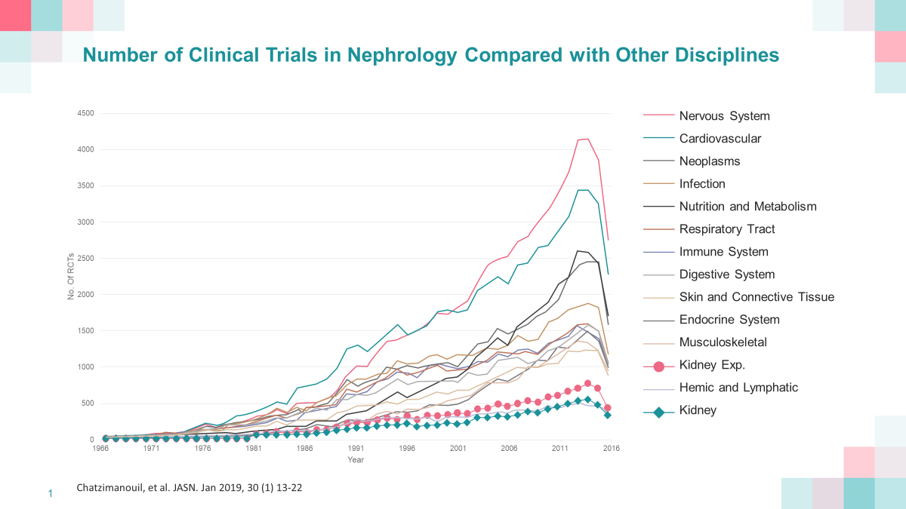
Then and now: Nephrology
Lowest number of trials of all specialties
Possible causes for poor engagement with clinical trials:
A culture of certainty (rather than the uncertainty needed to foster randomization)
Complicated small trial designs
Lack of standard approaches
Levin et al, KI 2020

Slide 3
Variability in definitions of endpoints has consequences
Difficulty with comparing between trials
For patients and clinicians
Confusion in interpreting results for similar compounds with different endpoints for similar disease states
Confusion in interpreting results for different compounds with similar disease states with different endpoints

Slide 4
The story: Kidney Failure outcomes for clinical trials
How we got to the first-ever consensus definitions for kidney failure and importance of it
Outcomes vs endpoints
Classification of ‘hard outcomes’ vs ‘surrogate’ outcomes
Adjudication issues were discussed:
Resource-poor vs rich countries
Availability of laboratory data
Size of study, # of events
What and how with different technologies
Nomenclature
Notes:
Objective was to develop standardized, internationally-accepted consensus definitions for clinical trial Kidney Failure outcomes and key surrogates which predict Progression to Kidney Failure.
To ensure accountability, transparency, and knowledge translation, the definitions presented were developed with patient partners and a range of stakeholders.
The document was reviewed by the collective of meeting participants and reflects consensus.

Slide 5
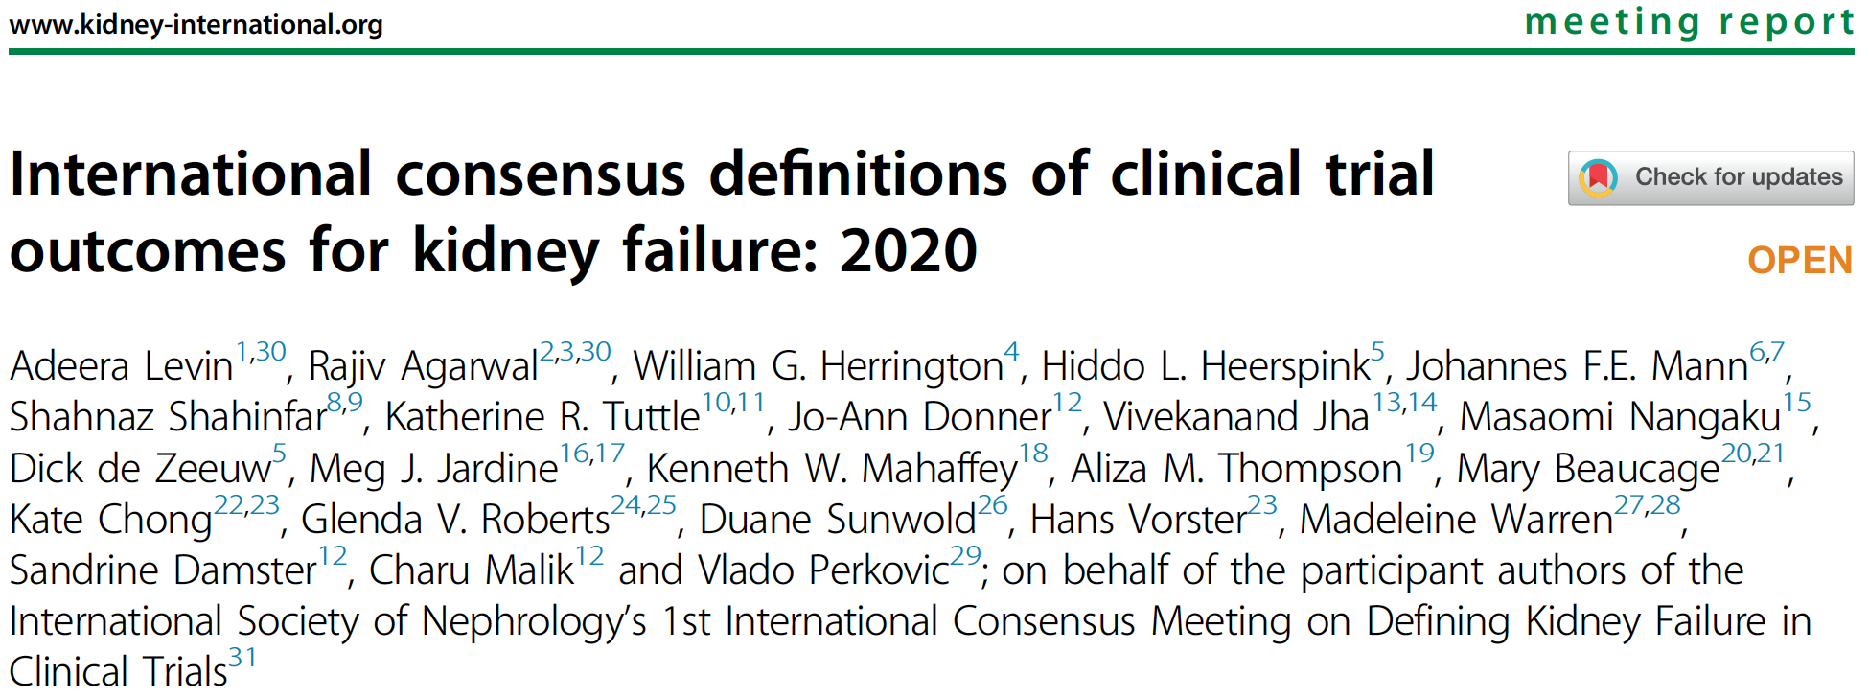
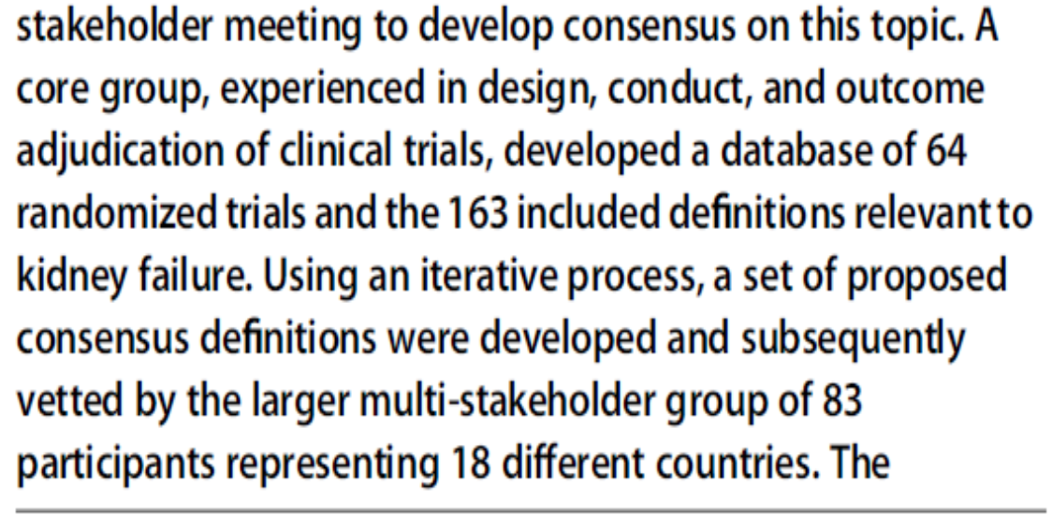
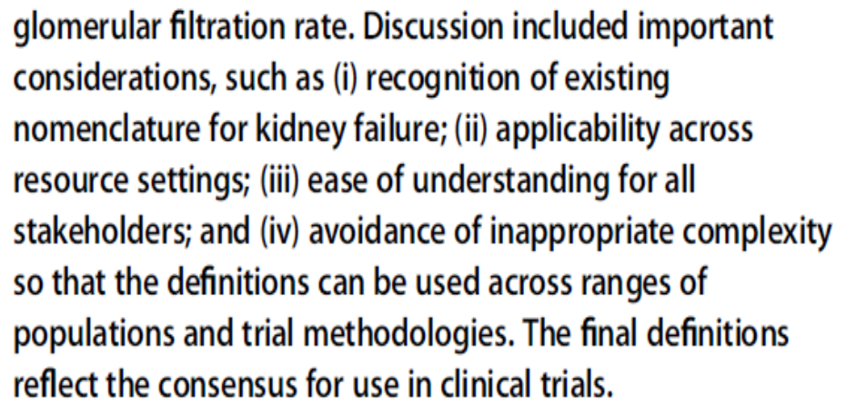
International Consensus Definitions of Clinical Trial Outcomes for Kidney Failure: 2020
International representation
Patients
Policy makers
Regulatory
Clinicians
Industry
Researchers
Notes:
The Research Collaborative Meeting and 1st International Consensus Meeting on Defining Kidney Failure in Clinical Trials that took place from January 31 - February 1, 2020, in Vancouver, Canada.
The ISN convened this international, multi-stakeholder meeting to develop consensus on definitions of kidney failure as endpoints in clinical trials. This was a significant step toward the long-term goal to improve the evidence base from which to treat patients with kidney diseases worldwide.

Slide 6
Patients’ participation and perspectives
Patient participants:
Canada
UK
US
Male, Female
CKD
Dialysis
Transplant
Age range
Ethno-cultural variability
Defining Kidney Failure from the patient lens is critical
Insights gained impacted definitions
Prefer term “kidney failure” to “end-stage kidney/renal disease”
Maintenance dialysis
Any dialysis duration constitutes Kidney Failure
4 weeks = suitable definition in most circumstances, and would appropriately exclude the majority of recoverable dialysis-requiring acute kidney injury (AKI) from a maintenance dialysis outcome
Any duration of dialysis is a serious failure of their kidneys
Trials which report Kidney Failure as an outcome should collect and report information on AKI requiring dialysis or consider reporting a patient-centered outcome of ‘Any Dialysis’

Slide 7
International Consensus Definitions of Clinical Trial Outcomes for Kidney Failure: 2020
Step | Activity
1 | Systematically generate a list of clinical trials, including cardiovascular disease, diabetes, kidney disease populations, in which Kidney Failure was an outcome (see Supplement Table S1 in article).
2 | Establish a database of definitions of clinical trial endpoints of Kidney Failure from available trial protocols and/or adjudication manuals (63 RCT, 163 definitions see Supplement Table S1 in article), and consider publications from the National Kidney Foundation-US Food and Drug Administration-European Medicines Agency (NKF-FDA-EMA) workshops addressing declines in estimated glomerular filtration rate as surrogates for Progression to Kidney Failure for clinical trials of CKD.
3 | Generate an independent definition of clinical trial outcomes of Kidney Failure from each Core Group member, with attention to modifications that may be required in trials conducted in different settings (high and low resource settings).
4 | Synthesize a single proposed Core Group-consensus set of definitions for review at the Consensus Meeting using an iterative review process.
5 | Develop an accompanying set of questions and controversies for discussion in the Consensus Meeting breakout groups to ensure scrutiny of the proposed definitions.
6 | Circulate Consensus Meeting materials to stakeholders two weeks before the meeting.
7 | Deliver Consensus Meeting: (a) Present the need, remit, and Core Group-proposed definitions in plenary sessions, followed by five facilitated breakout group discussions. (b) Present and discuss each breakout group’s key comments in a plenary forum.
8 | Refine definitions based on feedback during the Consensus Meeting.
9 | Send Consensus Meeting report and refined definitions for stakeholder comment and public review.
10 | Publish and disseminate.
Table 1. Development Steps for the International Consensus Definitions of Clinical Trial Outcomes for Kidney Failure

Slide 8
International Consensus Definitions of Clinical Trial Outcomes for Kidney Failure: 2020
Consensus: Clinical trial outcomes to represent Kidney Failure should be composed of:
Receipt of a Kidney Transplant,
Initiation of Maintenance Dialysis,
Death from Kidney Failure, and may also include
Outcomes based solely on laboratory measurements of Glomerular Filtration Rate (GFR) (Fig. 1).
Depending on the trial setting, different components may be included or omitted.
Currently: GFR <15 ml/min/1.73m² = laboratory-based indicator of Kidney Failure. Concept component proposed: “Sustained Low GFR”.
Last component = surrogate = Sustained Percent Decline in GFR.
Notes:
The consensus was that clinical trial outcomes to represent Kidney Failure should be comprised of a composite including: receipt of a Kidney Transplant, initiation of Maintenance Dialysis, Death from Kidney Failure, and may also include outcomes based solely on laboratory measurements of Glomerular Filtration Rate (GFR): a Sustained Low GFR and a Sustained Percent Decline in GFR (Figure 1).
Including these separate outcomes should enable Kidney Failure in various clinical presentations to be well captured in clinical trials.
Depending on the trial setting, different components may be included or omitted (e.g., a particularly long and large trial in those with advanced CKD disease may not need to include the Sustained Percent Decline in GFR, which is a surrogate of Progression to Kidney Failure rather than evidence of Kidney Failure itself, whilst a trial with less advanced CKD at entry may use that component to ensure a reasonable study duration.
Aligned with current clinical classification systems, GFR <15 ml/min/1.73m² is a laboratory-based indicator of Kidney Failure, although other thresholds may be used in specific circumstances. We propose the concept of a component called “Sustained Low GFR” which permits different thresholds to be used, depending on the population studied, and the GFR at study enrolment.
The last component is a surrogate, which is Sustained Percent Decline in GFR, highly predictive of Progression to Kidney Failure.

Slide 9
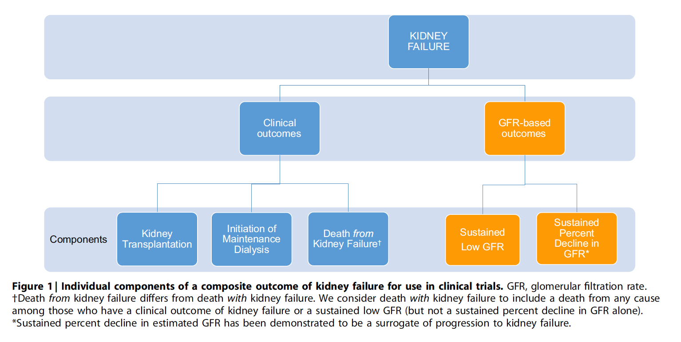
International Consensus Definitions of Clinical Trial Outcomes for Kidney Failure: 2020

Slide 10
Adjudication: discussed
Whether it is important to adjudicate trial outcomes is controversial
Interpretation of small trials with borderline power can be affected by false events (“noise”)
Large definitive randomized trials may be less affected by such issues depending on event rate
Under-appreciation of unintentional impacts of adjudication:
$$
Time
Human costs
Errors
Notes:
Other Considerations
The definitions above are designed for implementation into clinical trials and do not change or challenge existing KDIGO definitions of Kidney Failure. The proposed definitions do not address details nor specificity of data recording during conduct of a trial. Although good guidance exists on how kidney outcomes data should be stored in trial datasets, there are no standardized consensus methods for collecting Kidney Failure outcome during participant follow-up visits or review of health records. Timelines of kidney disease status and other diagnoses in computer systems have long been used by nephrologists and may be a simple option to adopt.
The need for adjudication (i.e., clinician-based verification) of Kidney Failure outcomes was discussed. Although consistent attribution of an Underlying Cause of Death in kidney trials usually requires a clinician-led adjudication process, there are examples from kidney populations in which adjudication of kidney replacement therapy had no major impact on Kidney Failure outcomes. Many past trials examining the outcome of Kidney Failure have been small and used different methods of data collection, necessitating adjudication. We also recognize that in trials anticipating fewer Kidney Failure events, in populations without kidney disease, or conducted by investigators without expertise in kidney disease, the adjudication of Kidney Failure in trials may be necessary. Death within 4 weeks of starting dialysis may also be an example when adjudication is necessary to distinguish Maintenance from acute dialysis. The group concluded that role of event adjudication for Kidney Failure needs to be evaluated within the specific context of the study planned.

Slide 11
Simple, accessible, understandable
Table 2. Summary International Consensus Definitions of Clinical Trial Outcomes for Kidney Failure
Components | Definition
Kidney Transplantation | Receipt of a kidney transplant
Maintenance Dialysis | Dialysis performed for at least 4 weeks
Death from Kidney Failure | The participant dies; AND Kidney replacement therapy was never started (irrespective of reason); AND Advanced chronic kidney disease is the underlying cause of death
Sustained Low GFR | GFR < 15† mL/min/1.73m² sustained over at least 4 weeks
Sustained Percent Decline in GFR | Percent decline in GFR of ≥ 40%* from a baseline start point sustained over at least 4 weeks
Concise, clear definitions
Applicable across multiple populations, settings
Wide range of interventions and trial methodologies
Need for modification in some situations
(See slide 14 for a more complete definition)
Footnote: † A GFR of <10 mL/min/1.73m² may be used in certain situations.
* a ≥ 30%, ≥ 40%, ≥ 50%, or ≥ 57% decline in GFR (a 57% decline in estimated GFR [eGFR] approximately corresponds to a doubling of serum creatinine) may be considered surrogates for Progression to Kidney Failure depending on the trial population and acute effects of study intervention on GFR. A doubling of creatinine is the most well established, whilst a ≥ 30% decline, in comparison, is the least reliable of these (putative) surrogates.

Slide 12
How to implement definitions in LMIC
Kidney Transplantation
Date of the procedure = date of the outcome. No modifications are required for low or high resource settings
Maintenance Dialysis
No need to refine for resource setting. However, it was recognized that participants may be dialyzed less frequently than those in high-income countries and may discontinue therapy because of non-availability due to financial or other reasons
Death from Kidney Failure
Presumes the driver of death is the low kidney function. No need to refine for resource setting, however it was recognized that death from Kidney Failure may be more common in lower resource settings

Slide 13
International Consensus Definition of Kidney Transplantation
Kidney Transplantation
Receiving a kidney transplant irrespective of source (cadaveric vs living donor), or successful implantation or graft function
Date of the procedure = date of the outcome. No modifications are required for low or high resource settings
Notes:
Kidney Transplantation:
This is defined as receiving a kidney transplant irrespective of source (cadaveric vs living donor), or successful implantation or graft function.
The date of the procedure constitutes the outcome’s date. No modifications are required for low or high resource settings.

Slide 14
International Consensus Definition of Maintenance Dialysis (incl. special considerations)
Maintenance Dialysis
At least 4 weeks (clinical trial) vs registry data (>90 days)
Death before 4 weeks, on dialysis ~ infer ‘maintenance’
Trajectory of progressive eGFR decline then dialysis ~ infer ‘maintenance’
Patient-centered outcome “any dialysis” (patients think that any duration of dialysis = bad outcome)
No need for frequency
# of times per week (low resource settings or patient-specific nuances may preclude standardized # per week)
Notes:
Maintenance Dialysis:
This is defined as dialysis (peritoneal or hemodialysis) performed for at least 4 weeks. A number of different confirmatory periods have been used (i.e., 4 weeks, 30, 60, or 90 days) in different trials; we agreed on 4 weeks for the sake of harmonization after careful discussion.
There are situations where the duration of at least 4 weeks may not be met, e.g., due to death or further data are unavailable, but an outcome of Kidney Failure requiring dialysis can be inferred. These include the start of dialysis after a trajectory of progressive CKD, or if dialysis treatment is discontinued within a few days due to either futility of therapy (dialysis withdrawal) or resource constraints, or the participant undergoes kidney transplantation shortly after dialysis initiation. All of these would constitute reaching a trial outcome of maintenance dialysis (see section on adjudication below).
Special Considerations
It was highlighted that although at least 4 weeks duration of dialysis is recommended for clinical trials, a longer duration (e.g., 90 days) is in keeping with most ‘registry’ definitions of maintenance dialysis. We also acknowledged that the duration of dialysis that confirms it to be maintenance dialysis may differ by the specific patient population under study (e.g., patients with vasculitis or glomerulonephritis may justify a longer duration).
Although some patients may recover from dialysis after being on it for 4 weeks, practical considerations of timely trial completion, and most importantly, the patients’ perspectives that “any dialysis duration constitutes Kidney Failure” was appreciated. Thus, we agreed that 4 weeks was a suitable definition in most circumstances, and would appropriately exclude the majority of recoverable dialysis-requiring acute kidney injury (AKI) from a maintenance dialysis outcome. Those who recover dialysis-independent kidney function could have this outcome revised, and be included in a sensitivity analyses to determine the impact of that change.
From patients’ perspectives, any duration of dialysis is a serious failure of their kidneys. Therefore, trials which report Kidney Failure as an outcome should collect and report information on AKI requiring dialysis or consider reporting a patient-centered outcome of ‘Any Dialysis.’
In low resource settings, no modifications to the definition is required, however, it was recognized that participants on maintenance dialysis may be dialyzed less frequently than in high-income countries and may discontinue therapy because of non-availability due to financial or other reasons. Dialysis frequency is thus not included in the outcome’s definition.

Slide 15
International Consensus Definition of Death from Kidney Failure (incl. special considerations)
Death from Kidney Failure
Presumes the driver of death is the low kidney function
No need to determine specific mechanism (e.g., hyperkalemia, volume overload)
No need to refine for resource setting
May not need to differentiate acute or chronic kidney disease, or those who are or are not offered dialysis
All can be prespecified for specific trial
Debate of death ‘from’ vs ‘with’ Kidney Failure
As a component of composite of Kidney Failure, death FROM but not WITH should be counted
‘With’ = sepsis, cardiovascular events, other, and failure of kidneys, vs
From = due to non-provision of replacement therapy for any reason
Notes:
Death from Kidney Failure:
This component usually represents a small proportion of Kidney Failure outcomes. Its inclusion allows recognition that those participants who have progressed to a GFR <15 mL/min/1.73m² and often much lower, and died as a result of non-availability of kidney replacement therapy or personal decision to not pursue dialysis, have reached the outcome. This is analogous to the KDIGO nomenclature death from “kidney failure without replacement therapy.” In these situations, the Underlying Cause of Death (i.e., the disease which initiated the train of morbid events leading directly to death) is advanced CKD. In the context of trials, distinguishing between Death with Kidney Failure and Death from Kidney failure is important (see below).
The ‘Death from Kidney Failure’ concept presumes the driver of death is the low kidney function (irrespective of specific mechanisms, such as hyperkalemia, fluid overload, etc.). There is no need for modification of this definition for different resource settings, but we recognized Death from Kidney Failure may be more common in lower resource settings. It is noted that those who develop AKI with no pre-existing CKD, and are not offered dialysis, refuse, or it is unavailable, may or may not be considered a ‘Death from Kidney Failure’, depending on circumstances, and study design. In the conduct of the trial, this should be pre-specified.
Special Considerations
Meeting attendees deliberated on the concepts of Death from Kidney Failure, and Death with Kidney Failure. There was extensive debate, but some agreement that Death with Kidney Failure should not be recommended to be a standard component of the Kidney Failure outcome definition (Figure 1). There is a need to differentiate deaths from other causes (e.g., overwhelming sepsis or fatal CVD) in people with Kidney Failure, from those who die from Kidney Failure (due to non-provision of replacement therapy for any reason AND advanced CKD). We appreciate the sometimes subtle differences, and recommend that Death with Kidney Failure may be considered as a subsidiary outcome in clinical trials. Death with Kidney Failure includes death, irrespective of cause, among those who have a clinical outcome of maintenance dialysis, kidney transplantation, or a sustained low GFR (but, importantly, not a sustained percent decline in GFR alone). Because an increasingly high proportion of patients with CKD in developed countries are elderly and multimorbid, Death with Kidney Failure may become more common.

Slide 16
International Consensus Definitions of eGFR-based Kidney Failure Outcomes (incl. special considerations)
GFR-based Outcomes and Surrogates of Progression to Kidney Failure
Non-clinical, laboratory-based
Central vs local lab debated
Strong prediction of progression to Kidney Failure (dialysis or transplantation, or death from Kidney Failure)
Sustained low GFR (GFR <15 mL/min/1.73m²), irrespective of dialysis need
Validity of specific thresholds discussed (depends on study)
CREDENCE, vs DAPA CKD, vs EMPA KIDNEY
Symptoms + GFR (patient-oriented research [POR])
Sustained percent decline in GFR
Surrogate
Established validity of these for use in clinical trials (NKF-FDA)
Customize to intervention and population of interest
Notes:
GFR-based Outcomes and Surrogates of Progression to Kidney Failure:
GFR-based outcomes represent non-clinical laboratory outcomes which are acceptable in clinical practice and trials. Some laboratory-based outcomes have been shown to strongly predict progression to clinical outcomes of Kidney Failure (i.e., Percent Decline in estimated GFR [eGFR]). They may also predict other serious complications, (e.g., CVD), which patients and clinicians view as a ‘poor’ outcome. Sustained Low GFR, irrespective of need for dialysis, is one outcome. A Sustained Percent Decline in GFR is offered here as another ‘acceptable’ GFR-based surrogate for the clinical trial outcome of Kidney Failure in specific circumstances.
We extensively discussed the use of the terms ‘eGFR’ and ‘GFR’, with no clear consensus as to what was preferred. Importantly, the validation work on surrogates of Progression to Kidney Failure (summarized below) are based on ‘eGFR’ and practical considerations for trials would favor the use of ‘eGFR’, instead of measured GFR. However, we recognized that there are situations in which one might measure GFR (mGFR). There were extensive discussions about formulae to be used and the need for validated equations (see below).
Acceptable Surrogate: Sustained Percent Decline in GFR as Predictive of Progression to Kidney Failure:
= Relative decline from baseline in GFR of ≥40% or other thresholds (30%, 50%, 57%) depending on circumstances.
Baseline for determining GFR decline.
Special Considerations
Percent Decline in GFR is not a clinical outcome, but rather a surrogate which predicts Progression to Kidney Failure.
Extensive analyses, supported by the NKF-FDA-EMA workshops, have established the validity of eGFR-based surrogates. These findings include:
The strong associations between a decline in eGFR and risk of end-stage kidney disease in observational analyses.
A ≥40% decline in eGFR provides consistent assessment of treatment effects compared to a doubling of creatinine in re-analyzed trials, using a range of different interventions;
(c) Simulation studies to advise on what percentage decline in eGFR to select for an intervention in different scenarios; these included populations with different rates of CKD progression, choice of start point eGFR, and using interventions with different acute effects on eGFR.

Slide 17
International Consensus Definitions of eGFR-based Kidney Failure Outcomes (special considerations)
Notes
Doubling of creatinine and percent decline of GFR can predict Kidney Failure; threshold should be determined in each trial
Blood for a baseline analysis of GFR should be drawn prior to randomization
GFRs should continue to be collected, even after this outcome is confirmed
Use of the term ‘outcome’ throughout this document, instead of ‘endpoint’ intentionally
Notes:
We noted that a doubling of creatinine was a particularly strong predictor of end-stage kidney disease. A 57% eGFR decline over 2 years (i.e., about a doubling of creatinine) is associated with a 32-times increased risk for Kidney Failure in those with an eGFR <60 mL/min/1.73². This surrogate may be particularly suitable for trials using routine healthcare data for follow-up, when it is not always possible to collect additional measurements.
The concept of ‘sustained’ decline in GFR does add specificity to this outcome compared to basing the percent decline on a single follow-up GFR. However, it was also recognized that to ensure the simplicity of study design, and consistency with clinical care, it is reasonable to confirm sustained declines in GFR (or sustained low GFR) at the next scheduled study visit in certain circumstances. Extra confirmation visits may be problematic as they add to participant burden and trial costs. With regular and relatively frequent follow-up, the definition of sustained could be applied without the need for additional trial-specific confirmatory measurements.
Blood for a baseline analysis of GFR should be drawn prior to randomization. It is recognized that an average of two measurements a few weeks apart may increase the precision of measurement of baseline GFR, but may not be mandatory depending on the purpose of the clinical trial, as the benefits of that precision may not outweigh the burden of extra measurements and visits, particularly in larger streamlined trials.
It is noted that GFRs should continue to be collected, even after this outcome is confirmed, in order to record a greater percent decline in GFR (e.g., ≥ 57% decline after ≥ 40% decline), a sustained low GFR, or for accompanying pre-specified GFR slope analyses. Follow-up for all outcomes (dialysis, transplant, or other) should continue for the full duration of any trial.
We have used the term ‘outcome’ throughout this document, instead of ‘endpoint’ intentionally. The term ‘endpoint’ is a misnomer as trial follow-up usually continues for any given participant who has ‘met an endpoint’ until study end.

Slide 18
International Consensus Definitions: Out of scope
Other Outcomes and Kidney Populations
For the purposes of clarity, these concepts were considered out of scope for the Consensus Meeting:
GFR slopes and changes in albuminuria
Patient-Reported Outcome Measures (PROMs) for Kidney Failure
Pediatric populations
Notes:
Out of Scope: Other Outcomes and Kidney Populations
For the purposes of clarity, below we describe those concepts that were out of scope.
GFR Slopes and Changes in Albuminuria
It has been recognized that total or chronic eGFR slope analyses and changes in albuminuria may fulfill the criteria for surrogacy for CKD progression. Such GFR slope analyses are particularly useful in early kidney disease and interventions with acute effects on GFR. Since the meeting focused on the clinical outcome of Kidney Failure per se, and whilst progression of CKD is on the pathway to Kidney Failure, we did not address progression specifically.
Patient-Reported Outcome Measures (PROMs) for Kidney Failure
We recognize that symptoms of Kidney Failure may present at different levels of GFR with variability between patients. Symptoms of Kidney Failure (e.g., fatigue, cognition) have been identified as important potential trial outcomes for people with CKD, including those on dialysis. When relevant and reliable PROMs have been developed, shown to be feasible to implement, and responsive to interventions, they should be included as outcomes in ongoing trials in CKD populations. This work is currently in progress. PROMS are extremely important, but they were considered out of scope for this meeting.
Pediatric Populations
We recognized that there is a current unmet need for clinical trials in pediatric patients with kidney disease. Pediatric populations are highly heterogeneous, have variable causes of disease across age groups, and different methods to estimate GFR. The meeting was focused on clinical trials in adults. However, the framework and key concepts are adaptable to pediatric nephrology clinical trials, and a process to engage the pediatric community will be undertaken.

Slide 19
Adjudication considerations
Lack of standardized methods for collecting Kidney Failure outcomes
Clear definitions is the first step
Need for adjudication discussed
Dialysis or Transplantation outcomes may not be materially impacted by adjudication
SHARP (Study of Heart and Renal Protection)
Adjudication for Kidney Failure may be of value in specific trials
With fewer Kidney Failure events
Those conducted by investigators without kidney expertise
Consistent attribution of Death FROM Kidney Failure?
Notes:
Important Future Research
The value of adopting these simple kidney failure outcome clinical trial definitions to support and encourage the conduct of larger clinical trials, including pragmatic trials, remains to be seen. Whilst there is much discussion about the precision of measurements and need for adjudication, further research is needed into when the use of central laboratories or adjudication of Kidney Failure outcomes is justified or needed. We need to review methods used to measure serum creatinine and other kidney markers, including point-of-care testing, which may be somewhat less reproducible and robust than gold-standard assays, but provide potential to facilitate large sample sizes, reduce trial costs, and/or increase participation. Such research could offer major scientific value in terms of the scalability of clinical research, and inclusivity around the world.
We acknowledged that there are differences in precision of CKD-EPI eGFR equations across different regions. Future research may evaluate the impact of using region- or population-specific eGFR equations in international trials in a rigorous manner. Clinical trials assess differences in treatment effects between allocated groups, so that regional differences should not bias a randomized comparison, however this question continues to perplex many. There is interest in examining potential differences in GFR equations in study populations in different regions, so as to test the assumption that there is no bias due to those differences.

Slide 20
International Consensus Definitions of Clinical Trial Outcomes for Kidney Failure: 2020
Dissemination
Role of patient partners and all relevant stakeholders in adopting these Consensus Definitions for Clinical Trial Outcomes of Kidney Failure
Engage the pediatric nephrology community
Educate the diabetes and CVD communities
Summary
An international multi-stakeholder Consensus Meeting of patient partners, clinicians and academic trialists, other researchers, regulators, funder representatives and industry researchers, have developed international Consensus Definitions of Clinical Trial Outcomes for Kidney Failure, based on available literature, using an iterative and inclusive process. These outcome definitions should enhance the ability to conduct clinical trials, harmonize and compare results, and improve the amount of reliable evidence to determine the best therapies for individuals living with kidney diseases.
Notes:
Dissemination
We wish to emphasize the role of patient partners and all relevant stakeholders in adopting these consensus definitions for clinical trial outcomes of Kidney Failure. The shared understanding of this work will enhance broad uptake. We need to engage the pediatric nephrology community, and to educate the diabetes and CVD communities regarding these definitions, since people with CKD and those conditions, are often recruited into their clinical trials.
Summary
An international multi-stakeholder Consensus Meeting of patient partners, clinicians and academic trialists, other researchers, regulators, funder representatives and industry researchers, have developed international consensus definitions of clinical trial outcomes for Kidney Failure, based on available literature, using an iterative and inclusive process. These outcome definitions should enhance the ability to conduct clinical trials, harmonize and compare results, and improve the amount of reliable evidence to determine the best therapies for individuals living with kidney diseases.

Slide 21
International Consensus Definitions of Clinical Trial Outcomes for Kidney Failure: 2020
Citation
Levin A, Agarwal R, Herrington WG, Heerspink HL, Mann JFE, Shahinfar S, Tuttle KR, Donner J, Jha V, Nangaku M, de Zeeuw D, Jardine MJ, Mahaffey KW, Thompson AM, Beaucage M, Chong K, Roberts GV, Sunwold D, Vorster H, Warren M, Damster S, Malik C, Perkovic V; participant authors of the International Society of Nephrology’s 1st International Consensus Meeting on Defining Kidney Failure in Clinical Trials. International consensus definitions of clinical trial outcomes for kidney failure: 2020. Kidney Int. 2020 Oct;98(4):849-859. doi: 10.1016/j.kint.2020.07.013. PMID: 32998816.
For all inquiries on the International Consensus Definitions of Clinical Trial Outcomes for Kidney Failure: 2020 publication, please contact research@theisn.org

Slide 22


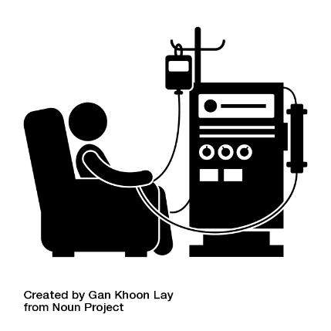

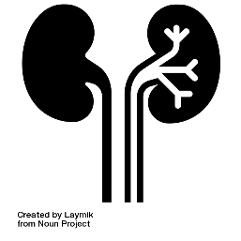


1st International Consensus Definitions of Kidney Failure for use in Clinical Trials
Kidney Transplantation
Maintenance Dialysis
Death from Kidney Failure
Sustained Low eGFR
Sustained % Decline in eGFR

Slide 23







Advancing Kidney Health Worldwide. Together.
www.theisn.org
Global Operations Center
Americas Operations Center
Avenue des Arts 1-2
1210 Brussels, Belgium
340 North Avenue 3rd Floor Cranford, NJ 07016-2496, United States
+32 2 808 04 20
+1 567 248 9703
info@theisn.org
info@theisn.org
Follow us

