Slide 1
THE GLOBAL KIDNEY HEALTH ATLAS
<Congress title>
Date
www.theisn.org/global-atlas

Slide 2
Overview
Aim
Methods
Key Results
Implications

Slide 3
Aim of the Global Kidney Health Atlas
To understand, compare and monitor how different countries around the world detect, treat, monitor and advocate for people with kidney disease (AKI or CKD)
Key focus on availability, accessibility, affordability and quality of ESKD care

Slide 4
Global Kidney Health Atlas survey
2016
2018
2022
2026

Slide 5
Design and scope
Desk research (across countries and regions)
Published and grey literature review
Systematic review ESKD burden and outcomes
Data extraction from major renal registries (USRDS, ERA-EDTA) and relevant national registries where available
Scoping review of KRT cost estimates
Online questionnaire-based survey July – September 2018
3 languages (English, French, Spanish)
Across 182 countries
≥3 stakeholders per country
National nephrology society leadership
Healthcare policymakers
Patients / patient advocacy groups
Discrepancies resolved by follow-up conferences with regional and country nephrology leaders
Notes:
REDCap Cloud. The questionnaire was peer reviewed for content validity and comprehensiveness before it was piloted with the 10 ISN regional boards to identify any logistical and feasibility issues (e.g., translation needs). Intensive follow-ups were conducted by email and telephone with ISN regional and national leaders to ensure complete and timely responses.
Data and reports published by the WHO Global Observatory, UN, World Bank, and OECD.
Both published and unpublished documents from international organizations/bodies and reports published by national governments on the organization and
delivery of ESKD.
Additional literature identified by key stakeholders (i.e., opinion leaders, national nephrology society leaders, ISN leaders) and through consultation with national nephrology societies and ISN regional boards.

Slide 6
Overall survey components

Slide 7
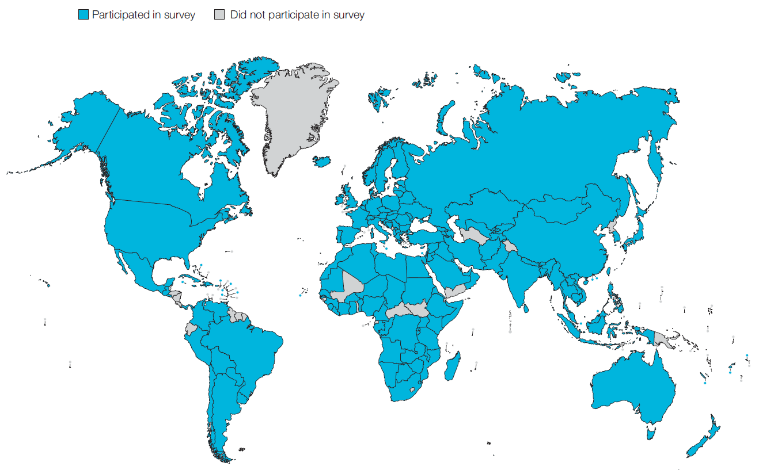
Overall GKHA response
160 countries (88%)
99% world’s population
317 individuals (69%) response
3 respondents/country (IQR 2-4)
113 countries participated in both GKHA surveys

Slide 8
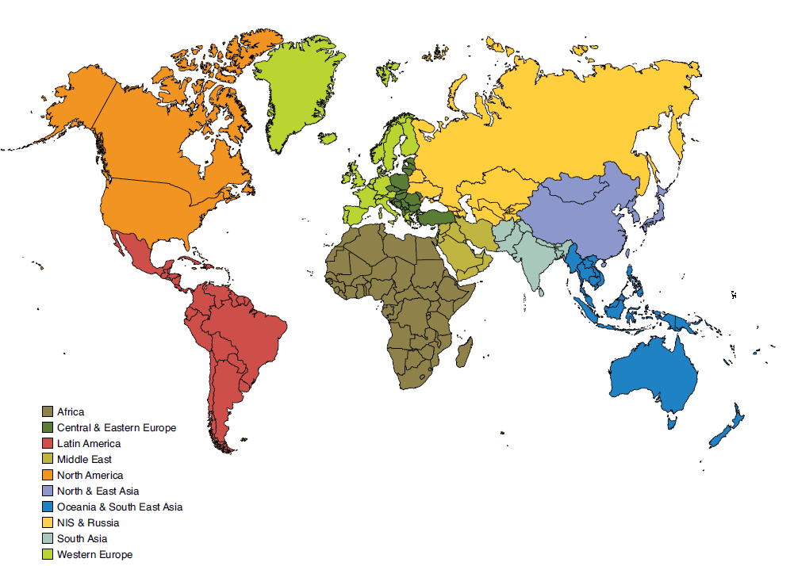
Results presented by ISN regions

Slide 9
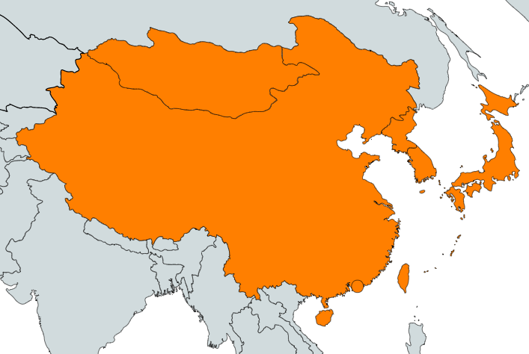
ISN Region: North & East Asia

Slide 10
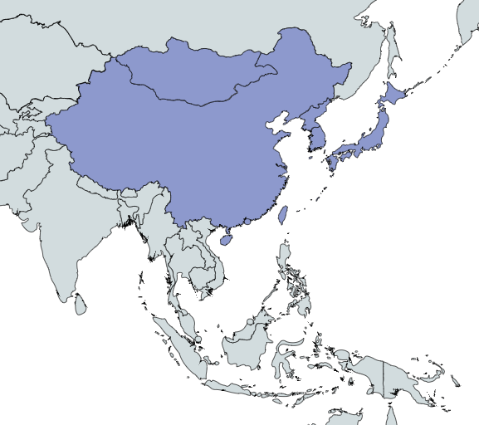
Demographics
Country | World bank ranking | Area (sq km) | Total population (2018) | GDP (PPP) ($ billion) | Total health expenditures (% of GDP)
China | Upper middle income | 9,596,960 | 1,384,688,986 | 23210 | 5.0
Hong Kong SAR, China | High income | 1,108 | 7,213,338 | 455.9 | -
Japan | High income | 377,915 | 126,168,156 | 5443 | 10.9
Korea, Dem. People's Rep. | Low income | 120,538 | 25,381,085 | 40 | -
Korea, Rep. | High income | 99,720 | 51,418,097 | 2035 | 7.4
Macao SAR, China | High income | 28.2 | 606,340 | 71.82 | -
Mongolia | Lower middle income | 1,564,116 | 3,103,428 | 39.73 | 3.9
Taiwan | High income | 35,980 | 23,545,963 | 1189 | -
‘ – ’ : data not reported/unavailable

Slide 11
CKD and its risk factors burden
Country | CKD Prevalence % (95% CI) | Death attributed to CKD % (95% CI) | DALYS attributed to CKD % (95% CI) | Obesity % (95% CI) | Increased BP % (95% CI) | Smoking % (95% CI)
China | 9.76 (8.98 - 10.6) | 1.68 (1.54 - 1.72) | 1.32 (1.21 - 1.41) | 6.6 (5.1 - 8.4) | 19.2 (14.9 - 24.0) | 22.0 (21.6 - 22.4)
Hong Kong SAR, China | - | - | - | - | - | -
Japan | 17.62 (16.43 - 19.08) | 2.6 (2.48 - 2.79) | 1.92 (1.74 - 2.08) | 4.4 (3.3 - 5.7) | 17.6 (14.1 - 21.5) | 17.2 (16.8 - 17.6)
Korea, Dem. People's Rep. | 8.95 (8.27 - 9.68) | 1.55 (1.37 - 1.74) | 1.46 (1.3 - 1.62) | 7.1 (3.8 - 6.2) | 18.2 (12.7 - 24.9) | 19.2 (17.4 - 21.1)
Korea, Rep. | 10.85 (10.01 - 11.71) | 2.03 (1.91 - 2.16) | 1.4 (1.26 - 1.53) | 4.9 (4.2 - 10.6) | 11 (8.2 - 14.3) | 22.1 (20.5 - 23.7)
Macao SAR, China | - | - | - | - | - | -
Mongolia | 8.68 (8.0 - 9.39) | 1.55 (1.43 - 1.84) | 1.25 (1.14 - 1.5) | 19.6 (15.6 - 23.9) | 29.0 (22.5 - 35.9) | 21.7 (19.1 - 24.5)
Taiwan | 12.2 (11.32 - 13.12) | 3.75 (3.57 - 3.93) | 2.53 (2.3 - 2.72) | - | - | 11.5 (9.8 - 13.4)
Abbreviations:
CKD (Chronic Kidney Disease),
DALYS (disability-adjusted life years),
BP (blood pressure),
CI (confidence interval)
Data source:
GBD study database
(http://www.healthdata.org/gbd),
WHO data observatory
(https://www.who.int/gho/en/)
‘ – ’ : data not reported/unavailable

Slide 12
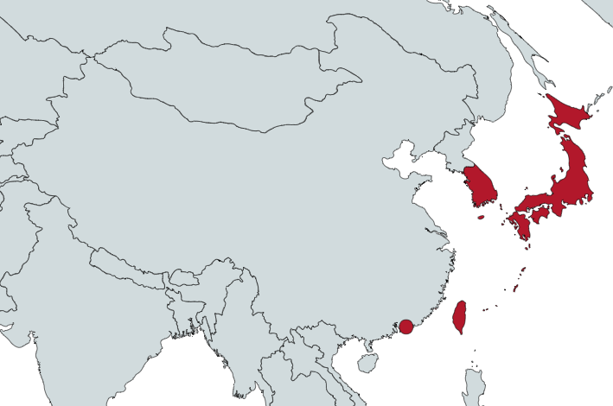
Burden of ESKD
Prevalence of treated ESKD
Country | Treated ESKD |  | Chronic dialysis (HD+PD) |  | Chronic HD |  | Chronic PD
 | Incidence | Prevalence | Incidence | Prevalence | Incidence | Prevalence | Incidence | Prevalence
China | - | - | - | 88.4 | 94.4 | 76.3 | - | 12.1
Hong Kong SAR, China | 171 | 1315 | 154.7 | 818 | 22.1 | 165.8 | 132.6 | 531
Japan | 296 | 2599 | - | 2532 | - | 2148.4 | - | 71.9
Korea, Dem. People's Rep. | - | - | - | - | - | - | - | -
Korea, Rep. | 311 | 1816 | 250 | 1464 | - | 1216 | - | 143
Macao SAR, China | - | - | - | - | - | - | - | -
Mongolia | - | - | - | - | - | - | - | -
Taiwan | 493 | 3392 | - | 3251 | - | 2106.8 | - | 216
Treated ESKD: all dialysis + transplant
* pmp (per million population)
Data source: Chi Bon Leung et al. (Kidney Int. Suppl.) 2015,
Jain et al. (JASN) 2012, 2017/2018 USRDS Annual Data Report
‘ – ’ : data not reported/unavailable

Slide 13
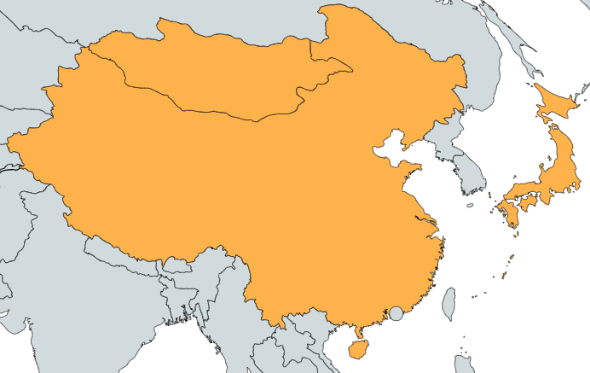
Burden of ESKD (cont’d)
Incidence of kidney transplantation
Country | Kidney transplantation
 | Incidence overall | Prevalence overall | Incidence of deceased donor | Incidence of living donor | Incidence of pre-emptive
China | 6.52 | - | 5.23 | 1.3 | -
Hong Kong SAR, China | - | 497 | - | - | -
Japan | 13.05 | 67 | 1.4 | 11.65 | -
Korea, Dem. People's Rep. | - | - | - | - | -
Korea, Rep. | - | 352 | - | - | -
Macao SAR, China | - | - | - | - | -
Mongolia | 6.67 | - | 0 | 6.67 | -
Taiwan | - | 141 | - | - | -
* pmp (per million population)
Data source: GODT database (http://www.transplant-observatory.org/data-charts-and-tables/),
2017/2018 USRDS Annual Data Report
‘ – ’ : data not reported/unavailable

Slide 14
Annual cost of kidney replacement therapy components
Country | Hemodialysis | Peritoneal dialysis | Kidney Transplant (First year) | Kidney Transplant (later years) | HD/PD cost ratio
China | 22,617 | 8,122 | 25,356 | - | 2.78
Hong Kong SAR, China | 35,074 | 15,199 | - | - | 2.31
Japan | 52,834 | 58,103 | 43,374 | 22,886 | 0.91
Korea, Dem. People's Rep. | - | - | - | - | -
Korea, Rep. | 19,812 | 15,330 | 50,613 | 35,765 | 1.29
Macao SAR, China | - | - | - | - | -
Mongolia | - | - | - | 5,392 | -
Taiwan | - | - | - | - | -
*Cost is in $US 2016
Abbreviations:
HD (hemodialysis),
PD (peritoneal dialysis)
Data source: Fukuhara et al. (2007), Hu et al. (1998), Kwon et al. (2011), Lee et al. (2014), Li & Chow (2001), Neil et al. (2009), Shimizu et al. (2012), Tumurbaatar et al. (2012), van der Tol et al. (2019), Yu et al. (2007)
‘ – ’ : data not reported/unavailable

Slide 15
Survey response
7 of 8 countries (88%) in North & East Asia responded to the 2018 survey
This represents 98.4% of the region’s population

Slide 16
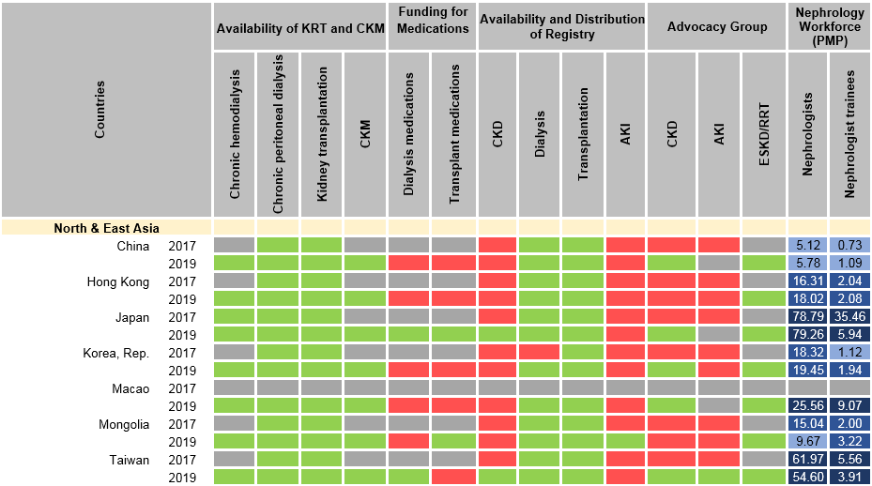
Country level scorecard
Yes
No
N/A
Abbreviations
KRT: kidney replacement therapy
CKM: conservative kidney management
CKD: chronic kidney disease
AKI: acute kidney injury
ESKD: end stage kidney disease
RRT: renal replacement therapy

Slide 17
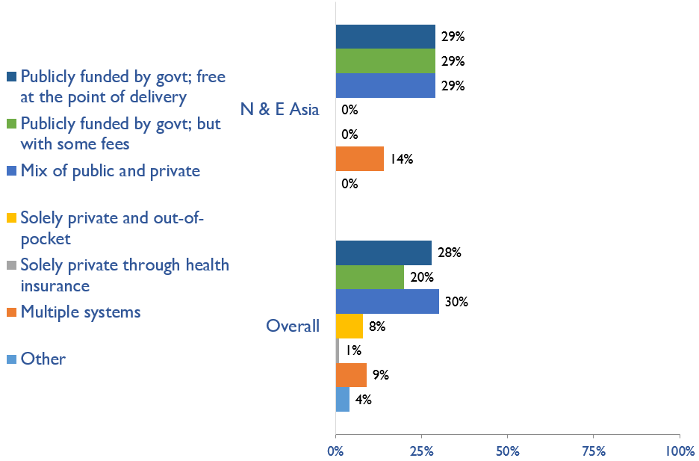
Funding for non-dialysis CKD
Country | Publicly funded by govt; free at the point of delivery | Publicly funded by govt but with some fees at the point of delivery | Mix of public and private funding systems | Solely private and out-of-pocket | Solely private through health insurance | Multiple systems | Other
China |  |  | X
Hong Kong SAR, China |  |  | X
Japan |  | X
Korea, Rep. |  | X
Macao SAR, China |  |  |  |  |  | X
Mongolia | X
Taiwan | X
X : Yes

Slide 18
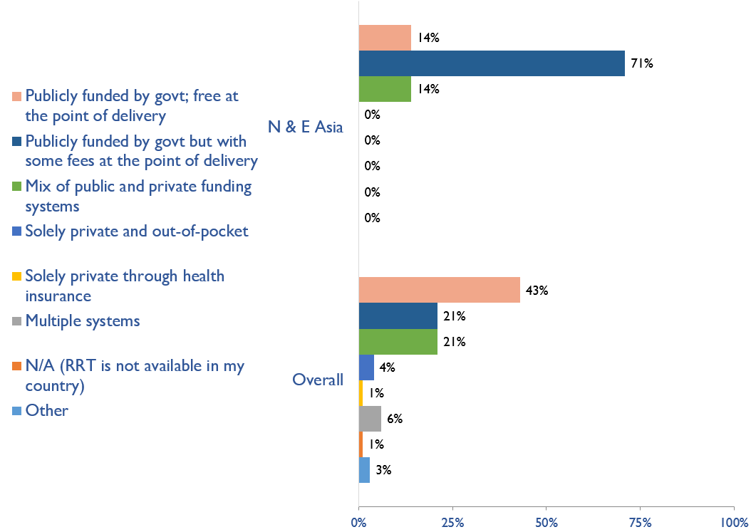
Funding for kidney replacement therapy (KRT)
Country | Publicly funded by govt; free at the point of delivery | Publicly funded by govt but with some fees at the point of delivery | Mix of public and private funding systems | Solely private and out-of-pocket | Solely private through health insurance | Multiple systems | N/A (RRT is not available in my country) | Other
China |  | X
Hong Kong SAR, China |  |  | X
Japan |  | X
Korea, Rep. |  | X
Macao SAR, China |  | X
Mongolia | X
Taiwan |  | X
X : Yes

Slide 19
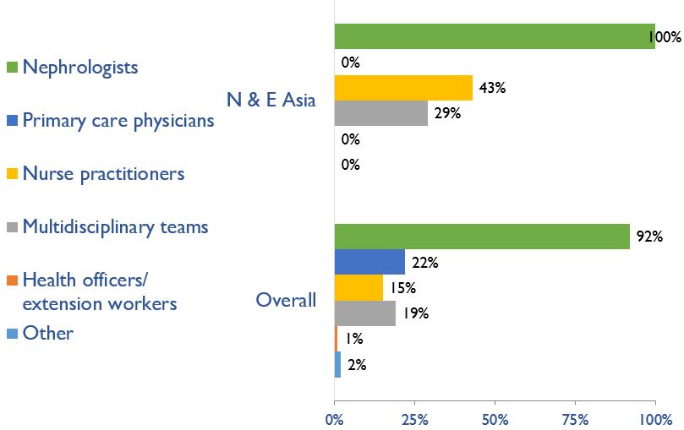
Providers primarily responsible for ESKD care
Country | Nephrologists | Primary care physicians | Nurse practitioners or specialized nurses | Multidisciplinary teams | Health officers/ extension workers | Other
China | X |  | X
Hong Kong SAR, China | X |  | X
Japan | X |  | X | X
Korea, Rep. | X
Macao SAR, China | X
Mongolia | X
Taiwan | X |  |  | X
X : Yes

Slide 20
Shortage of ESKD care providers
Country | Nephrologists | Transplant surgeons | Surgeons (HD access) | Surgeons (PD access) | Interventional radiologists (HD access) | Interventional radiologists (PD access) | Laboratory technicians | Dietitians | Radiologists (ultrasound) | Vascular access coordinators | Counsellors/psychologists | Transplant coordinators | Dialysis nurses | Dialysis technicians | No shortage
China
Hong Kong SAR, China
Japan
Korea, Rep.
Macao SAR, China
Mongolia
Taiwan
No shortage
Shortage

Slide 21
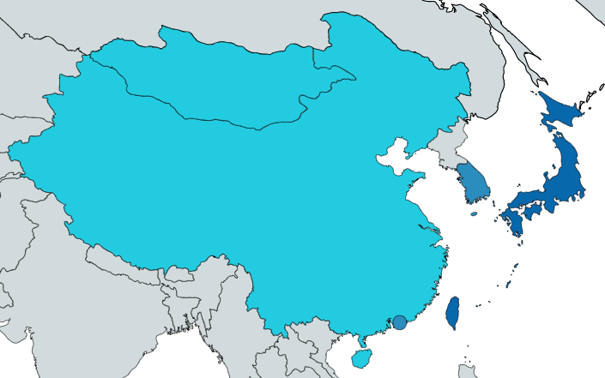
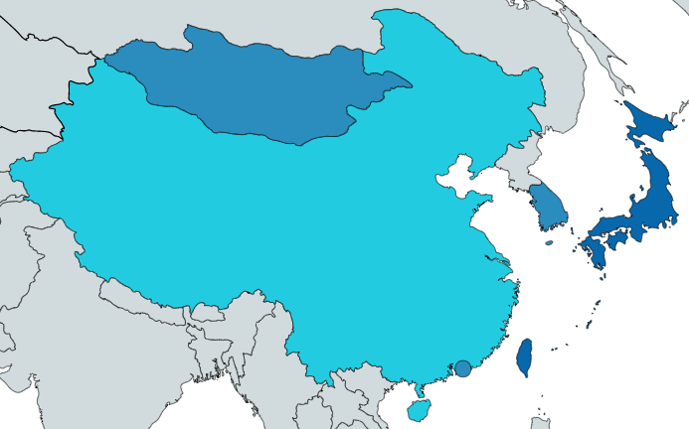
Prevalence of nephrologists and trainees
Nephrologists
Nephrology trainees
Country | Nephrologists PMP | Nephrology trainees PMP
China | 5.78 | 1.09
Hong Kong SAR, China | 18.02 | 2.08
Japan | 79.26 | 5.94
Korea, Rep. | 19.45 | 1.94
Macao SAR, China | 25.56 | 9.07
Mongolia | 9.67 | 3.22
Taiwan | 54.60 | 3.91
‘ – ’ : data not reported/unavailable

Slide 22
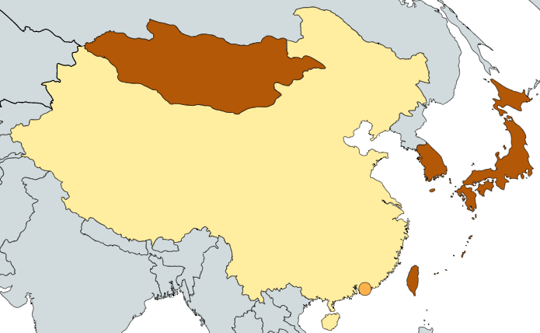
Capacity for chronic dialysis (HD)
Chronic HD centers
Country | Chronic HD Centres PMP
China | 0.54
Hong Kong SAR, China | 1.80
Japan | 34.84
Korea, Rep. | 14.16
Macao SAR, China | 4.95
Mongolia | 16.11
Taiwan | 35.36
Chronic HD services are available in all countries of the region
The North & East Asia average of HD treatment centers is 14.16 pmp
‘ – ’ : data not reported/unavailable

Slide 23
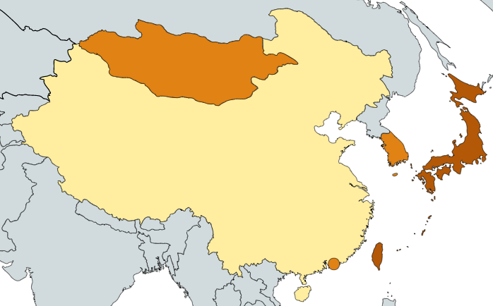
Capacity for chronic dialysis (PD)
Chronic PD centers
Country | Chronic PD Centres PMP
China | 0.36
Hong Kong SAR, China | 1.94
Japan | 3.96
Korea, Rep. | 1.94
Macao SAR, China | 1.65
Mongolia | 1.61
Taiwan | 5.44
Chronic PD services are available in all countries of the region
The North & East Asia average of PD treatment centers is 1.94 pmp
‘ – ’ : data not reported/unavailable

Slide 24
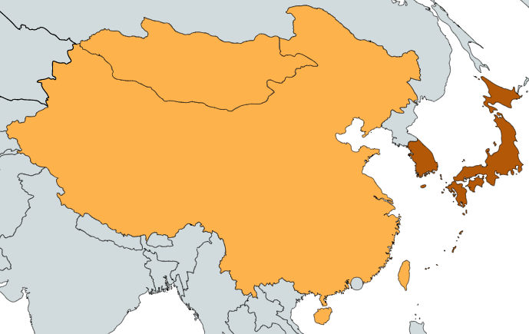
Capacity for kidney transplantation
Kidney transplantation centers
Country | Kidney Transplantation availability | Transplant centers PMP
China | X | 0.36
Hong Kong SAR, China | X | 0.55
Japan | X | 1.14
Korea, Rep. | X | 1.23
Macao SAR, China | X | 1.65
Mongolia | X | 0.32
Taiwan | X | 0.42
Kidney transplantation services are available in all countries of the region
The North & East Asia average of Kidney transplantation centers is 0.55 pmp
‘ – ’ : data not reported/unavailable
X : Yes

Slide 25
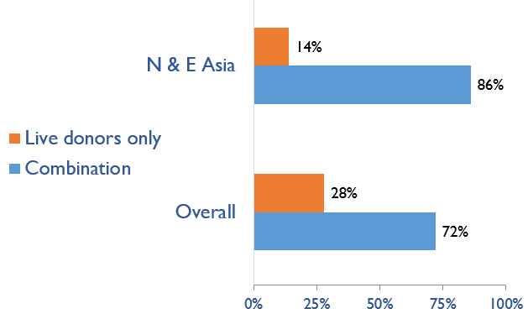
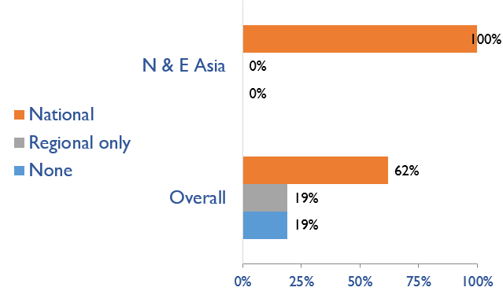
Capacity for kidney transplantation (cont’d)
Transplant donor type
Transplant waitlist
Country | Donor type |  | Transplant waitlist
 | Live donors only | Combination | National | Regional only | None
China |  | X | X
Hong Kong SAR, China |  | X | X
Japan |  | X | X
Korea, Rep. |  | X | X
Macao SAR, China | X |  | X
Mongolia |  | X | X
Taiwan |  | X | X
X : Yes

Slide 26
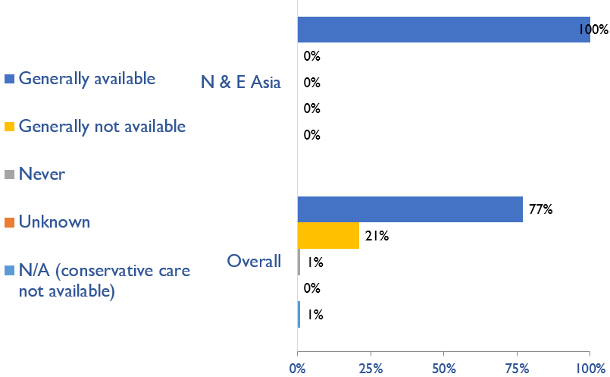
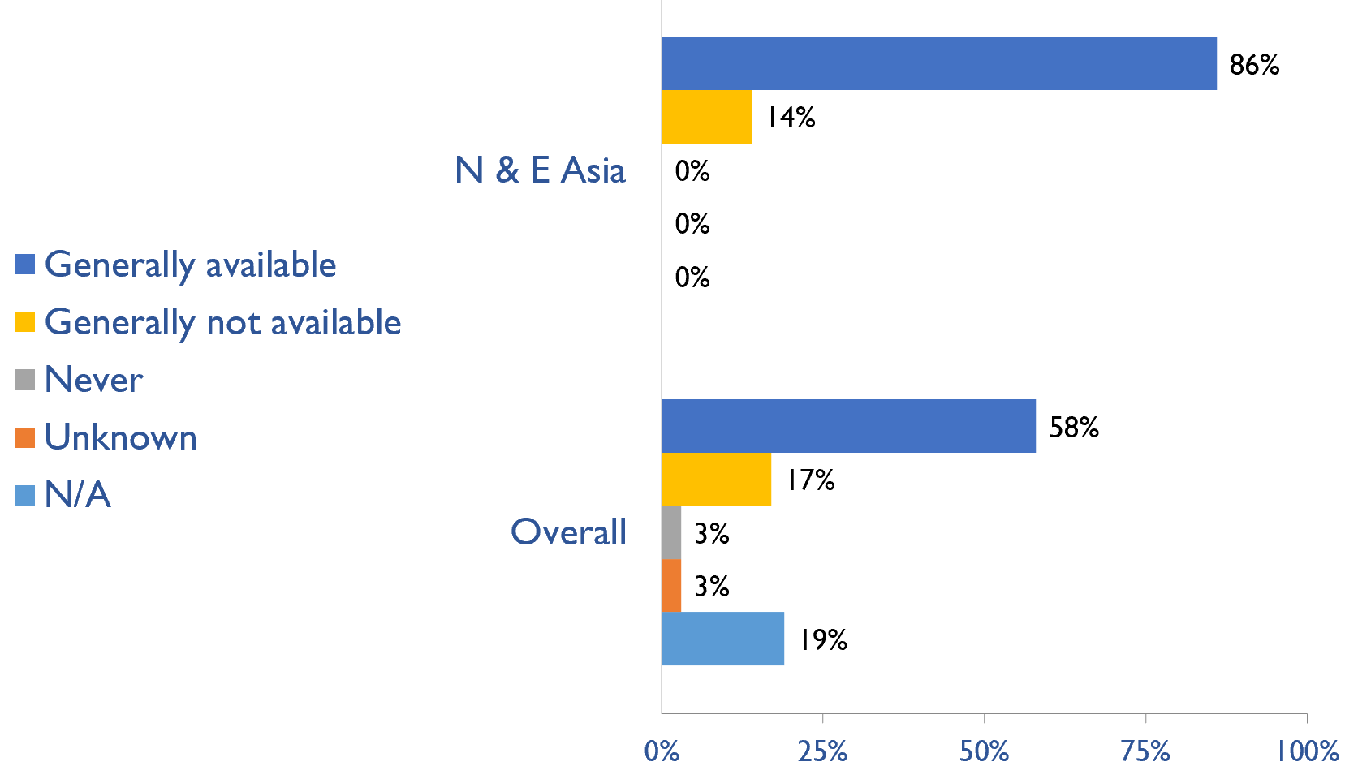
Availability of services within dialysis care
HD frequency
Country | HD frequency a center-based service that involves treatment 3x week/3-4x hours |  |  |  |  | PD frequency ability to do adequate exchanges 3-4x day (or equivalent cycles on automated PD)
 | Generally available | Generally not available | Never | Unknown | N/A (dialysis not provided) | Generally available | Generally not available | Never | Unknown | N/A (dialysis not provided)
China | X |  |  |  |  | X
Hong Kong SAR, China | X |  |  |  |  | X
Japan | X |  |  |  |  | X
Korea, Rep. | X |  |  |  |  | X
Macao SAR, China | X |  |  |  |  |  | X
Mongolia | X |  |  |  |  | X
Taiwan | X |  |  |  |  | X
PD frequency
X : Yes

Slide 27
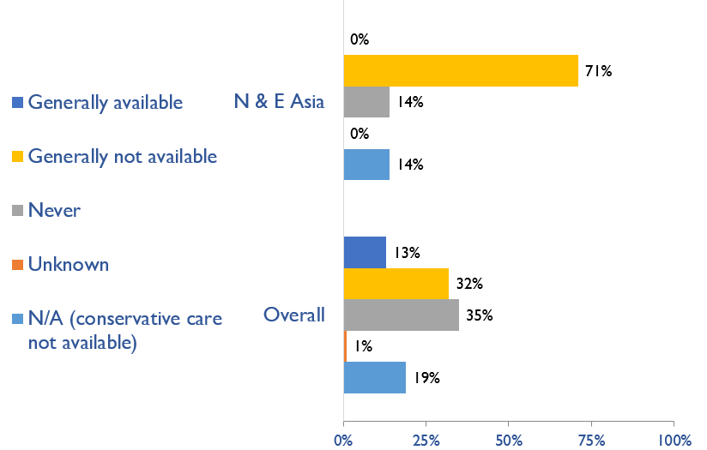
Availability of home hemodialysis
Country | Availability of Home hemodialysis
 | Generally available | Generally not available | Never | Unknown | N/A (dialysis not provided)
China |  | X
Hong Kong SAR, China |  | X
Japan |  | X
Korea, Rep. |  | X
Macao SAR, China |  |  | X
Mongolia |  |  |  |  | X
Taiwan |  | X
X : Yes

Slide 28
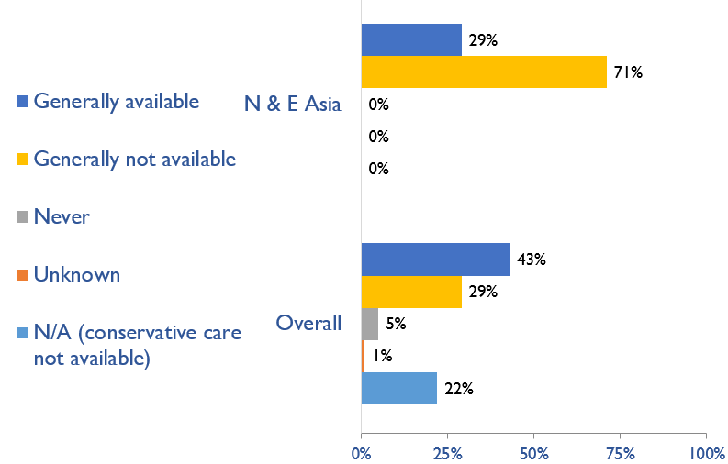
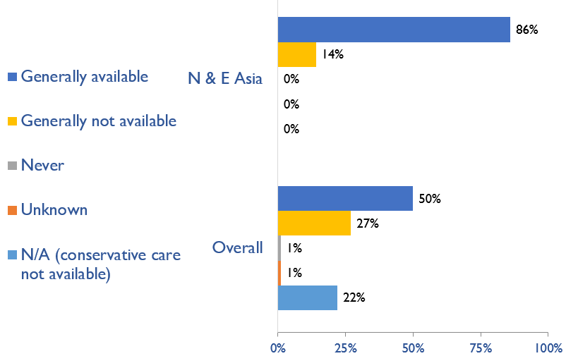
Capacity for conservative kidney management (CKM)
Choice–restricted CKM
Country | Established choice–restricted conservative care |  |  |  |  | Established conservative care that is chosen or medically advised
 | Generally available | Generally not available | Never | Unknown | N/A (conservative care not available) | Generally available | Generally not available | Never | Unknown | N/A (conservative not available)
China | X |  |  |  |  | X
Hong Kong SAR, China | X |  |  |  |  | X
Japan |  | X |  |  |  | X
Korea, Rep. |  | X |  |  |  | X
Macao SAR, China |  | X |  |  |  |  | X
Mongolia |  | X |  |  |  | X
Taiwan |  | X |  |  |  | X
Chosen or medically advised CKM
X : Yes

Slide 29
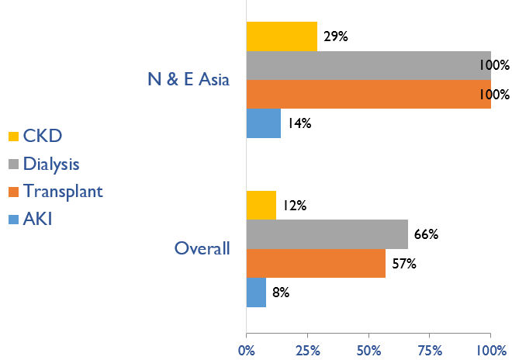
Availability of official registry
Country | CKD | Dialysis | Transplant | AKI
China |  | X | X
Hong Kong SAR, China |  | X | X
Japan | X | X | X
Korea, Rep. |  | X | X
Macao SAR, China |  | X | X
Mongolia |  | X | X | X
Taiwan | X | X | X
X : Yes

Slide 30
Summary of 2019 GKHA findings
KRT availability, access, and quality is high
Conservative kidney management is available, typically chosen or medically-advised
Government funding for medication is low but high for kidney care services
High registry use in end-stage kidney disease
Large variation in workforce capacity, highest in Japan, Korea, Taiwan
Strong advocacy for chronic kidney disease in North & East Asia, limited for acute

Slide 31
Implications
Increase health care financing for ESKD prevention and management
Address workforce shortages through multidisciplinary teams and telemedicine
Incorporate the collection and reporting of quality indicators in ESKD care
Expand health information systems to prevent and manage ESKD
Promote ESKD prevention and treatment by implementing policies, strategies, and advocacy, and mitigating barriers

Slide 32
To access the Atlas report:
www.theisn.org/global-atlas

