Slide 1
Advancing Kidney Health Worldwide. Together.

Slide 2

2023 ISN-GLOBAL KIDNEY HEALTH ATLAS (ISN-GKHA) ISN EASTERN AND CENTRAL EUROPE REGION
www.theisn.org/global-atlas

Slide 3

Overview
Aim
Methods
Key Results

Slide 4
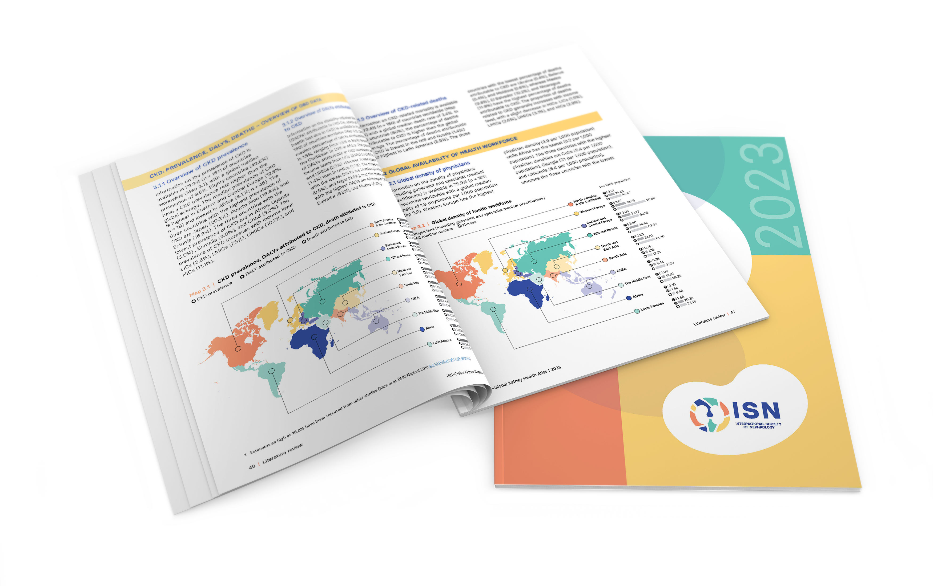
Aim of the ISN-Global Kidney Health Atlas
To understand, compare and monitor how different countries around the world detect, treat, monitor and advocate for people with kidney disease (AKI or CKD).
Key focus on availability, accessibility, affordability and quality of kidney failure care

Slide 5
ISN-Global Kidney Health Atlas Survey
2016
2018
2022
2026

Slide 6
Design and Scope
Online questionnary-based survey July – September 2022
3 languages (English, French, Spanish)
191 countries contacted
≥3 stakeholders per country
National nephrology society leadership
Healthcare policymakers
Patients / patient advocacy groups
Discrepancies resolved by follow-up conferences with regional board chairs and country nephrology leaders
Desk research (across countries and regions)
Published and grey literature review
Systematic review of kidney failure burden and outcomes
Data extraction from major kidney registries (USRDS, ERA-EDTA) and relevant national registries where available
Scoping review of KRT cost estimates
Notes:
REDCap Cloud. The questionnaire was peer reviewed for content validity and comprehensiveness before it was piloted with the 10 ISN regional boards to identify any logistical and feasibility issues (e.g., translation needs). Intensive follow-ups were conducted by email and telephone with ISN regional and national leaders to ensure complete and timely responses.
Data and reports published by the WHO Global Observatory, UN, World Bank, and OECD.
Both published and unpublished documents from international organizations/bodies and reports published by national governments on the organization and
delivery of ESKD.
Additional literature identified by key stakeholders (i.e., opinion leaders, national nephrology society leaders, ISN leaders) and through consultation with national nephrology societies and ISN regional boards.

Slide 7

Overall Survey Components

Slide 8
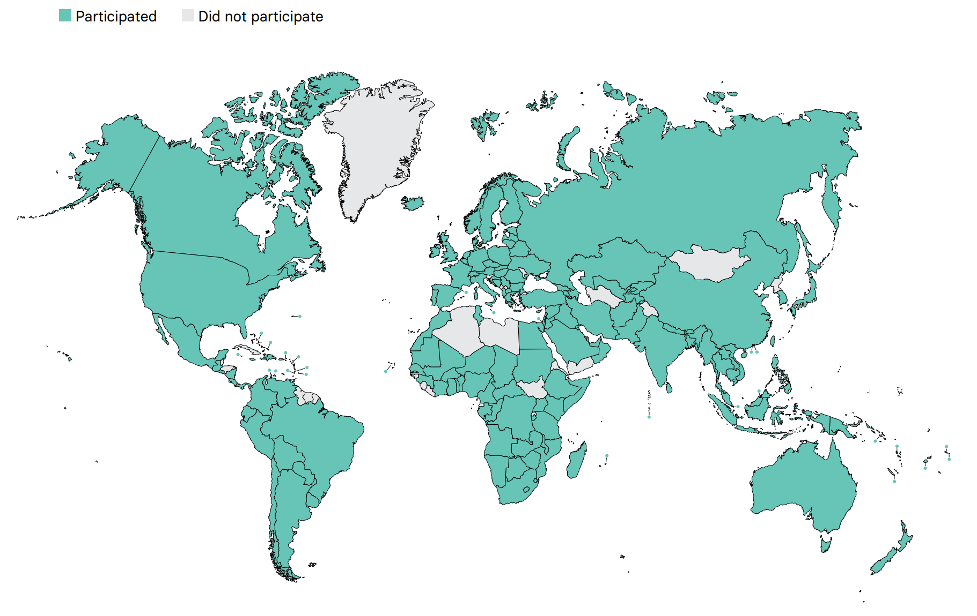
Overall ISN-GKHA response
167 countries (92%)
97% world’s population
329 individuals (63%) response
2 respondents/country (IQR 2-3)
108 countries participated in the 2017, 2019, and 2023 GKHA surveys

Slide 9
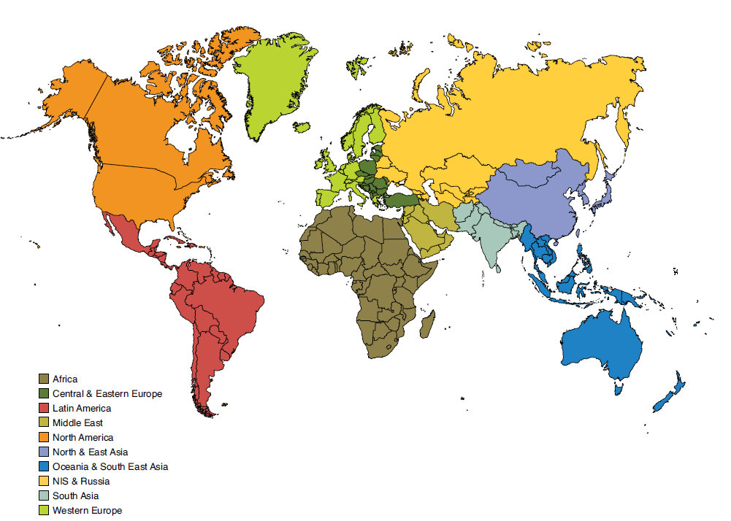
Results presented by ISN regions

Slide 10

ISN Region: Eastern and Central Europe

Slide 11
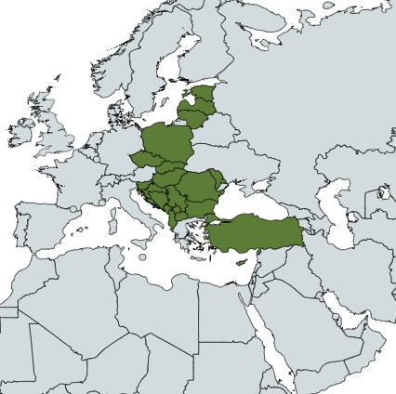
Demographics
Country | World bank ranking | Area (sq km) | Total population (2022) | GDP (PPP) ($ billion) | Total health expenditures (% of GDP)
Albania | Upper-middle income | 28,748 | 3,095,344 | 44.2 | 5.2
Bosnia and Herzegovina | Upper-middle income | 51,197 | 3,816,459 | 56.8 | 9.1
Bulgaria | Upper-middle income | 110,789 | 6,873,253 | 192.1 | 7.1
Croatia | High income | 56,594 | 4,188,853 | 133.8 | 7
Cyprus | High income | 9,251 | 1,295,102 | 39.7 | 7
Czech Republic | High income | 78,867 | 10,705,384 | 473.7 | 7.8
Estonia | High income | 45,228 | 1,211,524 | 56.1 | 6.7
Hungary | High income | 93,028 | 9,699,577 | 356.9 | 6.4
Kosovo | Upper-middle income | 10,887 | 1,952,701 | 23.3 | -
Latvia | High income | 64,589 | 1,842,226 | 64.9 | 6.6
Lithuania | High income | 65,300 | 2,683,546 | 119.3 | 7
Moldova | Upper-middle income | 33,851 | 3,287,326 | 40.2 | 6.4
Montenegro | Upper-middle income | 13,812 | 604,966 | 14.4 | 8.3
North Macedonia | Upper-middle income | 25,713 | 2,130,936 | 37.6 | 7.3
Poland | High income | 312,685 | 38,093,101 | 1428.2 | 6.5
Romania | High income | 238,391 | 18,519,899 | 685.8 | 5.7
Serbia | Upper-middle income | 77,474 | 6,739,471 | 147.0 | 8.7
Slovak Republic | High income | 49,035 | 5,431,252 | 179.8 | 7
Slovenia | High income | 20,273 | 2,101,208 | 91.9 | 8.5
Turkey | Upper-middle income | 783,562 | 83,047,706 | - | 4.3
Responses were received from 16 of 20 countries in Eastern and Central Europe (80%) representing 96.2% of the region’s population.
‘ – ’ : data not reported/unavailable

Slide 12
Demographics
Country | World bank ranking | Area (sq km) | Total population (2022) | GDP (PPP) ($ billion) | Total health expenditures (% of GDP) | Total Health Spending per person | Government Health Spending per person | Out-of-pocket Health Spending per person
Albania | Upper-middle income | 28,748 | 3,095,344 | 44.2 | 5.2 | 291 | 165 | 117
Bosnia and Herzegovina | Upper-middle income | 51,197 | 3,816,459 | 56.8 | 9.1 | 552 | 393 | 144
Bulgaria | Upper-middle income | 110,789 | 6,873,253 | 192.1 | 7.1 | 735 | 435 | 286
Croatia | High income | 56,594 | 4,188,853 | 133.8 | 7 | 1012 | 851 | 98
Cyprus | High income | 9,251 | 1,295,102 | 39.7 | 7 | 1275 | 569 | 544
Czech Republic | High income | 78,867 | 10,705,384 | 473.7 | 7.8 | 1971 | 1672 | 242
Estonia | High income | 45,228 | 1,211,524 | 56.1 | 6.7 | 1576 | 1174 | 374
Hungary | High income | 93,028 | 9,699,577 | 356.9 | 6.4 | 1110 | 793 | 273
Kosovo | Upper-middle income | 10,887 | 1,952,701 | 23.3 | - | - | - | -
Latvia | High income | 64,589 | 1,842,226 | 64.9 | 6.6 | 1198 | 755 | 434
Lithuania | High income | 65,300 | 2,683,546 | 119.3 | 7 | 1425 | 993 | 403
Moldova | Upper-middle income | 33,851 | 3,287,326 | 40.2 | 6.4 | 235 | 142 | 87
Montenegro | Upper-middle income | 13,812 | 604,966 | 14.4 | 8.3 | 710 | 437 | 270
North Macedonia | Upper-middle income | 25,713 | 2,130,936 | 37.6 | 7.3 | 408 | 247 | 158
Poland | High income | 312,685 | 38,093,101 | 1428.2 | 6.5 | 1093 | 817 | 196
Romania | High income | 238,391 | 18,519,899 | 685.8 | 5.7 | 833 | 682 | 141
Serbia | Upper-middle income | 77,474 | 6,739,471 | 147.0 | 8.7 | 515 | 319 | 183
Slovak Republic | High income | 49,035 | 5,431,252 | 179.8 | 7 | 1474 | 1214 | 233
Slovenia | High income | 20,273 | 2,101,208 | 91.9 | 8.5 | 2218 | 1642 | 241
Turkey | Upper-middle income | 783,562 | 83,047,706 | - | 4.3 | 333 | 262 | 53
‘ – ’ : data not reported/unavailable

Slide 13
CKD and its risk factors burden
Country | CKD Prevalence % (95% CI) | Death attributed to CKD % (95% CI) | DALYS attributed to CKD % (95% CI) | Obesity % (95% CI) | Increased BP % (95% CI) | Smoking % (95% CI)
Albania | 10.54 (9.83 - 11.25) | 1.45 (1.26 - 1.6) | 1.29 (1.12 - 1.45) | 22.3 (17.4 - 27.4) | 29.0 (22.4 - 36.2) | 15.6 (14.0 - 17.3)
Bosnia and Herzegovina | 12.23 (11.41 - 13.05) | 1.76 (1.59 - 1.9) | 1.43 (1.28 - 1.58) | 19.4 (15.1 - 24.1) | 30.8 (24.5 - 37.6) | 30.5 (27.3 - 33.7)
Bulgaria | 14.13 (13.15 - 15.06) | 1.57 (1.43 - 1.71) | 1.55 (1.4 - 1.71) | 27.4 (21.8 - 33.3) | 28.4 (21.7 - 35.5) | 30.3 (27.2 - 33.3)
Croatia | 14.23 (13.27 - 15.19) | 1.76 (1.59 - 1.95) | 1.3 (1.15 - 1.46) | 27.1 (22.4 - 32.1) | 32.4 (26.4 - 39.3) | 27.0 (24.1 - 30.1)
Cyprus | 9.25 (8.50 - 9.96) | 3.84 (3.41 - 4.24) | 1.77 (1.51 - 2.01) | 22.6 (17.4 - 28.3) | 19.8 (14.1 - 26.7) | 26.3 (23.9 - 28.9)
Czech Republic | 12.81 (11.92 - 13.74) | 1.16 (1.03 - 1.27) | 0.94 (0.82 - 1.06) | 28.5 (23.5 - 33.9) | 27.9 (21.5 - 34.7) | 24.5 (21.9 - 27.2)
Estonia | 16.78 (15.56 - 17.98) | 2.2 (1.92 - 2.43) | 1.41 (1.24 - 1.56) | 23.8 (19.8 - 28.1) | 27.4 (22.3 - 32.9) | 22.2 (20.1 - 24.4)
Hungary | 13.28 (12.29 - 14.28) | 1.41 (1.25 - 1.54) | 1.04 (0.93 - 1.16) | 28.6 (23.5 - 34.0) | 30.0 (23.3 - 36.9) | 25.1 (22.2 - 28.0)
Kosovo | - | - | - | - | - | -
Latvia | 16.01 (14.86 - 17.17) | 0.96 (0.85 - 1.05) | 0.84 (0.76 - 0.93) | 25.7 (19.9 - 31.7) | 29.4 (22.6 - 36.9) | 26.9 (24.7 - 29.2)
Lithuania | 15.14 (14.10 - 16.21) | 0.68 (0.61 - 0.74) | 0.66 (0.6 - 0.72) | 28.4 (23.2 - 33.8) | 29.3 (22.4 - 36.6) | 22.6 (20.4 - 24.9)
Moldova | 13.01 (11.99 - 14.04) | 0.6 (0.55 - 0.65) | 0.63 (0.57 - 0.69) | 20.1 (15.1 - 25.5) | 29.8 (23.1 - 37.0) | 19.4 (18.0 - 21.2)
Montenegro | 12.34 (11.48 - 13.20) | 1.87 (1.66 - 2.06) | 1.56 (1.37 - 1.73) | 24.9 (19.2 - 30.7) | 29.1 (22.4 -36.1) | 31.0 (28.0 - 34.0)
North Macedonia | 11.73 (10.91 - 12.57) | 1.51 (1.37 - 1.64) | 1.4 (1.25 - 1.56) | 23.9 (18.4 - 29.6) | 28.5 (21.9 - 36.1) | 31.4 (28.3 - 34.7)
Poland | 11.92 (11.01 - 12.80) | 1.16 (1.04 - 1.26) | 0.92 (0.82 - 1.03) | 25.6 (21.9 - 29.5) | 28.7 (23.0 - 35.0) | 24.1 (21.7 - 26.8)
Romania | 12.01 (11.17 - 12.83) | 1.16 (1.06 - 1.25) | 1.12 (1.01 - 1.24) | 24.5 (20.0 - 29.3) | 30.0 (23.4 - 37.3) | 21.9 (19.6 - 24.4)
Serbia | 12.86 (11.93 - 13.77) | 2.14 (1.97 - 2.3) | 1.64 (1.47 - 1.8) | 23.5 (19.1 - 28.1) | 29.5 (23.4 - 35.6) | 23.8 (20.9 - 27.0)
Slovak Republic | 11.94 (11.09 - 12.76) | 1.39 (1.25 - 1.53) | 1.13 (1 - 1.27) | 22.4 (17.9 - 27.3) | 28.5 (22.5 - 34.9) | 20.9 (18.3 - 23.6)
Slovenia | 13.02 (12.08 - 13.90) | 1.25 (1.06 - 1.43) | 0.88 (0.76 - 1.02) | 22.5 (17.2 - 28.2) | 30.5 (23.9 - 37.9) | 20.2 (17.8 - 22.7)
Turkey | 11.32 (10.56 - 12.07) | 4.22 (3.73 - 4.62) | 2.45 (2.12 - 2.77) | 32.2 (28.4 - 36.1) | 20.3 (15.9 - 24.9) | 22.9 (20.1 - 26.0)
Abbreviations: CKD (Chronic Kidney Disease), DALYS (disability-adjusted life years), BP (blood pressure), CI (confidence interval)
Data source: GBD study database (http://www.healthdata.org/gbd), WHO data observatory (https://www.who.int/gho/en/)
‘ – ’ : data not reported/unavailable

Slide 14
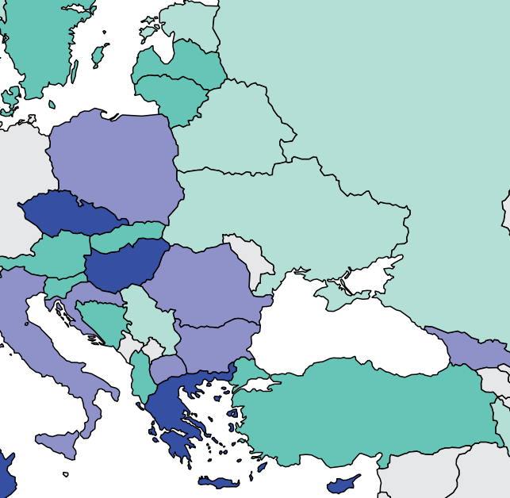
Burden of kidney failure
Country | Treated kidney failure |  | Chronic dialysis (HD+PD) |  | Chronic Hemodialysis |  | Chronic Peritoneal dialysis
 | Incidence | Prevalence | Incidence | Prevalence | Incidence | Prevalence | Incidence | Prevalence
Albania | 126 | 602 | - | 335 | - | - | - | -
Bosnia and Herzegovina | 111 | 763 | 110.8 | 655.4 | 106.8 | 627.6 | 4 | 27.8
Bulgaria | 170 | 627 | - | 528 | - | 300.3 | - | 21.4
Croatia | 191 | 1248 | - | 620.3 | - | 610.7 | - | 54.3
Cyprus | 284 | - | - | 23.5 | - | 21 | - | 2.5
Czech Republic | 216 | 1101 | - | 589 | - | 561.08 | - | 32.37
Estonia | 74 | 784 | 73.9 | 319.6 | 60.3 | 266.8 | 13.6 | 52.8
Hungary | 222 | 999 | - | 655 | - | 512 | - | 68.3
Kosovo | - | - | - | - | - | - | - | -
Latvia | 121 | 802 | - | 239 | - | 186.84 | - | 51.9
Lithuania | 113 | 868 | - | 491.2 | - | 364.6 | - | 16.8
Moldova | - | - | - | 67.1 | - | 66.6 | - | 0.5
Montenegro | - | - | - | - | - | - | - | -
North Macedonia | 183 | 893 | - | 775 | - | 776.91 | - | 8.93
Poland | 153 | 556 | - | 560 | - | 407 | - | 28.8
Romania | 191 | 1164 | 189.2 | 1065.5 | 187.2 | 1002.8 | 2 | 62.7
Serbia | 82 | 879 | 81.6 | 736.6 | 72.8 | 659.8 | 8.8 | 76.8
Slovak Republic | 122 | 681 | - | 620 | - | 532.1 | - | 37
Slovenia | 126.2 | 1008.3 | 112.7 | 680.1 | 101.5 | 654.9 | 11.2 | 25.2
Turkey | 138.7 | 996.8 | - | 777 | 122.5 | 735.84 | - | 40.32
Prevalence of treated kidney failure
Treated kidney failure: all dialysis + transplant
* pmp (per million population)
Data source: ERA-EDTA Registry Annual Report 2019, Jain et al. (JASN) 2012, Turkish Society of Nephrology Registry Report, 2019 USRDS Annual Data Report
‘ – ’ : data not reported/unavailable

Slide 15
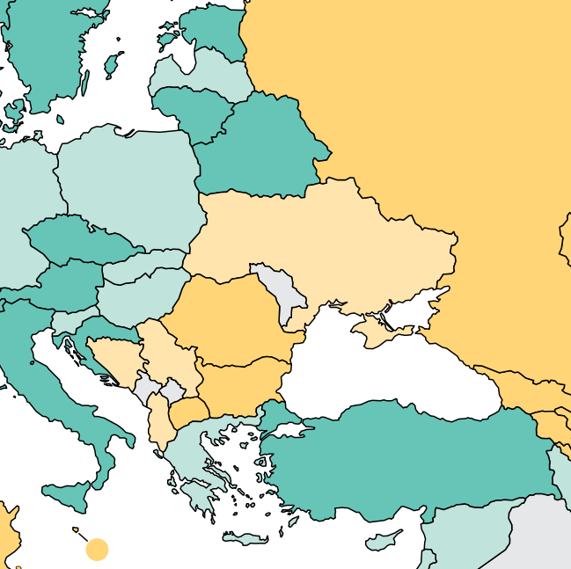
Burden of kidney failure (cont’d)
Country | Kidney transplantation
 | Incidence overall | Prevalence overall | Incidence of deceased donor | Incidence of living donor | Incidence of pre-emptive
Albania | 2.41 | 80 | 0 | 0 | -
Bosnia and Herzegovina | 1.21 | 107.9 | 0.61 | 0.61 | 0
Bulgaria | 4.78 | 83 | 2.75 | 2.03 | -
Croatia | 30.24 | - | 29.02 | 1.22 | -
Cyprus | 15.83 | - | 7.5 | 8.33 | -
Czech Republic | 42.62 | 490 | 38.69 | 3.93 | -
Estonia | 36.92 | 464.2 | 34.62 | 2.31 | 0
Hungary | 20.21 | 344 | 16.67 | 3.54 | -
Kosovo | - | - | - | - | -
Latvia | 14.74 | 280 | 13.68 | 1.05 | -
Lithuania | 37.78 | 288 | 34.81 | 2.96 | -
Moldova | - | - | - | - | -
Montenegro | - | - | - | - | -
North Macedonia | 10 | 110 | - | - | -
Poland | 20.37 | 282 | 19.21 | 1.16 | -
Romania | 8.17 | 98 | 4.61 | 3.56 | 1.6
Serbia | 0.57 | 137.1 | 0.57 | 0 | 0.2
Slovak Republic | 20.91 | 302 | 17.64 | 3.27 | -
Slovenia | 24.76 | 328.2 | 24.29 | 0.48 | 1.9
Turkey | 29.63 | 230 | 2.95 | 26.68 | -
Incidence of kidney transplantation
* pmp (per million population)
Data source: ERA-EDTA Registry Annual Report 2019, GODT database (http://www.transplant-observatory.org/data-charts-and-tables/), 2019 USRDS Annual Data Report
‘ – ’ : data not reported/unavailable

Slide 16
Annual cost of kidney replacement therapy components
Country | Hemodialysis | Peritoneal dialysis | Kidney Transplant (First year) | Kidney Transplant (later years) | HD/PD cost ratio
Albania | 16667 | 12243 | - | - | 1.36
Bosnia and Herzegovina | 19380 | 45344 | 15000 | - | 0.43
Bulgaria | 14535 | 21312 | - | - | 0.68
Croatia | 23971 | 26682 | 26412 | - | 0.90
Cyprus | - | - | - | - | -
Czech Republic | 23992 | 26851 | - | - | 0.89
Estonia | 25969 | 18138 | - | - | 1.43
Hungary | 13663 | 15644 | 47640 | 62912 | 0.87
Kosovo | 14535 | 27206 | - | - | 0.53
Latvia | 18604 | 17889 | - | - | 1.04
Lithuania | 21811 | 22218 | - | - | 0.98
Macedonia, FYR | - | - | - | - | -
Moldova | 50387 | 22671 | - | - | 2.22
Montenegro | 17830 | 20125 | - | - | 0.89
Poland | 18676 | 23748 | - | - | 0.79
Romania | 22868 | 15772 | - | - | 1.45
Serbia | 10659 | 20178 | 17768 | 15205 | 0.53
Slovak Republic | 24031 | 27206 | - | - | 0.88
Slovenia | 42635 | 37182 | 140066 | 15782 | 1.15
Turkey | 10057 | 2593 | 34324 | 14714 | 3.88
* Cost is in $US 2021
Abbreviations: HD (hemodialysis), PD (peritoneal dialysis)
Data source: Cala et al. (2007), Erek et al. (2004), Gazdikova K. et al. (2003), Iannazzo et al. (2012), Kalo et al. (2001), Kandus et al. (2006), Kandus et al. (2009), Mogyorosy et al. (2003), Neil et al. (2009), Perovic et al. (2009), Ursea et al. (1997), Utas (2008), Vaiciuniene et al. (2005), van der Tol et al. (2019), Vazelov et al. (2004), Wordsworth et al. (2005)
‘ – ’ : data not reported/unavailable

Slide 17
Country level scorecard
Country |  | Availability of KRT |  |  | Availability of CKM |  | Funding for Medications |  |  | Availability of Distribution of Registry |  |  |  | Advocacy Group |  |  | Nephrology Workforce (PMP)
 |  | HD | PD | Kidney transplantation | Shared decision | Choice restricted (limited) | CKD | Dialysis | Kidney transplantation | CKD | Dialysis | Kidney transplantation | AKI | CKD | AKI | RRT | Nephrologist | Nephrologist trainees
Albania | 2019 |  |  |  |  |  |  |  |  |  |  |  |  |  |  |  | 53.97 | 4.42
 | 2023 |  |  |  |  |  |  |  |  |  |  |  |  |  |  |  | 29.72 | 4.85
Bosnia and Herzegovina | 2019 |  |  |  |  |  |  |  |  |  |  |  |  |  |  |  | 15.58 | 2.60
 | 2023 |  |  |  |  |  |  |  |  |  |  |  |  |  |  |  | 18.34 | 5.24
Bulgaria | 2019 |  |  |  |  |  |  |  |  |  |  |  |  |  |  |  | 31.88 | 8.50
 | 2023 |  |  |  |  |  |  |  |  |  |  |  |  |  |  |  | 36.37 | 5.09
Croatia | 2019 |  |  |  |  |  |  |  |  |  |  |  |  |  |  |  | 39.81 | 9.95
 | 2023 |  |  |  |  |  |  |  |  |  |  |  |  |  |  |  | 47.75 | 11.94
Cyprus | 2019 |  |  |  |  |  |  |  |  |  |  |  |  |  |  |  | 20.21 | 2.43
 | 2023 |  |  |  |  |  |  |  |  |  |  |  |  |  |  |  | 31.66 | 2.32
Czech Republic | 2019 |  |  |  |  |  |  |  |  |  |  |  |  |  |  |  | 28.07 | 3.74
 | 2023 |  |  |  |  |  |  |  |  |  |  |  |  |  |  |  | 21.48 | 3.74
Estonia | 2019 |  |  |  |  |  |  |  |  |  |  |  |  |  |  |  | 14.47 | 2.81
 | 2023 |  |  |  |  |  |  |  |  |  |  |  |  |  |  |  | 24.76 | 2.48
Hungary | 2019 |  |  |  |  |  |  |  |  |  |  |  |  |  |  |  | 30.53 | 1.02
 | 2023 |  |  |  |  |  |  |  |  |  |  |  |  |  |  |  | 30.93 | 4.12
Kosovo | 2019 |  |  |  |  |  |  |  |  |  |  |  |  |  |  |  | 22.54 | 3.67
 | 2023
Latvia | 2019 |  |  |  |  |  |  |  |  |  |  |  |  |  |  |  | 23.39 | 1.56
 | 2023 |  |  |  |  |  |  |  |  |  |  |  |  |  |  |  | 21.71 | 6.51
Abbreviations
AKI: acute kidney injury
CKD: chronic kidney disease
CKM: conservative kidney management
HD: Hemodialysis
Nephrologist density | <1.2 PMP | 1.2 – 10.0 PMP | 10.1 – 22.9 PMP | >22.9 PMP
Nephrology trainees density | <0.3 PMP | 0.3 – 1.4 PMP | 1.5-3.7 PMP | >3.7 PMP
KRT: kidney replacement therapy
PD: Peritoneal Dialysis
RRT: renal replacement therapy
Yes | No | N/A

Slide 18
Country level scorecard
Country |  | Availability of KRT |  |  | Availability of CKM |  | Funding for Medications |  |  | Availability of Distribution of Registry |  |  |  | Advocacy Group |  |  | Nephrology Workforce (PMP)
 |  | HD | PD | Kidney transplantation | Shared decision | Choice restricted (limited) | CKD | Dialysis | Kidney transplantation | CKD | Dialysis | Kidney transplantation | AKI | CKD | AKI | RRT | Nephrologist | Nephrologist trainees
Lithuania | 2019 |  |  |  |  |  |  |  |  |  |  |  |  |  |  |  | 50.12 | 3.94
 | 2023 |  |  |  |  |  |  |  |  |  |  |  |  |  |  |  | 52.17 | 7.45
Macedonia | 2019 |  |  |  |  |  |  |  |  |  |  |  |  |  |  |  | 12.27 | 2.83
 | 2023 |  |  |  |  |  |  |  |  |  |  |  |  |  |  |  | 13.14 | 4.69
Moldova | 2019 |  |  |  |  |  |  |  |  |  |  |  |  |  |  |  | 11.64 | 1.45
 | 2023
Poland | 2019 |  |  |  |  |  |  |  |  |  |  |  |  |  |  |  | 26.03 | 6.51
 | 2023 |  |  |  |  |  |  |  |  |  |  |  |  |  |  |  | 18.38 | 3.15
Romania | 2019 |  |  |  |  |  |  |  |  |  |  |  |  |  |  |  | 25.63 | 3.26
 | 2023 |  |  |  |  |  |  |  |  |  |  |  |  |  |  |  | 24.30 | 8.64
Serbia | 2019 |  |  |  |  |  |  |  |  |  |  |  |  |  |  |  | 15.54 | 0.71
 | 2023 |  |  |  |  |  |  |  |  |  |  |  |  |  |  |  |  | 7.42
Slovak Republic | 2019 |  |  |  |  |  |  |  |  |  |  |  |  |  |  |  | 36.73 | 3.67
 | 2023 |  |  |  |  |  |  |  |  |  |  |  |  |  |  |  | 36.82 | 3.68
Slovenia | 2019 |  |  |  |  |  |  |  |  |  |  |  |  |  |  |  | 40.44 | 14.27
 | 2023
Turkey | 2019 |  |  |  |  |  |  |  |  |  |  |  |  |  |  |  | 8.00 | 1.08
 | 2023 |  |  |  |  |  |  |  |  |  |  |  |  |  |  |  | 9.63 | 0.60
Abbreviations
AKI: acute kidney injury
CKD: chronic kidney disease
CKM: conservative kidney management
HD: Hemodialysis
Nephrologist density | <1.2 PMP | 1.2 – 10.0 PMP | 10.1 – 22.9 PMP | >22.9 PMP
Nephrology trainees density | <0.3 PMP | 0.3 – 1.4 PMP | 1.5-3.7 PMP | >3.7 PMP
KRT: kidney replacement therapy
PD: Peritoneal Dialysis
RRT: renal replacement therapy
Yes | No | N/A

Slide 19
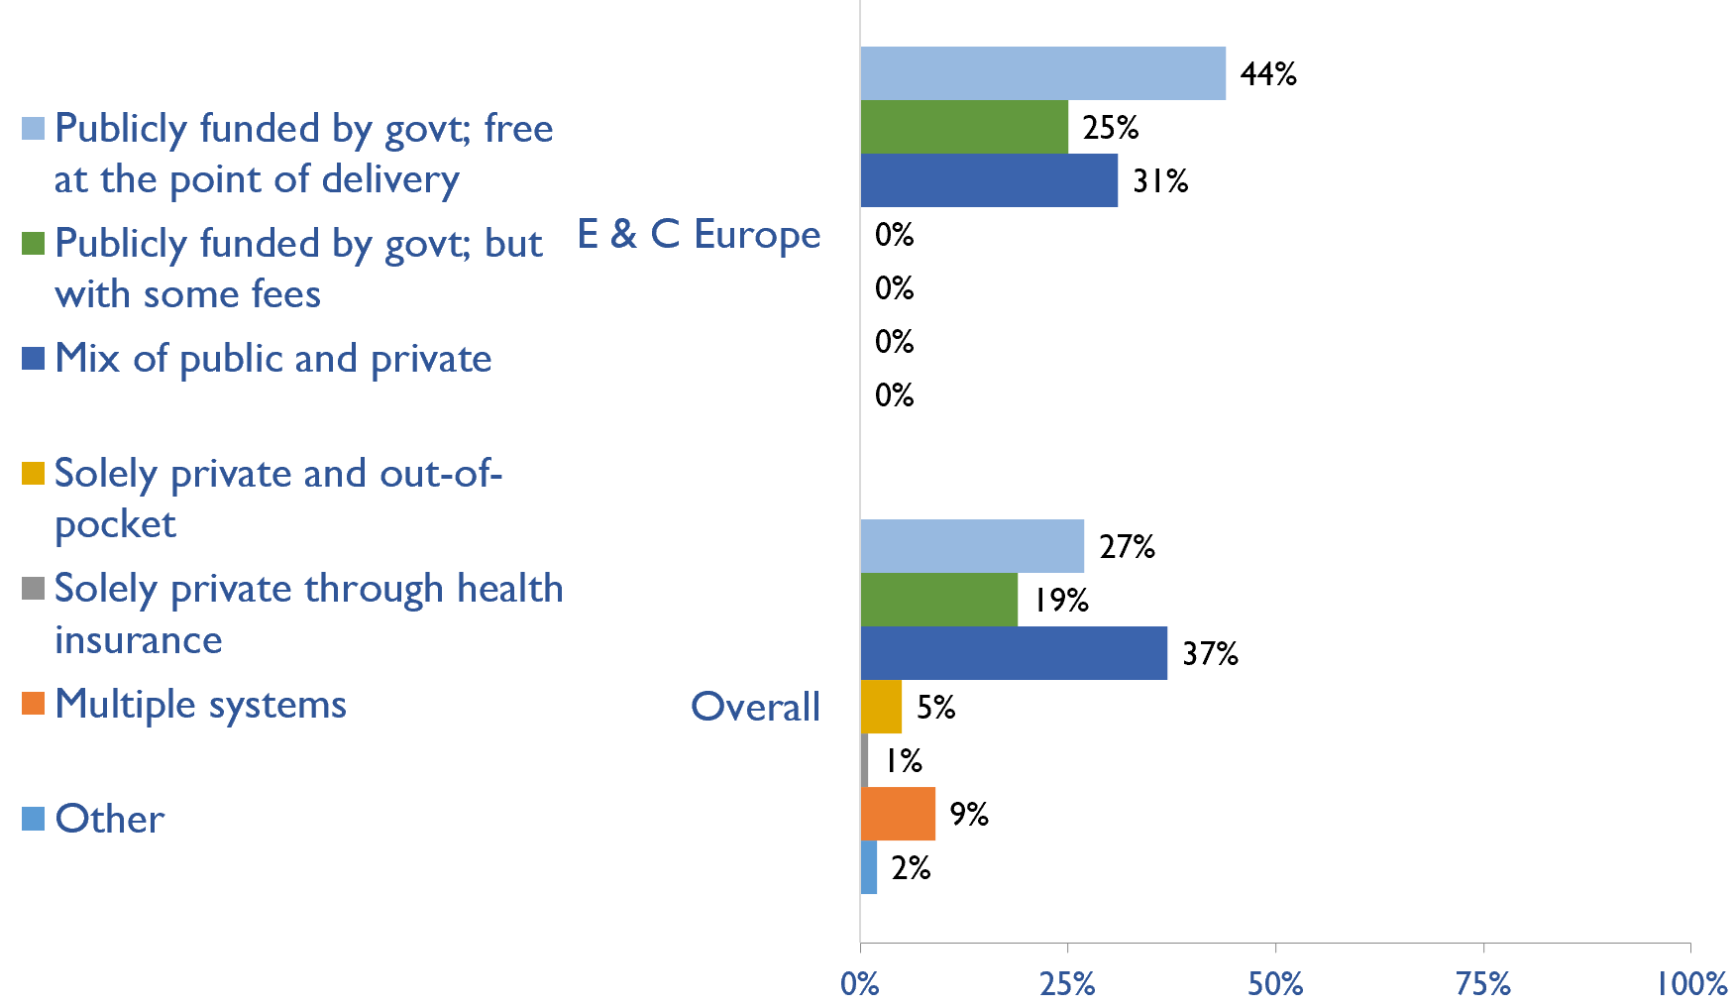
Funding for non-dialysis CKD
Country | Publicly funded by govt; free at the point of delivery | Publicly funded by govt but with some fees at the point of delivery | Mix of public and private funding systems | Solely private and out-of-pocket | Solely private through health insurance | Multiple systems | Other
Albania | X
Bosnia and Herzegovina | X
Bulgaria |  | X
Croatia |  | X
Cyprus |  |  | X
Czech Republic | X
Estonia |  |  | X
Hungary | X
Latvia |  | X
Lithuania |  |  | X
Macedonia, FYR | X
Poland |  |  | X
Romania | X
Serbia | X
Slovak Republic | X
Turkey |  |  | X
X : Yes

Slide 20
Funding for kidney replacement therapy (KRT)
Country | Publicly funded (free) |  |  |  | Publicly funded (some fees) |  |  |  | Mixed |  |  |  | Solely private (out-of-pocket) |  |  |  | Solely private (health insurance) |  |  |  | Multiple systems |  |  |  | N/A |  |  |  | Other
 | AKI | HD | PD | TX | AKI | HD | PD | TX | AKI | HD | PD | TX | AKI | HD | PD | TX | AKI | HD | PD | TX | AKI | HD | PD | TX | AKI | HD | PD | TX | AKI | HD | PD | TX
Albania | X |  | X | X |  |  |  |  |  | X
Bosnia and Herzegovina | X | X | X | X
Bulgaria |  |  |  |  | X | X | X | X
Croatia | X | X | X | X
Cyprus |  | X | X | X |  |  |  |  | X
Czech Republic | X | X | X | X
Estonia | X |  | X | X |  |  |  |  |  | X
Hungary | X | X | X | X
Latvia | X | X | X | X
Lithuania | X |  | X |  |  |  |  | X |  | X
Macedonia, FYR | X | X | X |  |  |  |  | X
Poland | X | X | X |  |  |  |  | X
Romania | X | X | X | X
Serbia | X | X | X | X
Slovak Republic |  |  |  | X |  |  |  |  | X | X | X
Turkey |  | X | X | X | X
X : Yes
Abbreviations: AKI (Acute kidney injury), HD (hemodialysis), PD (peritoneal dialysis), TX (transplant medications)

Slide 21
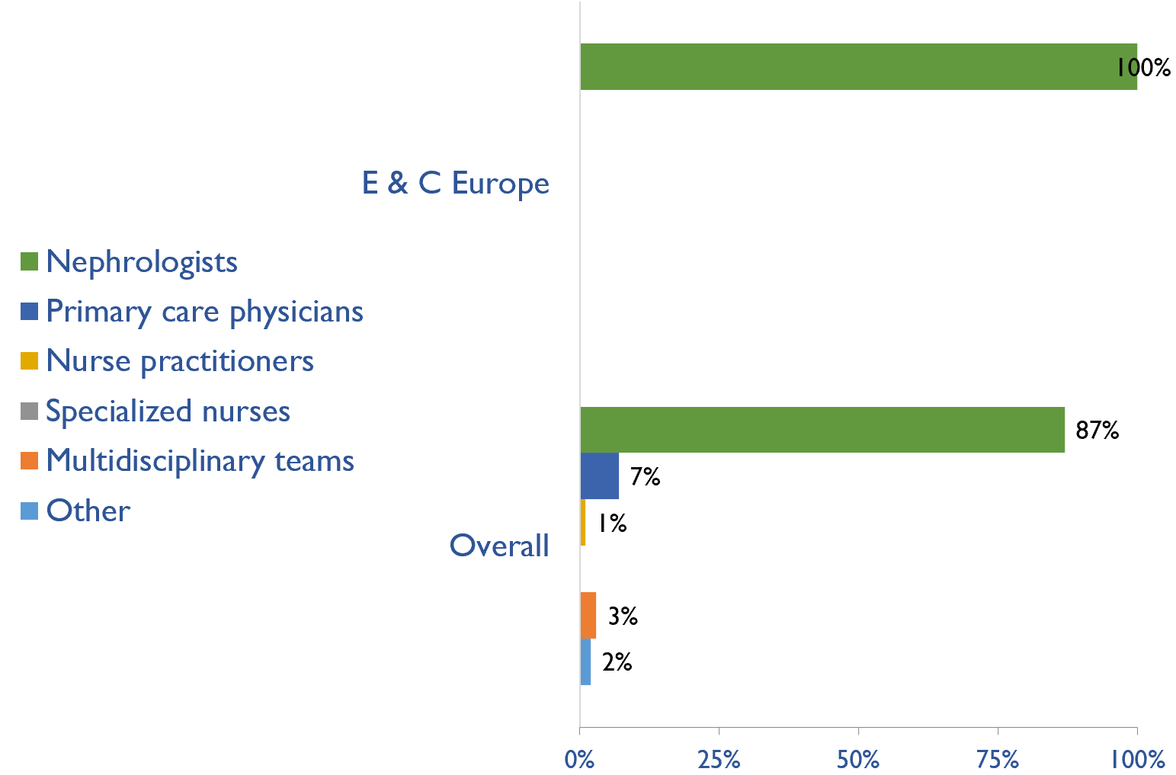
Providers primarily responsible for kidney failure care
Country | Nephrologists | Primary care physicians | Nurse practitioners | Specialized nurses | Multidisciplinary teams | Other
Albania | X
Bosnia and Herzegovina | X
Bulgaria | X
Croatia | X
Cyprus | X
Czech Republic | X
Estonia | X
Hungary | X
Latvia | X
Lithuania | X
Macedonia, FYR | X
Poland | X
Romania | X
Serbia | X
Slovak Republic | X
Turkey | X
X : Yes

Slide 22
Shortage of kidney failure care providers
Country | Nephrologists | Pediatric nephrologists | Transplant surgeons | Surgeons (HD access) | Surgeons (PD access) | Dietitians | Laboratory technicians | Radiologists (ultrasound) | Vascular access coordinators
Albania
Bosnia and Herzegovina
Bulgaria
Croatia
Cyprus
Czech Republic
Estonia
Hungary
Latvia
Lithuania
Macedonia, FYR
Poland
Romania
Serbia
Slovak Republic
Turkey
No shortage
Shortage

Slide 23
Shortage of kidney failure care providers
Country | Counsellors/ psychologists | Transplant coordinators | Dialysis nurses | Renal nurses | Dialysis technicians | Social workers | Palliative care physicians | Kidney supportive care nurses | No shortage
Albania
Bosnia and Herzegovina
Bulgaria
Croatia
Cyprus
Czech Republic
Estonia
Hungary
Latvia
Lithuania
Macedonia, FYR
Poland
Romania
Serbia
Slovak Republic
Turkey
No shortage
Shortage

Slide 24
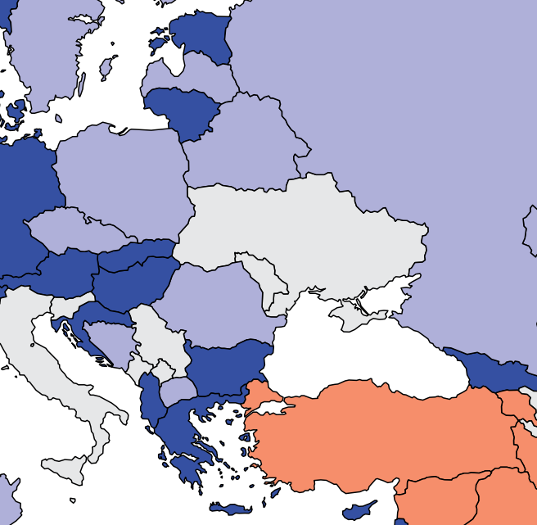
Prevalence of nephrologists and trainees
Country | Nephrologists PMP | Nephrology trainees PMP
Albania | 29.72 | 4.85
Bosnia and Herzegovina | 18.34 | 5.24
Bulgaria | 36.37 | 5.09
Croatia | 47.75 | 11.94
Cyprus | 31.66 | 2.32
Czech Republic | 21.48 | 3.74
Estonia | 24.76 | 2.48
Hungary | 30.93 | 4.12
Latvia | 21.71 | 6.51
Lithuania | 52.17 | 7.45
Macedonia, FYR | 13.14 | 4.69
Poland | 18.38 | 3.15
Romania | 24.30 | 8.64
Serbia | - | 7.42
Slovak Republic | 36.82 | 3.68
Turkey | 9.63 | 0.60
Nephrologists

Slide 25
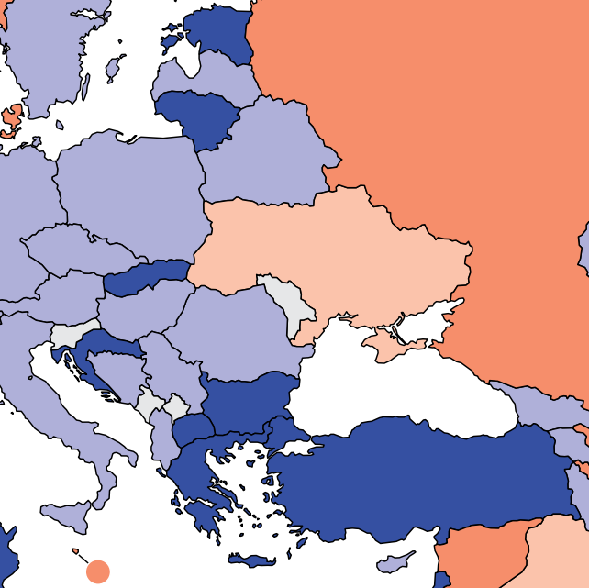
Capacity for chronic dialysis (HD)
Chronic HD centers
Country | Chronic HD Centres PMP
Albania | 4.85
Bosnia and Herzegovina | 7.60
Bulgaria | 11.64
Croatia | 11.94
Cyprus | 6.18
Czech Republic | 10.74
Estonia | 11.56
Hungary | 5.15
Latvia | 10.31
Lithuania | 25.34
Macedonia, FYR | 10.79
Poland | 6.83
Romania | 8.64
Serbia | 9.64
Slovak Republic | 13.81
Turkey | 10.86
Chronic HD services are available in all countries of the region
The Eastern and Central Europe average of HD treatment centers is 10.37 pmp

Slide 26
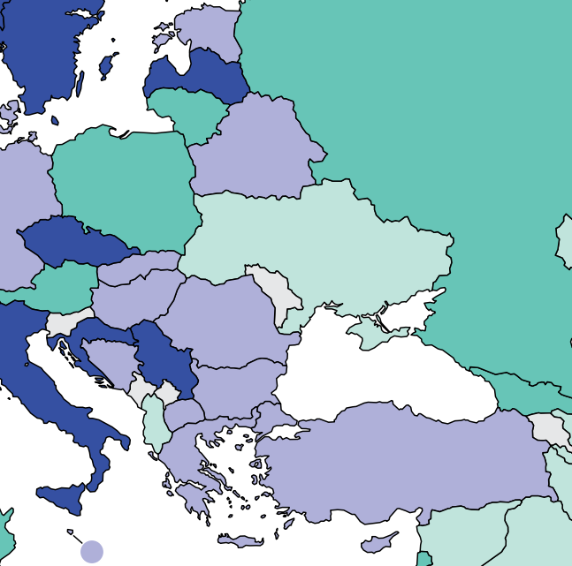
Capacity for chronic dialysis (PD)
Chronic PD centers
Country | Chronic PD Centres PMP
Albania | 0.32
Bosnia and Herzegovina | 1.57
Bulgaria | 1.75
Croatia | 4.77
Cyprus | 2.32
Czech Republic | 3.74
Estonia | 2.48
Hungary | 2.58
Latvia | 3.26
Lithuania | 1.49
Macedonia, FYR | 0.94
Poland | 1.31
Romania | 2.16
Serbia | 3.71
Slovak Republic | 1.84
Turkey | 1.57
Chronic PD services are available in all countries of the region
The Eastern and Central Europe average of PD treatment centers is 2.24 pmp
‘ – ’ : data not reported/unavailable

Slide 27
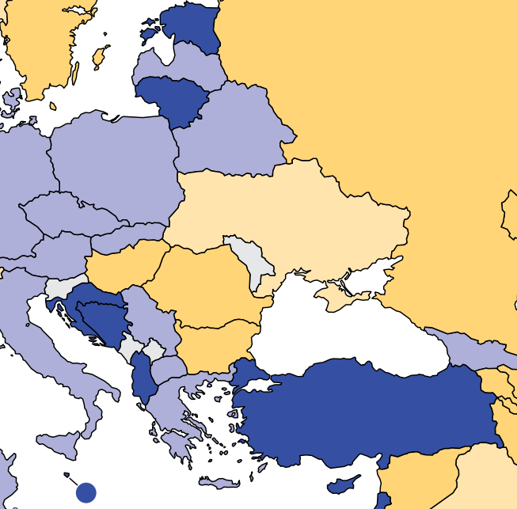
Capacity for Kidney Transplantation
Kidney transplantation centers
Country | Kidney Transplantation availability | Transplant centers PMP
Albania | X | 0.97
Bosnia and Herzegovina | X | 0.79
Bulgaria | X | 0.29
Croatia | X | 0.95
Cyprus | X | 0.77
Czech Republic | X | 0.65
Estonia | X | 0.83
Hungary | X | 0.41
Latvia | X | 0.54
Lithuania | X | 0.75
Macedonia, FYR | X | 0.47
Poland | X | 0.55
Romania | X | 0.27
Serbia | X | 0.59
Slovak Republic | X | 0.74
Turkey | X | 1.11
Kidney transplantation services are available in all countries of the region
The Eastern and Central Europe average of Kidney transplantation centers is 0.67 pmp
X : Yes
‘ – ’ : data not reported/unavailable

Slide 28
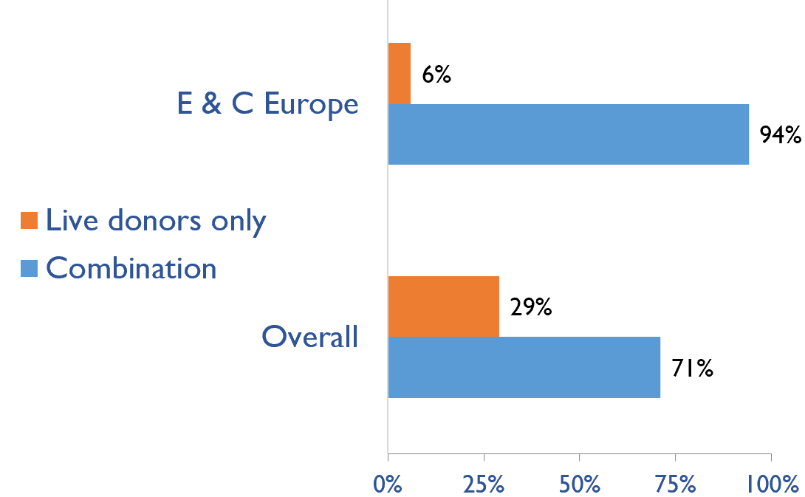
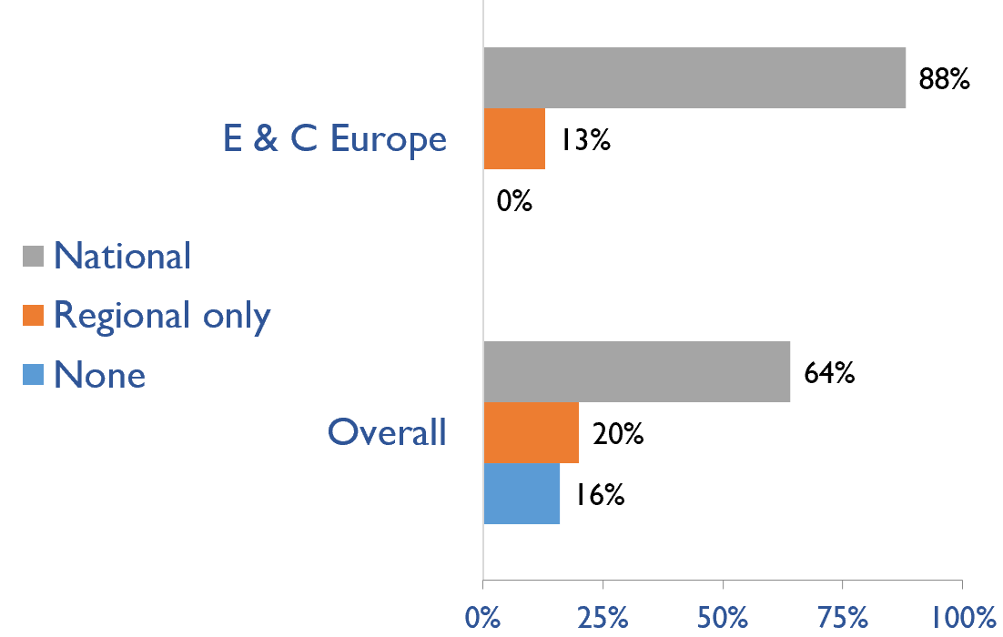
Capacity for Kidney Transplantation (cont’d)
Transplant donor type
Transplant waitlist
Country | Donor type |  | Transplant waitlist
 | Live donors only | Combination | National | Regional only | None
Albania | X |  | X
Bosnia and Herzegovina |  | X |  | X
Bulgaria |  | X | X
Croatia |  | X | X
Cyprus |  | X | X
Czech Republic |  | X | X
Estonia |  | X | X
Hungary |  | X | X
Latvia |  | X | X
Lithuania |  | X | X
Macedonia, FYR |  | X | X
Poland |  | X | X
Romania |  | X |  | X
Serbia |  | X | X
Slovak Republic |  | X | X
Turkey |  | X | X
X : Yes

Slide 29
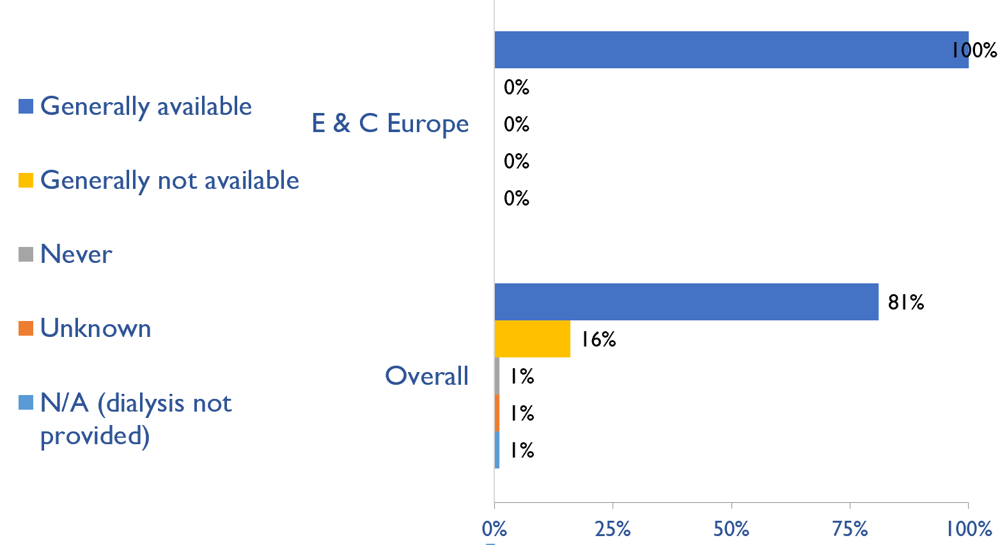
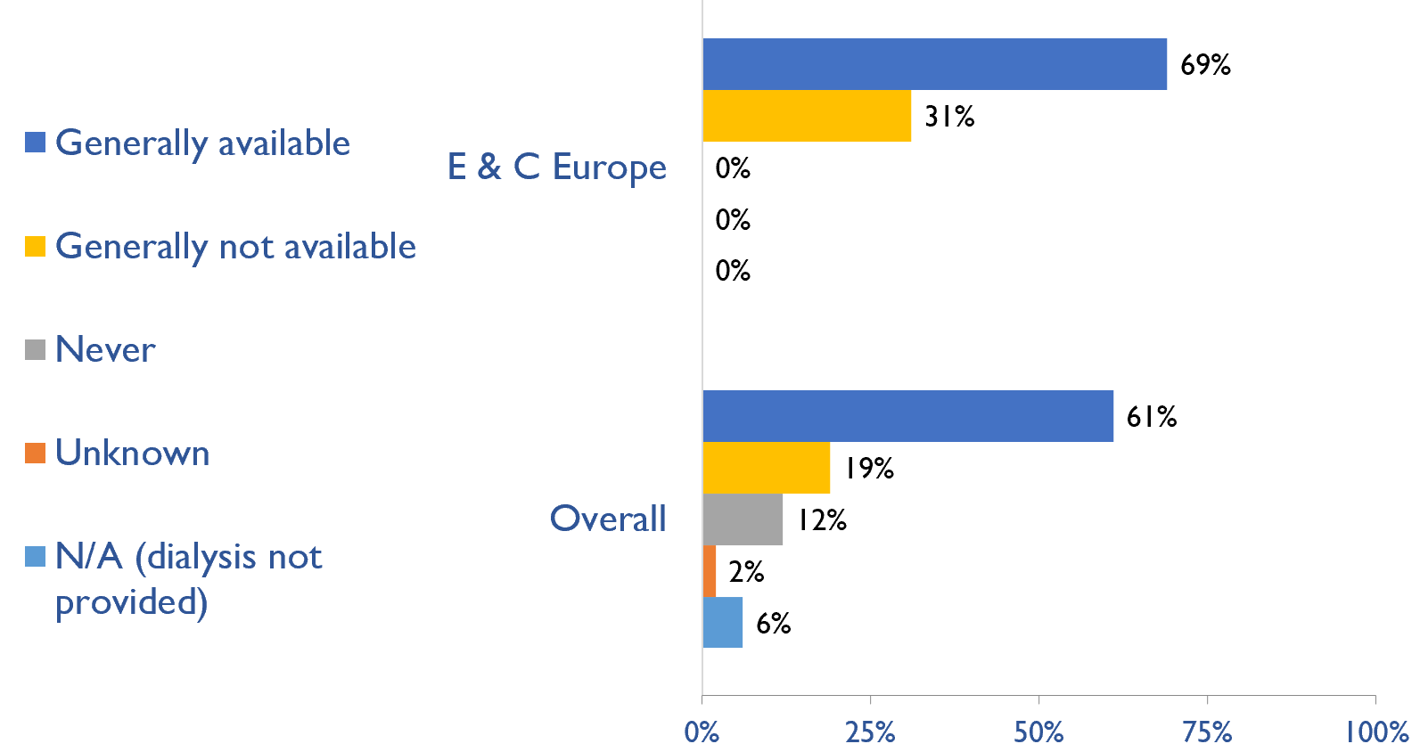
Availability of services within dialysis care
HD frequency
Country | HD frequency a center-based service that involves treatment 3x week/3-4x hours |  |  |  |  | PD frequency ability to do adequate exchanges 3-4x day (or equivalent cycles on automated PD)
 | Generally available | Generally not available | Never | Unknown | N/A (dialysis not provided) | Generally available | Generally not available | Never | Unknown | N/A (dialysis not provided)
Albania | X |  |  |  |  | X
Bosnia and Herzegovina | X |  |  |  |  | X
Bulgaria | X |  |  |  |  |  | X
Croatia | X |  |  |  |  | X
Cyprus | X |  |  |  |  | X
Czech Republic | X |  |  |  |  | X
Estonia | X |  |  |  |  | X
Hungary | X |  |  |  |  | X
Latvia | X |  |  |  |  | X
Lithuania | X |  |  |  |  |  | X
Macedonia, FYR | X |  |  |  |  |  | X
Poland | X |  |  |  |  | X
Romania | X |  |  |  |  | X
Serbia | X |  |  |  |  | X
Slovak Republic | X |  |  |  |  |  | X
Turkey | X |  |  |  |  |  | X
PD frequency
X : Yes

Slide 30
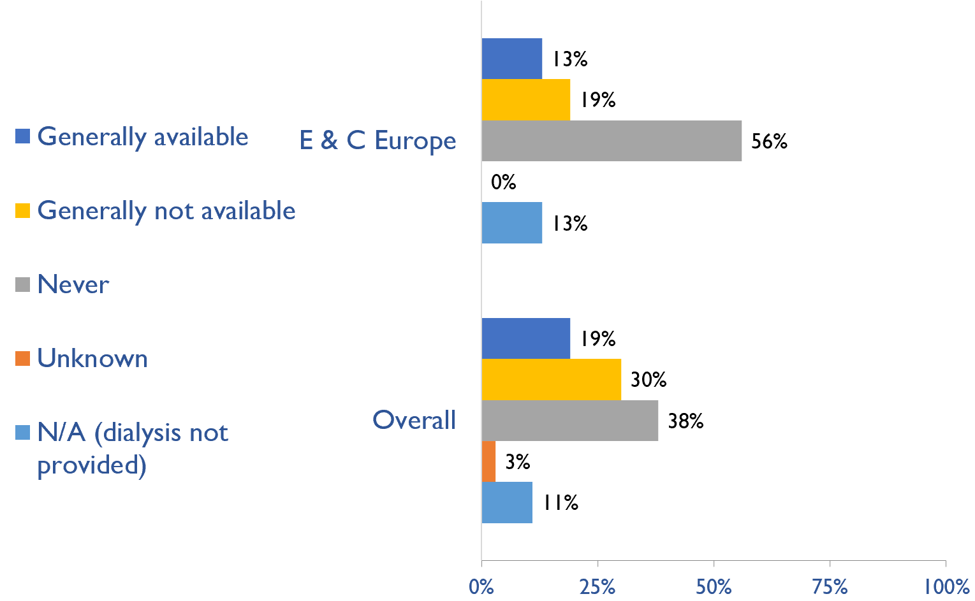
Availability of Home hemodialysis
Country | Availability of Home hemodialysis
 | Generally available | Generally not available | Never | Unknown | N/A (dialysis not provided)
Albania |  |  | X
Bosnia and Herzegovina |  |  | X
Bulgaria |  |  | X
Croatia |  |  | X
Cyprus |  |  | X
Czech Republic |  | X
Estonia |  |  | X
Hungary |  |  | X
Latvia |  |  |  |  | X
Lithuania |  |  | X
Macedonia, FYR |  | X
Poland |  | X
Romania |  |  | X
Serbia | X
Slovak Republic |  |  |  |  | X
Turkey | X
X : Yes

Slide 31
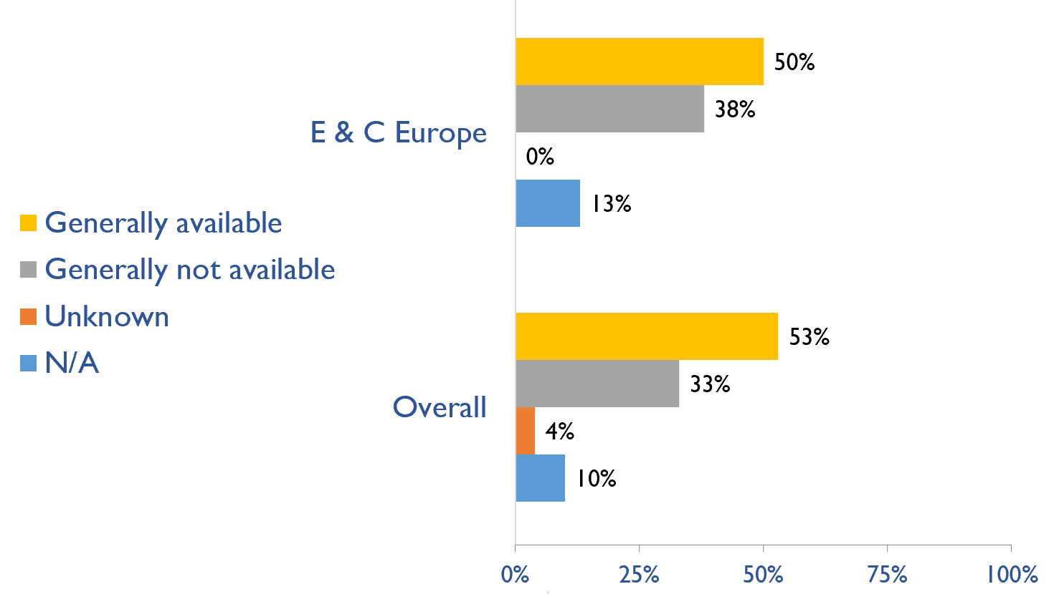
Capacity for conservative kidney management (CKM)
Country | Established conservative care that is chosen or medically advised
 | Generally available | Generally not available | Unknown | N/A (conservative care not available)
Albania | X
Bosnia and Herzegovina |  | X
Bulgaria | X
Croatia |  |  |  | X
Cyprus |  | X
Czech Republic |  | X
Estonia | X
Hungary |  | X
Latvia | X
Lithuania |  | X
Macedonia, FYR | X
Poland | X
Romania | X
Serbia |  | X
Slovak Republic | X
Turkey |  |  |  | X
X : Yes

Slide 32
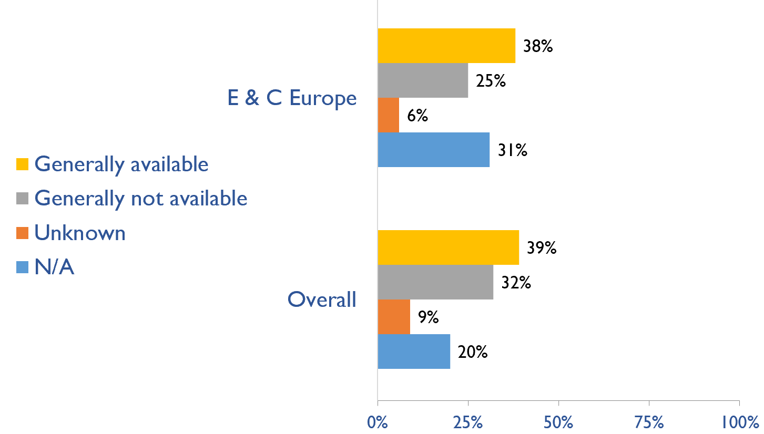
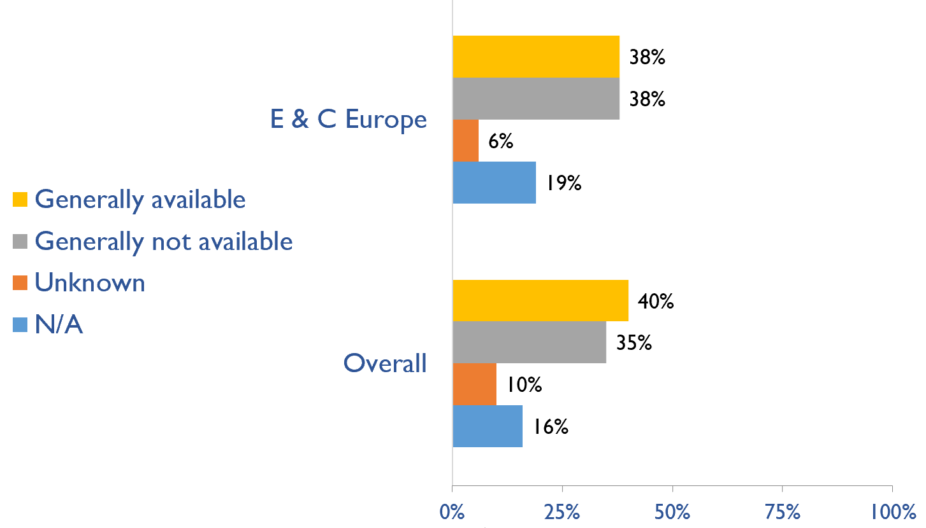
Capacity for conservative kidney management (CKM)
Where resource constraints to prevent or limit access to KRT
Country | where resource constraints to prevent or limit access to KRT |  |  |  | where there are no resource constraints to prevent or limit access to KRT
 | Generally available | Generally not available | Unknown | N/A (conservative care not available) | Generally available | Generally not available | Unknown | N/A (conservative care not available)
Albania | X |  |  |  | X
Bosnia and Herzegovina | X |  |  |  | X
Bulgaria | X |  |  |  | X
Croatia |  |  |  | X |  |  |  | X
Cyprus |  |  |  | X |  | X
Czech Republic |  | X |  |  |  | X
Estonia | X |  |  |  | X
Hungary |  |  |  | X |  | X
Latvia |  | X |  |  |  | X
Lithuania |  |  |  | X |  |  |  | X
Macedonia, FYR | X |  |  |  | X
Poland | X |  |  |  | X
Romania |  | X |  |  |  | X
Serbia |  | X |  |  |  | X
Slovak Republic |  |  | X |  |  |  | X
Turkey |  |  |  | X |  |  |  | X
Where there are no resource constraints to prevent or limit access to KRT
X : Yes

Slide 33
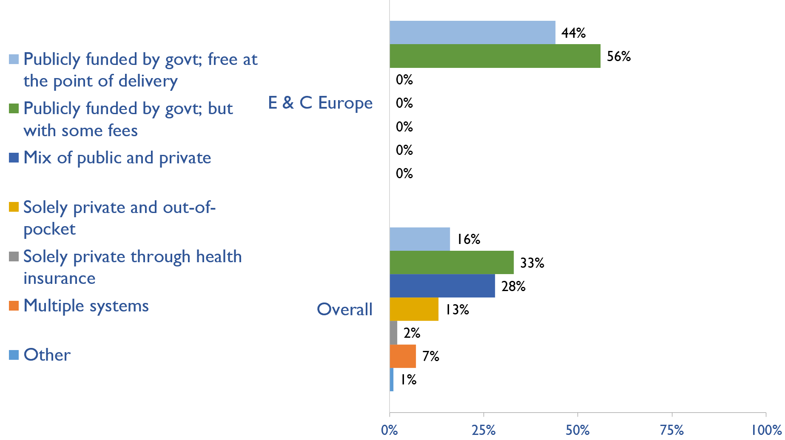
Funding for medications in CKD patients not on dialysis
Country | Publicly funded by govt; free at the point of delivery | Publicly funded by govt but with some fees at the point of delivery | Mix of public and private funding systems | Solely private and out-of-pocket | Solely private through health insurance providers | Multiple systems | Other
Albania | X
Bosnia and Herzegovina | X
Bulgaria |  | X
Croatia |  | X
Cyprus |  | X
Czech Republic | X
Estonia | X
Hungary |  | X
Latvia | X
Lithuania |  | X
Macedonia, FYR |  | X
Poland |  | X
Romania | X
Serbia | X
Slovak Republic |  | X
Turkey |  | X
X : Yes

Slide 34
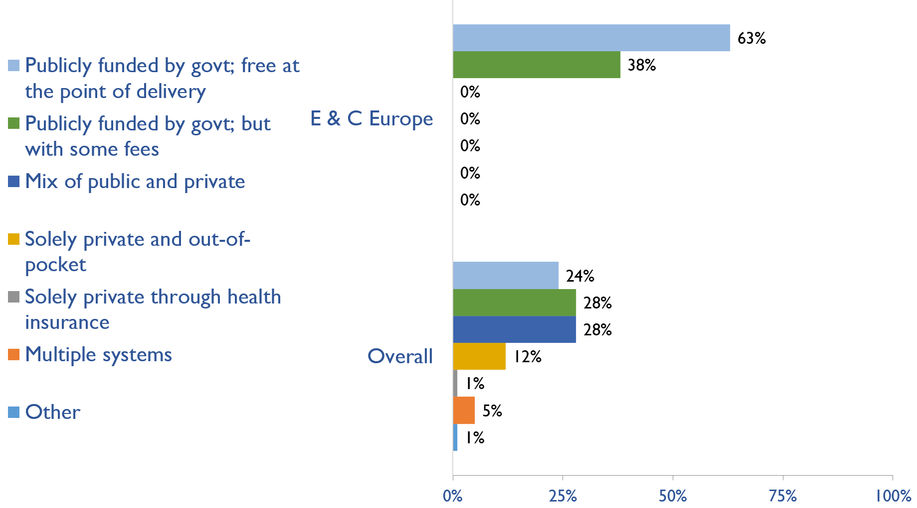
Funding for medications in all dialysis patients
Country | Publicly funded by govt; free at the point of delivery | Publicly funded by govt but with some fees at the point of delivery | Mix of public and private funding systems | Solely private and out-of-pocket | Solely private through health insurance providers | Multiple systems | Other
Albania | X
Bosnia and Herzegovina | X
Bulgaria | X
Croatia | X
Cyprus |  | X
Czech Republic | X
Estonia | X
Hungary |  | X
Latvia | X
Lithuania |  | X
Macedonia, FYR | X
Poland |  | X
Romania | X
Serbia | X
Slovak Republic |  | X
Turkey |  | X
X : Yes

Slide 35
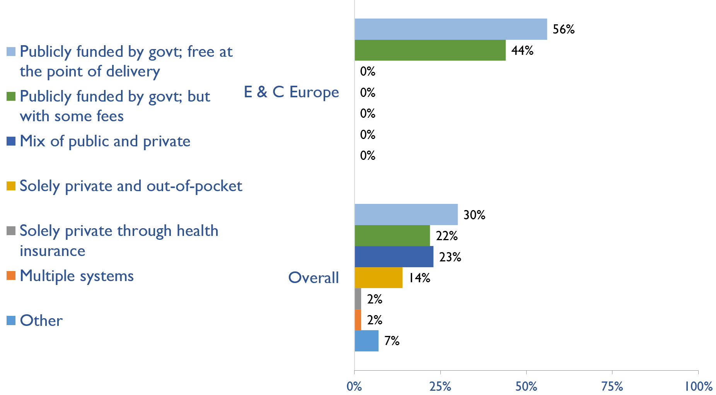
Funding for medications in all transplant patients
Country | Publicly funded by govt; free at the point of delivery | Publicly funded by govt but with some fees at the point of delivery | Mix of public and private funding systems | Solely private and out-of-pocket | Solely private through health insurance providers | Multiple systems | Other
Albania | X
Bosnia and Herzegovina | X
Bulgaria | X
Croatia | X
Cyprus |  | X
Czech Republic | X
Estonia | X
Hungary |  | X
Latvia | X
Lithuania |  | X
Macedonia, FYR |  | X
Poland |  | X
Romania | X
Serbia | X
Slovak Republic |  | X
Turkey |  | X
X : Yes

Slide 36
Availability of official registry
Country | CKD | Dialysis | Transplant | AKI | Conservative care
Albania | X | X | X | X | X
Bosnia and Herzegovina | X | X | X
Bulgaria | X | X | X
Croatia |  | X | X
Cyprus |  | X | X
Czech Republic |  | X | X
Estonia |  | X | X
Hungary |  | X | X
Latvia |  | X | X
Lithuania
Macedonia, FYR |  | X | X
Poland |  | X | X
Romania | X | X | X | X
Serbia |  | X | X
Slovak Republic |  | X | X
Turkey | X | X | X
X : Yes

Slide 37
Summary of Findings
In summary, the 2023 ISN-GKHA highlights several important findings for Eastern and Central Europe.
KRT availability, access, and quality is high.
HD and PD services are available in all countries in Eastern and Central Europe.
Quality of dialysis delivery was high in the region. Center-based service that involves treatment 3x week for 3-4 hours was generally available in all countries in the region for HD. However, capacity to provide adequate PD was generally not available in five countries (Bulgaria, Lithuania, Macedonia, Slovak Republic and Turkey).
Home HD was only available in 2 (13%) of countries (Serbia and Turkey)
KT centres are available in all countries in the region.
CKM is available and predominately chosen or medically advised.
Established CKM through shared decision making was available in 8 (50%) of countries.
6 (38%) of countries stated that CKM is choice-restricted, meaning that patients are not choosing to receive CKM because it is better for them but because they cannot receive KRT due to limitations in resources.
Also, 6 countries (38%) reported that CKM is chosen or medically-advised, meaning that the decision to not receive KRT wasn’t due to resource limitations.

Slide 38
Summary of Findings (cont’d)
Government funding for kidney care services and medication is high.
All countries in the region use public funding for cost of medications for patients receiving kidney care, however, reimbursement for KRT services utilizes other funding models.
Reimbursement for medications that is free at point of delivery for ND-CKD, dialysis, and KT are available in 7 (44%), 10 (63%), and in 9 (56%) countries, respectively.
Reimbursement that is free for acute dialysis, chronic HD, and chronic PD were available in 12 (75%), 11 (69%), and 14 (88%) countries, respectively.
Most have registries for advanced kidney disease, few for CKD or AKI
Most countries in E&C Europe have a registry for dialysis and KT.
Dialysis and KT registries are available in 15 (93.8%) countries in the region (except Lithuania); 2 (12.5%) countries had acute dialysis registry; and only one country (Albania) had a CKM registry.
Many workforce limitations, especially nephrologists
Eastern and Central Europe had the third largest prevalence of nephrologists (24.8 pmp) after North East Asia (28.7 pmp) and Western Europe (25 pmp). Lithuania had the highest density of nephrologists (52.2 pmp) while Turkey had the lowest (9.6 pmp).
Prevalence of nephrology trainees in the region was 4.8 pmp and was highest in Croatia (11.9 pmp) and lowest in Turkey (0.6 pmp).
Less than half of countries reported shortages of nephrologists (44%), transplant surgeons (31%), surgeons for PD access (44%), laboratory technicians (6%), radiologists (6%), transplant coordinators (31%), and dialysis technicians (31%).
Moderate advocacy for kidney disease in Eastern and Central Europe
Advocacy groups for CKD, kidney failure and KRT remains low in the region.

Slide 39
Implications
There are important implications to consider. Based on these survey findings, key recommendations to drive future activities for optimizing kidney care globally are proposed:
Increase health care financing for kidney failure prevention and management.
While resource limitations are an obvious barrier, focusing on preventing kidney failure through appropriate hypertension and diabetes management may be more cost-effective overall. Government funding to cover medication costs may allow more patients to treat earlier stage CKD, thereby preventing the need for more costly kidney failure treatment and the obvious burden this has on patients’ wellbeing.
Address workforce shortages through multidisciplinary teams and telemedicine
Shortages of nephrologists, surgeons, dialysis nurses, and other key allied health professionals were noted across most countries. Similarly, simply producing more nephrologists may not be feasible or appropriate, and sharing the workload across multiple providers will not only promote the use of multidisciplinary teams but further, allow for more and better care delivery across more patients. Telemedicine may help particularly in addressing gaps in care among rural patients and enhancing capacity through training programs such as ISN Fellowship, visiting ambassador programs, etc.

Slide 40
Implications (cont’d)
Incorporate the collection and reporting of quality indicators in kidney failure care.
Measuring and reporting on key quality indicators is an important driver in healthcare improvement. Ensuring facilities are supported with information systems that allow for the systematic measurement and reporting of indicators is a first key step to increasing the rate of monitoring among countries. Further, understanding if or how the collection and reporting of indicators are being used to improve care is needed.
Expand health information systems to prevent and manage kidney failure.
Similarly, good quality HIS are vital for kidney disease management within a country. A lack of data on disease prevalence, incidence, resource use, and quality of care limits government and provider ability to monitor and evaluate the care provided as well as predicts appropriate resource allocation so that sufficient facilities, medicines, and healthcare professionals are trained and available.
Promote kidney failure prevention and treatment by implementing policies, strategies, and advocacy, and mitigating barriers.
Lastly, policies and strategies are important for consistent approaches within a country for optimal care delivery, as well as for accountability, leadership, and knowledge exchange. Advocacy may help promote the increase of government prioritization and further, public awareness of how to prevent and manage kidney disease. Without acknowledging and mitigating barriers, it would be a challenge to achieve of successes out of these recommendations. Competing priorities and needs (for example, clean water supply and basic sanitation, maternal and child health, malnutrition, etc.) represent formidable barriers that can limit implementation of the recommended strategies in the region.

Slide 41







www.theisn.org
Global Operations Center
Americas Operations Center
Avenue des Arts 1-2
1210 Brussels, Belgium
340 North Avenue 3rd Floor Cranford, NJ 07016-2496, United States
+ 32 2 808 04 20
+1 904 345 0866
info@theisn.org
info@theisn.org
Follow us

