Slide 1
Advancing Kidney Health Worldwide. Together.

Slide 2

2023 ISN-GLOBAL
KIDNEY HEALTH ATLAS
(ISN-GKHA)
ISN LATIN AMERICA REGION
www.theisn.org/global-atlas

Slide 3

Overview
Aim
Methods
Key Results

Slide 4
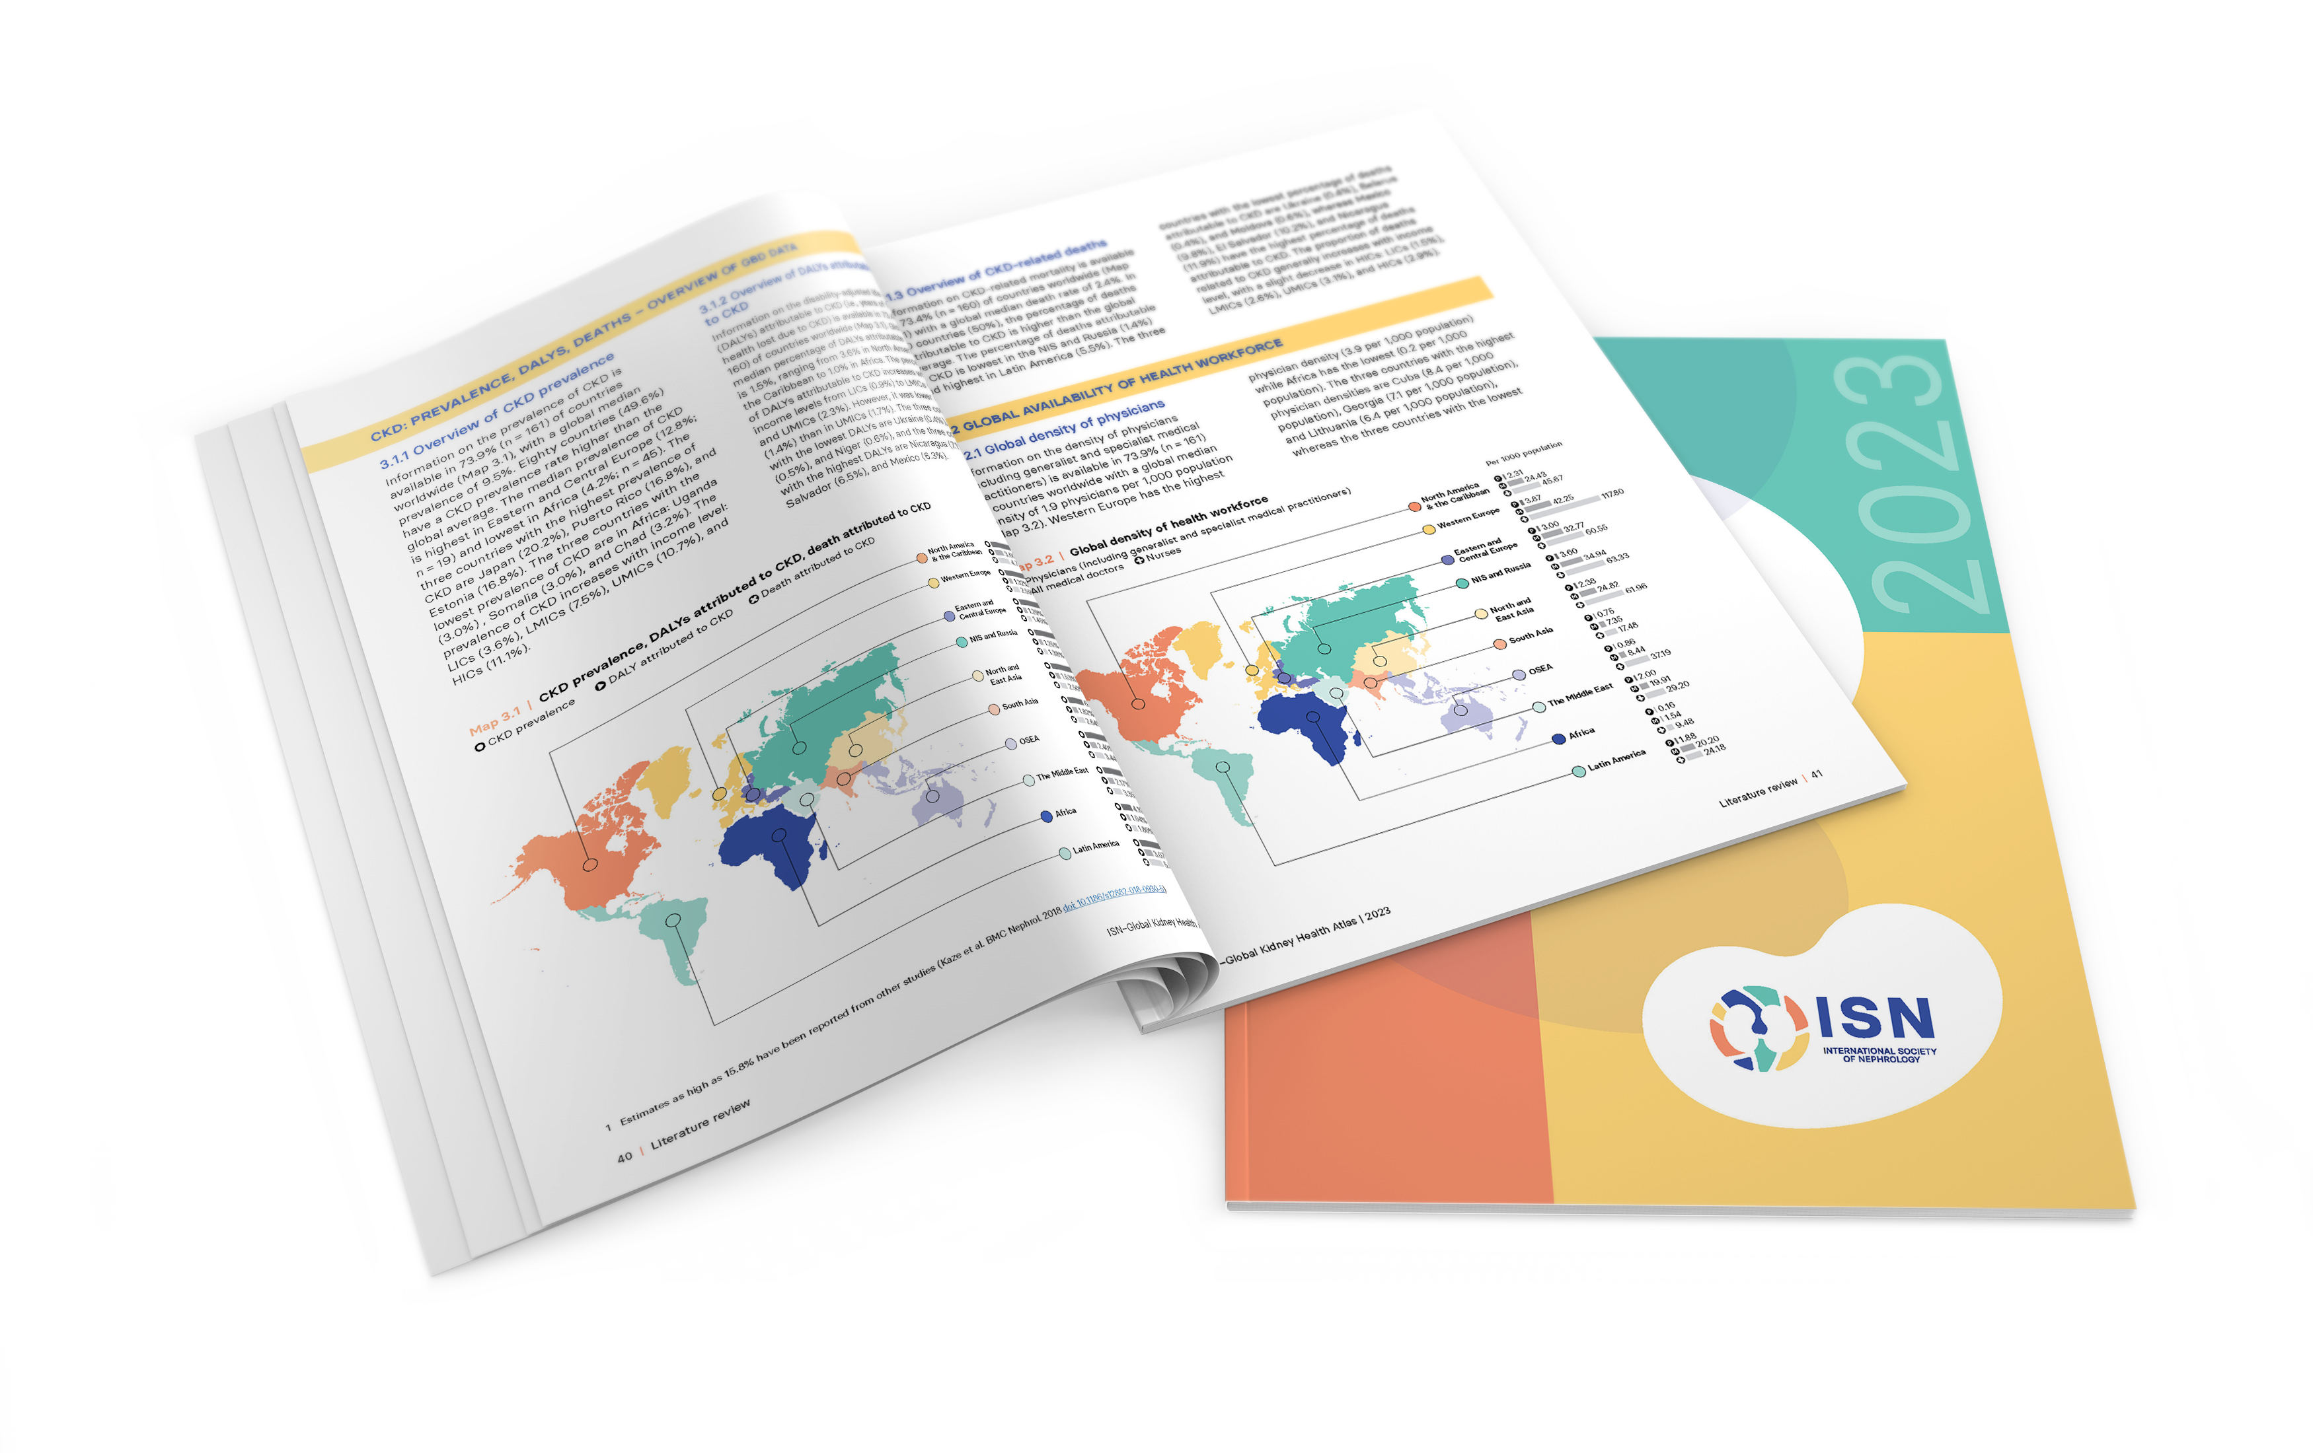
Aim of the ISN-Global Kidney Health Atlas
To understand, compare and monitor how different countries around the world detect, treat, monitor and advocate for people with kidney disease (AKI or CKD).
Key focus on availability, accessibility,
affordability and quality of kidney failure care

Slide 5
ISN-Global Kidney Health Atlas Survey
2016
2018
2022
2026

Slide 6
Design and Scope
Desk research (across countries and regions)
  Published and grey literature review
  Systematic review of kidney failure burden and outcomes
  Data extraction from major kidney registries (USRDS, ERA-EDTA) and relevant national registries where available
  Scoping review of KRT cost estimates
Online questionnaire-based survey July – September 2022
  3 languages (English, French, Spanish)
  191 countries contacted
  ≥3 stakeholders per country
    National nephrology society leadership
    Healthcare policymakers
    Patients / patient advocacy groups
  Discrepancies resolved by follow-up conferences with regional board chairs and country nephrology leaders
Notes:
REDCap Cloud. The questionnaire was peer reviewed for content validity and comprehensiveness before it was piloted with the 10 ISN regional boards to identify any logistical and feasibility issues (e.g., translation needs). Intensive follow-ups were conducted by email and telephone with ISN regional and national leaders to ensure complete and timely responses.
Data and reports published by the WHO Global Observatory, UN, World Bank, and OECD.
Both published and unpublished documents from international organizations/bodies and reports published by national governments on the organization and
delivery of ESKD.
Additional literature identified by key stakeholders (i.e., opinion leaders, national nephrology society leaders, ISN leaders) and through consultation with national nephrology societies and ISN regional boards.

Slide 7

Overall Survey Components

Slide 8
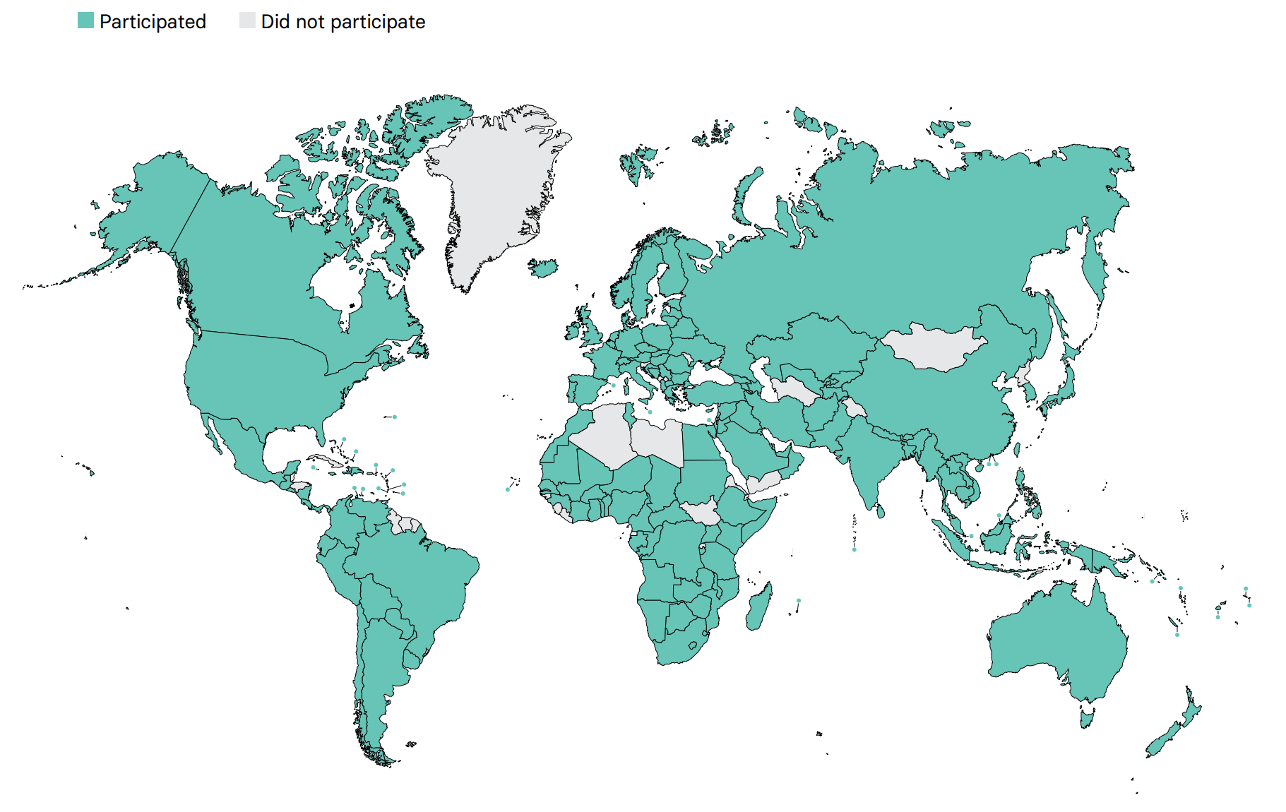
Overall ISN-GKHA response
167 countries (92%)
97% world’s population
329 individuals (63%) response
2 respondents/country
(IQR 2-3)
108 countries participated in the 2017, 2019, and 2023 GKHA surveys

Slide 9
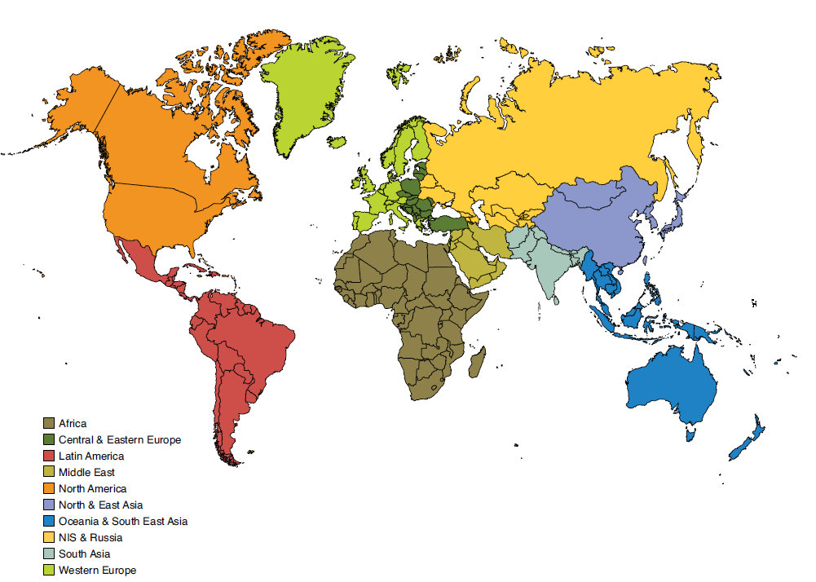
Results presented by ISN regions

Slide 10

ISN Region: Latin America

Slide 11
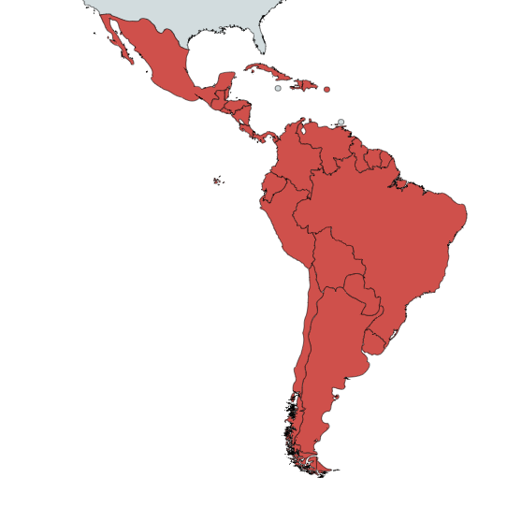
ISN Region: Latin America
Country | World bank ranking | Area (sq km) | Total population (2022) | GDP (PPP) ($ billion) | Total health expenditures (% of GDP)
Argentina | Upper-middle income | 2,780,400 | 44,694,198 | 1083.4 | 9.5
Bolivia | Lower-middle income | 1,098,581 | 11,306,341 | 106.9 | 6.9
Brazil | Upper-middle income | 8,515,770 | 208,846,892 | 3435.9 | 9.6
British Virgin Islands | High income | 151 | 39,369 | 0.5 | -
Cayman Islands | High income | 264 | 64,309 | 5.1 | -
Chile | High income | 756,102 | 17,925,262 | 559.2 | 9.3
Colombia | Upper-middle income | 1,138,910 | 48,168,996 | 866.5 | 7.7
Costa Rica | Upper-middle income | 51,100 | 5,204,411 | 120.2 | 7.3
Cuba | Upper-middle income | 110,860 | 11,116,396 | 137 | 11.3
Dominican Republic | Upper-middle income | 48,670 | 10,298,756 | 227.5 | 5.9
Ecuador | Upper-middle income | 283,561 | 17,483,326 | 189.9 | 8.5
El Salvador | Lower-middle income | 21,041 | 6,187,271 | 63.0 | 7.2
Guatemala | Upper-middle income | 108,889 | 16,581,273 | 167.8 | 6.2
Haiti | Lower-middle income | 27,750 | 10,788,440 | 36.1 | 4.7
Honduras | Lower-middle income | 112,090 | 9,571,352 | 57.3 | 9
Mexico | Upper-middle income | 1,964,375 | 125,959,205 | 2569.2 | 5.4
Nicaragua | Lower-middle income | 130,370 | 6,301,880 | 42.4 | 8.4
Panama | High income | 75,420 | 3,800,644 | 138.8 | 7.6
Paraguay | Upper-middle income | 406,752 | 7,025,763 | 100.8 | 7.2
Peru | Upper-middle income | 1,285,216 | 31,331,228 | 463.5 | 5.2
Puerto Rico | High income | 13,791 | 3,294,626 | 117.0 | -
Uruguay | High income | 176,215 | 3,369,299 | 85.8 | 9.4
Venezuela, RB | Upper-middle income | 912,050 | 31,689,176 | 269.1 | 5.4
Virgin Islands (U.S.) | High income | 1,910 | 106,977 | 3.8 | -
Responses were received from 22 of 31 countries in Latin America (71%) representing 96.5% of the region’s population.
‘ – ’ : data not reported/unavailable
July 2023

Slide 12
Demographics
Country | World bank ranking | Area (sq km) | Total population (2022) | GDP (PPP) ($ billion) | Total health expenditures (% of GDP) | Total Health Spending per person | Government Health Spending per person | Out-of-pocket Health Spending per person
Argentina | Upper-middle income | 2,780,400 | 44,694,198 | 1083.4 | 9.5 | 871 | 547 | 217
Bolivia | Lower-middle income | 1,098,581 | 11,306,341 | 106.9 | 6.9 | 197 | 135 | 48
Brazil | Upper-middle income | 8,515,770 | 208,846,892 | 3435.9 | 9.6 | 666 | 300 | 165
British Virgin Islands | High income | 151 | 39,369 | 0.5 | - | - | - | -
Cayman Islands | High income | 264 | 64,309 | 5.1 | - | - | - | -
Chile | High income | 756,102 | 17,925,262 | 559.2 | 9.3 | 1270 | 695 | 379
Colombia | Upper-middle income | 1,138,910 | 48,168,996 | 866.5 | 7.7 | 431 | 307 | 63
Costa Rica | Upper-middle income | 51,100 | 5,204,411 | 120.2 | 7.3 | 1032 | 743 | 196
Cuba | Upper-middle income | 110,860 | 11,116,396 | 137 | 11.3 | 1116 | 1004 | 110
Dominican Republic | Upper-middle income | 48,670 | 10,298,756 | 227.5 | 5.9 | 430 | 216 | 171
Ecuador | Upper-middle income | 283,561 | 17,483,326 | 189.9 | 8.5 | - | - | -
El Salvador | Lower-middle income | 21,041 | 6,187,271 | 63.0 | 7.2 | 353 | 243 | 80
Guatemala | Upper-middle income | 108,889 | 16,581,273 | 167.8 | 6.2 | 299 | 121 | 153
Haiti | Lower-middle income | 27,750 | 10,788,440 | 36.1 | 4.7 | 53 | 6 | 20
Honduras | Lower-middle income | 112,090 | 9,571,352 | 57.3 | 9 | - | - | -
Mexico | Upper-middle income | 1,964,375 | 125,959,205 | 2569.2 | 5.4 | 492 | 268 | 186
Nicaragua | Lower-middle income | 130,370 | 6,301,880 | 42.4 | 8.4 | 168 | 103 | 53
Panama | High income | 75,420 | 3,800,644 | 138.8 | 7.6 | 1072 | 701 | 297
Paraguay | Upper-middle income | 406,752 | 7,025,763 | 100.8 | 7.2 | 389 | 196 | 152
Peru | Upper-middle income | 1,285,216 | 31,331,228 | 463.5 | 5.2 | 328 | 224 | 78
Puerto Rico | High income | 13,791 | 3,294,626 | 117.0 | - | 1223 | 941 | 243
Uruguay | High income | 176,215 | 3,369,299 | 85.8 | 9.4 | 1500 | 1117 | 235
Venezuela, RB | Upper-middle income | 912,050 | 31,689,176 | 269.1 | 5.4 | 89 | 31 | 38
Virgin Islands (U.S.) | High income | 1,910 | 106,977 | 3.8 | - | - | - | -
‘ – ’ : data not reported/unavailable

Slide 13
CKD and its risk factors burden
Country | CKD Prevalence % (95% CI) | Death attributed to CKD % (95% CI) | DALYS attributed to CKD % (95% CI) | Obesity % (95% CI) | Increased BP % (95% CI) | Smoking % (95% CI)
Argentina | 8.64 (8.09 - 9.23) | 4.49 (4.09 - 4.88) | 2.55 (2.29 - 2.83) | 28.5 (23.7 - 33.7) | 22.6 (17.0 - 28.9) | 17.7 (15.5 - 19.9)
Bolivia | 6.16 (5.75 - 6.56) | 5.83 (4.91 - 6.82) | 3.08 (2.54 - 3.67) | 18.7 (14.2 - 23.7) | 17.9 (12.5 - 24.1) | 19.6 (16.5 - 23.1)
Brazil | 8.35 (7.81 - 8.85) | 3 (2.77 - 3.15) | 1.81 (1.65 - 1.97) | 22.3 (18.9 - 25.9) | 23.3 (18.1 - 28.8) | 10.6 (9.8 - 11.5)
British Virgin Islands | - | - | - | - | - | 4.1 (3.1 - 5.5)
Cayman Islands | - | - | - | - | - | -
Chile | 10.15 (9.48 - 10.83) | 4.45 (4 - 4.83) | 2.26 (1.99 - 2.53) | 28.8 (24.2 - 33.7) | 20.9 (15.8 - 26.8) | 25.6 (22.7 - 28.4)
Colombia | 11.47 (10.67 - 12.29) | 3.85 (3.35 - 4.22) | 2.26 (1.96 - 2.53) | 22.1 (18.3 - 26.2) | 19.2 (14.2 - 24.7) | 10.4 (8.1 - 13.0)
Costa Rica | 14.75 (14.07 - 15.52) | 5.62 (5.03 - 6.1) | 3.62 (3.12 - 4.08) | 25.7 (21.2 – 30.6) | 18.7 (14.0 – 24.3) | 7.8 (6.0 – 9.9)
Cuba | 12.31 (11.48 - 13.16) | 2.57 (2.35 - 2.79) | 2.28 (2.02 - 2.54) | 26.7 (21.9 - 31.7) | 19.0 (13.8 - 25.3) | 16.2 (13.1 - 19.6)
Dominican Republic | 7.60 (7.07 - 8.12) | 3.23 (2.65 - 3.97) | 2.28 (1.9 - 2.76) | 26.9 ( 22.0 - 32.2) | 21.5 (15.4 - 28.4) | 6.7 (5.2 - 8.5)
Ecuador | 8.27 (7.73 – 8.82) | 7.47 (6.84 – 7.95) | 3.88 (3.34 – 4.42) | 19.3 (14.9 – 24.3) | 17.9 (12.6 – 23.7) | 5.0 (4.2 – 6.0)
El Salvador | 11.87 (11.08 - 12.63) | 10.15 (9.2 - 10.89) | 6.47 (5.58 - 7.32) | 22.7 (18.0 - 27.7) | 18.7 (13.3 - 24.7) | 6.1 (4.6 - 8.0)
Guatemala | 8.90 (8.29 - 9.50) | 6.35 (5.91 - 6.74) | 3.7 (3.34 - 4.04) | 18.8 (14.9 - 23.2) | 21.2 (15.3 - 27.7) | 7.2 (5.5 - 9.2)
Haiti | 5.80 (5.34 - 6.22) | 2.37 (1.87 - 3.39) | 1.57 (1.29 - 2.05) | 20.5 (16.0 - 25.6) | 24.5 (17.8 - 31.9) | 5.2 (4.1 - 6.7)
Honduras | 8.03 (7.45 – 8.61) | 6.02 (5.09 – 7.49) | 3.62 (3.11 – 4.31) | 19.4 (15.1 – 24.1) | 21.4 (15.6 – 27.9) | 9.0 (7.3 – 10.9)
Mexico | 13.81 (12.95 - 14.65) | 9.82 (9.29 - 10.22) | 6.32 (5.64 - 6.98) | 28.4 (24.7 - 32.3) | 19.7 (14.8 - 25.1) | 9.5 (9.1 - 10.1)
Nicaragua | 10.79 (10.10 - 11.50) | 11.89 (11.08 - 12.64) | 7.07 (6.13 - 7.98) | 21.8 (17.3 – 26.7) | 20.8 (15.1 – 27.3) | 8.8 (6.6 – 11.4)
Panama | 11.72 (10.96 - 12.51) | 5.82 (5.19 - 6.29) | 3.41 (2.97 - 3.84) | 22.5 (18.0 - 27.4) | 19.9 (14.8 - 25.8) | 3.5 (2.8 - 4.3)
Paraguay | 7.55 (7.04 - 8.03) | 5.51 (4.95 - 5.96) | 3.07 (2.64 - 3.51) | 19.0 (13.9 - 24.6) | 24.6 (17.9 - 31.8) | 9.9 (7.6 - 12.7)
Peru | 10.00 (8.27 - 12.26) | 5.28 (4.59 - 5.8) | 2.63 (2.24 - 3.01) | 19.1 (16.0 - 22.4) | 13.7 (10.5 - 17.4) | 8.1 (6.5 - 10.0)
Puerto Rico | 16.82 (15.64 - 18.08) | 6.25 (5.47 - 6.87) | 4.33 (3.76 - 4.92) | - | - | 8.8 (7.2 - 10.8)
Uruguay | 9.76 (9.12 - 10.36) | 2.92 (2.59 - 3.22) | 1.7 (1.51 - 1.87) | 28.9 (23.7 - 34.4) | 20.7 (15.3 - 26.6) | 18.6 (16.4 - 20.9)
Venezuela, RB | 12.28 (11.44 - 13.04) | 5.56 (5.03 - 6.05) | 3.62 (3.17 - 4.02) | 25.2 (20.9 - 29.8) | 18.6 (13.7 - 24.1) | 13.3 (10.6 - 16.5)
Virgin Islands (U.S.) | 14.23 (13.23 – 15.28) | 4.08 (3.68 – 4.48) | 3.39 (3.04 – 3.75) | - | - | 4.1 (3.1 – 5.5)
Abbreviations: CKD (Chronic Kidney Disease), DALYS (disability-adjusted life years), BP (blood pressure), CI (confidence interval)
Data source: GBD study database (http://www.healthdata.org/gbd), WHO data observatory (https://www.who.int/gho/en/)
‘ – ’ : data not reported/unavailable
July 2023

Slide 14
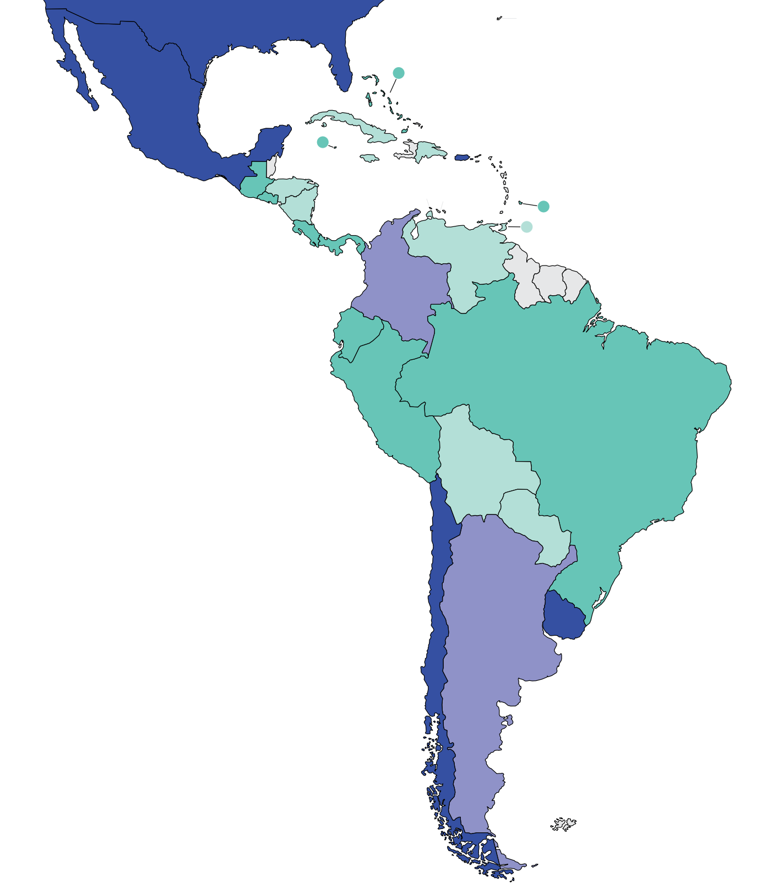
Burden of kidney failure
Prevalence of treated kidney failure
Country | Treated kidney failure |  | Chronic dialysis (HD+PD) |  | Chronic HD |  | Chronic PD
 | Incidence | Prevalence | Incidence | Prevalence | Incidence | Prevalence | Incidence | Prevalence
Argentina | 198 | 963 | 163 | 720 | - | 674 | - | 46
Bolivia | 116 | 457 | 114 | 454 | - | 452 | - | 2
Brazil | 209 | 684 | 218 | 665 | - | 618 | - | 47
British Virgin Islands | - | - | - | - | - | - | - | -
Cayman Islands | - | 819.5 | - | 963.8 | - | 963.8 | - | 0
Chile | 226 | 1550 | 204 | 1317 | - | 1236 | - | 81
Colombia | 122 | 858 | 103 | 702 | - | 516 | - | 185
Costa Rica | 53 | 567 | 38 | 249 | - | 40 | - | 209
Cuba | 123 | 430 | 108 | 299 | - | 293 | - | 6
Dominican Republic | 226 | 485 | - | 438 | - | 340 | - | 98
Ecuador | 19 | 768 | 6 | 756 | - | 735 | - | 21
El Salvador | 223 | 776 | 217 | 677 | - | 297 | - | 380
Guatemala | 146 | 575 | 140 | 525 | - | 304 | - | 221
Haiti | - | - | - | - | - | - | - | -
Honduras | 96 | 405 | 96 | 392 | - | 370 | - | 22
Mexico | 526.5 | 1905 | - | 1201 | - | 730.8 | - | 473.95
Nicaragua | 33 | 111 | 31 | 100 | - | 35 | - | 65
Panama | 189 | 701 | 181 | 601 | - | 488 | - | 113
Paraguay | 40 | 387 | 36 | 333 | - | 317 | - | 16
Peru | 65 | 618 | - | 572 | - | 515 | - | 57
Puerto Rico | 437 | 2129 | - | 1737 | - | 1607 | - | 130
Uruguay | 227 | 1194 | - | 796 | - | 734 | - | 62
Venezuela, RB | 97 | 320 | - | 320 | - | 310 | - | 10
Virgin Islands (U.S). | - | - | - | 1441.5 | - | 1399.1 | - | 42.4
Treated kidney failure: all dialysis + transplant
* pmp (per million population)
Data source: Brazilian Dialysis Survey 2020, The Latin American Dialysis and Renal Transplantation Registry: report 2019, 2019 USRDS Annual Data Report
‘ – ’ : data not reported/unavailable
July 2023

Slide 15
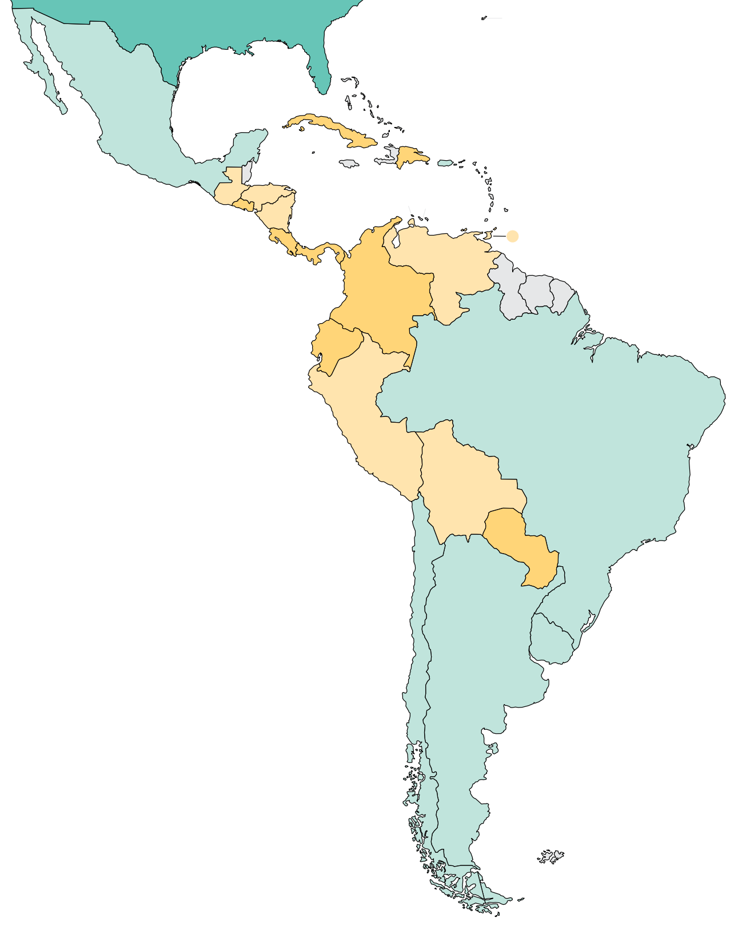
Burden of kidney failure (cont’d)
Country | Kidney transplantation
 | Incidence overall | Prevalence overall | Incidence of deceased donor | Incidence of living donor | Incidence of pre-emptive
Argentina | 27.13 | 243 | 22.28 | 4.85 | -
Bolivia | 0.85 | 3 | 0 | 0.85 | -
Brazil | 21.3 | 299 | 19.73 | 1.57 | -
British Virgin Islands | - | - | - | - | -
Cayman Islands | - | - | - | - | -
Chile | 12.81 | 233 | 10 | 2.81 | -
Colombia | 10.33 | 157 | 7.98 | 2.36 | -
Costa Rica | 5.88 | 318 | 3.14 | 2.75 | -
Cuba | 5.66 | 131 | 4.87 | 0.8 | -
Dominican Republic | 4.09 | 47 | 1.45 | 2.64 | -
Ecuador | 3.24 | 12 | 2.9 | 0.34 | -
El Salvador | 4.15 | 99 | 0 | 4.15 | -
Guatemala | 1.62 | 51 | 0 | 1.62 | -
Haiti | - | - | - | - | -
Honduras | 0.1 | 13 | 0 | 0.1 | -
Mexico | 15.15 | 704 | 3.65 | 11.5 | -
Nicaragua | 2 | 11 | 0.31 | 1.41 | -
Panama | 3.02 | 100 | 1.4 | 1.63 | -
Paraguay | 4.58 | 54 | 3.33 | 1.25 | -
Peru | 1.48 | 46 | 0.88 | 0.61 | -
Puerto Rico | 18 | 392 | - | - | -
Uruguay | 26.29 | 398 | 22.29 | 4 | -
Venezuela, RB | 0.11 | 0 | 0 | 0.11 | -
Virgin Islands (U.S.) | - | - | - | - | -
Incidence of kidney transplantation
* pmp (per million population)
Data source: Brazilian Dialysis Survey 2020, The Latin American Dialysis and Renal Transplantation Registry: report 2019, GODT database (http://www.transplant-observatory.org/data-charts-and-tables/), 2019 USRDS Annual Data Report
‘ – ’ : data not reported/unavailable
July 2023

Slide 16
Annual cost of kidney replacement therapy components
Country | Hemodialysis | Peritoneal dialysis | Kidney Transplant (First year) | Kidney Transplant (later years) | HD/PD cost ratio
Argentina | 17241 | 19893 | 23500 | - | 0.87
Bolivia | 20689 | - | 15250 | - | -
Brazil | 9615 | 7823 | 48845 | 5571 | 1.23
British Virgin Islands | - | - | - | - | -
Cayman Islands | - | - | - | - | -
Chile | 14551 | 18152 | - | - | 0.80
Colombia | 10034 | 10173 | 20837 | - | 0.99
Costa Rica | 103444 | 24203 | 23934 | - | 4.27
Cuba | - | - | - | - | -
Dominican Republic | - | - | - | - | -
Ecuador | 18531 | 15846 | - | - | 1.17
El Salvador | - | - | - | - | -
Guatemala | 14589 | 5992 | - | - | 2.43
Haiti | - | - | - | - | -
Honduras | - | - | - | - | -
Mexico | 10689 | 5474 | 18244 | 4922 | 1.95
Nicaragua | - | - | - | - | -
Panama | 22900 | 22186 | - | - | 1.03
Paraguay | 15517 | 16942 | - | - | 0.92
Peru | 14275 | 15329 | 15599 | - | 0.93
Puerto Rico | - | - | - | - | -
Uruguay | 25861 | 14588 | - | - | 1.77
Venezuela, RB | - | - | - | - | -
Virgin Islands (U.S.) | - | - | - | - | -
*Cost is in $US 2021
Abbreviations: HD (hemodialysis), PD (peritoneal dialysis)
Data source: Aimaretti & Arze (2016), Arredondo et al. (1998), Arze & Zambrana (2016), Babakhani et al. (2013), Balshaw et al. (2005), Cerdas (2005), Chacon et al. (2006), Garcia & Sanchez-Polo (2020), Rosselli et al. (2015), Saldarriaga et al. (2021), Silva et al. (2016), Torres et al. (2022), van der Tol et al. (2019)
‘ – ’ : data not reported/unavailable
July 2023

Slide 17
Country level scorecard
Country |  | Availability of KRT |  |  | Availability of CKM |  | Funding for Medications |  |  | Availability of Distribution of Registry |  |  |  | Advocacy Group |  |  | Nephrology Workforce (PMP)
 |  | HD | PD | Kidney transplantation | Shared decision | Choice restricted (limited) | CKD | Dialysis | Kidney transplantation | CKD | Dialysis | Kidney transplantation | AKI | CKD | AKI | RRT | Nephrologist | Nephrologist trainees
Argentina | 2019 |  |  |  |  |  |  |  |  |  |  |  |  |  |  |  | 31.32 | 3.36
 | 2023 |  |  |  |  |  |  |  |  |  |  |  |  |  |  |  | 25.95 | 3.24
Bolivia | 2019 |  |  |  |  |  |  |  |  |  |  |  |  |  |  |  | 9.55 | 3.18
 | 2023 |  |  |  |  |  |  |  |  |  |  |  |  |  |  |  | 9.95 | 3.32
Brazil | 2019 |  |  |  |  |  |  |  |  |  |  |  |  |  |  |  | 19.73 | 2.39
 | 2023 |  |  |  |  |  |  |  |  |  |  |  |  |  |  |  | 18.41 | 1.15
British Virgin Islands | 2019 |  |  |  |  |  |  |  |  |  |  |  |  |  |  |  | 0 | 0
 | 2023 |  |  |  |  |  |  |  |  |  |  |  |  |  |  |  | 25.89 | 0
Cayman Islands | 2019
 | 2023 |  |  |  |  |  |  |  |  |  |  |  |  |  |  |  | 31.1 | 0
Chile | 2019 |  |  |  |  |  |  |  |  |  |  |  |  |  |  |  | 18.13 | 1.39
 | 2023 |  |  |  |  |  |  |  |  |  |  |  |  |  |  |  | 17.15 | 1.36
Colombia | 2019 |  |  |  |  |  |  |  |  |  |  |  |  |  |  |  | 5.19 | 0.42
 | 2023 |  |  |  |  |  |  |  |  |  |  |  |  |  |  |  | 9.99
Costa Rica | 2019
 | 2023 |  |  |  |  |  |  |  |  |  |  |  |  |  |  |  | 5.38 | 1.15
Cuba | 2019 |  |  |  |  |  |  |  |  |  |  |  |  |  |  |  | 38.95 | 20.6
 | 2023
Abbreviations
AKI: acute kidney injury
CKD: chronic kidney disease
CKM: conservative kidney management
HD: Hemodialysis
Nephrologist density | <1.2 PMP | 1.2 – 10.0 PMP | 10.1 – 22.9 PMP | >22.9 PMP
Nephrology trainees density | <0.3 PMP | 0.3 – 1.4 PMP | 1.5-3.7 PMP | >3.7 PMP
KRT: kidney replacement therapy
PD: Peritoneal Dialysis
RRT: renal replacement therapy
Yes | No | N/A
July 2023

Slide 18
Country level scorecard
Country |  | Availability of KRT |  |  | Availability of CKM |  | Funding for Medications |  |  | Availability of Distribution of Registry |  |  |  | Advocacy Group |  |  | Nephrology Workforce (PMP)
 |  | HD | PD | Kidney transplantation | Shared decision | Choice restricted (limited) | CKD | Dialysis | Kidney transplantation | CKD | Dialysis | Kidney transplantation | AKI | CKD | AKI | RRT | Nephrologist | Nephrologist trainees
Curaçao | 2019
 | 2023 |  |  |  |  |  |  |  |  |  |  |  |  |  |  |  | 45.94 | 0
Dominican Republic | 2019 |  |  |  |  |  |  |  |  |  |  |  |  |  |  |  | 15.92 | 3.4
 | 2023 |  |  |  |  |  |  |  |  |  |  |  |  |  |  |  | 20.01 | 3.09
Ecuador | 2019
 | 2023 |  |  |  |  |  |  |  |  |  |  |  |  |  |  |  | 12.26 | 1.16
El Salvador | 2019 |  |  |  |  |  |  |  |  |  |  |  |  |  |  |  | 8.73 | 1.29
 | 2023 |  |  |  |  |  |  |  |  |  |  |  |  |  |  |  | 5.94 | 7.61
Guatemala | 2019 |  |  |  |  |  |  |  |  |  |  |  |  |  |  |  | 4.34 | 0.84
 | 2023 |  |  |  |  |  |  |  |  |  |  |  |  |  |  |  | 6.27 | 0.9
Haiti | 2019 |  |  |  |  |  |  |  |  |  |  |  |  |  |  |  | 0.56 | 0
 | 2023 |  |  |  |  |  |  |  |  |  |  |  |  |  |  |  | 0.44 | 0.18
Mexico | 2019 |  |  |  |  |  |  |  |  |  |  |  |  |  |  |  | 8.73 | 1.19
 | 2023 |  |  |  |  |  |  |  |  |  |  |  |  |  |  |  | 10.45 | 0.93
Nicaragua | 2019
 | 2023 |  |  |  |  |  |  |  |  |  |  |  |  |  |  |  | 5.08 | 2.38
Panama | 2019 |  |  |  |  |  |  |  |  |  |  |  |  |  |  |  | 9.21 | 0.92
 | 2023 |  |  |  |  |  |  |  |  |  |  |  |  |  |  |  | 8.53 | 0.92
Abbreviations
AKI: acute kidney injury
CKD: chronic kidney disease
CKM: conservative kidney management
HD: Hemodialysis
Nephrologist density | <1.2 PMP | 1.2 – 10.0 PMP | 10.1 – 22.9 PMP | >22.9 PMP
Nephrology trainees density | <0.3 PMP | 0.3 – 1.4 PMP | 1.5-3.7 PMP | >3.7 PMP
KRT: kidney replacement therapy
PD: Peritoneal Dialysis
RRT: renal replacement therapy
Yes | No | N/A
July 2023

Slide 19
Country level scorecard
Country |  | Availability of KRT |  |  | Availability of CKM |  | Funding for Medications |  |  | Availability of Distribution of Registry |  |  |  | Advocacy Group |  |  | Nephrology Workforce (PMP)
 |  | HD | PD | Kidney transplantation | Shared decision | Choice restricted (limited) | CKD | Dialysis | Kidney transplantation | CKD | Dialysis | Kidney transplantation | AKI | CKD | AKI | RRT | Nephrologist | Nephrologist trainees
Paraguay | 2019 |  |  |  |  |  |  |  |  |  |  |  |  |  |  |  | 9.96 | 1.35
 | 2023 |  |  |  |  |  |  |  |  |  |  |  |  |  |  |  | 12.51 | 2.72
Peru | 2019 |  |  |  |  |  |  |  |  |  |  |  |  |  |  |  | 9.26 | 0.77
 | 2023 |  |  |  |  |  |  |  |  |  |  |  |  |  |  |  | 18.06 | 1.43
Puerto Rico | 2019 |  |  |  |  |  |  |  |  |  |  |  |  |  |  |  | 30.35 | 1.52
 | 2023 |  |  |  |  |  |  |  |  |  |  |  |  |  |  |  | 27.43 | 1.94
Uruguay | 2019 |  |  |  |  |  |  |  |  |  |  |  |  |  |  |  | 53.42 | 4.45
 | 2023 |  |  |  |  |  |  |  |  |  |  |  |  |  |  |  | 64.57 | 13.21
Venezuela | 2019 |  |  |  |  |  |  |  |  |  |  |  |  |  |  |  | 15.94 | 1.64
 | 2023 |  |  |  |  |  |  |  |  |  |  |  |  |  |  |  |  | 1.68
Abbreviations
AKI: acute kidney injury
CKD: chronic kidney disease
CKM: conservative kidney management
HD: Hemodialysis
Nephrologist density | <1.2 PMP | 1.2 – 10.0 PMP | 10.1 – 22.9 PMP | >22.9 PMP
Nephrology trainees density | <0.3 PMP | 0.3 – 1.4 PMP | 1.5-3.7 PMP | >3.7 PMP
KRT: kidney replacement therapy
PD: Peritoneal Dialysis
RRT: renal replacement therapy
Yes | No | N/A
July 2023

Slide 20
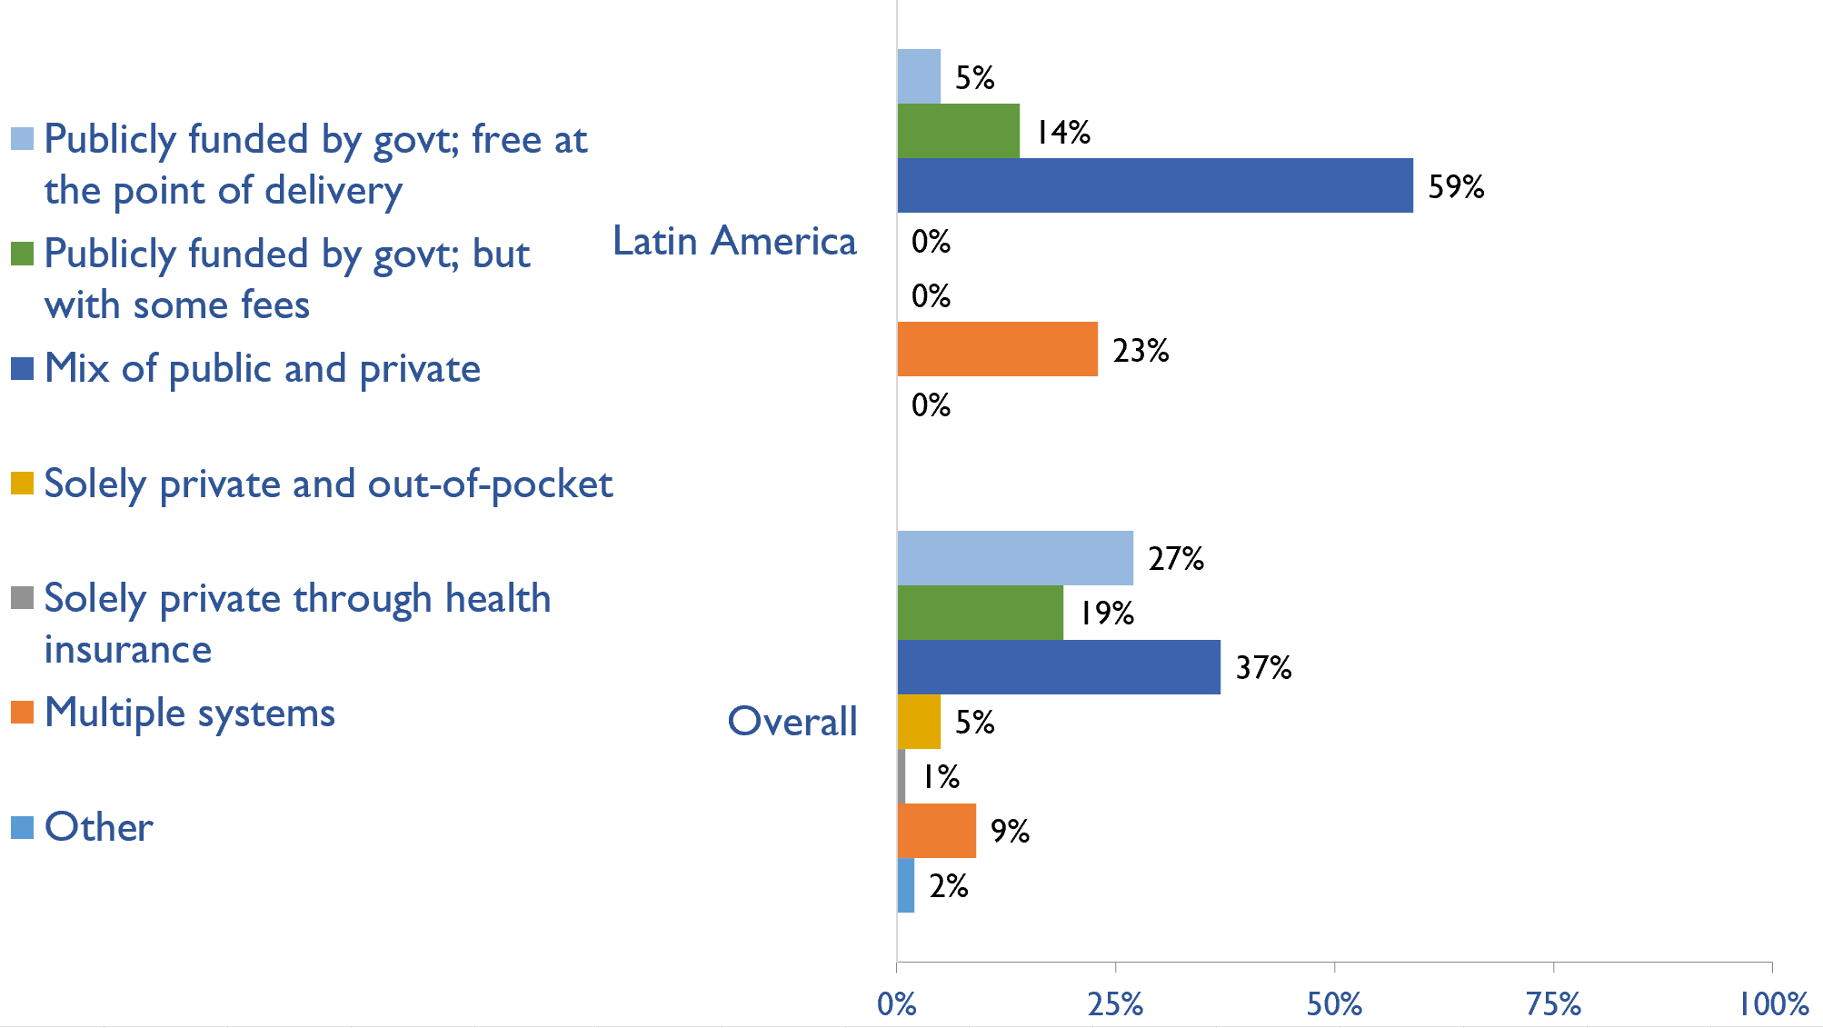
Funding for non-dialysis CKD
Country | Publicly funded by govt; free at the point of delivery | Publicly funded by govt but with some fees at the point of delivery | Mix of public and private funding systems | Solely private and out-of-pocket | Solely private through health insurance | Multiple systems | Other
Argentina |  |  | X
Bolivia |  |  | X
Brazil |  |  |  |  |  | X
British Virgin Islands |  | X
Cayman Islands |  |  | X
Chile |  |  | X
Colombia |  | X
Costa Rica |  | X
Curaçao |  |  | X
Dominican Republic |  |  | X
Ecuador | X
El Salvador |  |  |  |  |  | X
Guatemala |  |  |  |  |  | X
Haiti |  |  | X
Mexico |  |  | X
Nicaragua |  |  |  |  |  | X
Panama |  |  | X
Paraguay |  |  | X
Peru |  |  | X
Puerto Rico |  |  | X
Uruguay |  |  | X
Venezuela, RB |  |  |  |  |  | X
X : Yes
July 2023

Slide 21
Funding for kidney replacement therapy (KRT)
Country | Publicly funded (free) |  |  |  | Publicly funded (some fees) |  |  |  | Mixed |  |  |  | Solely private (out-of-pocket) |  |  |  | Solely private (health insurance) |  |  |  | Multiple systems |  |  |  | N/A |  |  |  | Other
 | AKI | HD | PD | TX | AKI | HD | PD | TX | AKI | HD | PD | TX | AKI | HD | PD | TX | AKI | HD | PD | TX | AKI | HD | PD | TX | AKI | HD | PD | TX | AKI | HD | PD | TX
Argentina |  |  |  |  |  |  |  |  | X | X | X | X
Bolivia |  |  |  |  |  |  |  |  | X | X | X | X
Brazil | X |  |  | X |  |  |  |  |  | X | X
British Virgin Islands |  |  |  |  | X | X |  | X |  |  |  |  |  |  |  |  |  |  |  |  |  |  |  |  |  |  | X
Cayman Islands |  |  |  | X |  |  |  |  | X | X | X
Chile |  |  |  |  |  |  |  |  | X | X | X | X
Colombia | X | X | X | X
Costa Rica | X |  |  |  |  | X | X | X
Curaçao |  |  |  |  |  |  |  |  | X | X | X | X
Dominican Republic |  |  |  | X |  |  |  |  | X | X | X
Ecuador |  | X | X |  | X |  |  | X
El Salvador |  |  |  |  |  |  |  |  | X | X | X | X
Guatemala |  |  |  |  |  |  |  |  | X |  | X | X |  |  |  |  |  |  |  |  |  | X
Haiti |  |  |  |  |  |  |  |  | X | X |  |  |  |  |  |  |  |  |  |  |  |  |  |  |  |  | X | X
Mexico |  |  |  |  |  |  |  |  | X | X | X | X
Nicaragua | X | X | X |  |  |  |  |  |  |  |  |  |  |  |  |  |  |  |  | X
Panama |  |  |  |  | X | X | X | X
Paraguay | X | X | X | X
Peru |  |  |  |  |  |  |  |  | X | X | X | X
Puerto Rico |  |  |  |  |  |  |  |  |  |  |  |  |  |  |  |  |  |  |  |  | X | X | X | X
Uruguay | X | X | X |  |  |  |  |  |  |  |  | X
Venezuela, RB | X | X | X | X
X : Yes
Abbreviations: AKI (Acute kidney injury), HD (hemodialysis), PD (peritoneal dialysis), TX (transplant medications)
July 2023

Slide 22
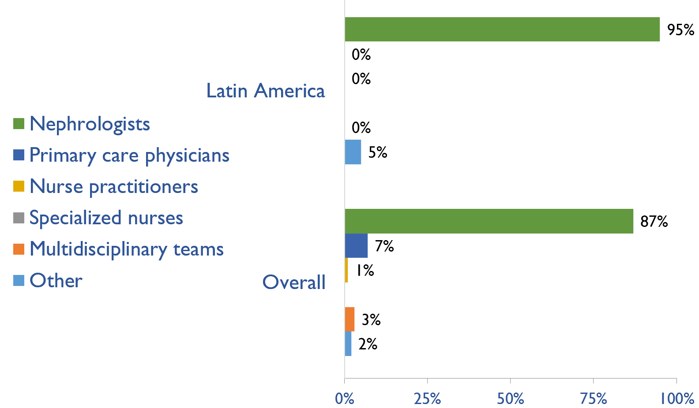
Providers primarily responsible for kidney failure care
Country | Nephrologists | Primary care physicians | Nurse practitioners | Specialized nurses | Multidisciplinary teams | Other
Argentina | X
Bolivia | X
Brazil | X
British Virgin Islands |  |  |  |  |  | X
Cayman Islands | X
Chile | X
Colombia | X
Costa Rica | X
Curaçao | X
Dominican Republic | X
Ecuador | X
El Salvador | X
Guatemala | X
Haiti | X
Mexico | X
Nicaragua | X
Panama | X
Paraguay | X
Peru | X
Puerto Rico | X
Uruguay | X
Venezuela, RB | X
X : Yes
July 2023

Slide 23
Shortage of kidney failure care providers
Country | Nephrologists | Pediatric nephrologists | Transplant surgeons | Surgeons (HD access) | Surgeons (PD access) | Dietitians | Laboratory technicians | Radiologists (ultrasound) | Vascular access coordinators
Argentina
Bolivia
Brazil
British Virgin Islands
Cayman Islands
Chile
Colombia
Costa Rica
Curaçao
Dominican Republic
Ecuador
El Salvador
Guatemala
Haiti
Mexico
Nicaragua
Panama
Paraguay
Peru
Puerto Rico
Uruguay
Venezuela, RB
No shortage
Shortage
July 2023

Slide 24
Shortage of kidney failure care providers
Country | Counsellors/ psychologists | Transplant coordinators | Dialysis nurses | Renal nurses | Dialysis technicians | Social workers | Palliative care physicians | Kidney supportive care nurses | No shortage
Argentina
Bolivia
Brazil
British Virgin Islands
Cayman Islands
Chile
Colombia
Costa Rica
Curaçao
Dominican Republic
Ecuador
El Salvador
Guatemala
Haiti
Mexico
Nicaragua
Panama
Paraguay
Peru
Puerto Rico
Uruguay
Venezuela, RB
No shortage
Shortage
July 2023

Slide 25
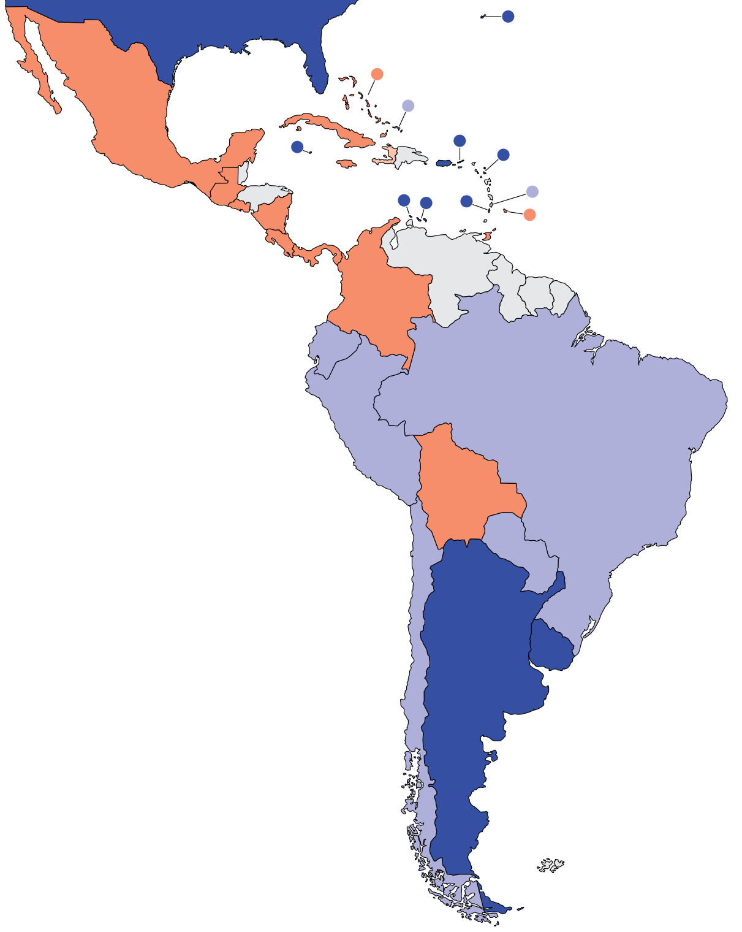
Prevalence of nephrologists and trainees
Nephrologists
Country | Nephrologists PMP | Nephrology trainees PMP
Argentina | 25.95 | 3.24
Bolivia | 9.95 | 3.32
Brazil | 18.41 | 1.15
British Virgin Islands | 25.89 | 0.00
Cayman Islands | 31.10 | 0.00
Chile | 17.15 | 1.36
Colombia | 9.99 | -
Costa Rica | 5.38 | 1.15
Curaçao | 45.94 | 0.00
Dominican Republic | 20.01 | 3.09
Ecuador | 12.26 | 1.16
El Salvador | 5.94 | 7.61
Guatemala | 6.27 | 0.90
Haiti | 0.44 | 0.18
Mexico | 10.45 | 0.93
Nicaragua | 5.08 | 2.38
Panama | 8.53 | 0.92
Paraguay | 12.51 | 2.72
Peru | 18.06 | 1.43
Puerto Rico | 27.43 | 1.94
Uruguay | 64.57 | 13.21
Venezuela, RB | - | 1.68
‘ – ’ : data not reported/unavailable
July 2023

Slide 26
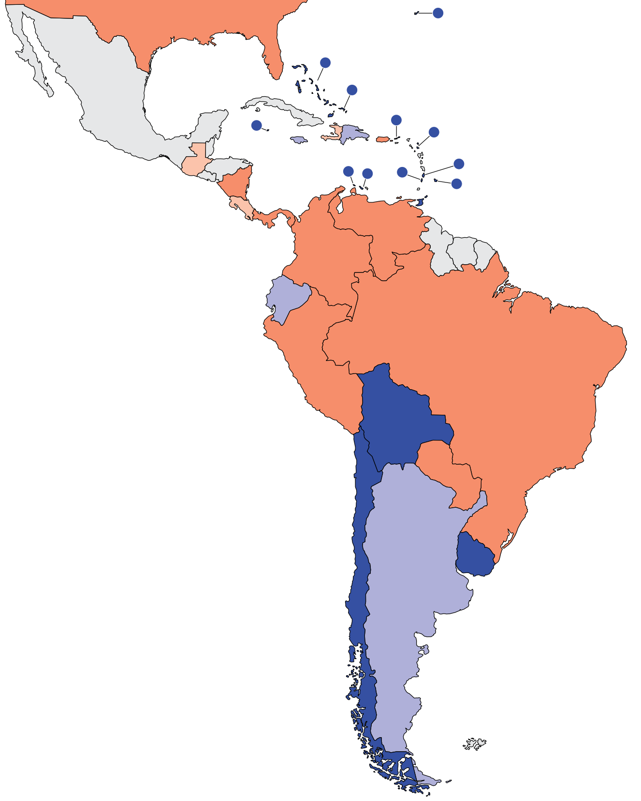
Capacity for chronic dialysis (HD)
Chronic HD centers
Country | Chronic HD Centres PMP
Argentina | 9.97
Bolivia | 12.44
Brazil | 3.87
British Virgin Islands | 25.89
Cayman Islands | 31.10
Chile | 14.16
Colombia | 3.67
Costa Rica | 1.15
Curaçao | 13.13
Dominican Republic | 9.54
Ecuador | 5.32
El Salvador | -
Guatemala | 1.47
Haiti | 0.71
Mexico | -
Nicaragua | 1.75
Panama | 4.61
Paraguay | 2.72
Peru | 4.65
Puerto Rico | 4.84
Uruguay | 11.74
Venezuela, RB | 3.69
Chronic HD services are available in all countries of the region
The Latin America average of HD treatment centers is 8.32 pmp
‘ – ’ : data not reported/unavailable
July 2023

Slide 27
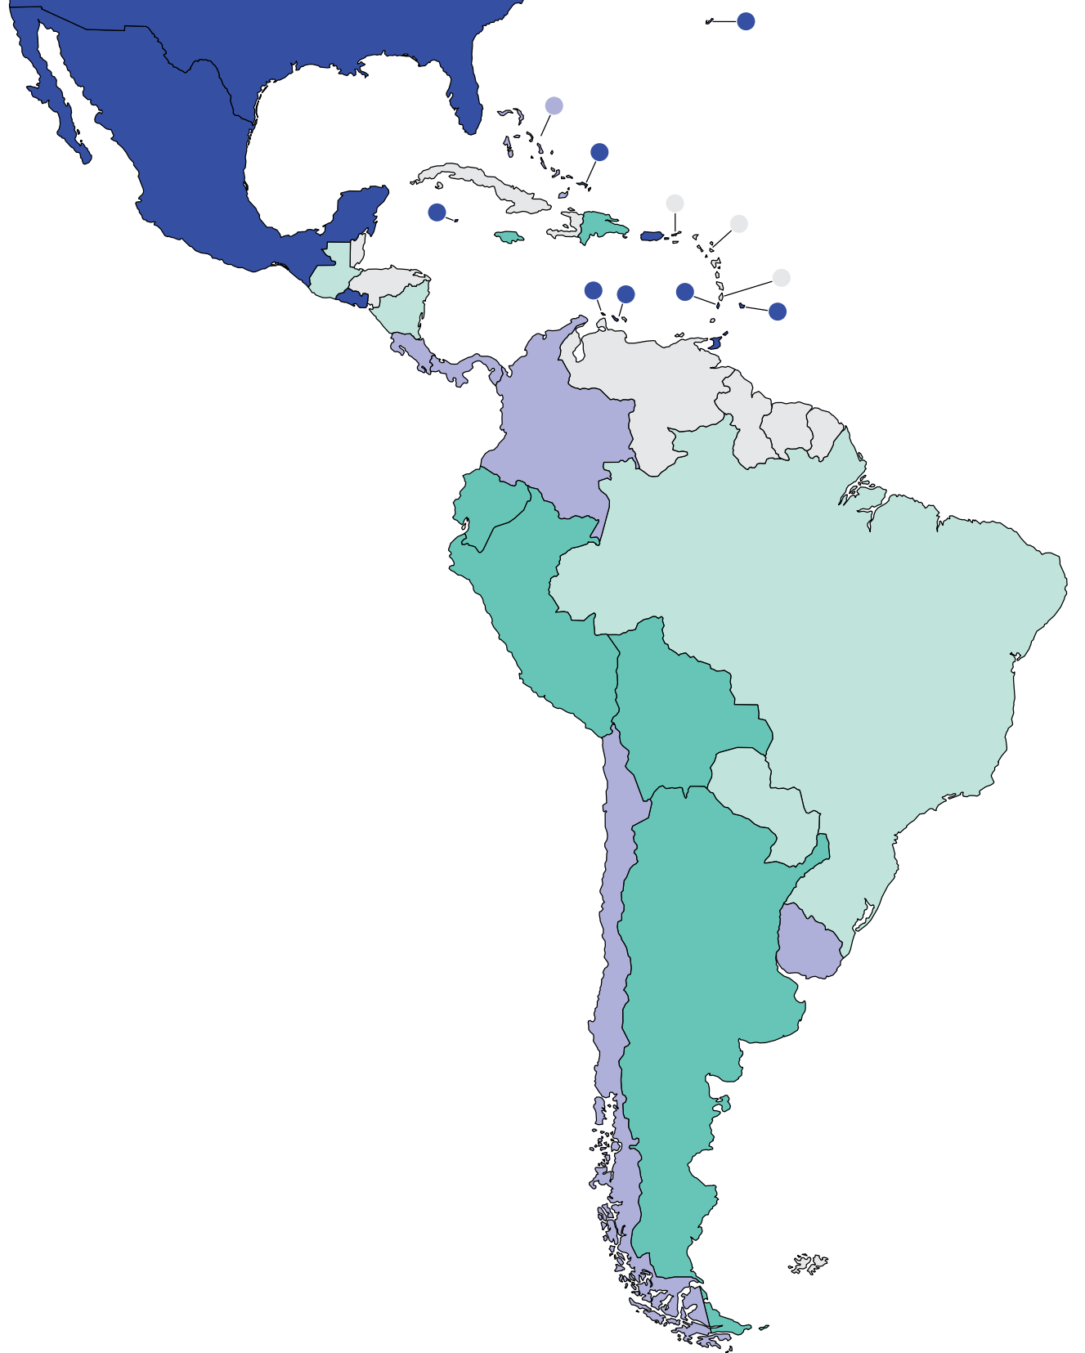
Capacity for chronic dialysis (PD)
Chronic PD centers
Country | Chronic PD Centres PMP
Argentina | 1.08
Bolivia | 0.50
Brazil | 0.37
British Virgin Islands | -
Cayman Islands | 15.55
Chile | 2.39
Colombia | 2.45
Costa Rica | 1.92
Curaçao | 6.56
Dominican Republic | 0.56
Ecuador | 0.58
El Salvador | 3.81
Guatemala | 0.40
Haiti | -
Mexico | 3.10
Nicaragua | 0.48
Panama | 2.54
Paraguay | 0.41
Peru | 1.39
Puerto Rico | 5.16
Uruguay | 1.76
Venezuela, RB | -
Chronic PD services are available in 20 (91%) countries of the region
The Latin America average of PD treatment centers is 2.68 pmp
‘ – ’ : data not reported/unavailable
July 2023

Slide 28
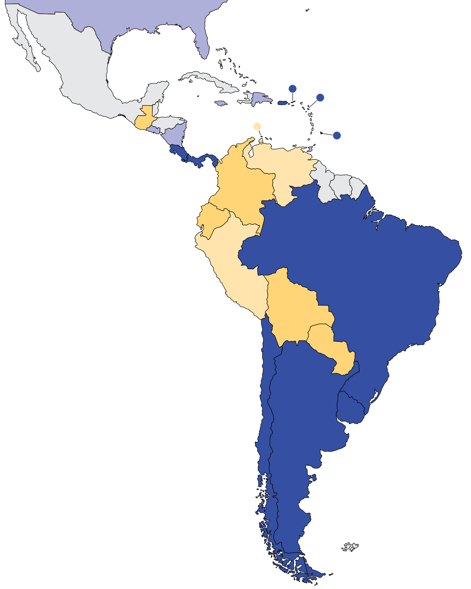
Capacity for Kidney Transplantation
Kidney transplantation centers
Country | Kidney Transplantation availability | Transplant centers PMP
Argentina | X | 0.86
Bolivia | X | 0.41
Brazil | X | 0.92
British Virgin Islands | X | 25.89
Cayman Islands
Chile | X | 1.25
Colombia | X | 0.29
Costa Rica | X | 0.96
Curaçao
Dominican Republic | X | 0.47
Ecuador | X | 0.29
El Salvador | X | 0.46
Guatemala | X | 0.23
Haiti
Mexico
Nicaragua | X | 0.48
Panama | X | 0.92
Paraguay | X | 0.41
Peru | X | 0.19
Puerto Rico | X | 0.97
Uruguay | X | 1.17
Venezuela, RB | X | 0.10
Kidney transplantation services are available in 19 (86%) countries of the region
The Latin America average of Kidney transplantation centers is 2.01 pmp
X : Yes
‘ – ’ : data not reported/unavailable
July 2023

Slide 29
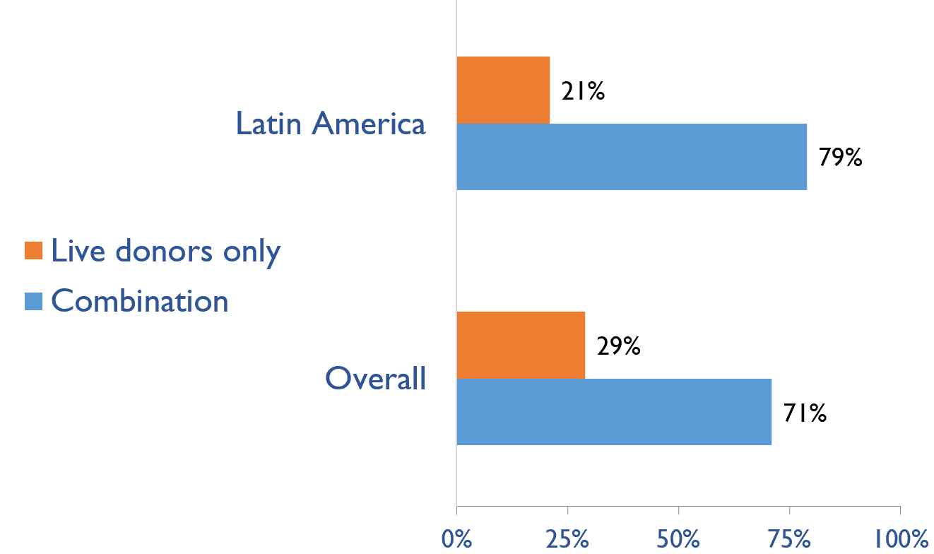
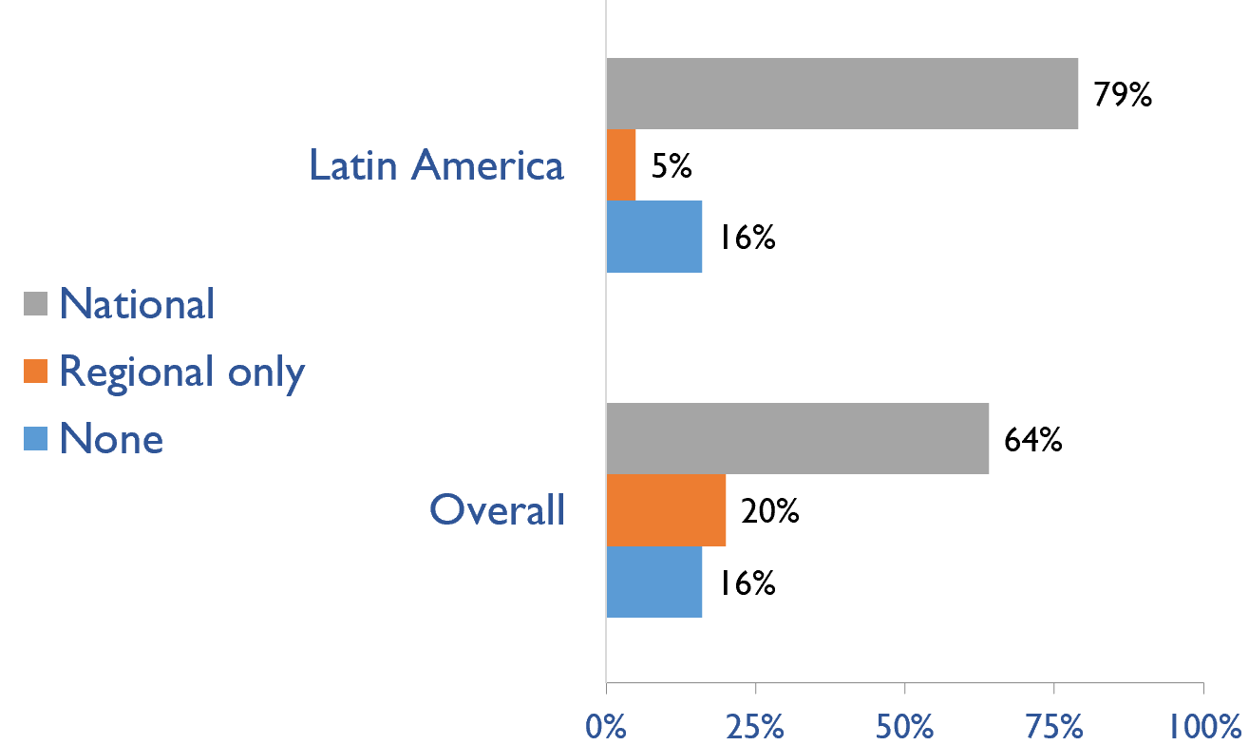
Capacity for Kidney Transplantation (cont’d)
Country | Donor type |  | Transplant waitlist
 | Live donors only | Combination | National | Regional only | None
Argentina |  | X | X
Bolivia | X |  | X
Brazil |  | X | X
British Virgin Islands | X |  |  |  | X
Cayman Islands
Chile |  | X | X
Colombia |  | X | X
Costa Rica |  | X | X
Curaçao
Dominican Republic |  | X | X
Ecuador |  | X | X
El Salvador | X |  |  |  | X
Guatemala |  | X |  | X
Haiti
Mexico |  | X | X
Nicaragua |  | X | X
Panama |  | X | X
Paraguay |  | X | X
Peru |  | X | X
Puerto Rico |  | X | X
Uruguay |  | X | X
Venezuela, RB | X |  |  |  | X
Transplant donor type
Transplant waitlist
X : Yes
July 2023

Slide 30
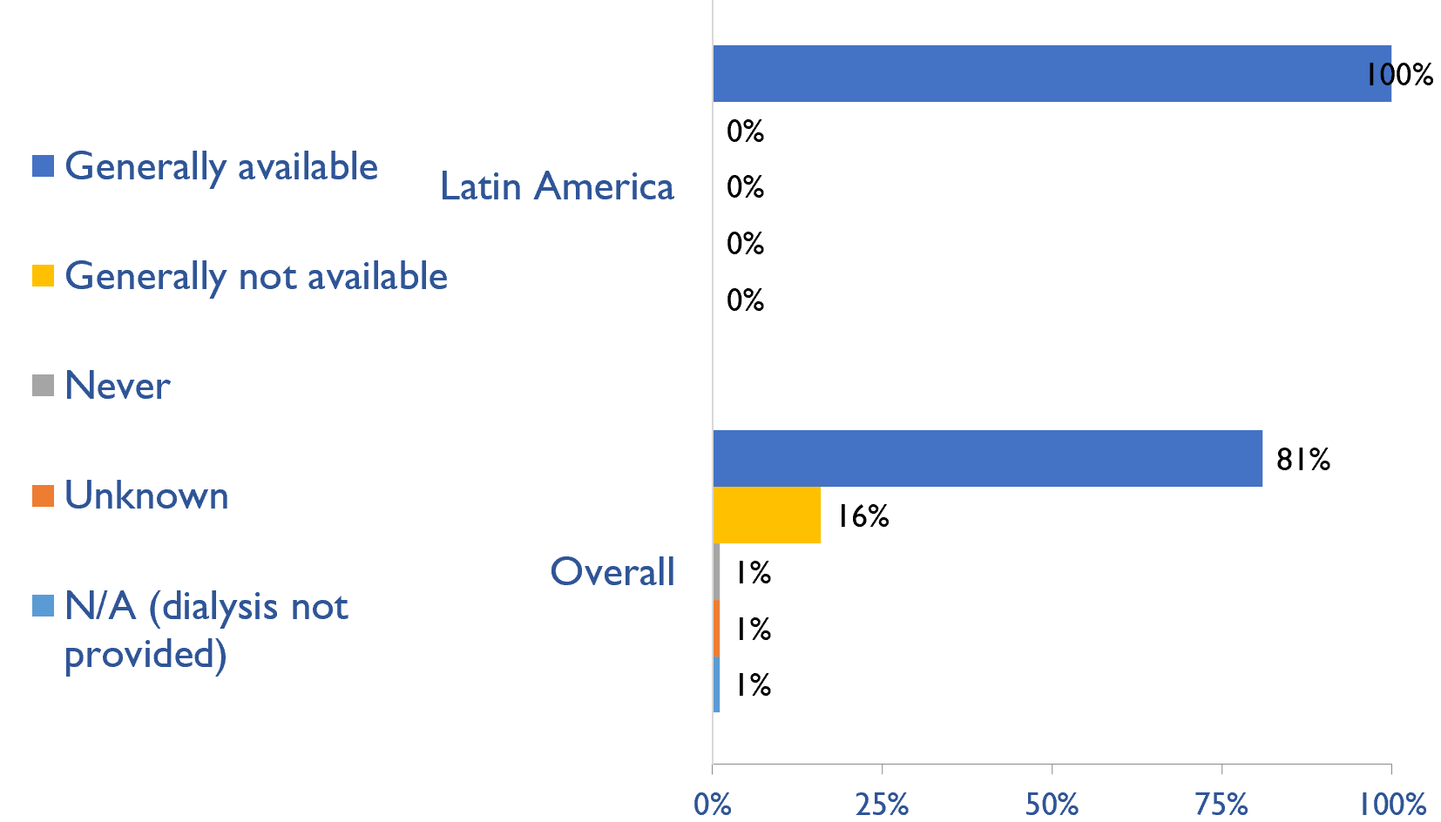
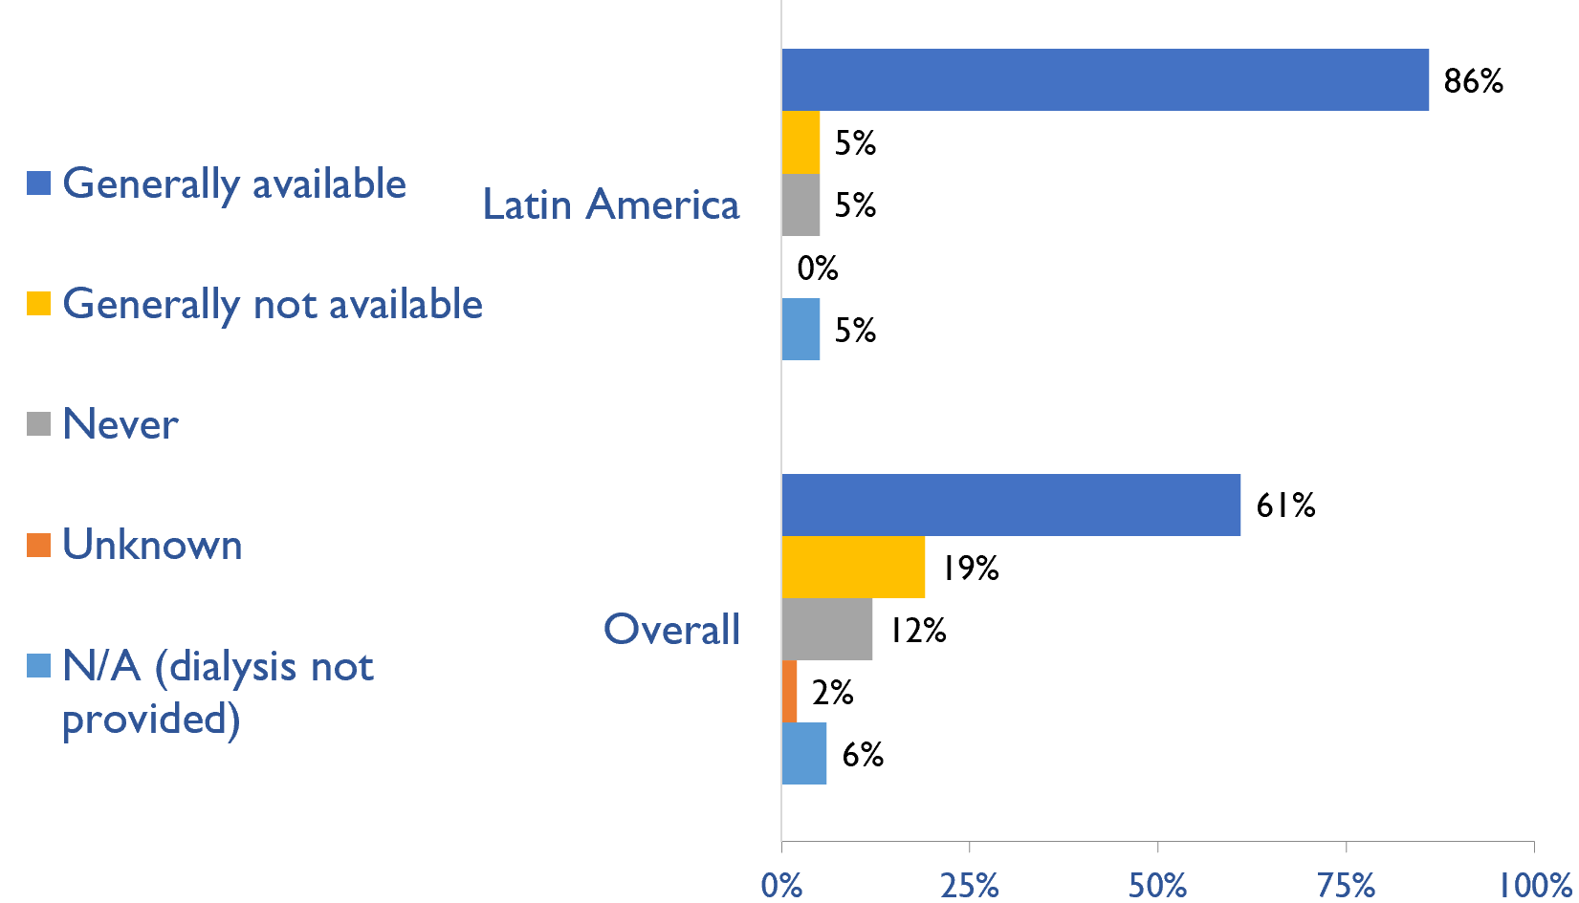
Availability of services within dialysis care
HD frequency
Country | HD frequency a center-based service that involves treatment 3x week/3-4x hours |  |  |  |  | PD frequency ability to do adequate exchanges 3-4x day (or equivalent cycles on automated PD)
 | Generally available | Generally not available | Never | Unknown | N/A (dialysis not provided) | Generally available | Generally not available | Never | Unknown | N/A (dialysis not provided)
Argentina | X |  |  |  |  | X
Bolivia | X |  |  |  |  |  | X
Brazil | X |  |  |  |  | X
British Virgin Islands | X |  |  |  |  |  |  |  |  | X
Cayman Islands | X |  |  |  |  | X
Chile | X |  |  |  |  | X
Colombia | X |  |  |  |  | X
Costa Rica | X |  |  |  |  | X
Curaçao | X |  |  |  |  | X
Dominican Republic | X |  |  |  |  | X
Ecuador | X |  |  |  |  | X
El Salvador | X |  |  |  |  | X
Guatemala | X |  |  |  |  | X
Haiti | X |  |  |  |  |  |  | X
Mexico | X |  |  |  |  | X
Nicaragua | X |  |  |  |  | X
Panama | X |  |  |  |  | X
Paraguay | X |  |  |  |  | X
Peru | X |  |  |  |  | X
Puerto Rico | X |  |  |  |  | X
Uruguay | X |  |  |  |  | X
Venezuela, RB | X |  |  |  |  | X
PD frequency
X : Yes
July 2023

Slide 31
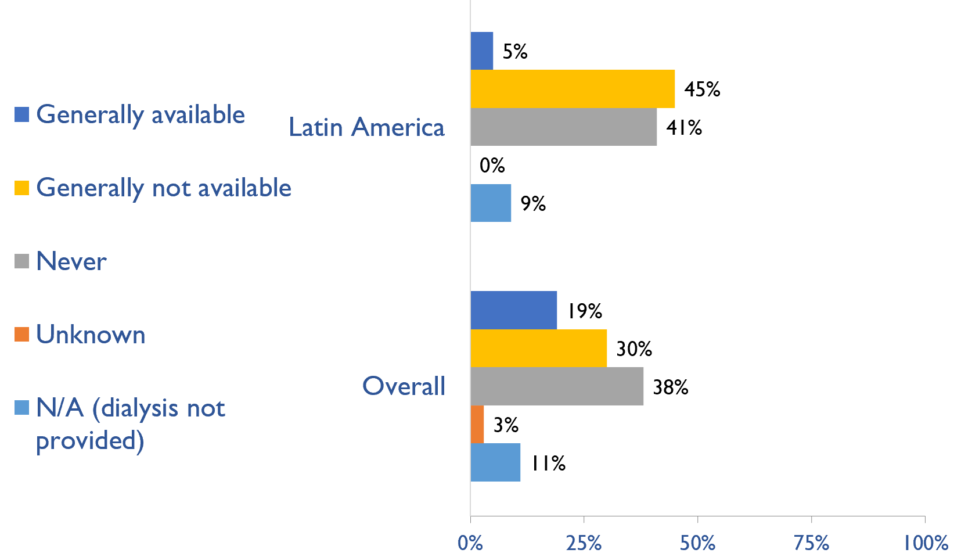
Availability of Home hemodialysis
Country | Availability of Home hemodialysis
 | Generally available | Generally not available | Never | Unknown | N/A (dialysis not provided)
Argentina |  | X
Bolivia |  |  | X
Brazil |  | X
British Virgin Islands |  |  |  |  | X
Cayman Islands |  | X
Chile |  | X
Colombia |  | X
Costa Rica |  | X
Curaçao |  |  | X
Dominican Republic |  |  | X
Ecuador |  | X
El Salvador |  |  | X
Guatemala |  |  | X
Haiti |  | X
Mexico |  | X
Nicaragua |  |  | X
Panama |  |  |  |  | X
Paraguay |  | X
Peru |  |  | X
Puerto Rico | X
Uruguay |  |  | X
Venezuela, RB |  |  | X
X : Yes
July 2023

Slide 32
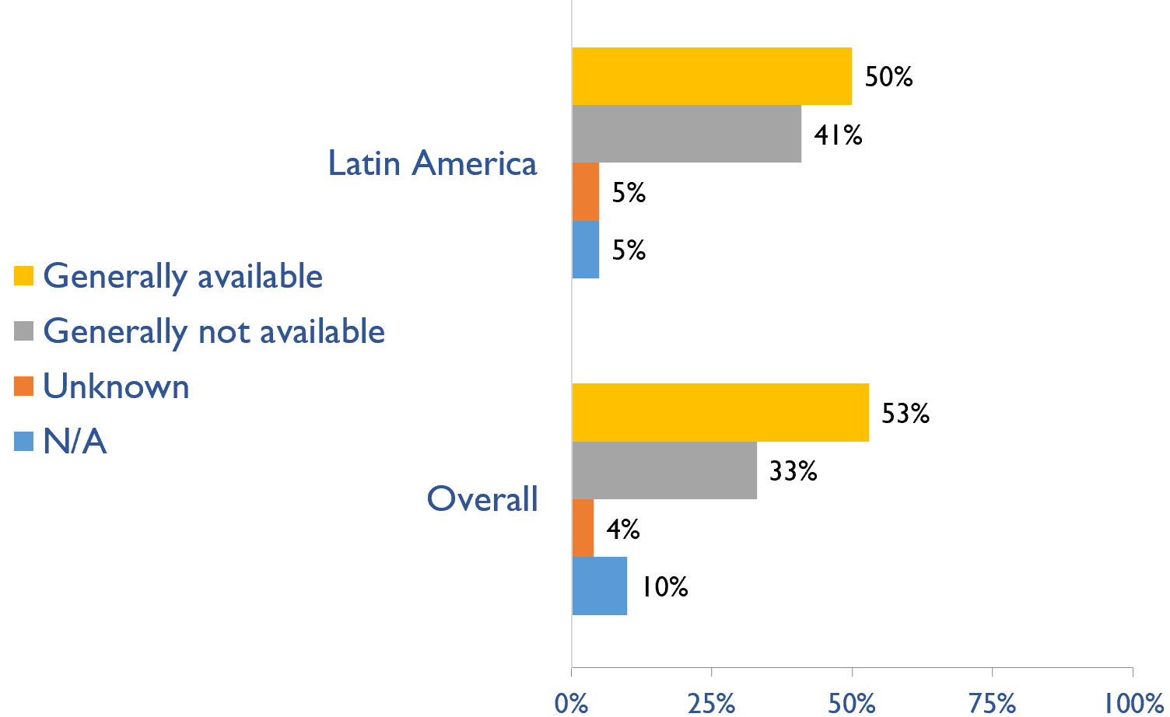
Capacity for conservative kidney management (CKM)
Country | Established conservative care that is chosen or medically advised
 | Generally available | Generally not available | Unknown | N/A (conservative care not available)
Argentina | X
Bolivia |  | X
Brazil |  | X
British Virgin Islands |  | X
Cayman Islands | X
Chile |  | X
Colombia | X
Costa Rica | X
Curaçao | X
Dominican Republic | X
Ecuador |  | X
El Salvador |  | X
Guatemala |  |  |  | X
Haiti | X
Mexico |  | X
Nicaragua | X
Panama | X
Paraguay | X
Peru |  | X
Puerto Rico | X
Uruguay |  | X
Venezuela, RB |  |  | X
X : Yes
July 2023

Slide 33
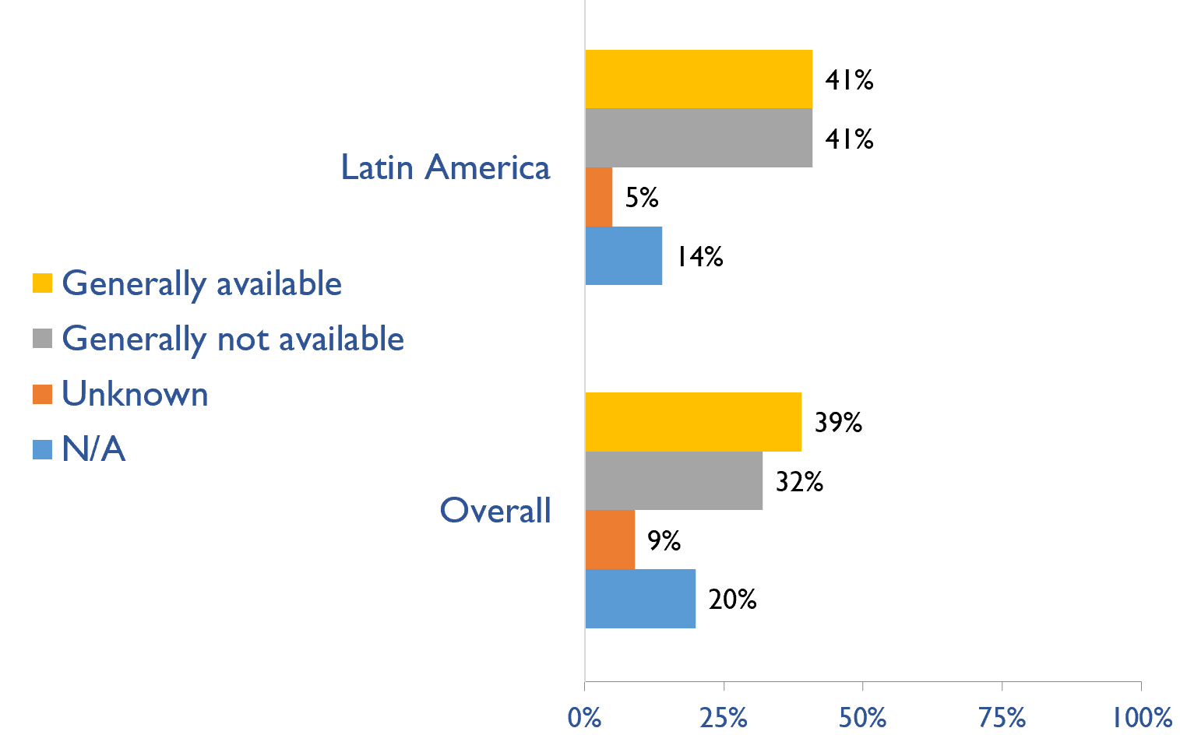
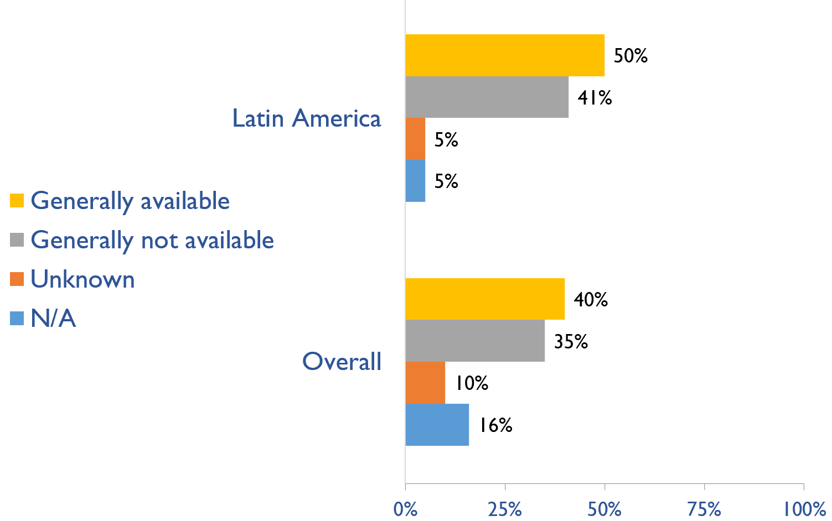
Capacity for conservative kidney management (CKM)
Where resource constraints to prevent or limit access to KRT
Country | where resource constraints to prevent or limit access to KRT |  |  |  | where there are no resource constraints to prevent or limit access to KRT
 | Generally available | Generally not available | Unknown | N/A (conservative care not available) | Generally available | Generally not available | Unknown | N/A (conservative care not available)
Argentina | X |  |  |  | X
Bolivia |  | X |  |  |  | X
Brazil |  | X |  |  |  | X
British Virgin Islands |  | X |  |  |  | X
Cayman Islands |  |  |  | X | X
Chile |  | X |  |  |  | X
Colombia | X |  |  |  | X
Costa Rica | X |  |  |  | X
Curaçao |  |  |  | X | X
Dominican Republic | X |  |  |  | X
Ecuador |  | X |  |  |  | X
El Salvador |  | X |  |  | X
Guatemala |  |  |  |  |  |  |  | X
Haiti | X |  |  |  | X
Mexico |  | X |  |  |  | X
Nicaragua | X |  |  |  |  | X
Panama | X |  |  |  | X
Paraguay | X |  |  |  | X
Peru |  | X |  |  |  | X
Puerto Rico | X |  |  |  | X
Uruguay |  | X |  |  |  | X
Venezuela, RB |  |  | X |  |  |  | X
Where there are no resource constraints to prevent or limit access to KRT
X : Yes
July 2023

Slide 34
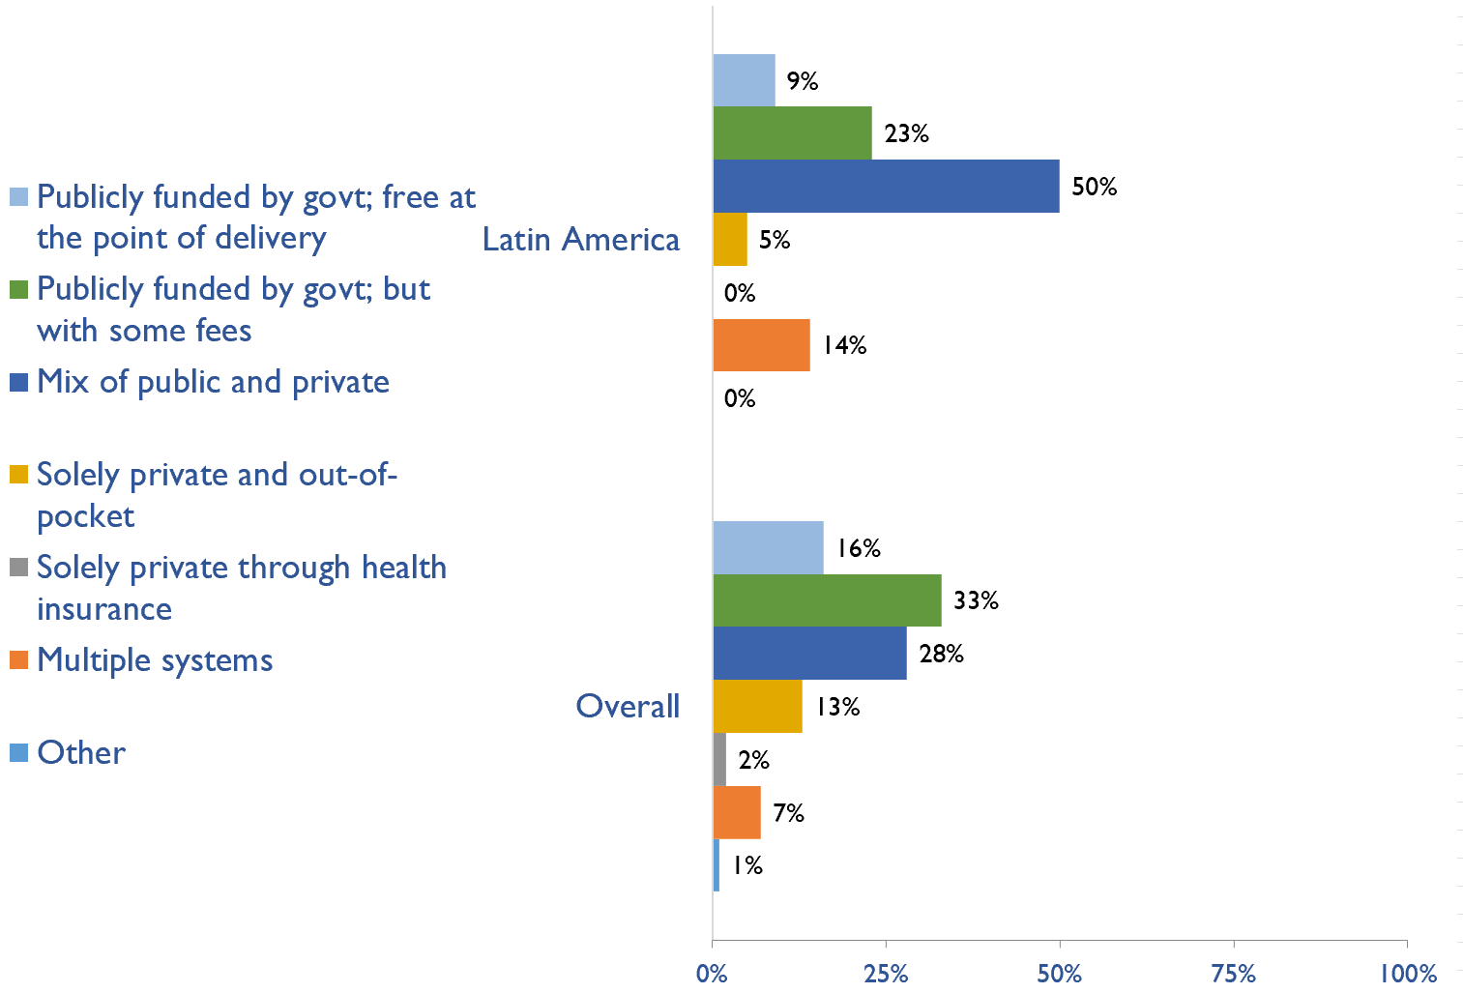
Funding for medications in CKD patients not on dialysis
Country | Publicly funded by govt; free at the point of delivery | Publicly funded by govt but with some fees at the point of delivery | Mix of public and private funding systems | Solely private and out-of-pocket | Solely private through health insurance providers | Multiple systems | Other
Argentina |  |  | X
Bolivia |  |  | X
Brazil | X
British Virgin Islands |  | X
Cayman Islands |  |  | X
Chile |  |  | X
Colombia |  | X
Costa Rica |  | X
Curaçao |  |  | X
Dominican Republic |  |  | X
Ecuador |  | X
El Salvador |  |  | X
Guatemala |  |  |  |  |  | X
Haiti |  |  |  | X
Mexico |  |  | X
Nicaragua | X
Panama |  | X
Paraguay |  |  | X
Peru |  |  | X
Puerto Rico |  |  |  |  |  | X
Uruguay |  |  | X
Venezuela, RB |  |  |  |  |  | X
X : Yes
July 2023

Slide 35
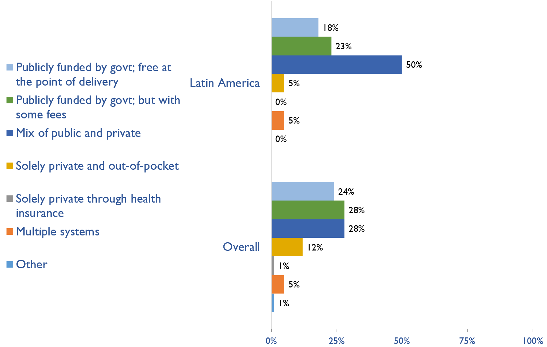
Funding for medications in all dialysis patients
Country | Publicly funded by govt; free at the point of delivery | Publicly funded by govt but with some fees at the point of delivery | Mix of public and private funding systems | Solely private and out-of-pocket | Solely private through health insurance providers | Multiple systems | Other
Argentina |  |  | X
Bolivia |  |  | X
Brazil | X
British Virgin Islands |  | X
Cayman Islands |  |  | X
Chile |  |  | X
Colombia | X
Costa Rica |  | X
Curaçao |  |  | X
Dominican Republic |  |  | X
Ecuador |  | X
El Salvador |  |  | X
Guatemala |  |  | X
Haiti |  |  |  | X
Mexico |  |  | X
Nicaragua | X
Panama |  | X
Paraguay |  |  | X
Peru |  |  | X
Puerto Rico |  |  |  |  |  | X
Uruguay |  | X
Venezuela, RB | X
X : Yes
July 2023

Slide 36
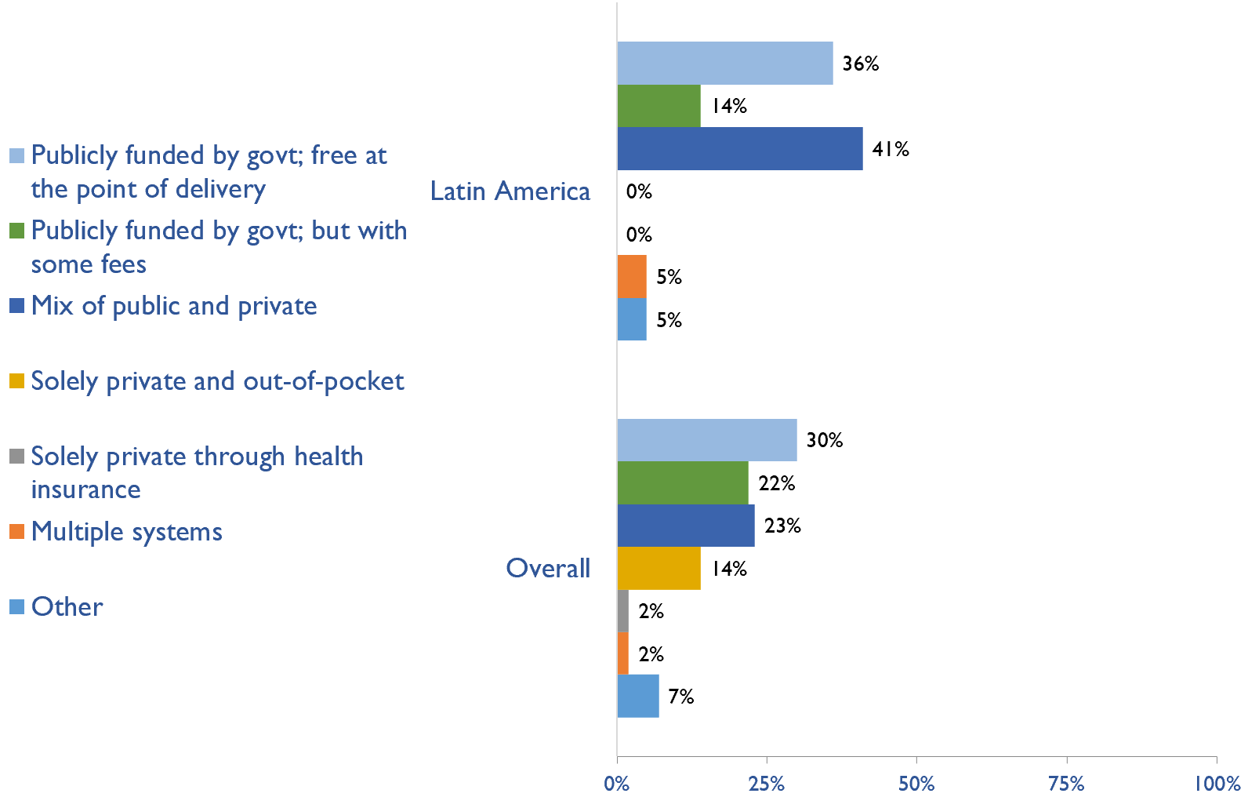
Funding for medications in all transplant patients
Country | Publicly funded by govt; free at the point of delivery | Publicly funded by govt but with some fees at the point of delivery | Mix of public and private funding systems | Solely private and out-of-pocket | Solely private through health insurance providers | Multiple systems | Other
Argentina |  |  | X
Bolivia |  |  | X
Brazil | X
British Virgin Islands |  |  | X
Cayman Islands | X
Chile |  |  | X
Colombia | X
Costa Rica | X
Curaçao |  |  | X
Dominican Republic | X
Ecuador |  | X
El Salvador |  |  | X
Guatemala |  |  | X
Haiti |  |  |  |  |  |  | X
Mexico |  |  | X
Nicaragua | X
Panama |  | X
Paraguay | X
Peru |  |  | X
Puerto Rico |  |  |  |  |  | X
Uruguay |  | X
Venezuela, RB | X
X : Yes
July 2023

Slide 37
Funding for medications in all transplant patients
Country | CKD | Dialysis | Transplant | AKI | Conservative care
Argentina | X | X | X
Bolivia | X | X | X
Brazil | X | X | X
British Virgin Islands
Cayman Islands |  | X
Chile | X | X | X
Colombia | X | X | X
Costa Rica | X | X | X | X | X
Curaçao
Dominican Republic |  | X | X
Ecuador | X | X | X
El Salvador |  | X
Guatemala |  | X | X
Haiti
Mexico |  |  | X
Nicaragua
Panama | X | X | X
Paraguay | X | X | X | X
Peru |  | X | X
Puerto Rico | X | X | X | X | X
Uruguay | X | X | X
Venezuela, RB
X : Yes
July 2023

Slide 38
Summary of Findings
In summary, the 2023 ISN-GKHA highlights several important findings for Latin America.
KRT availability, access, and quality is high.
  HD is available in all countries; however, PD services are unavailable in British Virgin Islands and Haiti.
  Capacity to provide adequate frequency of HD i.e., three times weekly for 3 – 4 hours per session, was available in all (100%) Latin America countries.
  Capacity to provide adequate PD exchanges i.e., three to four exchanges per day was available in 19 (86%) countries.
  Home HD was only available in Puerto Rico.
  KT centres are available in 19 (86%) countries with a median prevalence of KT centres of 0.47 pmp.
CKM is available and predominately chosen or medically advised.
  Established CKM through shared decision making was available in 11 (50%) countries.
  9 (41%) countries stated that CKM is choice-restricted, meaning that patients are not choosing to receive CKM because it is better for them but because they cannot receive KRT due to limitations in resources.
  Also, 11 (50%) countries reported that CKM is chosen or medically-advised, meaning that the decision to not receive KRT wasn’t due to resource limitations.
Government funding for kidney care services and medication is low.
  Reimbursement for medications that is free at point of delivery for ND-CKD, dialysis, and KT are available in 2 (9%), 4 (18%), and in 8 (36%) countries, respectively.
  Reimbursement that is free for acute dialysis, chronic HD, and chronic PD were available in 7 (31.8%), 6 (27.3%), and 6 (27.3%) countries, respectively.

Slide 39
Summary of Findings (cont’d)
Most have registries for advanced kidney disease, few for CKD or AKI
  Availability of kidney registries varied across countries in the region.
  ND-CKD registries are available in 11 (50%) countries; dialysis registries in 16 (72.7%), and KT registries are available in 15 (68.2%) countries in the region. Acute dialysis registry was available in 3 (13.6%) (Costa Rica, Paraguay, and Puerto Rico), and 2 (9.1%) countries (Costa Rica and Puerto Rico) had a CKM registry.
Many workforce limitations are present.
  The median prevalence of nephrologists was 12.5 pmp with the highest prevalence in Uruguay (64.6 pmp) and the lowest in Nicaragua (5.1 pmp).
  The median prevalence of nephrology trainees in the region was 1.4 pmp and was highest in Uruguay (13.2 pmp) and lowest in Haiti (0.18 pmp).
  More than two-thirds of countries in the region reported shortages of nephrologists (68%), paediatric nephrologists (73%), transplant surgeons (86%), and palliative care physicians (68%).
Moderate advocacy for kidney disease in Latin America.
  Advocacy groups for CKD, kidney failure and KRT remains low in the region.

Slide 40
Implications
There are important implications to consider. Based on these survey findings, key recommendations to drive future activities for optimizing kidney care globally are proposed:
Increase health care financing for kidney failure prevention and management.
  While resource limitations are an obvious barrier, focusing on preventing kidney failure through appropriate hypertension and diabetes management may be more cost-effective overall. Government funding to cover medication costs may allow more patients to treat earlier stage CKD, thereby preventing the need for more costly kidney failure treatment and the obvious burden this has on patients’ wellbeing.
Address workforce shortages through multidisciplinary teams and telemedicine
  Shortages of nephrologists, surgeons, dialysis nurses, and other key allied health professionals were noted across most countries. Similarly, simply producing more nephrologists may not be feasible or appropriate, and sharing the workload across multiple providers will not only promote the use of multidisciplinary teams but further, allow for more and better care delivery across more patients. Telemedicine may help particularly in addressing gaps in care among rural patients and enhancing capacity through training programs such as ISN Fellowship, visiting ambassador programs, etc.

Slide 41
Implications (cont’d)
Incorporate the collection and reporting of quality indicators in kidney failure care.
  Measuring and reporting on key quality indicators is an important driver in healthcare improvement. Ensuring facilities are supported with information systems that allow for the systematic measurement and reporting of indicators is a first key step to increasing the rate of monitoring among countries. Further, understanding if or how the collection and reporting of indicators are being used to improve care is needed.
Expand health information systems to prevent and manage kidney failure.
  Similarly, good quality HIS are vital for kidney disease management within a country. A lack of data on disease prevalence, incidence, resource use, and quality of care limits government and provider ability to monitor and evaluate the care provided as well as predicts appropriate resource allocation so that sufficient facilities, medicines, and healthcare professionals are trained and available.
Promote kidney failure prevention and treatment by implementing policies, strategies, and advocacy, and mitigating barriers.
  Lastly, policies and strategies are important for consistent approaches within a country for optimal care delivery, as well as for accountability, leadership, and knowledge exchange. Advocacy may help promote the increase of government prioritization and further, public awareness of how to prevent and manage kidney disease. Without acknowledging and mitigating barriers, it would be a challenge to achieve of successes out of these recommendations. Competing priorities and needs (for example, clean water supply and basic sanitation, maternal and child health, malnutrition, etc.) represent formidable barriers that can limit implementation of the recommended strategies in the region.

Slide 42







www.theisn.org
Global Operations Center
Americas Operations Center
Avenue des Arts 1-2
1210 Brussels, Belgium
340 North Avenue 3rd Floor
Cranford, NJ 07016-2496, United States
+ 32 2 808 04 20
+1 904 345 0866
info@theisn.org
info@theisn.org
Follow us

