Slide 1
Advancing Kidney Health Worldwide. Together.

Slide 2
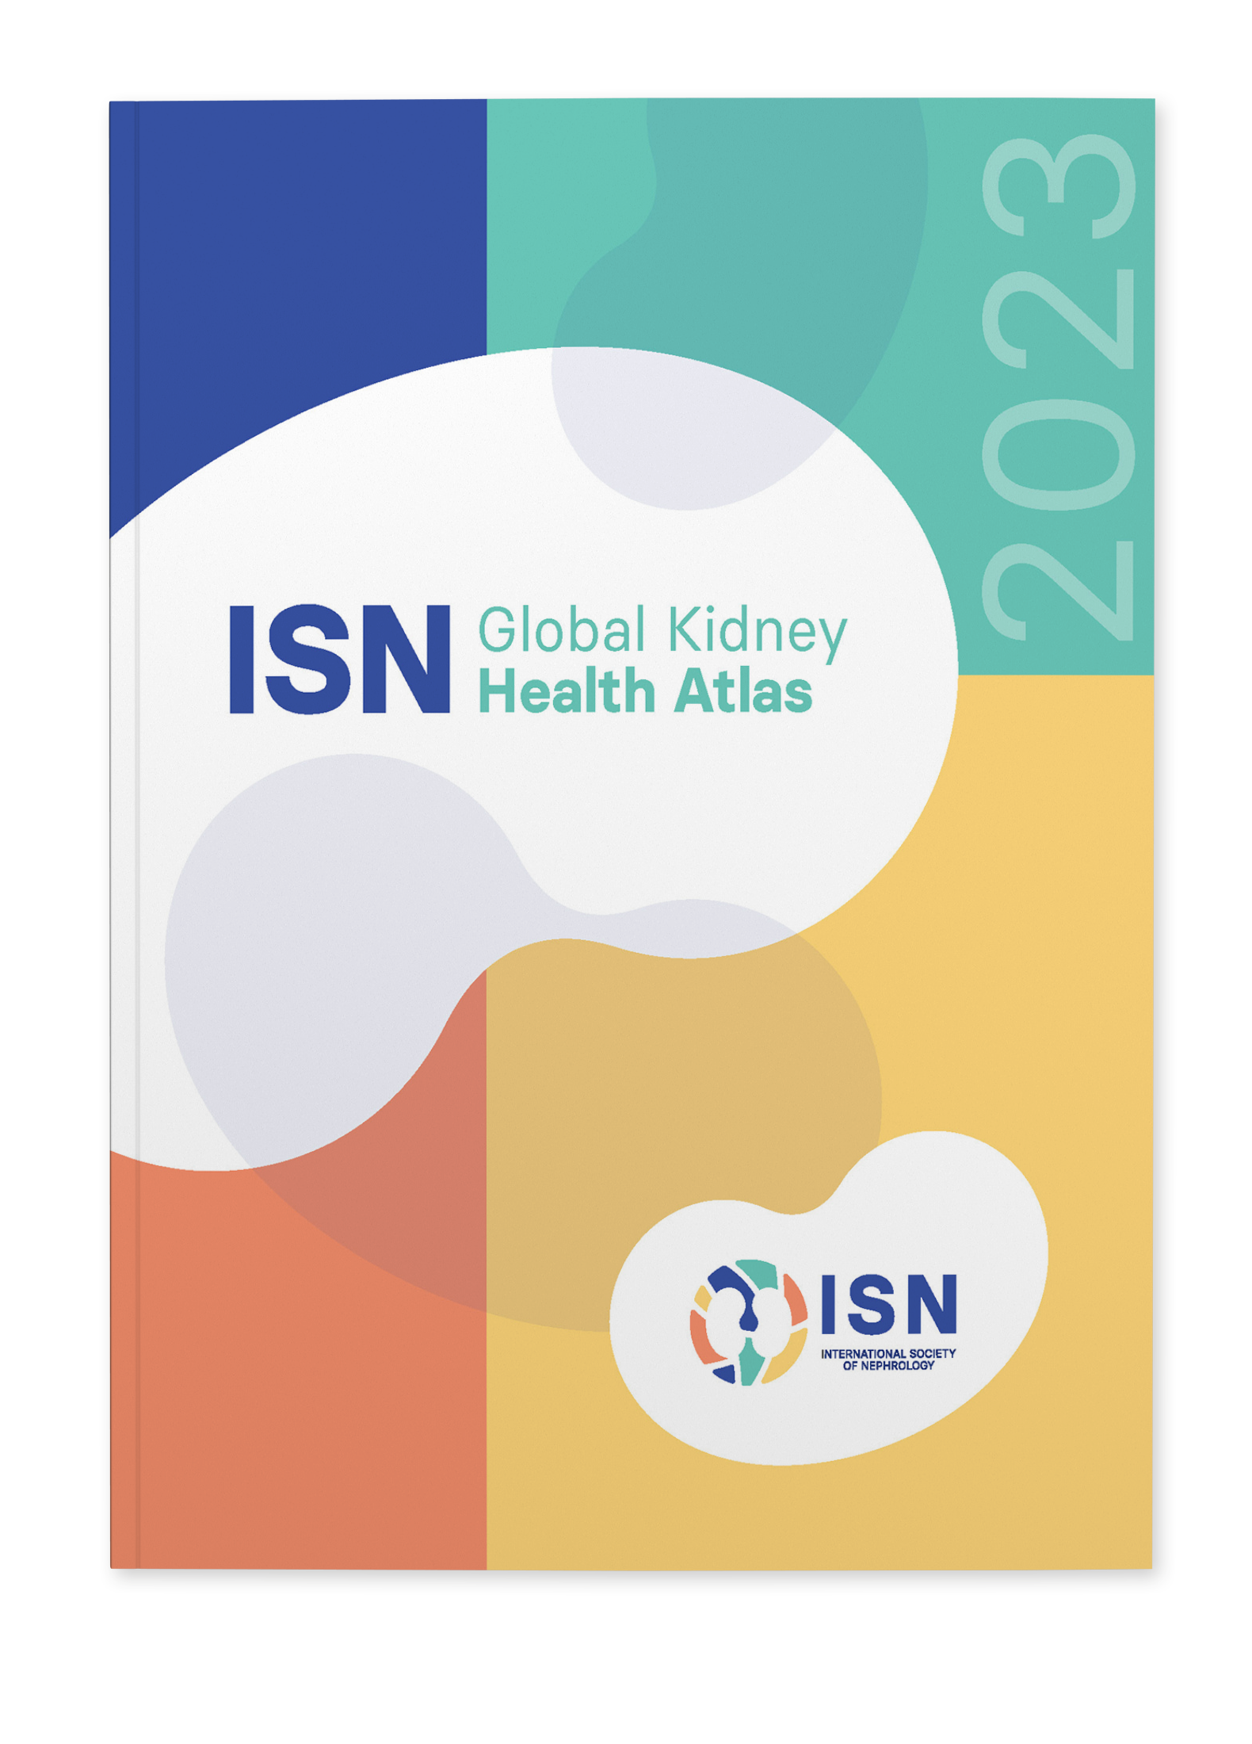
2023 ISN-GLOBAL
KIDNEY HEALTH ATLAS
(ISN-GKHA)
ISN OCEANIA AND SOUTH EAST ASIA REGION
www.theisn.org/global-atlas

Slide 3

Overview
Aim
Methods
Key Results

Slide 4
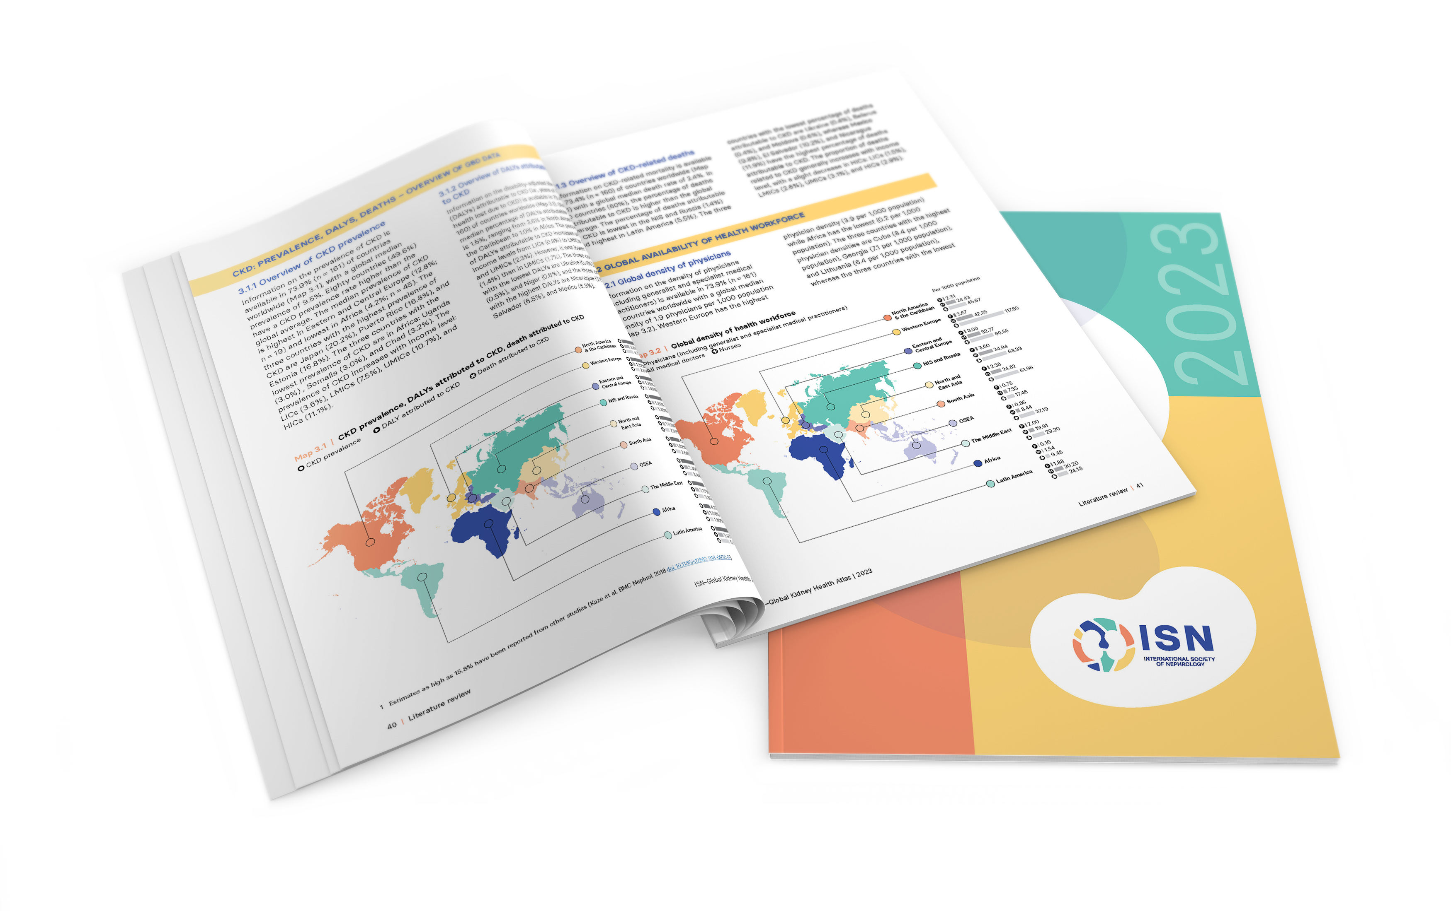
Aim of the ISN-Global Kidney Health Atlas
To understand, compare and monitor how different countries around the world detect, treat, monitor and advocate for people with kidney disease (AKI or CKD).
Key focus on availability, accessibility,
affordability and quality of kidney failure care

Slide 5
ISN-Global Kidney Health Atlas Survey
2016
2018
2022
2026

Slide 6
Design and Scope
Online questionnary-based survey July – September 2022
  3 languages (English, French, Spanish)
  191 countries contacted
  ≥3 stakeholders per country
    National nephrology society leadership
    Healthcare policymakers
    Patients / patient advocacy groups
  Discrepancies resolved by follow-up conferences with regional board chairs and country nephrology leaders
Desk research (across countries and regions)
  Published and grey literature review
  Systematic review of kidney failure burden and outcomes
  Data extraction from major kidney registries (USRDS, ERA-EDTA) and relevant national registries where available
  Scoping review of KRT cost estimates
Notes:
REDCap Cloud. The questionnaire was peer reviewed for content validity and comprehensiveness before it was piloted with the 10 ISN regional boards to identify any logistical and feasibility issues (e.g., translation needs). Intensive follow-ups were conducted by email and telephone with ISN regional and national leaders to ensure complete and timely responses.
Data and reports published by the WHO Global Observatory, UN, World Bank, and OECD.
Both published and unpublished documents from international organizations/bodies and reports published by national governments on the organization and
delivery of ESKD.
Additional literature identified by key stakeholders (i.e., opinion leaders, national nephrology society leaders, ISN leaders) and through consultation with national nephrology societies and ISN regional boards.

Slide 7
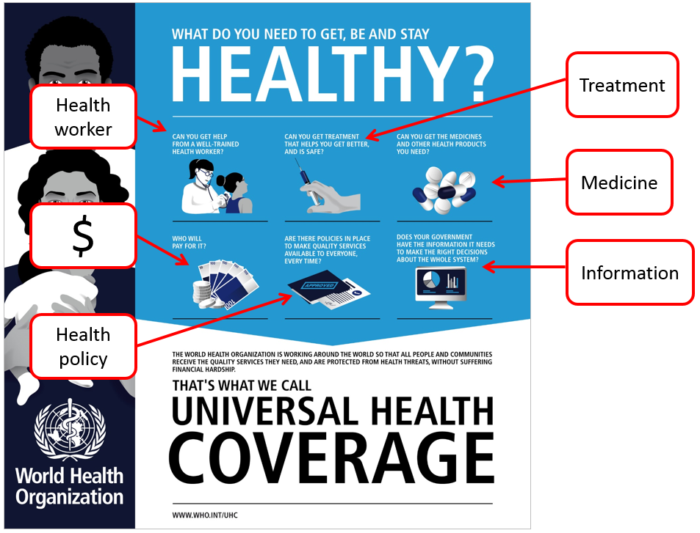
Overall Survey Components

Slide 8
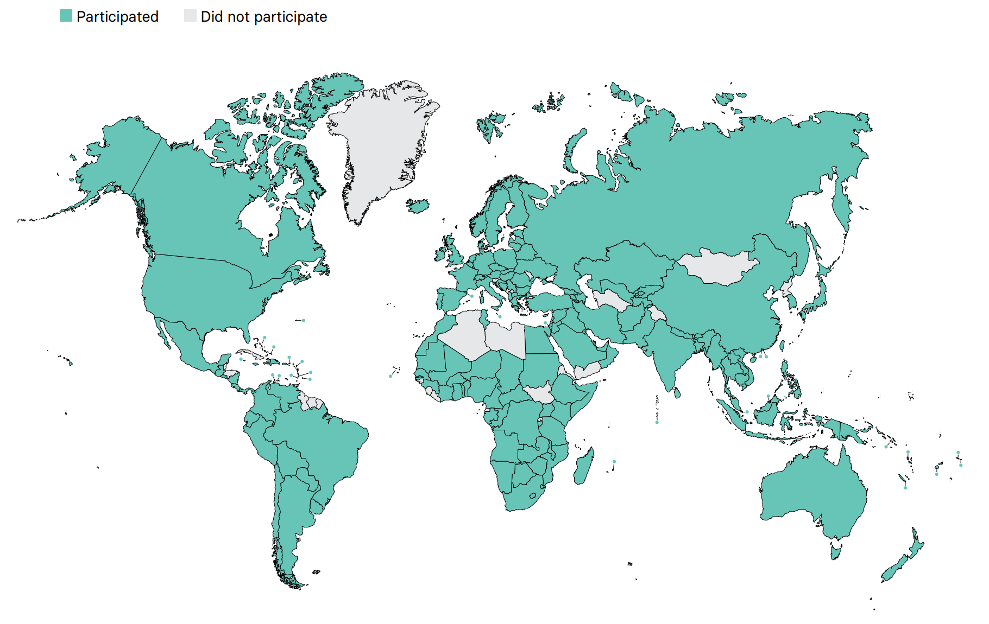
Overall ISN-GKHA response
167 countries (92%)
97% world’s population
329 individuals (63%) response
2 respondents/country
(IQR 2-3)
108 countries participated in the 2017, 2019, and 2023 GKHA surveys

Slide 9
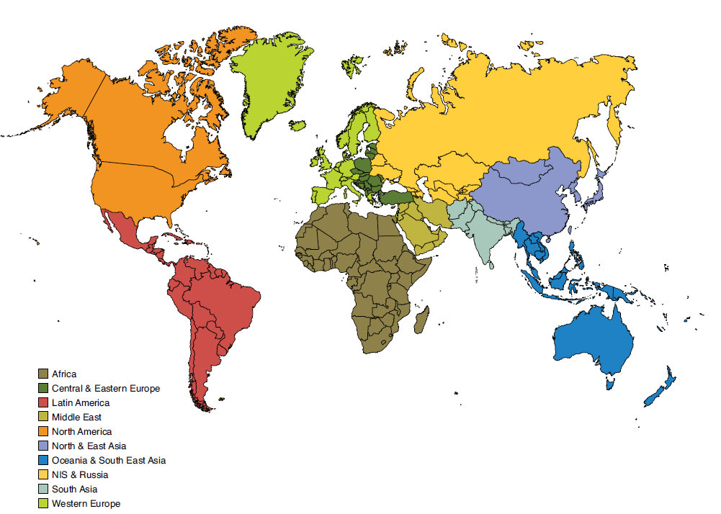
Results presented by ISN regions

Slide 10

ISN Region: Oceania and South East Asia

Slide 11
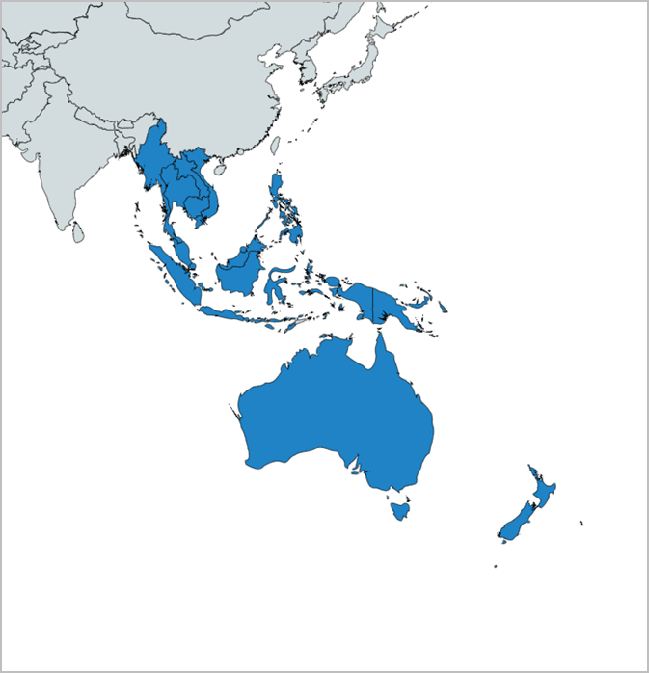
Demographics
Country | World bank ranking | Area (sq km) | Total population (2022) | GDP (PPP) ($ billion) | Total health expenditures (% of GDP)
Australia | High income | 7,741,220 | 26,141,369 | 1445.8 | 9.9
Brunei Darussalam | High income | 5,756 | 478,054 | 29.4 | 2.2
Cambodia | Lower-middle income | 181,035 | 16,713,015 | 79.4 | 7
Fiji | Upper-middle income | 18,274 | 943,737 | 10.5 | 3.8
Indonesia | Lower-middle income | 1,904,569 | 277,300,000 | 3566.3 | 2.9
Lao PDR | Lower-middle income | 236,800 | 7,749,595 | 64.0 | -
Malaysia | Upper-middle income | 329,847 | 33,871,431 | 971.3 | 3.8
Myanmar | Lower-middle income | 676,578 | 57,526,449 | 238.3 | -
New Caledonia | High income | 18,575 | 297,160 | 11.1 | -
New Zealand | High income | 268,838 | 5,053,004 | 237.8 | 9.7
Philippines | Lower-middle income | 300,000 | 114,600,000 | 1012.7 | 4.1
Samoa | Lower-middle income | 2,831 | 206,179 | 1.3 | 6.4
Singapore | High income | 697 | 5,921,231 | 635.3 | 4.1
Thailand | Upper-middle income | 513,120 | 69,648,117 | 1343.3 | 3.8
Vietnam | Lower-middle income | 331,210 | 103,800,000 | 1138.0 | 5.3
Responses were received from 19 of 30 of countries in OSEA (63.3%) representing 97.7% of the region’s population.
‘ – ’ : data not reported/unavailable
International Society of Nephrology
11
July 2023
11

Slide 12
Demographics
Country | World bank ranking | Area (sq km) | Total population (2022) | GDP (PPP) ($ billion) | Total health expenditures (% of GDP) | Total Health Spending per person | Government Health Spending per person | Out-of-pocket Health Spending per person
Australia | High income | 7,741,220 | 26,141,369 | 1445.8 | 9.9 | 5598 | 4057 | 858
Brunei Darussalam | High income | 5,756 | 478,054 | 29.4 | 2.2 | 635 | 608 | 26
Cambodia | Lower-middle income | 181,035 | 16,713,015 | 79.4 | 7 | 82 | 21 | 54
Fiji | Upper-middle income | 18,274 | 943,737 | 10.5 | 3.8 | 205 | 129 | 28
Indonesia | Lower-middle income | 1,904,569 | 277,300,000 | 3566.3 | 2.9 | 126 | 65 | 41
Lao PDR | Lower-middle income | 236,800 | 7,749,595 | 64.0 | - | 60 | 19 | 28
Malaysia | Upper-middle income | 329,847 | 33,871,431 | 971.3 | 3.8 | 466 | 261 | 144
Myanmar | Lower-middle income | 676,578 | 57,526,449 | 238.3 | - | 60 | 9 | 47
New Caledonia | High income | 18,575 | 297,160 | 11.1 | - | - | - | -
New Zealand | High income | 268,838 | 5,053,004 | 237.8 | 9.7 | 4385 | 3460 | 465
Philippines | Lower-middle income | 300,000 | 114,600,000 | 1012.7 | 4.1 | 158 | 58 | 77
Samoa | Lower-middle income | 2,831 | 206,179 | 1.3 | 6.4 | 257 | 196 | 26
Singapore | High income | 697 | 5,921,231 | 635.3 | 4.1 | 3982 | 2669 | 799
Thailand | Upper-middle income | 513,120 | 69,648,117 | 1343.3 | 3.8 | 342 | 271 | 32
Vietnam | Lower-middle income | 331,210 | 103,800,000 | 1138.0 | 5.3 | 164 | 79 | 71
‘ – ’ : data not reported/unavailable
July 2023
12

Slide 13
CKD and its risk factors burden
Country | CKD Prevalence % (95% CI) | Death attributed to CKD % (95% CI) | DALYS attributed to CKD % (95% CI) | Obesity % (95% CI) | Increased BP % (95% CI) | Smoking % (95% CI)
Australia | 10.83 (10.17 - 11.51) | 3.05 (2.53 - 3.44) | 1.38 (1.2 - 1.56) | 30.4 (26.5 - 34.4) | 15.2 (11.5 - 19.4) | 14.6 (13.6 - 15.6)
Brunei Darussalam | 8.42 (7.73 - 9.12) | 4.16 (3.88 - 4.45) | 2.44 (2.16 - 2.73) | 14.7 (11.0 - 18.9) | 18.9 (13.5 - 25.2) | 12.7 (11.3 - 14.2)
Cambodia | 8.20 (7.58 - 8.88) | 1.98 (1.77 - 2.18) | 1.55 (1.38 - 1.73) | 3.5 (2.3 - 5.1) | 26.1 (19.6 - 33.0) | 15.4 (13.7 - 17.1)
Fiji | 10.73 (9.91 - 11.54) | 3.94 (3.61 - 4.3) | 3.1 (2.79 - 3.39) | 30.0 (24.4 - 35.9) | 21.7 (15.6 - 28.7) | 11.1 (9.5 - 12.9)
Indonesia | 10.34 (9.54 - 11.18) | 2.47 (2.35 - 2.6) | 2.12 (1.93 - 2.32) | 6.9 (5.1 - 9.1) | 23.8 (18.5 - 29.5) | 25.6 (23.6 - 27.8)
Lao PDR | 8.55 (7.89 - 9.25) | 3.85 (3.36 - 4.54) | 2.54 (2.21 - 2.96) | 4.5 (3.0 - 6.4) | 24.8 (18.8 - 31.1) | 25.1 (21.6 - 29.2)
Malaysia | 10.54 (9.79 - 11.31) | 3.47 (3.12 - 3.82) | 2.5 (2.2 - 2.79) | 15.3 (12.3 - 18.7) | 22.9 (17.9 - 28.7) | 17.2 (15.2 - 19.2)
Myanmar | 10.12 (9.35 - 10.93) | 2.74 (2.55 - 3.03) | 2.25 (2.06 - 2.46) | 5.7 (4.0 - 7.8) | 24.6 (18.5 - 31.1) | 15.0 (13.3 - 17.0)
New Caledonia | - | - | - | - | - | -
New Zealand | 11.08 (10.28 - 11.87) | 2.65 (2.31 - 2.91) | 1.48 (1.29 - 1.65) | 32.0 (28.4 - 35.6) | 16.2 (12.3 - 20.8) | 15.3 (14.4 - 16.2)
Philippines | 9.54 (8.83 - 10.23) | 5.22 (4.97 - 5.59) | 3.52 (3.14 - 3.9) | 6.0 (4.3 - 8.1) | 22.6 (17.4 - 28.1) | 20.1 (17.5 - 23.0)
Samoa | 9.08 (8.41 - 9.78) | 4.49 (3.93 - 5.15) | 3.4 (2.93 - 3.88) | 45.5 (39.8 - 51.5) | 24.0 (17.9 - 30.8) | 21.5 (18.5 - 24.7)
Singapore | 13.86 (12.87 - 14.84) | 3.26 (2.84 - 3.56) | 1.93 (1.7 - 2.16) | 6.6 (4.6 - 9.0) | 14.6 (10.8 - 19.0) | 12.4 (11.1 - 13.7)
Thailand | 16.67 (15.51 - 17.85) | 5.51 (4.9 - 6.01) | 3.5 (3.05 - 3.95) | 10.8 (8.0 - 14.0) | 22.3 (16.9 - 28.3) | 17.9 (15.8 - 20.3)
Vietnam | 10.74 (9.89 - 11.59) | 3.4 (2.79 - 3.81) | 2.36 (1.99 - 2.68) | 2.1 (1.4 - 3.1) | 23.4 (18.0 - 29.4) | 18.8 (16.8 - 20.9)
Abbreviations: CKD (Chronic Kidney Disease), DALYS (disability-adjusted life years), BP (blood pressure), CI (confidence interval)
Data source: GBD study database (http://www.healthdata.org/gbd), WHO data observatory (https://www.who.int/gho/en/)
‘ – ’ : data not reported/unavailable
July 2023
13

Slide 14
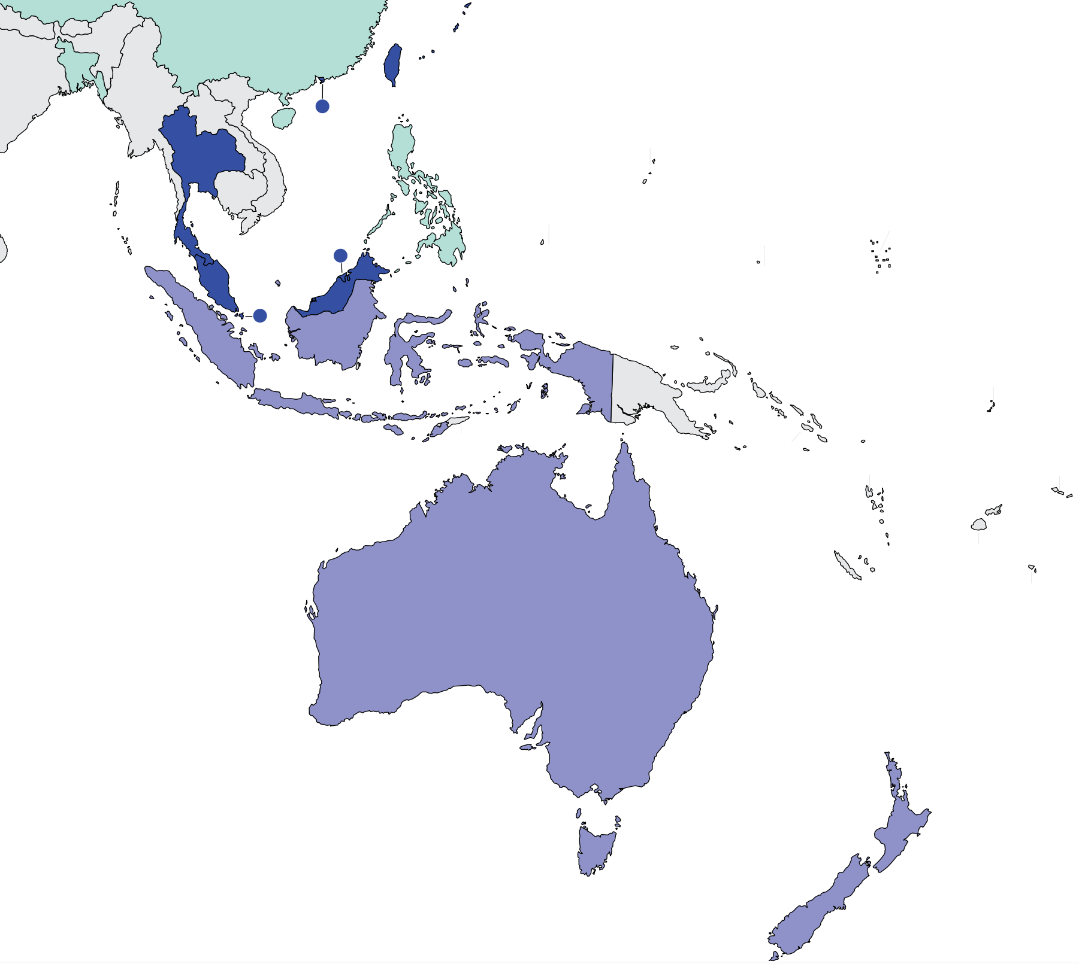
Burden of kidney failure
Prevalence of treated kidney failure
Country | Treated kidney failure |  | Chronic dialysis (HD+PD) |  | Chronic Hemodialysis |  | Chronic Peritoneal dialysis
 | Incidence | Prevalence | Incidence | Prevalence | Incidence | Prevalence | Incidence | Prevalence
Australia | 127 | 1054 | 119 | 549 | 119.1 | 453.65 | 46.38 | 94.95
Brunei Darussalam | 393 | 1673 | - | 1235 | - | 1064.6 | - | 170.4
Cambodia | - | - | - | - | - | - | - | -
Fiji | - | - | - | - | - | - | - | -
Indonesia | 306 | 973 | - | 973 | - | - | - | 3.3
Lao PDR | - | - | - | - | - | - | - | -
Malaysia | 259 | 1352 | 245.7 | 1295 | 185 | 970 | 25 | 95
Myanmar | - | - | - | - | - | - | - | 0
New Caledonia | - | - | - | - | - | - | - | -
New Zealand | 133 | 1009 | 119 | 583 | 108.1 | 484.32 | 69.67 | 181.62
Philippines | 172 | 319 | - | 314 | - | 69.2 | - | 10.1
Samoa | - | - | - | - | - | - | - | -
Singapore | 364.2 | 2030.3 | 364.2 | 2030.3 | 321.7 | 1761.8 | 42.5 | 268.5
Thailand | 377 | 2063 | 308.57 | 1969 | 168.01 | 823.5 | 140.56 | 369
Vietnam | - | - | - | 53.2 | - | 41.7 | - | 11.5
Treated kidney failure: all dialysis + transplant
*pmp (per million population)
Abbreviations: ESKD (end stage kidney disease)
Data source: Annual Report Thailand Renal Replacement Therapy 2015, ANZDATA 43rd Annual Report 2020, Jain et al. (JASN) 2012, Singapore Renal Registry Annual Report 2020, 2019 USRDS Annual Data Report
‘ – ’ : data not reported/unavailable
July 2023
14

Slide 15
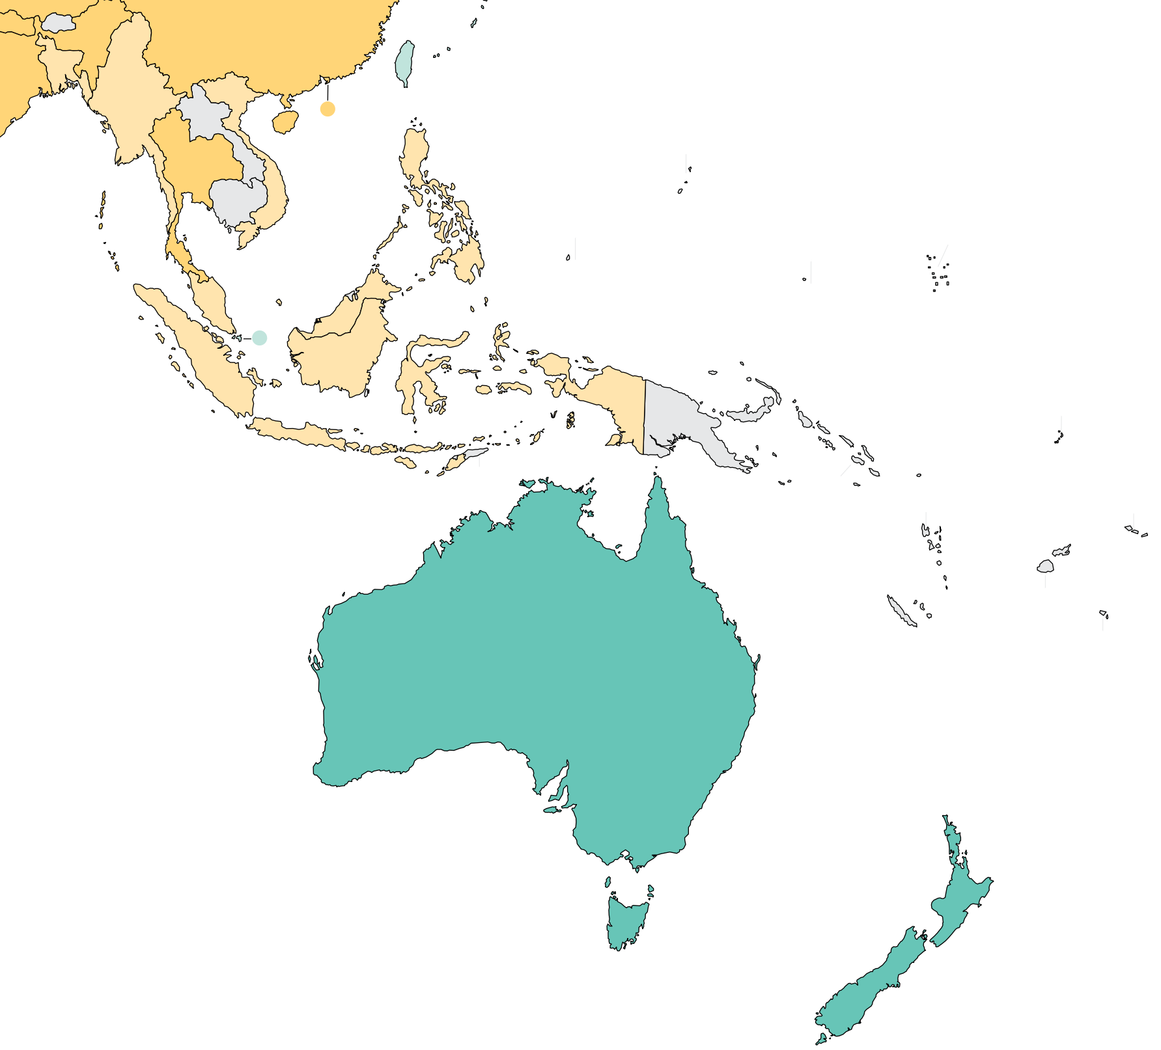
Burden of kidney failure (cont’d)
Country | Kidney transplantation
 | Incidence overall | Prevalence overall | Incidence of deceased donor | Incidence of living donor | Incidence of pre-emptive
Australia | 34.71 | 505 | 27.61 | 7.1 | -
Brunei Darussalam | - | - | - | - | -
Cambodia | - | - | - | - | -
Fiji | - | - | - | - | -
Indonesia | 1.98 | - | 0 | 1.98 | -
Lao PDR | - | - | - | - | -
Malaysia | 2.38 | 58 | 0.46 | 1.92 | -
Myanmar | 0.04 | - | 0 | 0.04 | -
New Caledonia | - | - | - | - | -
New Zealand | 38.96 | 426 | 20.83 | 18.13 | -
Philippines | 1.2 | 5 | 0.11 | 1.09 | -
Samoa | - | - | - | - | -
Singapore | 12.4 | 397.9 | 2.54 | 5.25 | -
Thailand | 10.2 | 93 | 8.28 | 1.92 | -
Vietnam | 2.89 | - | 0.1 | 2.79 | -
Incidence of kidney transplantation
* pmp (per million population)
Data source: Annual Report Thailand Renal Replacement 2015, ANZDATA 43rd Annual Report 2020, GODT database (http://www.transplant-observatory.org/data-charts-and-tables/), Singapore Renal Registry Annual Report 2020, 2019 USRDS Annual Data Report
‘ – ’ : data not reported/unavailable
July 2023
15

Slide 16
Annual cost of kidney replacement therapy components
Country | Hemodialysis | Peritoneal dialysis | Kidney Transplant (First year) | Kidney Transplant (later years) | HD/PD cost ratio
Australia | 44432 | 48026 | 71270 | 10287 | 0.93
Brunei Darussalam | 22845 | 8954 | - | - | 2.55
Cambodia | 10086 | - | - | - | -
Fiji | - | - | - | - | -
Indonesia | 8176 | 7664 | 14181 | 3216 | 1.07
Lao PDR | - | - | - | - | -
Malaysia | 10344 | 10610 | 30133 | 6466 | 0.98
Myanmar | 3644 | 5011 | 4680 | - | 0.73
New Caledonia | - | - | - | - | -
New Zealand | 29264 | 28211 | 42877 | 21212 | 1.04
Philippines | 5205 | 5205 | 8509 | 6098 | 1.00
Samoa | - | - | - | - | -
Singapore | 35545 | 17062 | 71621 | 17996 | 2.08
Thailand | 7758 | 6631 | 31554 | 14595 | 1.17
Vietnam | 7809 | 7809 | 4978 | - | 1.00
*Cost is in $US 2021
Abbreviations: HD (hemodialysis), PD (peritoneal dialysis)
Data source: Ashton & Marshall (2007), Bavanandan et al. (2015), Bhargava et al. (2021), Hyodo et al. (2020), Khan et al. (2022), Kristina et al. (2021), Lim & Tan (2021), Sitprija (2003), van der Tol et al. (2019), Vareesangthip et al. (2022), Yang et al. (2016), Ying et al. (2020)
‘ – ’ : data not reported/unavailable
July 2023
16

Slide 17
Country level scorecard
Country |  | Availability of KRT |  |  | Availability of CKM |  | Funding for Medications |  |  | Availability of Distribution of Registry |  |  |  | Advocacy Group |  |  | Nephrology Workforce (PMP)
 |  | HD | PD | Kidney transplantation | Shared decision | Choice restricted (limited) | CKD | Dialysis | Kidney transplantation | CKD | Dialysis | Kidney transplantation | AKI | CKD | AKI | RRT | Nephrologist | Nephrologist trainees
American Samoa | 2019
 | 2023
Australia | 2019 |  |  |  |  |  |  |  |  |  |  |  |  |  |  |  | 21.30 | 5.20
 | 2023 |  |  |  |  |  |  |  |  |  |  |  |  |  |  |  | 23.11 | 5.74
Brunei Darussalam | 2019 |  |  |  |  |  |  |  |  |  |  |  |  |  |  |  | 28.85 | 11.10
 | 2023 |  |  |  |  |  |  |  |  |  |  |  |  |  |  |  | 12.55 | 6.28
Cambodia | 2019 |  |  |  |  |  |  |  |  |  |  |  |  |  |  |  | 0.91 | 0.30
 | 2023 |  |  |  |  |  |  |  |  |  |  |  |  |  |  |  | 1.02 | 0.30
Fiji | 2019 |  |  |  |  |  |  |  |  |  |  |  |  |  |  |  | 1.08 | 1.08
 | 2023 |  |  |  |  |  |  |  |  |  |  |  |  |  |  |  | 3.18 | 1.06
Indonesia | 2019 |  |  |  |  |  |  |  |  |  |  |  |  |  |  |  | 0.49 | 0.23
 | 2023 |  |  |  |  |  |  |  |  |  |  |  |  |  |  |  | 0.80 | 0.20
Lao PDR | 2019 |  |  |  |  |  |  |  |  |  |  |  |  |  |  |  |  | 11.34
 | 2023 |  |  |  |  |  |  |  |  |  |  |  |  |  |  |  | 1.03 | 1.03
Malaysia | 2019 |  |  |  |  |  |  |  |  |  |  |  |  |  |  |  | 5.66 | 1.10
 | 2023 |  |  |  |  |  |  |  |  |  |  |  |  |  |  |  | 5.90 | 0.89
Myanmar | 2019 |  |  |  |  |  |  |  |  |  |  |  |  |  |  |  | 0.49 | 0.31
 | 2023 |  |  |  |  |  |  |  |  |  |  |  |  |  |  |  | 0.61 | 0.26
New Caledonia | 2019 |  |  |  |  |  |  |  |  |  |  |  |  |  |  |  | 40.67 | 0.00
 | 2023 |  |  |  |  |  |  |  |  |  |  |  |  |  |  |  | 33.65 | 6.73
Abbreviations
AKI: acute kidney injury
CKD: chronic kidney disease
CKM: conservative kidney management
HD: Hemodialysis
Nephrologist density | <1.2 PMP | 1.2 – 10.0 PMP | 10.1 – 22.9 PMP | >22.9 PMP
Nephrology trainees density | <0.3 PMP | 0.3 – 1.4 PMP | 1.5-3.7 PMP | >3.7 PMP
KRT: kidney replacement therapy
PD: Peritoneal Dialysis
RRT: renal replacement therapy
Yes | No | N/A

Slide 18
Country level scorecard
Country |  | Availability of KRT |  |  | Availability of CKM |  | Funding for Medications |  |  | Availability of Distribution of Registry |  |  |  | Advocacy Group |  |  | Nephrology Workforce (PMP)
 |  | HD | PD | Kidney transplantation | Shared decision | Choice restricted (limited) | CKD | Dialysis | Kidney transplantation | CKD | Dialysis | Kidney transplantation | AKI | CKD | AKI | RRT | Nephrologist | Nephrologist trainees
New Zealand | 2019 |  |  |  |  |  |  |  |  |  |  |  |  |  |  |  | 15.40 | 4.51
 | 2023 |  |  |  |  |  |  |  |  |  |  |  |  |  |  |  | 12.86 | 3.96
Papua New Guinea | 2019
 | 2023 |  |  |  |  |  |  |  |  |  |  |  |  |  |  |  | 0.10 | 0.10
Philippines | 2019 |  |  |  |  |  |  |  |  |  |  |  |  |  |  |  | 5.67 | 0.85
 | 2023 |  |  |  |  |  |  |  |  |  |  |  |  |  |  |  | 8.87 | 1.22
Samoa | 2019 |  |  |  |  |  |  |  |  |  |  |  |  |  |  |  | 4.97 | 0.00
 | 2023 |  |  |  |  |  |  |  |  |  |  |  |  |  |  |  | 0.00 | 0.00
Singapore | 2019 |  |  |  |  |  |  |  |  |  |  |  |  |  |  |  | 16.59 | 3.50
 | 2023 |  |  |  |  |  |  |  |  |  |  |  |  |  |  |  | 25.33 | 3.88
Solomon Islands | 2019
 | 2023 |  |  |  |  |  |  |  |  |  |  |  |  |  |  |  | 0.00 | 0.00
Thailand | 2019 |  |  |  |  |  |  |  |  |  |  |  |  |  |  |  | 11.66 | 1.31
 | 2023 |  |  |  |  |  |  |  |  |  |  |  |  |  |  |  | 12.92 | 1.44
Vanuatu | 2019
 | 2023 |  |  |  |  |  |  |  |  |  |  |  |  |  |  |  | 0.00 | 0.00
Vietnam | 2019 |  |  |  |  |  |  |  |  |  |  |  |  |  |  |  | 3.09 | 0.52
 | 2023 |  |  |  |  |  |  |  |  |  |  |  |  |  |  |  |  | 0.29
Abbreviations
AKI: acute kidney injury
CKD: chronic kidney disease
CKM: conservative kidney management
HD: Hemodialysis
Nephrologist density | <1.2 PMP | 1.2 – 10.0 PMP | 10.1 – 22.9 PMP | >22.9 PMP
Nephrology trainees density | <0.3 PMP | 0.3 – 1.4 PMP | 1.5-3.7 PMP | >3.7 PMP
KRT: kidney replacement therapy
PD: Peritoneal Dialysis
RRT: renal replacement therapy
Yes | No | N/A

Slide 19
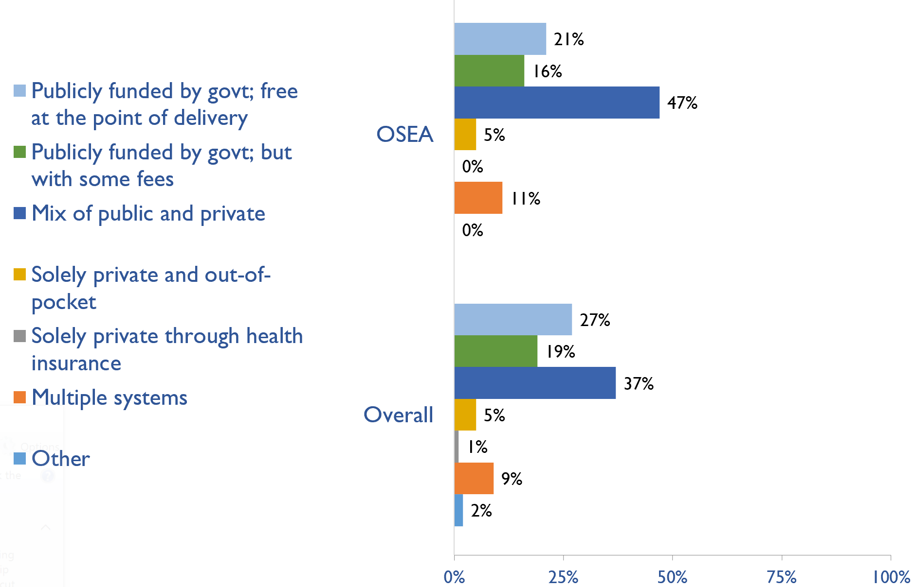
Funding for non-dialysis CKD
Country | Publicly funded by govt; free at the point of delivery | Publicly funded by govt but with some fees | Mix of public and private | Solely private and out-of-pocket | Solely private through health insurance | Multiple systems | Other
American Samoa | X
Australia | X
Brunei Darussalam | X
Cambodia |  |  |  |  |  | X
Fiji |  |  | X
Indonesia |  |  | X
Lao PDR |  | X
Malaysia |  |  | X
Myanmar |  |  | X
New Caledonia |  |  | X
New Zealand |  | X
Papua New Guinea |  |  |  | X
Philippines |  |  | X
Samoa |  |  | X
Singapore |  |  |  |  |  | X
Solomon Islands | X
Thailand |  | X
Vanuatu |  |  | X
Vietnam |  |  | X
X : Yes
July 2023
19

Slide 20
Funding for kidney replacement therapy (KRT)
Country | Publicly funded (free) |  |  |  | Publicly funded (some fees) |  |  |  | Mixed |  |  |  | Solely private (out-of-pocket) |  |  |  | Solely private (health insurance) |  |  |  | Multiple systems |  |  |  | N/A |  |  |  | Other
 | AKI | HD | PD | TX | AKI | HD | PD | TX | AKI | HD | PD | TX | AKI | HD | PD | TX | AKI | HD | PD | TX | AKI | HD | PD | TX | AKI | HD | PD | TX | AKI | HD | PD | TX
American Samoa
Australia | X | X |  | X |  |  |  |  |  |  | X
Brunei Darussalam | X | X | X | X
Cambodia |  |  |  |  |  |  |  |  |  |  |  |  |  |  | X | X |  |  |  |  | X | X
Fiji |  |  |  |  |  |  |  |  |  |  |  |  |  |  | X |  |  |  |  | X | X | X
Indonesia | X |  |  |  |  | X | X | X
Lao PDR |  |  |  |  | X | X |  |  |  |  |  |  |  |  |  |  |  |  |  |  |  |  |  |  |  |  | X | X
Malaysia |  |  |  |  |  |  |  |  | X | X | X | X
Myanmar | X |  |  |  |  |  |  |  |  | X |  | X |  |  | X
New Caledonia |  |  |  |  |  |  |  |  | X | X | X | X
New Zealand | X | X | X | X
Papua New Guinea |  |  |  |  |  |  |  |  |  |  |  |  | X | X | X | X
Philippines |  |  |  |  | X | X | X |  |  |  |  |  |  |  |  |  |  |  |  |  |  |  |  | X
Samoa |  |  |  |  |  | X |  |  | X |  |  |  |  |  |  |  |  |  |  |  |  |  |  |  |  |  | X | X
Singapore |  |  |  |  |  |  |  |  | X |  |  | X |  |  |  |  |  |  |  |  |  | X | X
Solomon Islands |  |  |  |  |  |  |  |  |  |  |  |  |  |  |  |  |  |  |  |  |  |  |  |  | X | X | X | X
Thailand |  |  |  |  | X | X | X | X
Vanuatu |  |  |  |  |  |  |  |  |  |  |  |  | X | X | X | X
Vietnam |  |  |  |  | X | X | X | X
X : Yes
Abbreviations: AKI (Acute kidney injury), HD (hemodialysis), PD (peritoneal dialysis), TX (transplant medications)
July 2023
20
Notes:
A1.2.1. Acute dialysis for AKI (hemodialysis or peritoneal dialysis) - (N, %)

Slide 21
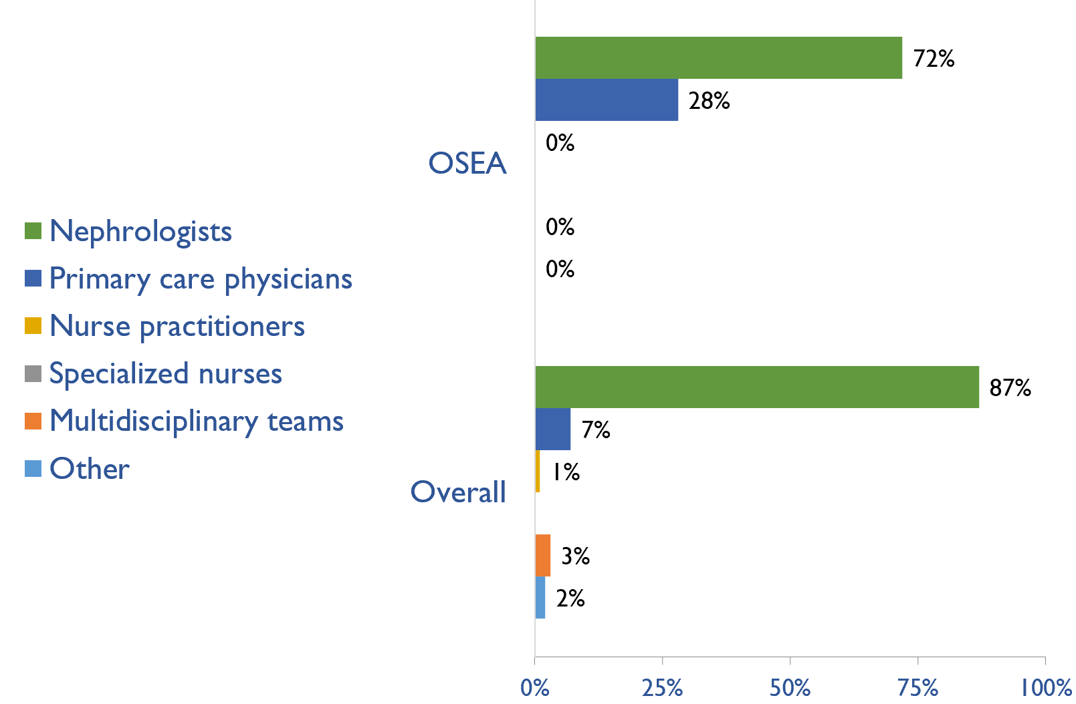
Providers primarily responsible for kidney failure care
Country | Nephrologists | Primary care physicians | Nurse practitioners or specialized nurses | Multidisciplinary teams | Health officers/ extension workers | Other
American Samoa
Australia | X
Brunei Darussalam | X
Cambodia | X
Fiji | X
Indonesia | X
Lao PDR | X
Malaysia | X
Myanmar | X
New Caledonia | X
New Zealand | X
Papua New Guinea |  | X
Philippines | X
Samoa |  | X
Singapore | X
Solomon Islands |  | X
Thailand | X
Vanuatu |  | X
Vietnam |  | X
X : Yes
July 2023
21

Slide 22
Shortage of kidney failure care providers
Country | Nephrologists | Pediatric nephrologists | Transplant surgeons | Surgeons (HD access) | Surgeons (PD access) | Dietitians | Laboratory technicians | Radiologists (ultrasound) | Vascular access coordinators
Australia
Brunei Darussalam
Cambodia
Fiji
Indonesia
Lao PDR
Malaysia
Myanmar
New Caledonia
New Zealand
Philippines
Samoa
Singapore
Thailand
Vietnam
No shortage
Shortage
June 2023
22

Slide 23
Shortage of kidney failure care providers
Country | Counsellors/ psychologists | Transplant coordinators | Dialysis nurses | Renal nurses | Dialysis technicians | Social workers | Palliative care physicians | Kidney supportive care nurses | No shortage
Australia
Brunei Darussalam
Cambodia
Fiji
Indonesia
Lao PDR
Malaysia
Myanmar
New Caledonia
New Zealand
Philippines
Samoa
Singapore
Thailand
Vietnam
No shortage
Shortage
June 2023
23

Slide 24
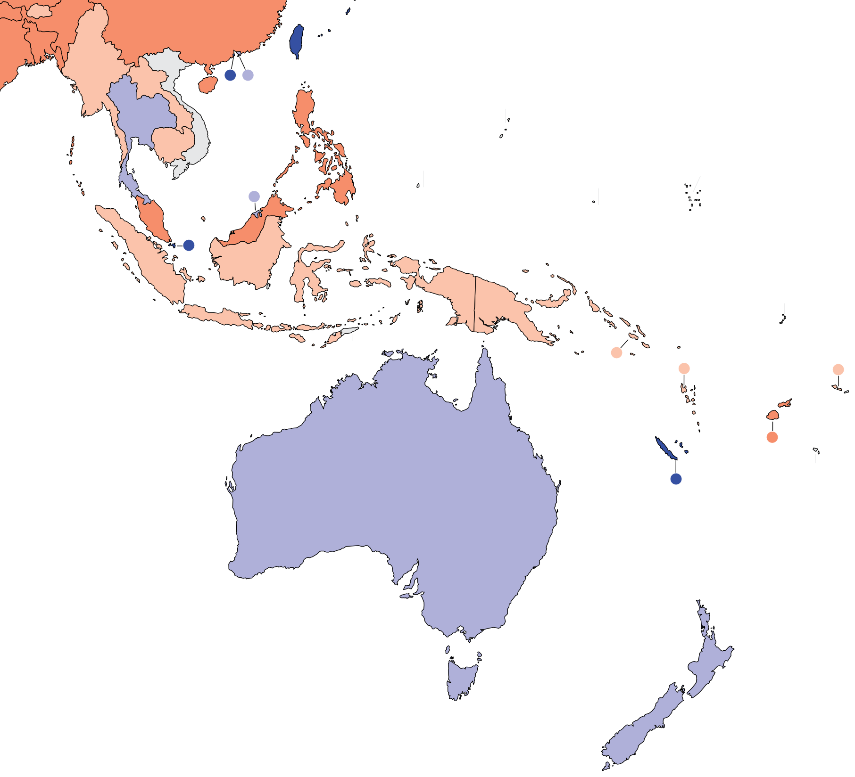
Prevalence of nephrologists and trainees
Nephrologists
Country | Nephrologists PMP | Nephrology trainees PMP
American Samoa | - | -
Australia | 23.11 | 5.74
Brunei Darussalam | 12.55 | 6.28
Cambodia | 1.02 | 0.30
Fiji | 3.18 | 1.06
Indonesia | 0.80 | 0.20
Lao PDR | 1.03 | 1.03
Malaysia | 5.90 | 0.89
Myanmar | 0.61 | 0.26
New Caledonia | 33.65 | 6.73
New Zealand | 12.86 | 3.96
Papua New Guinea | 0.10 | 0.10
Philippines | 8.87 | 1.22
Samoa | 0.00 | 0.00
Singapore | 25.33 | 3.88
Solomon Islands | 0.00 | 0.00
Thailand | 12.92 | 1.44
Vanuatu | 0.00 | 0.00
Vietnam | - | 0.29
‘ – ’ : data not reported/unavailable
July 2023
24

Slide 25
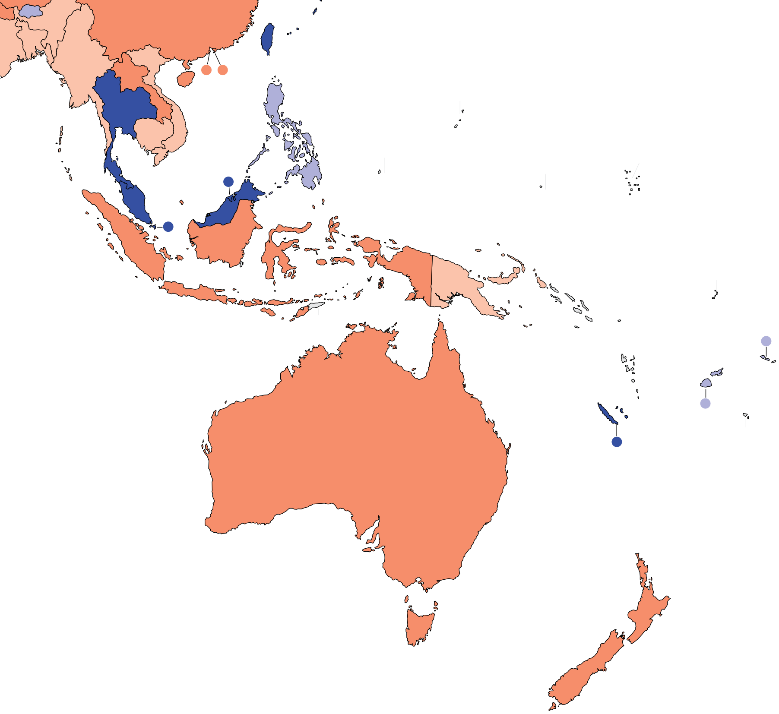
Capacity for chronic dialysis (HD)
Chronic HD centers
Country | Chronic HD Centres (PMP)
American Samoa | -
Australia | 3.56
Brunei Darussalam | 14.64
Cambodia | 0.90
Fiji | 8.48
Indonesia | 3.75
Lao PDR | 2.45
Malaysia | 27.16
Myanmar | 0.70
New Caledonia | 40.38
New Zealand | 3.17
Papua New Guinea | 0.21
Philippines | 7.31
Samoa | 9.70
Singapore | 13.51
Solomon Islands | -
Thailand | 12.92
Vanuatu | -
Vietnam | 0.96
Chronic HD services are available in 16 (89%) countries of the region
The OSEA average of HD treatment centers is 9.36 pmp
July 2023
25

Slide 26
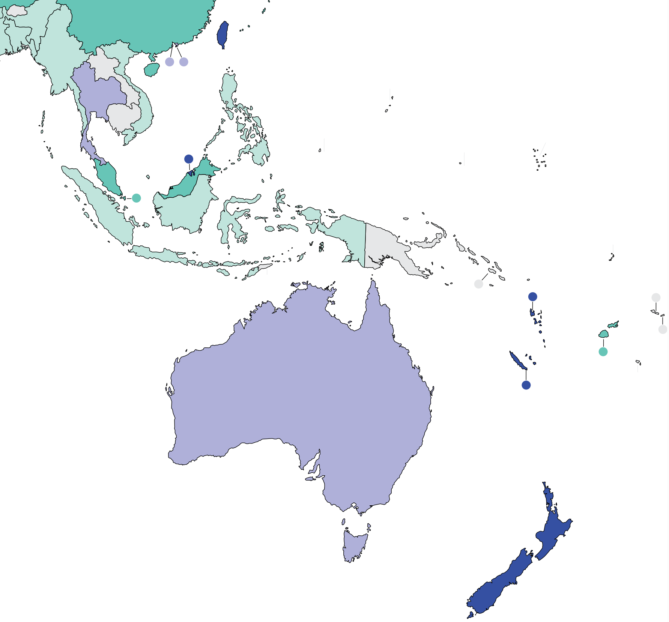
Capacity for chronic dialysis (PD)
Chronic PD centers
Country | Chronic PD Centres (PMP)
American Samoa | -
Australia | 2.33
Brunei Darussalam | 4.18
Cambodia | -
Fiji | 1.06
Indonesia | 0.14
Lao PDR | -
Malaysia | 1.48
Myanmar | 0.02
New Caledonia | 3.37
New Zealand | 3.17
Papua New Guinea | -
Philippines | 0.45
Samoa | -
Singapore | 1.35
Solomon Islands | -
Thailand | 1.72
Vanuatu | 3.25
Vietnam | 0.29
Chronic PD services are available in 13 (72%) countries of the region
The OSEA average of PD treatment centers is 1.75 pmp
‘ – ’ : data not reported/unavailable
July 2023
26

Slide 27
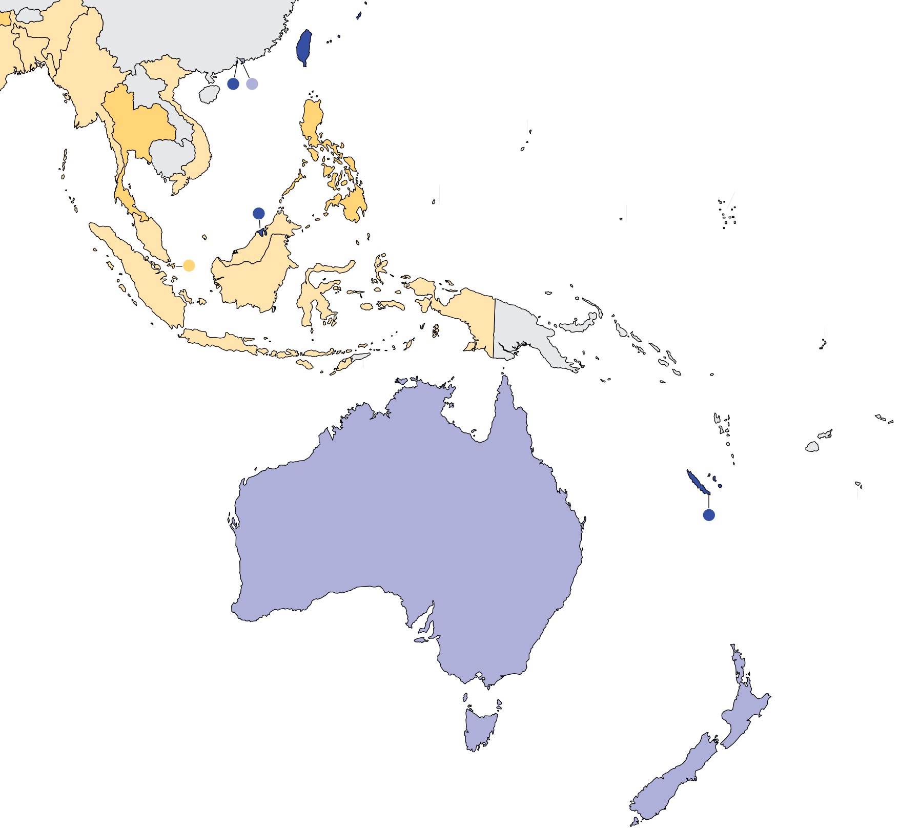
Capacity for Kidney Transplantation
Country | Kidney Transplantation Availability | Transplant Centers (PMP)
American Samoa
Australia | X | 0.57
Brunei Darussalam | X | 2.09
Cambodia
Fiji
Indonesia | X | 0.03
Lao PDR
Malaysia | X | 0.18
Myanmar | X | 0.12
New Caledonia | X | 3.37
New Zealand | X | 0.59
Papua New Guinea
Philippines | X | 0.28
Samoa
Singapore | X | 0.34
Solomon Islands
Thailand | X | 0.43
Vanuatu
Vietnam | X | 0.17
Kidney transplantation centers
Kidney transplantation services are available in 11 (61%) countries of the region
The OSEA average of Kidney transplantation centers is 0.74 pmp
July 2023
X : Yes
‘ – ’ : data not reported/unavailable
27

Slide 28
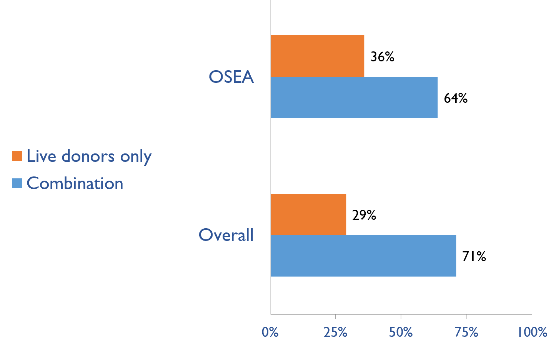
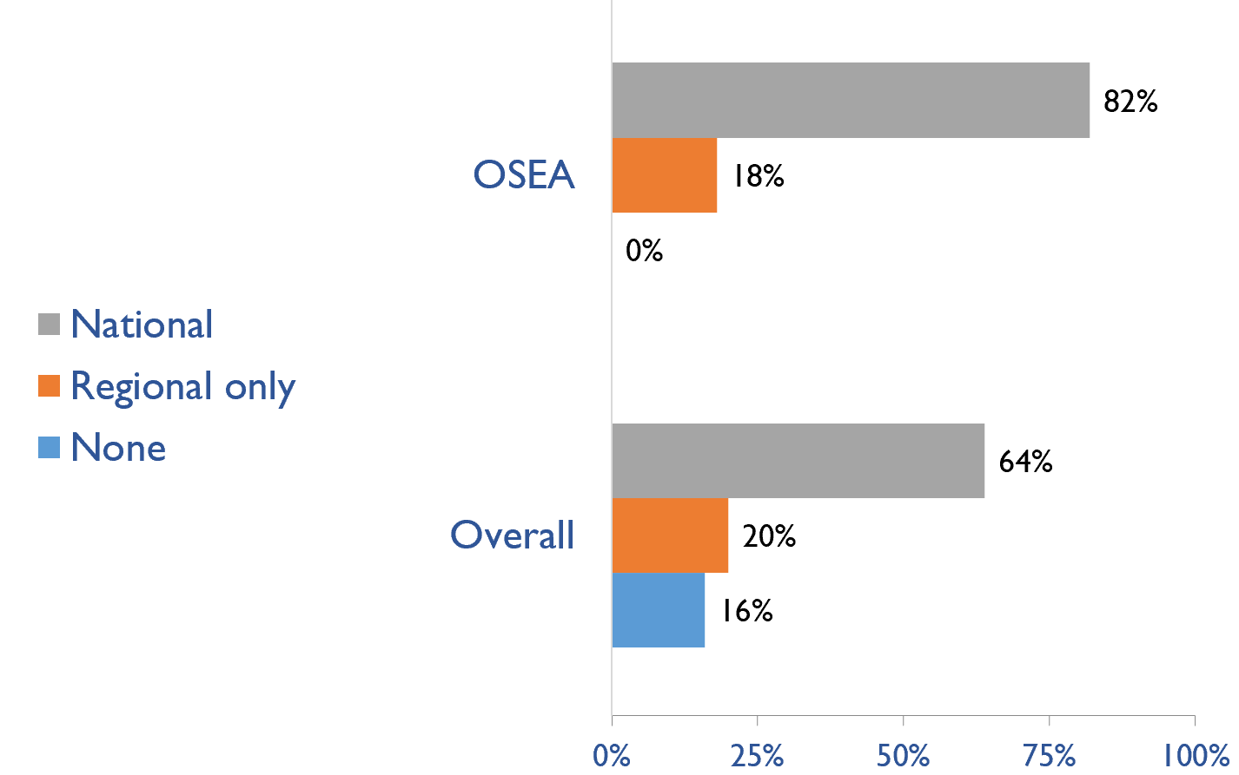
Capacity for Kidney Transplantation (cont’d)
Country | Donor Type |  | Transplant waitlist
 | Live donors only | Combination | National | Regional only | None
American Samoa
Australia |  | X | X
Brunei Darussalam | X |  | X
Cambodia
Fiji
Indonesia | X |  | X
Lao PDR
Malaysia |  | X | X
Myanmar | X |  |  | X
New Caledonia |  | X |  | X
New Zealand |  | X | X
Papua New Guinea
Philippines |  | X | X
Samoa
Singapore |  | X | X
Solomon Islands
Thailand |  | X | X
Vanuatu
Vietnam | X |  | X
Transplant donor type
Transplant waitlist
X : Yes
July 2023
28

Slide 29
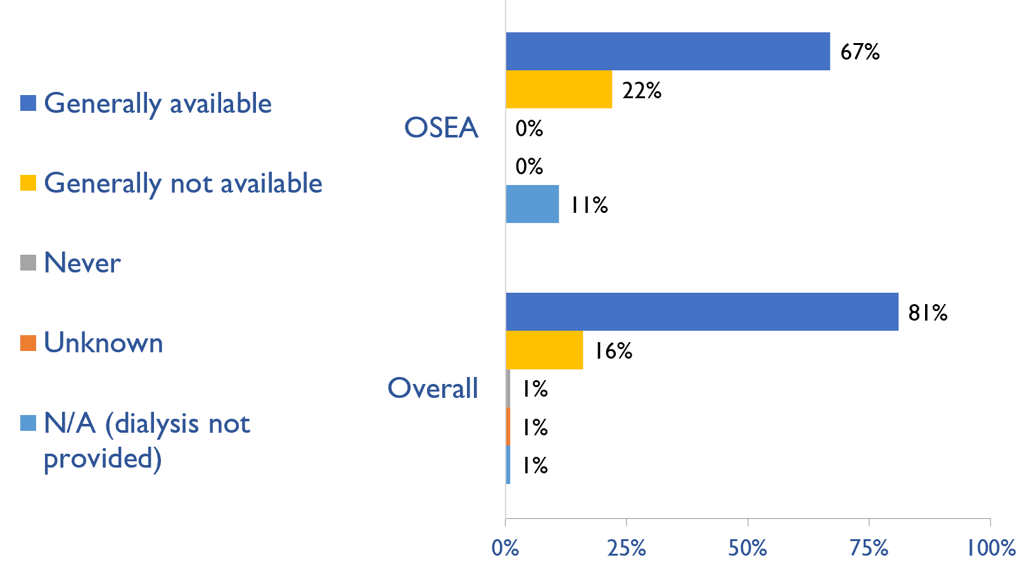
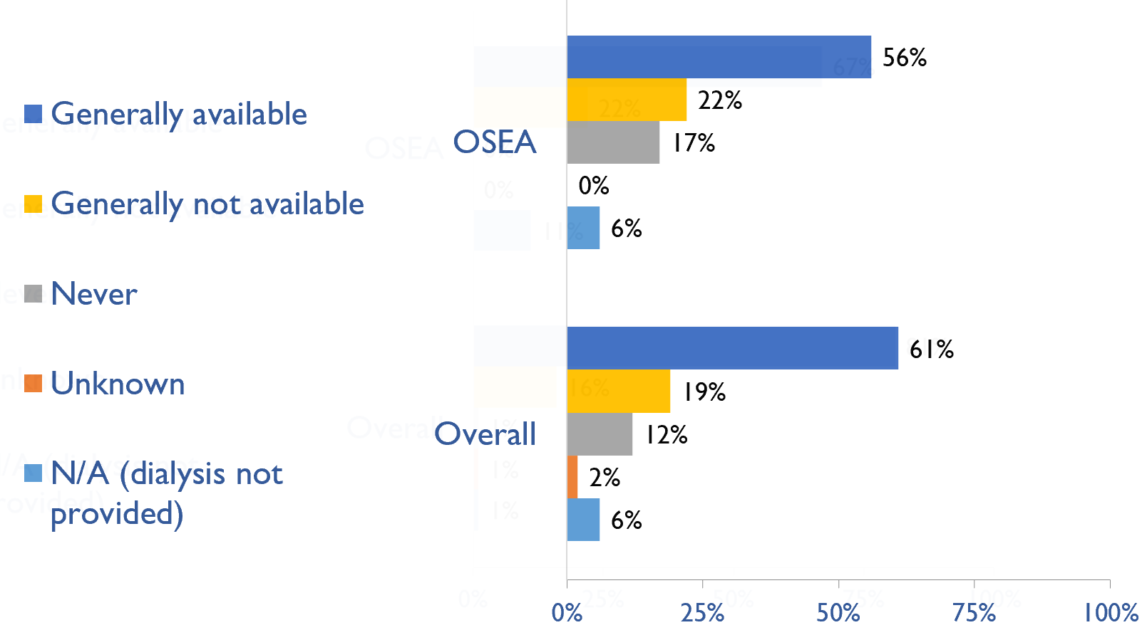
Availability of services within dialysis care
HD frequency
Country | HD frequency a center-based service that involves treatment 3x week/3-4x hours |  |  |  |  | PD frequency ability to do adequate exchanges 3-4x day (or equivalent cycles on automated PD)
 | Generally available | Generally not available | Never | Unknown | N/A (dialysis not provided) | Generally available | Generally not available | Never | Unknown | N/A (dialysis not provided)
American Samoa
Australia | X |  |  |  |  | X
Brunei Darussalam | X |  |  |  |  | X
Cambodia | X |  |  |  |  |  | X
Fiji | X |  |  |  |  |  | X
Indonesia | X |  |  |  |  | X
Lao PDR |  | X |  |  |  |  |  | X
Malaysia | X |  |  |  |  | X
Myanmar |  | X |  |  |  | X
New Caledonia | X |  |  |  |  | X
New Zealand | X |  |  |  |  | X
Papua New Guinea |  | X |  |  |  |  |  | X
Philippines | X |  |  |  |  | X
Samoa | X |  |  |  |  |  |  | X
Singapore | X |  |  |  |  | X
Solomon Islands |  |  |  |  | X |  |  |  |  | X
Thailand | X |  |  |  |  | X
Vanuatu |  |  |  |  | X |  | X
Vietnam |  | X |  |  |  |  | X
PD frequency
X : Yes
July 2023
29

Slide 30
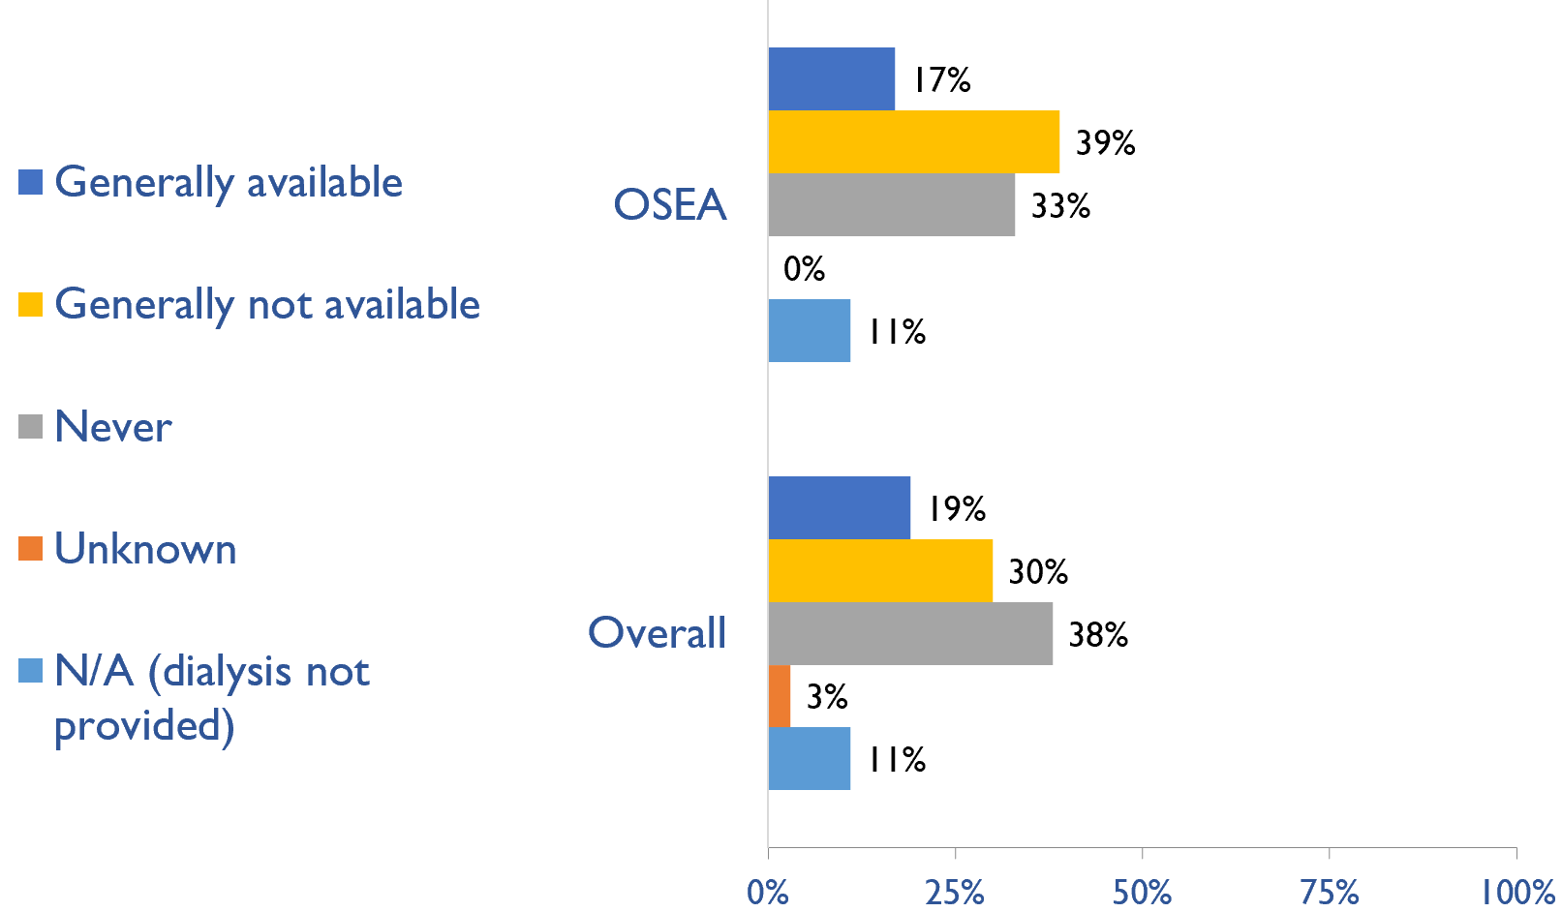
Availability of Home hemodialysis
Country | Availability of Home hemodialysis
 | Generally available | Generally not available | Never | Unknown | N/A (dialysis not provided)
American Samoa
Australia | X
Brunei Darussalam |  |  | X
Cambodia |  | X
Fiji |  |  | X
Indonesia |  | X
Lao PDR |  |  | X
Malaysia |  | X
Myanmar |  | X
New Caledonia |  |  | X
New Zealand | X
Papua New Guinea |  |  | X
Philippines | X
Samoa |  |  | X
Singapore |  | X
Solomon Islands |  |  |  |  | X
Thailand |  | X
Vanuatu |  |  |  |  | X
Vietnam |  | X
X : Yes
July 2023
30

Slide 31
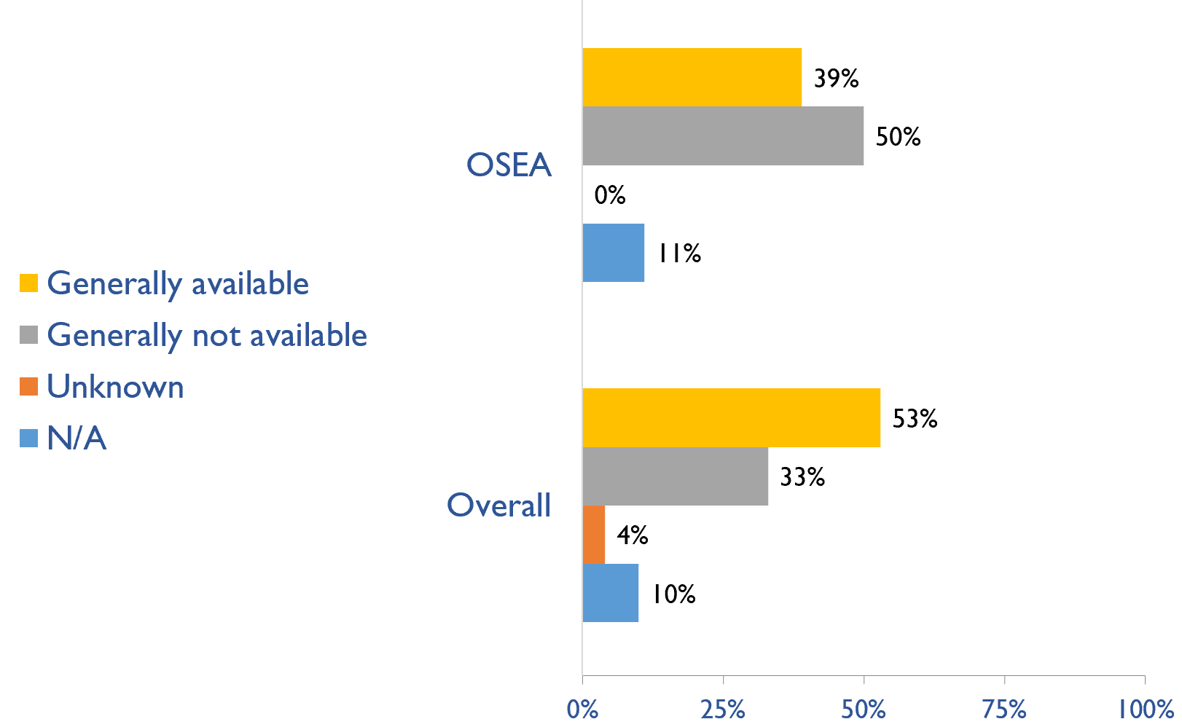
Capacity for conservative kidney management (CKM)
Country | Established conservative care that is chosen or medically advised
 | Generally available | Generally not available | Unknown | N/A (conservative care not available)
American Samoa
Australia | X
Brunei Darussalam | X
Cambodia |  | X
Fiji |  | X
Indonesia | X
Lao PDR |  | X
Malaysia | X
Myanmar | X
New Caledonia |  | X
New Zealand | X
Papua New Guinea |  | X
Philippines |  | X
Samoa |  | X
Singapore |  | X
Solomon Islands |  |  |  | X
Thailand | X
Vanuatu |  |  |  | X
Vietnam |  | X
X : Yes
July 2023
31

Slide 32
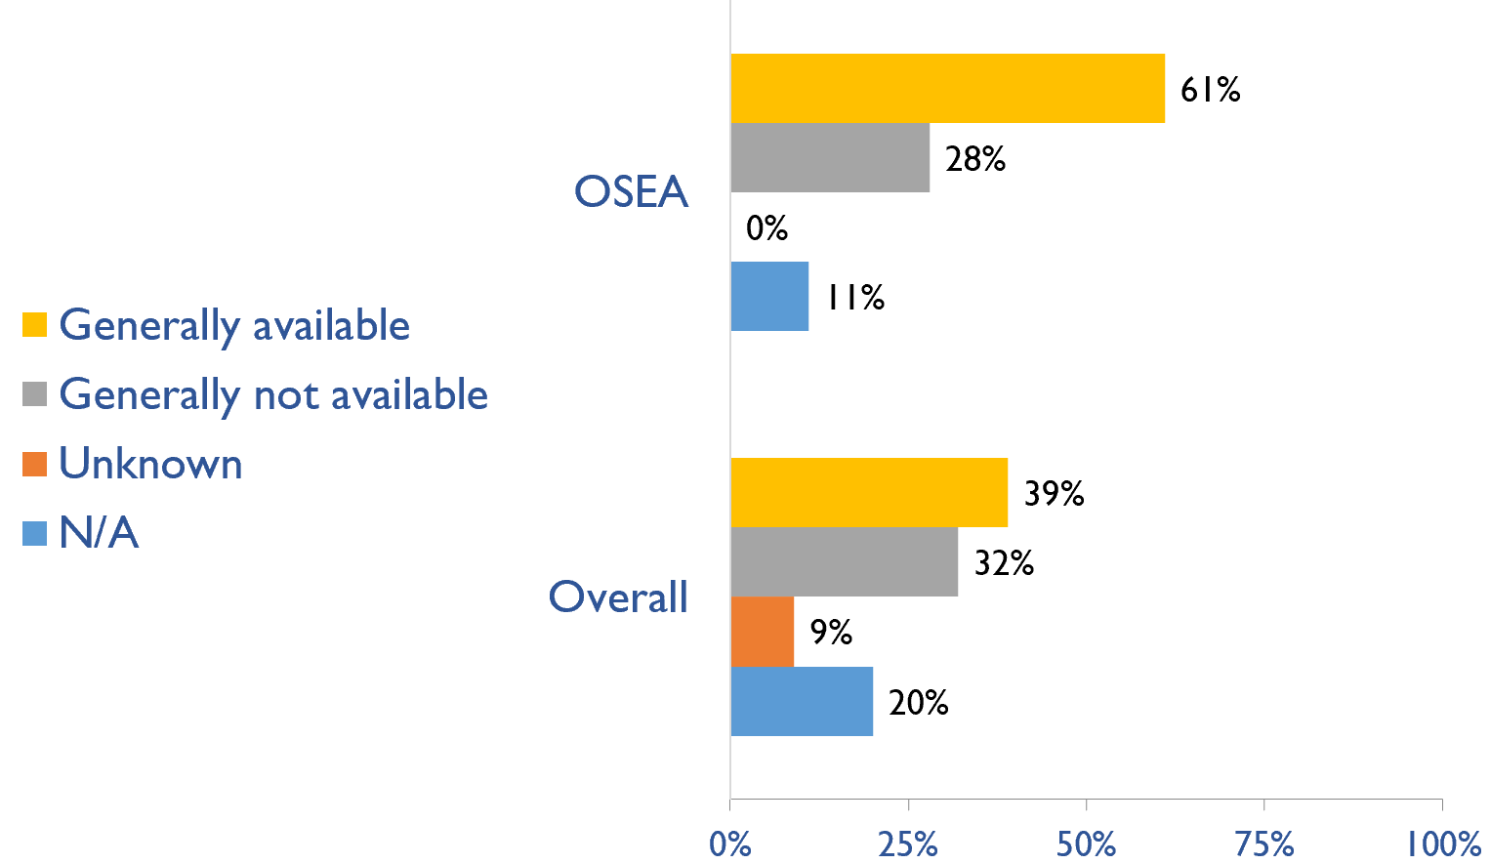
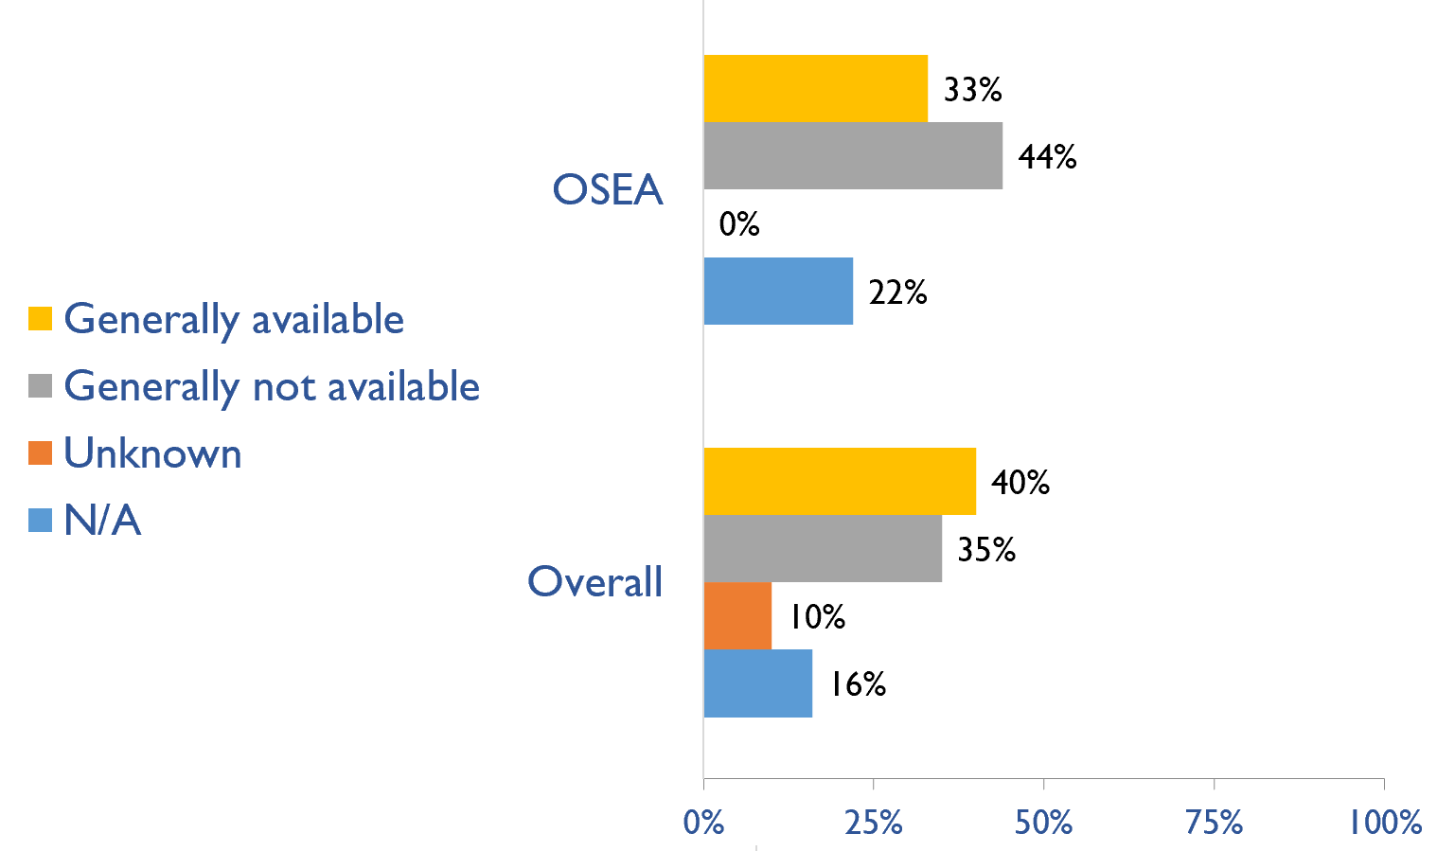
Capacity for conservative kidney management (CKM)
Where resource constraints to prevent or limit access to KRT
Country | where resource constraints to prevent or limit access to KRT |  |  |  | where there are no resource constraints to prevent or limit access to KRT
 | Generally available | Generally not available | Unknown | N/A (conservative care not available) | Generally available | Generally not available | Unknown | N/A (conservative care not available)
American Samoa
Australia | X |  |  |  | X
Brunei Darussalam | X |  |  |  | X
Cambodia | X |  |  |  | X
Fiji | X |  |  |  |  | X
Indonesia | X |  |  |  | X
Lao PDR |  | X |  |  |  | X
Malaysia | X |  |  |  | X
Myanmar | X |  |  |  | X
New Caledonia | X |  |  |  |  | X
New Zealand |  |  |  | X |  |  |  | X
Papua New Guinea |  | X |  |  |  | X
Philippines |  | X |  |  |  | X
Samoa |  | X |  |  |  |  |  | X
Singapore | X |  |  |  |  | X
Solomon Islands | X |  |  |  |  |  |  | X
Thailand | X |  |  |  |  | X
Vanuatu |  |  |  | X |  |  |  | X
Vietnam |  | X |  |  |  | X
Where there are no resource constraints to prevent or limit access to KRT
X : Yes
July 2023
32

Slide 33
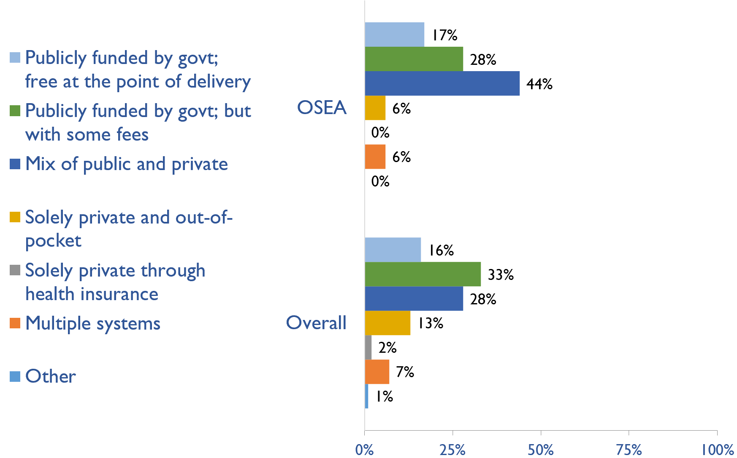
Funding for medications in CKD patients not on dialysis
Country | Publicly funded by govt; free at the point of delivery | Publicly funded by govt but with some fees at the point of delivery | Mix of public and private funding systems | Solely private and out-of-pocket | Solely private through health insurance providers | Multiple systems | Other
American Samoa
Australia |  | X
Brunei Darussalam | X
Cambodia |  |  |  |  |  | X
Fiji |  |  | X
Indonesia |  |  | X
Lao PDR |  | X
Malaysia |  |  | X
Myanmar |  |  | X
New Caledonia |  |  | X
New Zealand |  | X
Papua New Guinea |  |  |  | X
Philippines |  |  | X
Samoa |  | X
Singapore |  |  | X
Solomon Islands | X
Thailand |  | X
Vanuatu |  | X
Vietnam |  |  | X
X : Yes
July 2023
33

Slide 34
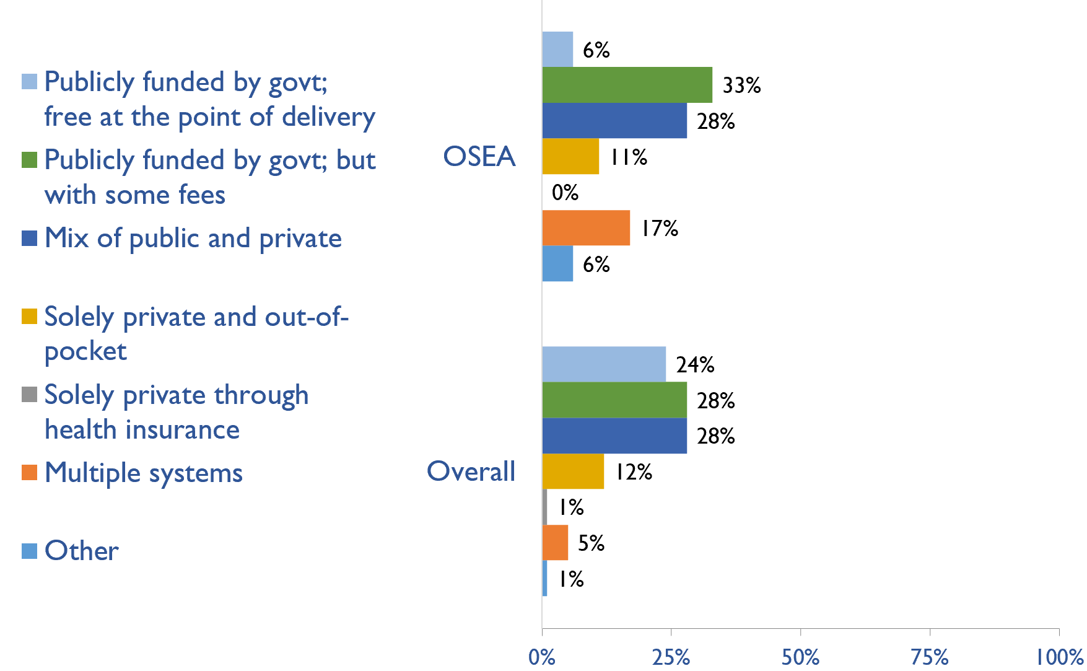
Funding for medications in all dialysis patients
Country | Publicly funded by govt; free at the point of delivery | Publicly funded by govt but with some fees at the point of delivery | Mix of public and private funding systems | Solely private and out-of-pocket | Solely private through health insurance providers | Multiple systems | Other
American Samoa
Australia |  | X
Brunei Darussalam | X
Cambodia |  |  |  |  |  | X
Fiji |  |  | X
Indonesia |  | X
Lao PDR |  | X
Malaysia |  |  | X
Myanmar |  |  | X
New Caledonia |  |  | X
New Zealand |  | X
Papua New Guinea |  |  |  | X
Philippines |  |  |  |  |  | X
Samoa |  | X
Singapore |  |  |  |  |  | X
Solomon Islands |  |  |  |  |  |  | X
Thailand |  | X
Vanuatu |  |  |  | X
Vietnam |  |  | X
X : Yes
July 2023
34

Slide 35
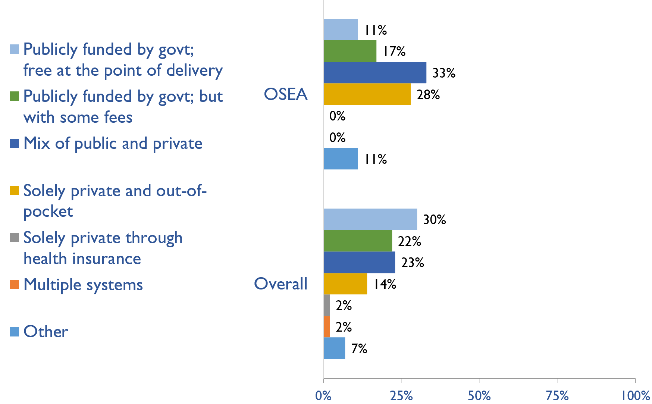
Funding for medications in all transplant patients
Country | Publicly funded by govt; free at the point of delivery | Publicly funded by govt but with some fees at the point of delivery | Mix of public and private funding systems | Solely private and out-of-pocket | Solely private through health insurance providers | Multiple systems | Other
American Samoa
Australia |  | X
Brunei Darussalam | X
Cambodia |  |  |  | X
Fiji |  |  |  | X
Indonesia | X
Lao PDR |  |  |  | X
Malaysia |  |  | X
Myanmar |  |  | X
New Caledonia |  |  | X
New Zealand |  | X
Papua New Guinea |  |  |  | X
Philippines |  |  | X
Samoa |  |  |  |  |  |  | X
Singapore |  |  | X
Solomon Islands |  |  |  |  |  |  | X
Thailand |  | X
Vanuatu |  |  |  | X
Vietnam |  |  | X
X : Yes
July 2023
35

Slide 36
Availability of official registry
Country | Official Registry
 | CKD | Dialysis | Transplant | AKI | Conservative care
American Samoa
Australia |  | X | X
Brunei Darussalam |  | X | X
Cambodia
Fiji |  | X
Indonesia |  | X | X
Lao PDR
Malaysia |  | X | X
Myanmar |  | X
New Caledonia |  | X | X
New Zealand |  | X | X
Papua New Guinea
Philippines |  | X | X
Samoa
Singapore |  | X | X
Solomon Islands
Thailand |  | X | X
Vanuatu
Vietnam
X : Yes
July 2023
36

Slide 37
Summary of Findings
In summary, the 2023 ISN-GKHA highlights several important findings for OSEA.
KRT availability, access, and quality is high.
  Only Solomon Islands and Vanuatu do not have HD services. PD and KT services were variably available.
  Capacity to provide adequate frequency of HD i.e., three times weekly for 3 – 4 hours per session, was available in 67% of countries.
  Capacity to provide adequate PD exchanges i.e., three to four exchanges per day was available in 56% of countries.
  Home HD was only available in Australia, New Zealand, and Philippines.
CKM is available and predominately chosen or medically advised.
  Conservative kidney management (CKM) established through shared-decision making was available in 7 (39%) countries.
  Choice restricted CKM (where resource constraints prevent or limit access) was only available in 11 (61%) countries.
  Choice restricted CKM (where no resource constraints prevent or limit access) was available in 6 (33%) of countries.
Government funding for kidney care services and medication is low.
  Medications for ND-CKD are funded publicly and free in 2 (17%) countries (Brunei and Solomon Islands).
  Medications for dialysis patients (HD or PD) are free in only Brunei Darussalam, while publicly funded with some fees was used in 6 (33%) countries.
  KT medications are funded through public funds and free in 2 (11%) (Brunei and Indonesia)
  Reimbursement that is free for acute dialysis, chronic HD, and chronic PD were available in 5 (26.3%), 3 (15.8%), and 2 (13.3%) countries, respectively.

Slide 38
Summary of Findings (cont’d)
Most have registries for advanced kidney disease, few for CKD or AKI
  Availability of kidney registries varied across countries in the region.
  ND-CKD registry was not available in the region. However, 11 (57.9%) and 9 (47.4%) countries, respectively, have a dialysis and KT registries. Acute dialysis and CKM registries are not available in the region.
Some workforce limitations are present.
  The median prevalence of nephrologists in OSEA was 3.2 pmp (global median of 11.75 pmp). New Caledonia had the highest density of nephrologists (33.7 pmp) while Papua New Guinea had the lowest (0.1 pmp). Samoa, Solomon Islands, and Vanuatu do not have nephrologists.
  Overall, median prevalence of nephrology trainees was 0.96 pmp; New Caledonia had the highest density of nephrology trainees (6.73 pmp) while Papua New Guinea had the lowest (0.10 pmp).
  Approximately three quarters of countries reported shortages across different cadres of healthcare workers. Such shortages were reported for nephrologists (74%), paediatric nephrologists (79%), transplant surgeons (79%), transplant coordinators (74%), dialysis nurses (74%), and kidney supportive care nurses (74%).
Moderate advocacy for kidney disease in OSEA.
  Advocacy groups for CKD, kidney failure and KRT remains low in the region.

Slide 39
Implications
There are important implications to consider. Based on these survey findings, key recommendations to drive future activities for optimizing kidney care globally are proposed:
Increase health care financing for kidney failure prevention and management.
  While resource limitations are an obvious barrier, focusing on preventing kidney failure through appropriate hypertension and diabetes management may be more cost-effective overall. Government funding to cover medication costs may allow more patients to treat earlier stage CKD, thereby preventing the need for more costly kidney failure treatment and the obvious burden this has on patients’ wellbeing.
Address workforce shortages through multidisciplinary teams and telemedicine
  Shortages of nephrologists, surgeons, dialysis nurses, and other key allied health professionals were noted across most countries. Similarly, simply producing more nephrologists may not be feasible or appropriate, and sharing the workload across multiple providers will not only promote the use of multidisciplinary teams but further, allow for more and better care delivery across more patients. Telemedicine may help particularly in addressing gaps in care among rural patients and enhancing capacity through training programs such as ISN Fellowship, visiting ambassador programs, etc.

Slide 40
Implications (cont’d)
Incorporate the collection and reporting of quality indicators in kidney failure care.
  Measuring and reporting on key quality indicators is an important driver in healthcare improvement. Ensuring facilities are supported with information systems that allow for the systematic measurement and reporting of indicators is a first key step to increasing the rate of monitoring among countries. Further, understanding if or how the collection and reporting of indicators are being used to improve care is needed.
Expand health information systems to prevent and manage kidney failure.
  Similarly, good quality HIS are vital for kidney disease management within a country. A lack of data on disease prevalence, incidence, resource use, and quality of care limits government and provider ability to monitor and evaluate the care provided as well as predicts appropriate resource allocation so that sufficient facilities, medicines, and healthcare professionals are trained and available.
Promote kidney failure prevention and treatment by implementing policies, strategies, and advocacy, and mitigating barriers.
  Lastly, policies and strategies are important for consistent approaches within a country for optimal care delivery, as well as for accountability, leadership, and knowledge exchange. Advocacy may help promote the increase of government prioritization and further, public awareness of how to prevent and manage kidney disease. Without acknowledging and mitigating barriers, it would be a challenge to achieve of successes out of these recommendations. Competing priorities and needs (for example, clean water supply and basic sanitation, maternal and child health, malnutrition, etc.) represent formidable barriers that can limit implementation of the recommended strategies in the region.

Slide 41







www.theisn.org
Global Operations Center
Americas Operations Center
Avenue des Arts 1-2
1210 Brussels, Belgium
340 North Avenue 3rd Floor
Cranford, NJ 07016-2496, United States
+ 32 2 808 04 20
+1 904 345 0866
info@theisn.org
info@theisn.org
Follow us

