Slide 1
Advancing Kidney Health Worldwide. Together.

Slide 2

2023 ISN-GLOBAL
KIDNEY HEALTH ATLAS
(ISN-GKHA)
ISN NORTH AMERICA AND THE CARIBBEAN REGION
www.theisn.org/global-atlas

Slide 3

Overview
Aim
Methods
Key Results

Slide 4
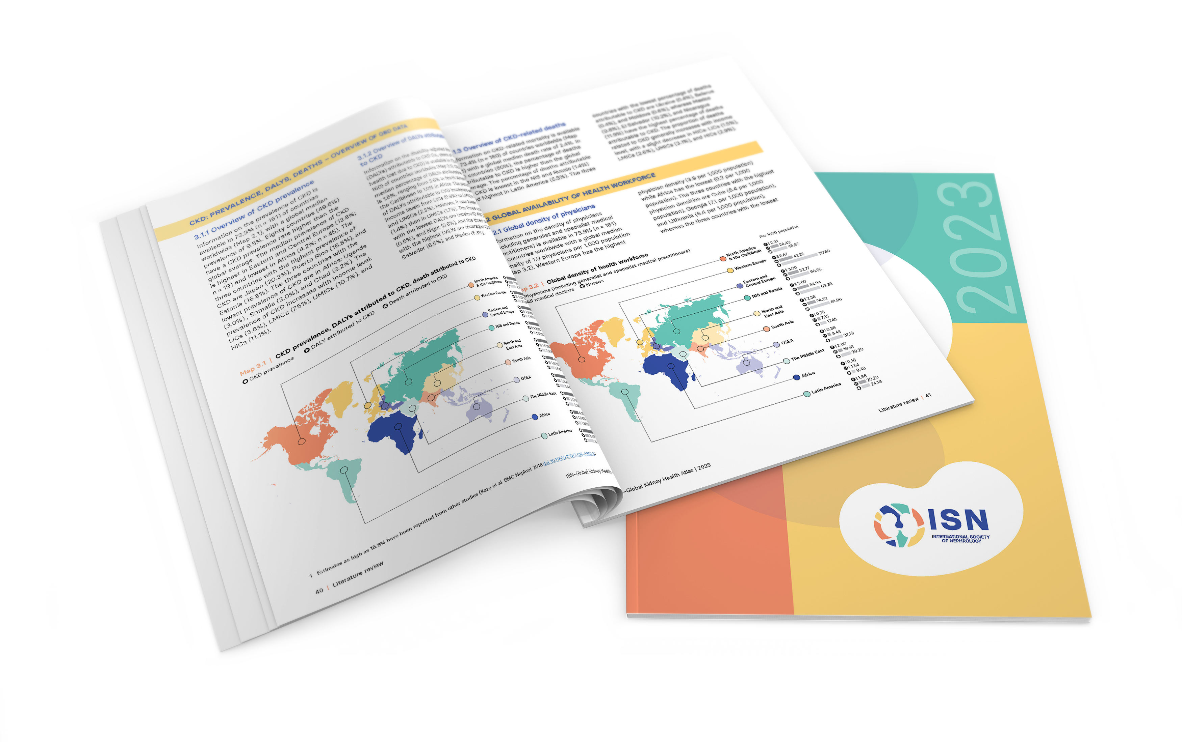
Aim of the ISN-Global Kidney Health Atlas
To understand, compare and monitor how different countries around the world detect, treat, monitor and advocate for people with kidney disease (AKI or CKD).
Key focus on availability, accessibility,
affordability and quality of kidney failure care

Slide 5
ISN-Global Kidney Health Atlas Survey
2016
2018
2022
2026

Slide 6
Design and Scope
Desk research (across countries and regions)
  Published and grey literature review
  Systematic review of kidney failure burden and outcomes
  Data extraction from major kidney registries (USRDS, ERA-EDTA) and relevant national registries where available
  Scoping review of KRT cost estimates
Online questionnaire-based survey July – September 2022
  3 languages (English, French, Spanish)
  191 countries contacted
  ≥3 stakeholders per country
    National nephrology society leadership
    Healthcare policymakers
    Patients / patient advocacy groups
  Discrepancies resolved by follow-up conferences with regional board chairs and country nephrology leaders
Notes:
REDCap Cloud. The questionnaire was peer reviewed for content validity and comprehensiveness before it was piloted with the 10 ISN regional boards to identify any logistical and feasibility issues (e.g., translation needs). Intensive follow-ups were conducted by email and telephone with ISN regional and national leaders to ensure complete and timely responses.
Data and reports published by the WHO Global Observatory, UN, World Bank, and OECD.
Both published and unpublished documents from international organizations/bodies and reports published by national governments on the organization and
delivery of ESKD.
Additional literature identified by key stakeholders (i.e., opinion leaders, national nephrology society leaders, ISN leaders) and through consultation with national nephrology societies and ISN regional boards.

Slide 7

Overall Survey Components

Slide 8
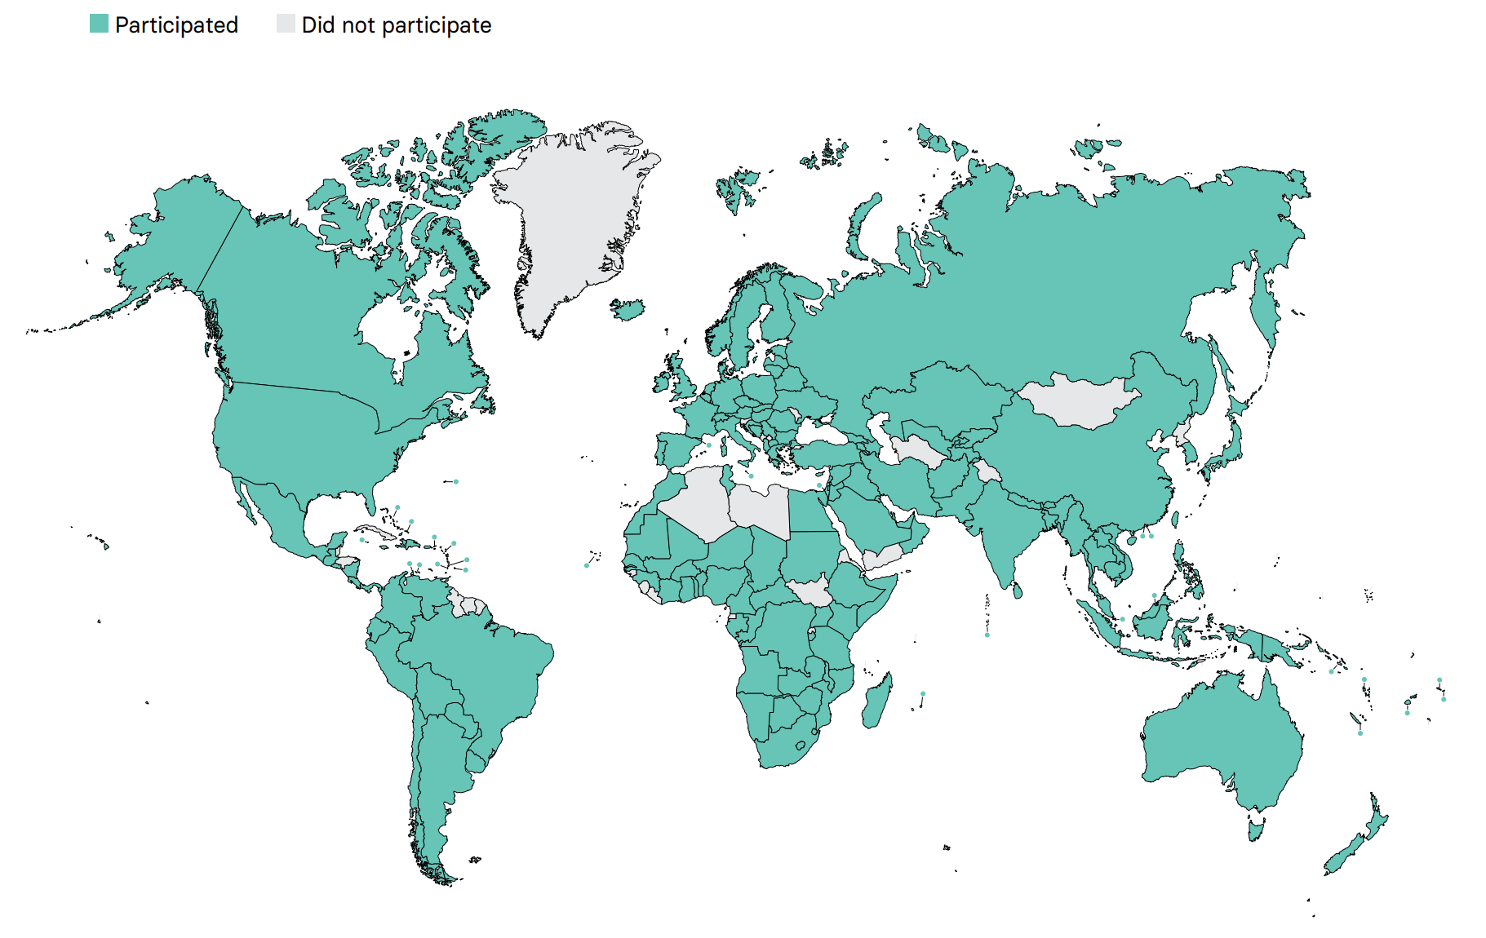
Overall ISN-GKHA response
167 countries (92%)
97% world’s population
329 individuals (63%) response
2 respondents/country
(IQR 2-3)
108 countries participated in the 2017, 2019, and 2023 GKHA surveys

Slide 9
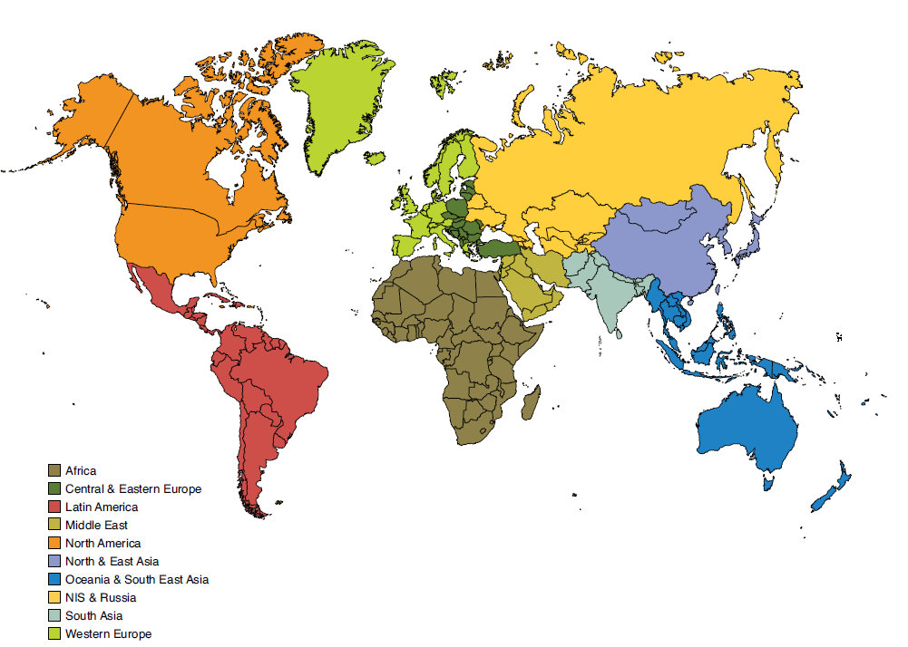
Results presented by ISN regions

Slide 10

ISN Region: North America and the Caribbean

Slide 11
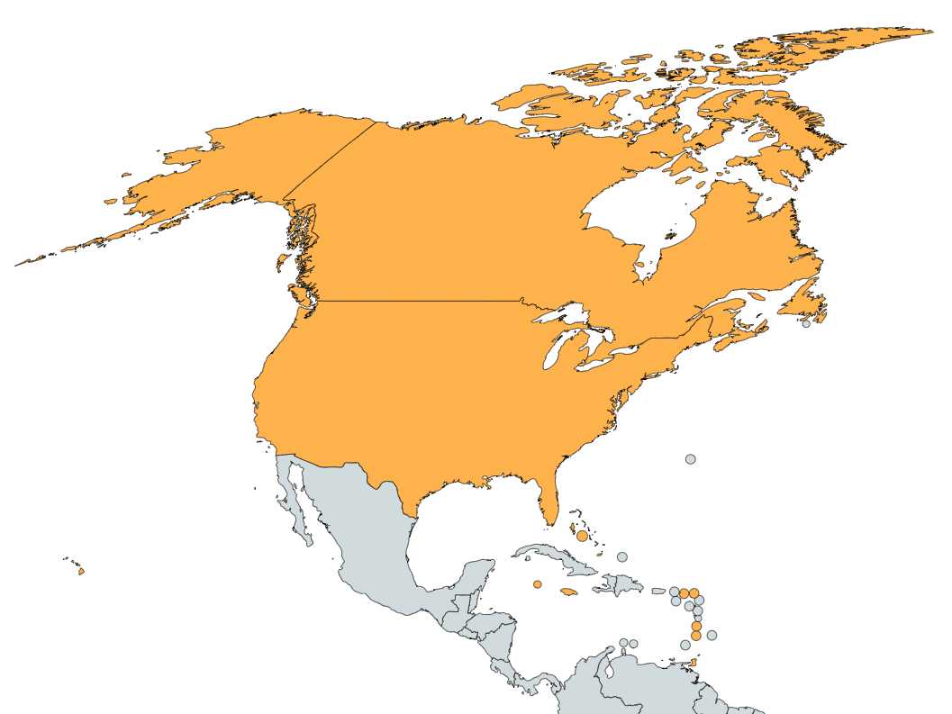
Demographics
Country | World bank ranking | Area (sq km) | Total population (2022) | GDP (PPP) ($ billion) | Total health expenditures (% of GDP)
Antigua and Barbuda | High income | 443 | 100,335 | 2.0 | 4.4
Bahamas, The | High income | 13,880 | 355,608 | 13.5 | 5.8
Barbados | High income | 430 | 303,431 | 3.9 | 7.2
Canada | High income | 9,984,670 | 38,232,593 | 1992.1 | 10.8
Jamaica | Upper-middle income | 10,991 | 2,818,596 | 29.8 | 6.1
St. Kitts and Nevis | High income | 261 | 54,488 | 1.4 | 5.4
St. Lucia | Upper-middle income | 616 | 167,122 | 2.6 | 4.3
St. Vincent and the Grenadines | Upper-middle income | 389 | 100,969 | 1.6 | 4.8
Trinidad and Tobago | High income | 5,128 | 1,405,646 | 38.6 | 7.0
Turks and Caicos Islands | High income | 948 | 59,367 | 0.8 | -
United States of America | High income | 9,833,517 | 337,300,000 | 22996.1 | 16.8
Responses were received from 12 of 14 countries in North America and the Caribbean (85.7%) representing 99% of the region’s population.
‘ – ’ : data not reported/unavailable

Slide 12
Demographics
Country | World bank ranking | Area (sq km) | Total population (2022) | GDP (PPP) ($ billion) | Total health expenditures (% of GDP) | Total Health Spending per person | Government Health Spending per person | Out-of-pocket Health Spending per person
Antigua and Barbuda | High income | 443 | 100,335 | 2.0 | 4.4 | 1027 | 623 | 259
Bahamas, The | High income | 13,880 | 355,608 | 13.5 | 5.8 | 2180 | 1216 | 512
Barbados | High income | 430 | 303,431 | 3.9 | 7.2 | 7.2 | - | -
Canada | High income | 9,984,670 | 38,232,593 | 1992.1 | 10.8 | 5936 | 4705 | 666
Jamaica | Upper-middle income | 10,991 | 2,818,596 | 29.8 | 6.1 | 354 | 211 | 52
St. Kitts and Nevis | High income | 261 | 54,488 | 1.4 | 5.4 | 969 | 476 | 443
St. Lucia | Upper-middle income | 616 | 167,122 | 2.6 | 4.3 | 529 | 284 | 204
St. Vincent and the Grenadines | Upper-middle income | 389 | 100,969 | 1.6 | 4.8 | 353 | 225 | 83
Trinidad and Tobago | High income | 5,128 | 1,405,646 | 38.6 | 7.0 | 1109 | 584 | 450
Turks and Caicos Islands | High income | 948 | 59,367 | 0.8 | - | - | - | -
United States of America | High income | 9,833,517 | 337,300,000 | 22996.1 | 16.8 | 11705 | 6578 | 1071
‘ – ’ : data not reported/unavailable

Slide 13
CKD and its risk factors burden
Country | CKD Prevalence % (95% CI) | Death attributed to CKD % (95% CI) | DALYS attributed to CKD % (95% CI) | Obesity % (95% CI) | Increased BP % (95% CI) | Smoking % (95% CI)
Antigua and Barbuda | 12.37 (11.35 - 13.62) | 5.96 (5.4 - 6.55) | 4.28 (3.76 - 4.82) | 19.1 (13.9 - 24.8) | 23.4 (16.6 - 31.1) | 3.3 (2.5 - 4.5)
Bahamas, The | 9.82 (9.17 - 10.47) | 4.11 (3.81 - 4.42) | 3.1 (2.78 - 3.43) | 32.1 (26.1 - 38.5) | 20.9 (15.1 - 27.9) | 6.1 (4.7 - 8.0)
Barbados | 13.29 (12.37 – 14.18) | 3.97 (3.60 – 4.32) | 3.26 (2.89 – 3.63) | 24.8 (19.8 – 30.2) | 24.4 (18.0 – 31.5) | 4.2 (3.2 - 5.5)
Canada | 10.87 (10.10 - 11.64) | 2.6 (2.22 - 2.91) | 1.37 (1.21 - 1.53) | 31.3 (27.4 - 35.3) | 13.2 (9.4 - 17.7) | 13.8 (12.0 - 15.9)
Jamaica | 9.78 (9.15 - 10.39) | 4.77 (4.36 - 5.13) | 3.6 (3.16 - 4.05) | 24.4 (19.9 - 29.2) | 21.8 (16.0 - 28.4) | 9.4 (7.3 - 11.7)
St. Kitts and Nevis | 11.42 (10.59 - 12.24) | 6.32 (5.42 - 7.1) | 4.62 (3.74 - 5.35) | 23.1 (17.7 - 29.1) | 25.3 (18.7 - 32.4) | -
St. Lucia | 11.36 (10.59 - 12.12) | 5.08 (4.59 - 5.54) | 3.82 (3.4 - 4.24) | 19.8 (14.9 - 25.1) | 27.1 (20.2 - 35.0) | 8.0 (6.4 - 10.1)
St. Vincent and the Grenadines | 10.51 (9.81 - 11.17) | 4.52 (4.16 - 4.89) | 3.58 (3.22 - 3.92) | 23.8 (18.4 - 29.8) | 23.3 (17.0 - 30.5) | 6.4 (5.0 - 8.0)
Trinidad and Tobago | 11.73 (10.95 - 12.54) | 5.25 (4.79 - 5.73) | 3.88 (3.39 - 4.36) | 19.7 (14.5 - 25.7) | 25.8 (18.7 - 33.9) | 14.6 (12.1 - 17.2)
Turks and Caicos Islands | - | - | - | - | - | -
United States | 12.94 (12.09 - 13.78) | 3.63 (3.26 - 3.88) | 2.06 (1.87 - 2.27) | 37.3 (33.4 - 41.3) | 12.9 (9.8 - 16.8) | 13.3 (13.0 - 13.6)
Abbreviations: CKD (Chronic Kidney Disease), DALYS (disability-adjusted life years), BP (blood pressure), CI (confidence interval)
Data source: GBD study database (http://www.healthdata.org/gbd), WHO data observatory (https://www.who.int/gho/en/)
‘ – ’ : data not reported/unavailable

Slide 14
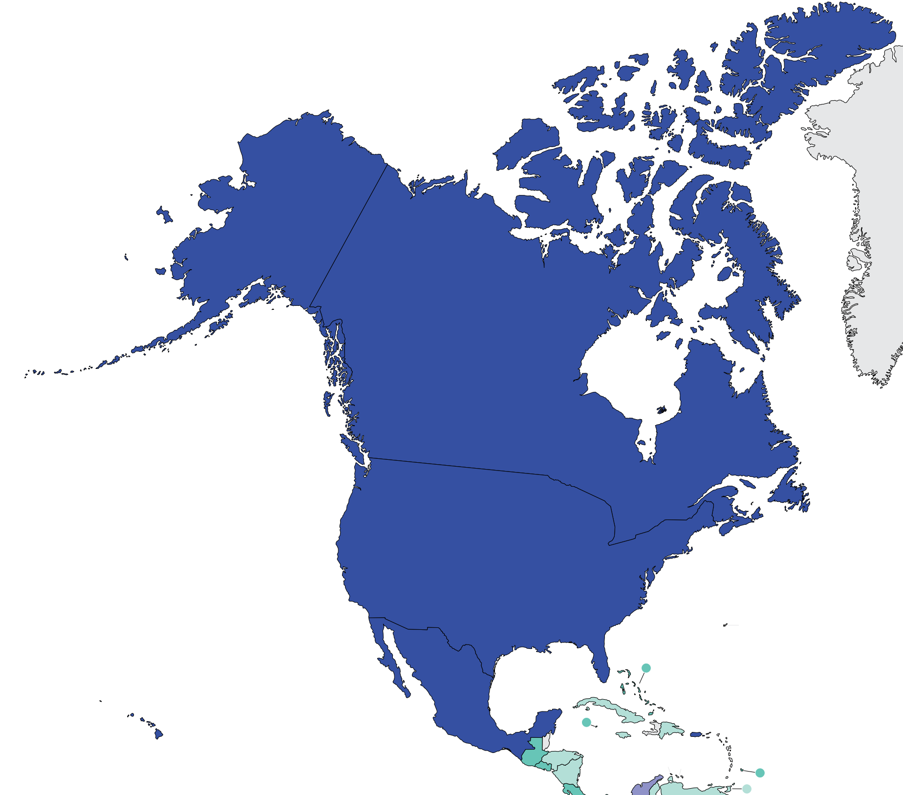
Burden of kidney failure
Prevalence of treated kidney failure
Country | Treated kidney failure |  | Chronic dialysis (HD+PD) |  | Chronic HD |  | Chronic PD
 | Incidence | Prevalence | Incidence | Prevalence | Incidence | Prevalence | Incidence | Prevalence
Antigua and Barbuda | - | - | - | 515.4 | - | 515.4 | - | 0
Bahamas, The | - | 651.1 | - | 620.3 | - | 506.1 | - | 114.2
Barbados | - | 682.5 | - | 678.8 | - | 678.8 | - | 0
Canada | 208.1 | 1415.9 | 203.1 | 805.6 | 154.8 | 639.6 | 48.3 | 166
Jamaica | - | 137.4 | - | 131.5 | - | 192.7 | - | 11.5
St. Kitts and Nevis | - | - | - | - | - | - | - | -
St. Lucia | - | - | - | 321 | - | 321 | - | 0
St. Vincent and the Grenadines | - | - | - | - | - | - | - | -
Trinidad and Tobago | - | 334.6 | - | 334.61 | - | 278.6 | - | 56.02
Turks and Caicos Islands | - | - | - | 1882.4 | - | 1882.4 | - | 0
United States | 410 | 2465 | 374.1 | 1736 | 336.7 | 1552.95 | 37.4 | 197.2
* pmp (per million population)
Data source: Annual Statistics on Organ Replacement in Canada: Dialysis, Transplantation and Donation (2020 Data), Jain et al. (JASN) 2012, Soyibo & Barton (West Indian Medical Journal) 2007, 2019 USRDS Annual Data Report
‘ – ’ : data not reported/unavailable
Treated kidney failure: all dialysis + transplant

Slide 15
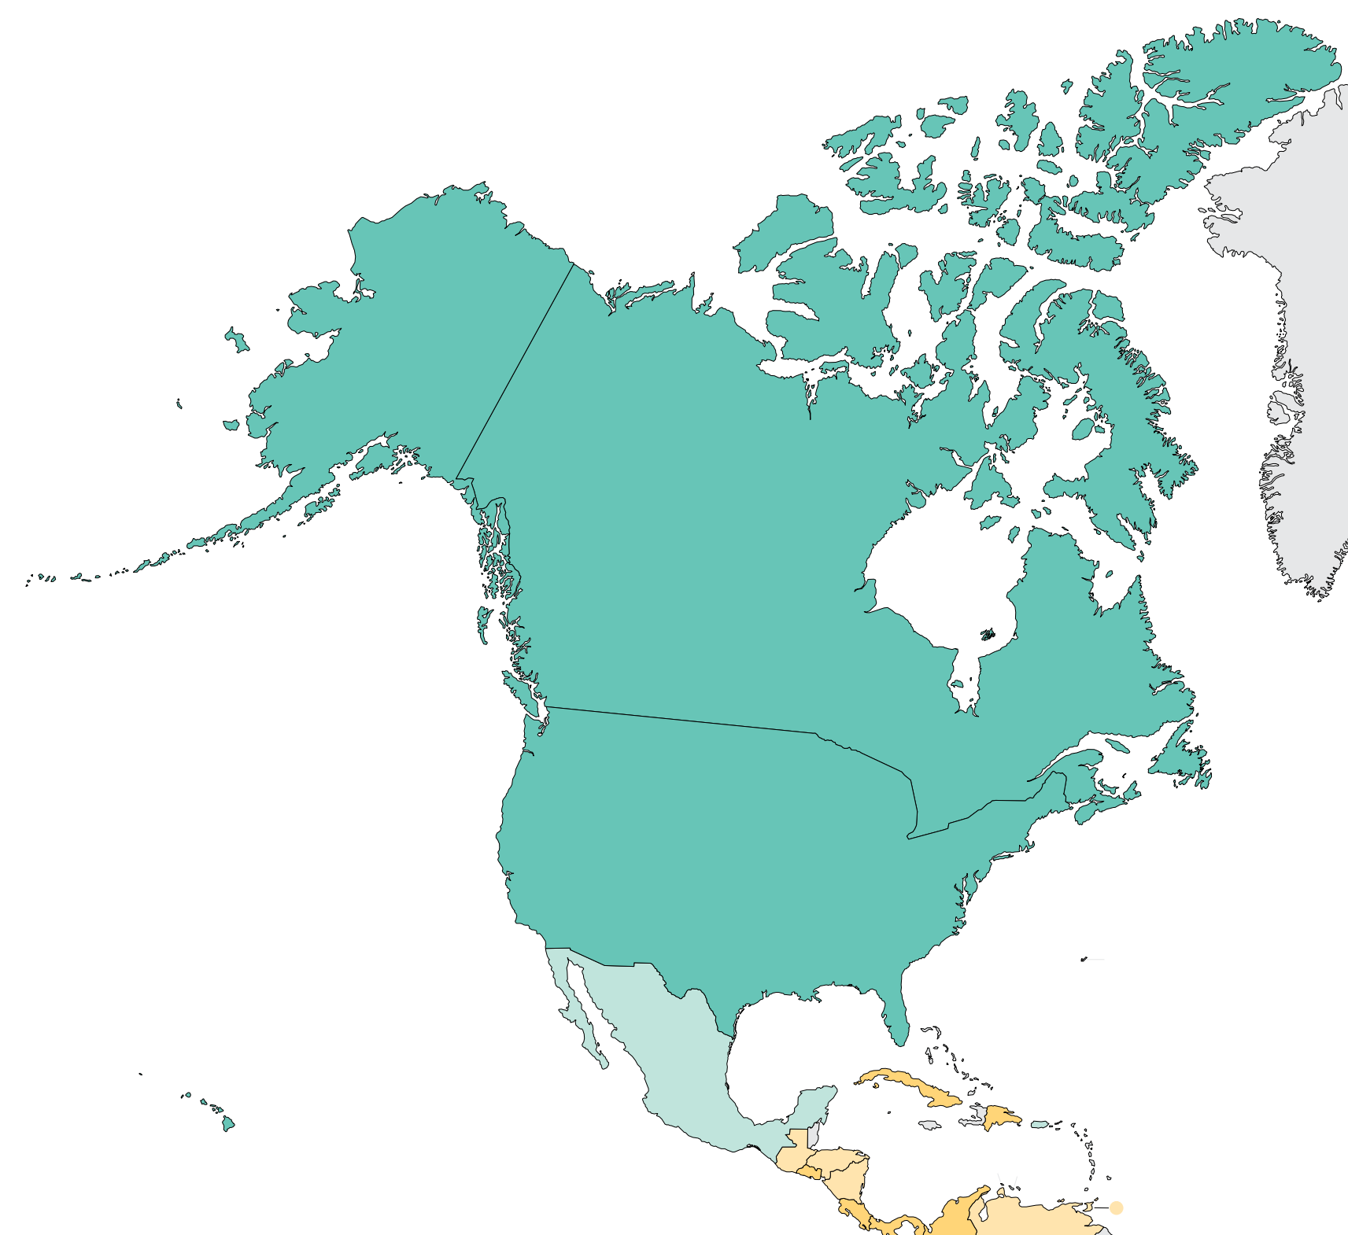
Burden of kidney failure (cont’d)
Incidence of kidney transplantation
Country | Kidney transplantation
 | Incidence overall | Prevalence overall | Incidence of deceased donor | Incidence of living donor | Incidence of pre-emptive
Antigua and Barbuda | - | - | - | - | -
Bahamas, The | - | 3.1 | - | - | -
Barbados | - | 3.7 | - | - | -
Canada | 40.27 | 610.3 | 29.76 | 10.5 | 5
Jamaica | - | 6.8 | - | - | -
St. Kitts and Nevis | - | - | - | - | -
St. Lucia | - | - | - | - | -
St. Vincent and the Grenadines | - | - | - | - | -
Trinidad and Tobago | 2.14 | - | 0 | 2.14 | -
Turks and Caicos Islands | - | - | - | - | -
United States | 76.57 | 729 | 58.63 | 17.93 | 59
* pmp (per million population)
Data source: Annual Statistics on Organ Replacement in Canada: Dialysis, Transplantation and Donation (2020 Data), Soyibo & Barton (West Indian Medical Journal) 2007, 2019 USRDS Annual Data Report
‘ – ’ : data not reported/unavailable

Slide 16
Annual cost of kidney replacement therapy components
Country | Hemodialysis | Peritoneal dialysis | Kidney Transplant (First year) | Kidney Transplant (later years) | HD/PD cost ratio
Antigua and Barbuda | - | - | - | - | -
Bahamas, The | - | - | - | - | -
Barbados | 28096 | - | - | - | -
Canada | 42147 | 25224 | 78393 | 22366 | 1.67
Jamaica | 17622 | - | - | - | -
St. Kitts and Nevis | - | - | - | - | -
St. Lucia | - | - | - | - | -
St. Vincent and the Grenadines | - | - | - | - | -
Trinidad and Tobago | - | - | - | - | -
Turks and Caicos Islands | - | - | - | - | -
United States | 39826 | 39826 | 451698 | - | 1.00
*Cost is in $US 2021
Abbreviations: HD (hemodialysis), PD (peritoneal dialysis)
Data source: Adomakoh et al. (2004), Barnieh et al. (2014), Kramer et al. (2018), van der Tol et al. (2019). Wang & Hart (2021)
‘ – ’ : data not reported/unavailable

Slide 17
Country level scorecard
Country |  | Availability of KRT |  |  | Availability of CKM |  | Funding for Medications |  |  | Availability of Distribution of Registry |  |  |  | Advocacy Group |  |  | Nephrology Workforce (PMP)
 |  | HD | PD | Kidney transplantation | Shared decision | Choice restricted (limited) | CKD | Dialysis | Kidney transplantation | CKD | Dialysis | Kidney transplantation | AKI | CKD | AKI | RRT | Nephrologist | Nephrologist trainees
Antigua and Barbuda | 2019 |  |  |  |  |  |  |  |  |  |  |  |  |  |  |  | 31.29 | 0.00
 | 2023 |  |  |  |  |  |  |  |  |  |  |  |  |  |  |  | 29.90 | 0.00
Aruba | 2019
 | 2023 |  |  |  |  |  |  |  |  |  |  |  |  |  |  |  | 40.88 | 40.88
Bahamas, The | 2019
 | 2023 |  |  |  |  |  |  |  |  |  |  |  |  |  |  |  | 19.68 | 0.00
Barbados | 2019
 | 2023 |  |  |  |  |  |  |  |  |  |  |  |  |  |  |  | 9.91 | 0.00
Bermuda | 2019
 | 2023 |  |  |  |  |  |  |  |  |  |  |  |  |  |  |  | 41.47 | 13.82
Canada | 2019 |  |  |  |  |  |  |  |  |  |  |  |  |  |  |  | 15.33 | 1.74
 | 2023 |  |  |  |  |  |  |  |  |  |  |  |  |  |  |  | 13.08 | 1.31
Cayman Islands | 2019 |  |  |  |  |  |  |  |  |  |  |  |  |  |  |  | 16.77 | 0.00
 | 2023
Jamaica | 2019 |  |  |  |  |  |  |  |  |  |  |  |  |  |  |  | 4.27
 | 2023 |  |  |  |  |  |  |  |  |  |  |  |  |  |  |  | 4.97 | 0.35
St. Kitts and Nevis | 2019 |  |  |  |  |  |  |  |  |  |  |  |  |  |  |  | 18.83 | 18.83
 | 2023
Abbreviations
AKI: acute kidney injury
CKD: chronic kidney disease
CKM: conservative kidney management
HD: Hemodialysis
Nephrologist density | <1.2 PMP | 1.2 – 10.0 PMP | 10.1 – 22.9 PMP | >22.9 PMP
Nephrology trainees density | <0.3 PMP | 0.3 – 1.4 PMP | 1.5-3.7 PMP | >3.7 PMP
KRT: kidney replacement therapy
PD: Peritoneal Dialysis
RRT: renal replacement therapy
Yes | No | N/A

Slide 18
Country level scorecard
Country |  | Availability of KRT |  |  | Availability of CKM |  | Funding for Medications |  |  | Availability of Distribution of Registry |  |  |  | Advocacy Group |  |  | Nephrology Workforce (PMP)
 |  | HD | PD | Kidney transplantation | Shared decision | Choice restricted (limited) | CKD | Dialysis | Kidney transplantation | CKD | Dialysis | Kidney transplantation | AKI | CKD | AKI | RRT | Nephrologist | Nephrologist trainees
St. Lucia | 2019 |  |  |  |  |  |  |  |  |  |  |  |  |  |  |  | 18.13 | 0.00
 | 2023 |  |  |  |  |  |  |  |  |  |  |  |  |  |  |  | 17.95 | 0.00
St. Vincent and the Grenadines | 2019 |  |  |  |  |  |  |  |  |  |  |  |  |  |  |  | 29.46 | 0.00
 | 2023 |  |  |  |  |  |  |  |  |  |  |  |  |  |  |  | 29.71 | 0.00
Trinidad and Tobago | 2019 |  |  |  |  |  |  |  |  |  |  |  |  |  |  |  | 5.76 | 0.00
 | 2023 |  |  |  |  |  |  |  |  |  |  |  |  |  |  |  | 8.54 | 0.00
Turks and Caicos Islands | 2019
 | 2023 |  |  |  |  |  |  |  |  |  |  |  |  |  |  |  | 17.16 | 0.00
United States | 2019 |  |  |  |  |  |  |  |  |  |  |  |  |  |  |  | 29.54 | 1.74
 | 2023 |  |  |  |  |  |  |  |  |  |  |  |  |  |  |  | 29.64 | 2.37
Abbreviations
AKI: acute kidney injury
CKD: chronic kidney disease
CKM: conservative kidney management
HD: Hemodialysis
Nephrologist density | <1.2 PMP | 1.2 – 10.0 PMP | 10.1 – 22.9 PMP | >22.9 PMP
Nephrology trainees density | <0.3 PMP | 0.3 – 1.4 PMP | 1.5-3.7 PMP | >3.7 PMP
KRT: kidney replacement therapy
PD: Peritoneal Dialysis
RRT: renal replacement therapy
Yes | No | N/A

Slide 19
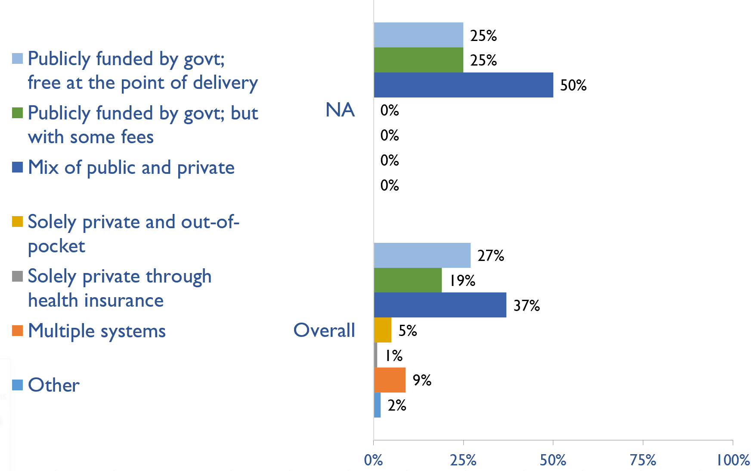
Funding for non-dialysis CKD
Country | Publicly funded by govt; free at the point of delivery | Publicly funded by govt but with some fees at the point of delivery | Mix of public and private funding systems | Solely private and out-of-pocket | Solely private through health insurance | Multiple systems | Other
Antigua and Barbuda |  |  | X
Aruba |  | X
Bahamas, The |  |  | X
Barbados | X
Bermuda |  | X
Canada | X
Jamaica |  |  | X
St. Lucia |  |  | X
St. Vincent and the Grenadines |  | X
Trinidad and Tobago |  |  | X
Turks and Caicos Islands | X
United States |  |  | X
X : Yes

Slide 20
Funding for kidney replacement therapy (KRT)
Country | Publicly funded (free) |  |  |  | Publicly funded (some fees) |  |  |  | Mixed |  |  |  | Solely private (out-of-pocket) |  |  |  | Solely private (health insurance) |  |  |  | Multiple systems |  |  |  | N/A |  |  |  | Other
 | AKI | HD | PD | TX | AKI | HD | PD | TX | AKI | HD | PD | TX | AKI | HD | PD | TX | AKI | HD | PD | TX | AKI | HD | PD | TX | AKI | HD | PD | TX | AKI | HD | PD | TX
Antigua and Barbuda | X |  |  | X |  | X |  |  |  |  |  |  |  |  |  |  |  |  |  |  |  |  |  |  |  |  | X
Aruba | X | X | X |  |  |  |  | X
Bahamas, The |  |  |  |  |  |  |  |  | X | X | X | X
Barbados | X | X | X | X
Bermuda |  |  |  |  | X | X | X | X
Canada | X | X | X |  |  |  |  |  |  |  |  | X
Jamaica |  |  |  |  |  |  |  | X | X | X | X
St. Lucia |  |  |  |  |  |  |  |  | X | X |  |  |  |  |  |  |  |  |  |  |  |  |  |  |  |  | X | X
St. Vincent and the Grenadines |  |  | X |  |  |  |  | X | X | X
Trinidad and Tobago | X |  | X | X |  |  |  |  |  | X
Turks and Caicos Islands | X | X | X |  |  |  |  | X
United States |  |  |  |  | X | X | X | X
X : Yes
Abbreviations: AKI (Acute kidney injury), HD (hemodialysis), PD (peritoneal dialysis), TX (transplant medications)

Slide 21
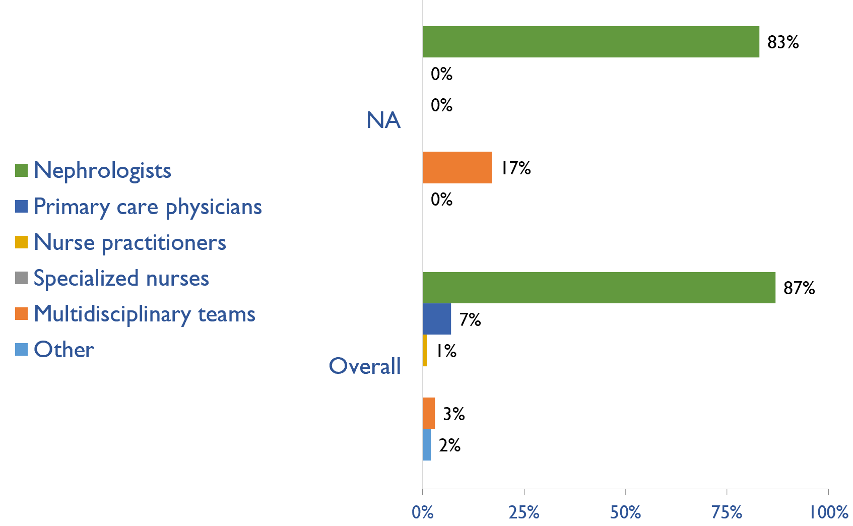
Providers primarily responsible for kidney failure care
Country | Nephrologists | Primary care physicians | Nurse practitioners | Specialized nurses | Multidisciplinary teams | Other
Antigua and Barbuda | X
Aruba | X
Bahamas, The |  |  |  |  | X
Barbados | X
Bermuda | X
Canada | X
Jamaica | X
St. Lucia | X
St. Vincent and the Grenadines | X
Trinidad and Tobago |  |  |  |  | X
Turks and Caicos Islands | X
United States | X
X : Yes

Slide 22
Shortage of kidney failure care providers
Country | Nephrologists | Pediatric nephrologists | Transplant surgeons | Surgeons (HD access) | Surgeons (PD access) | Dietitians | Laboratory technicians | Radiologists (ultrasound) | Vascular access coordinators
Antigua and Barbuda
Aruba
Bahamas, The
Barbados
Bermuda
Canada
Jamaica
St. Lucia
St. Vincent and the Grenadines
Trinidad and Tobago
Turks and Caicos Islands
United States
No shortage
Shortage

Slide 23
Shortage of kidney failure care providers
Country | Counsellors/ psychologists | Transplant coordinators | Dialysis nurses | Renal nurses | Dialysis technicians | Social workers | Palliative care physicians | Kidney supportive care nurses | No shortage
Antigua and Barbuda
Aruba
Bahamas, The
Barbados
Bermuda
Canada
Jamaica
St. Lucia
St. Vincent and the Grenadines
Trinidad and Tobago
Turks and Caicos Islands
United States
No shortage
Shortage

Slide 24
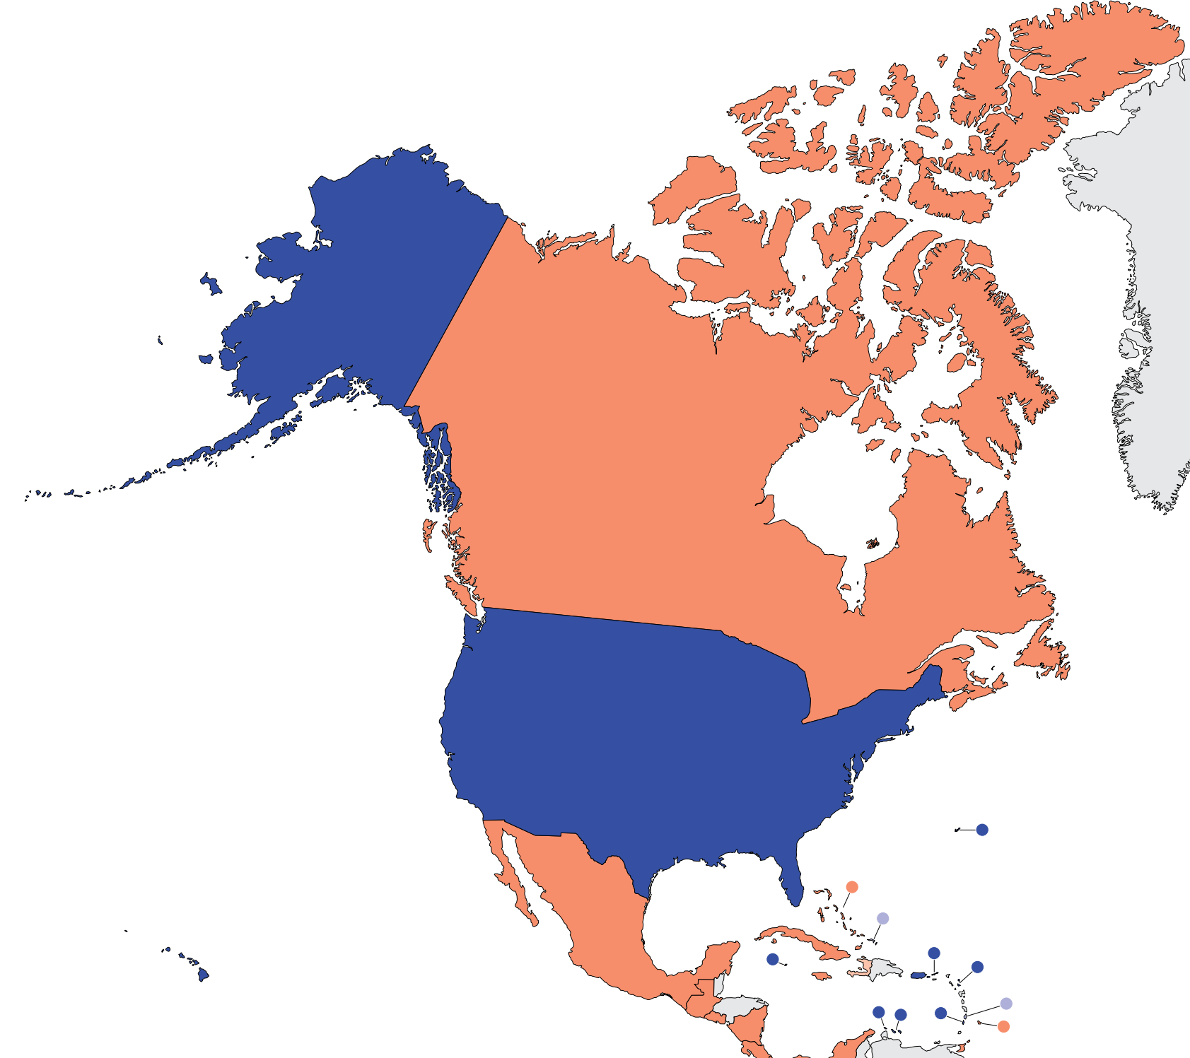
Prevalence of nephrologists and trainees
Nephrologists
Country | Nephrologists PMP | Nephrology trainees PMP
Antigua and Barbuda | 29.90 | 0.00
Aruba | 40.88 | 40.88
Bahamas, The | 19.68 | 0.00
Barbados | 9.91 | 0.00
Bermuda | 41.47 | 13.82
Canada | 13.08 | 1.31
Jamaica | 4.97 | 0.35
St. Lucia | 17.95 | 0.00
St. Vincent and the Grenadines | 29.71 | 0.00
Trinidad and Tobago | 8.54 | 0.00
Turks and Caicos Islands | 17.16 | 0.00
United States | 29.64 | 2.37
‘ – ’ : data not reported/unavailable

Slide 25
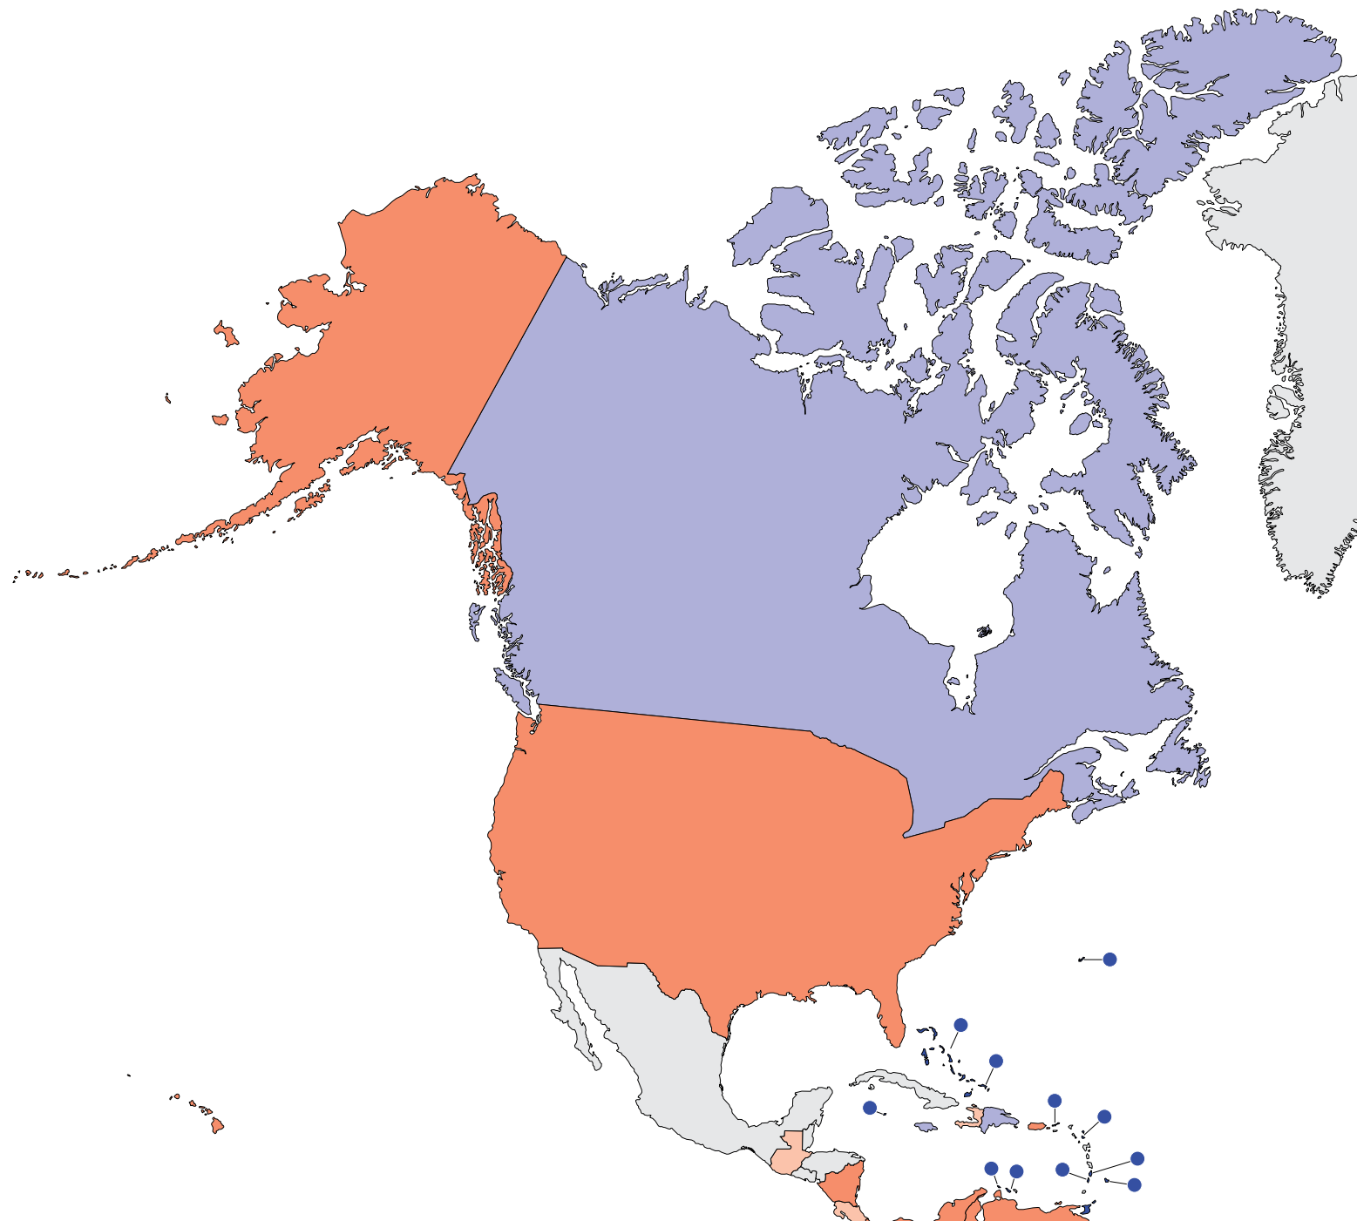
Capacity for chronic dialysis (HD)
Chronic HD centers
Country | Chronic HD Centres PMP
Antigua and Barbuda | 29.90
Aruba | 16.35
Bahamas, The | 19.68
Barbados | 16.52
Bermuda | 41.47
Canada | 8.50
Jamaica | 7.81
St. Lucia | 23.93
St. Vincent and the Grenadines | 29.71
Trinidad and Tobago | 11.38
Turks and Caicos Islands | 17.16
United States | 22.23
Chronic HD services are available in all countries of the region
The North America average of HD treatment centers is 20.39 pmp
‘ – ’ : data not reported/unavailable

Slide 26
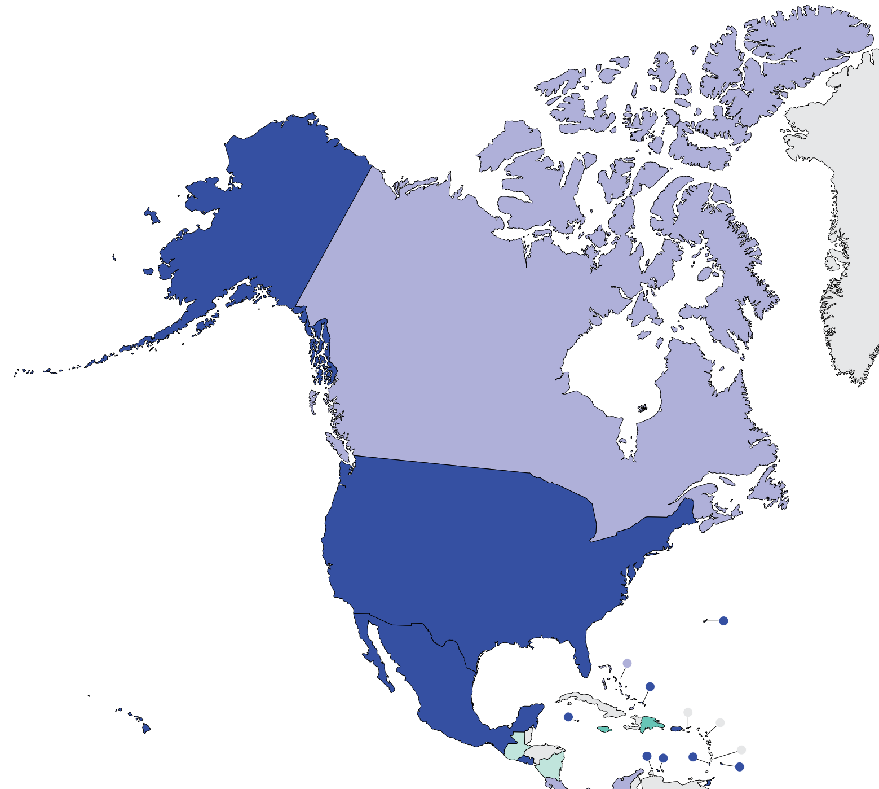
Capacity for chronic dialysis (PD)
Chronic PD centers
Country | Chronic PD Centres PMP
Antigua and Barbuda | -
Aruba | 16.35
Bahamas, The | 2.81
Barbados | 3.30
Bermuda | 41.47
Canada | 1.57
Jamaica | 1.42
St. Lucia | -
St. Vincent and the Grenadines | 19.81
Trinidad and Tobago | 3.56
Turks and Caicos Islands | 17.16
United States | 20.75
Chronic PD services are available in 10 (83%) countries of the region
The North America average of PD treatment centers is 12.82 pmp
‘ – ’ : data not reported/unavailable

Slide 27
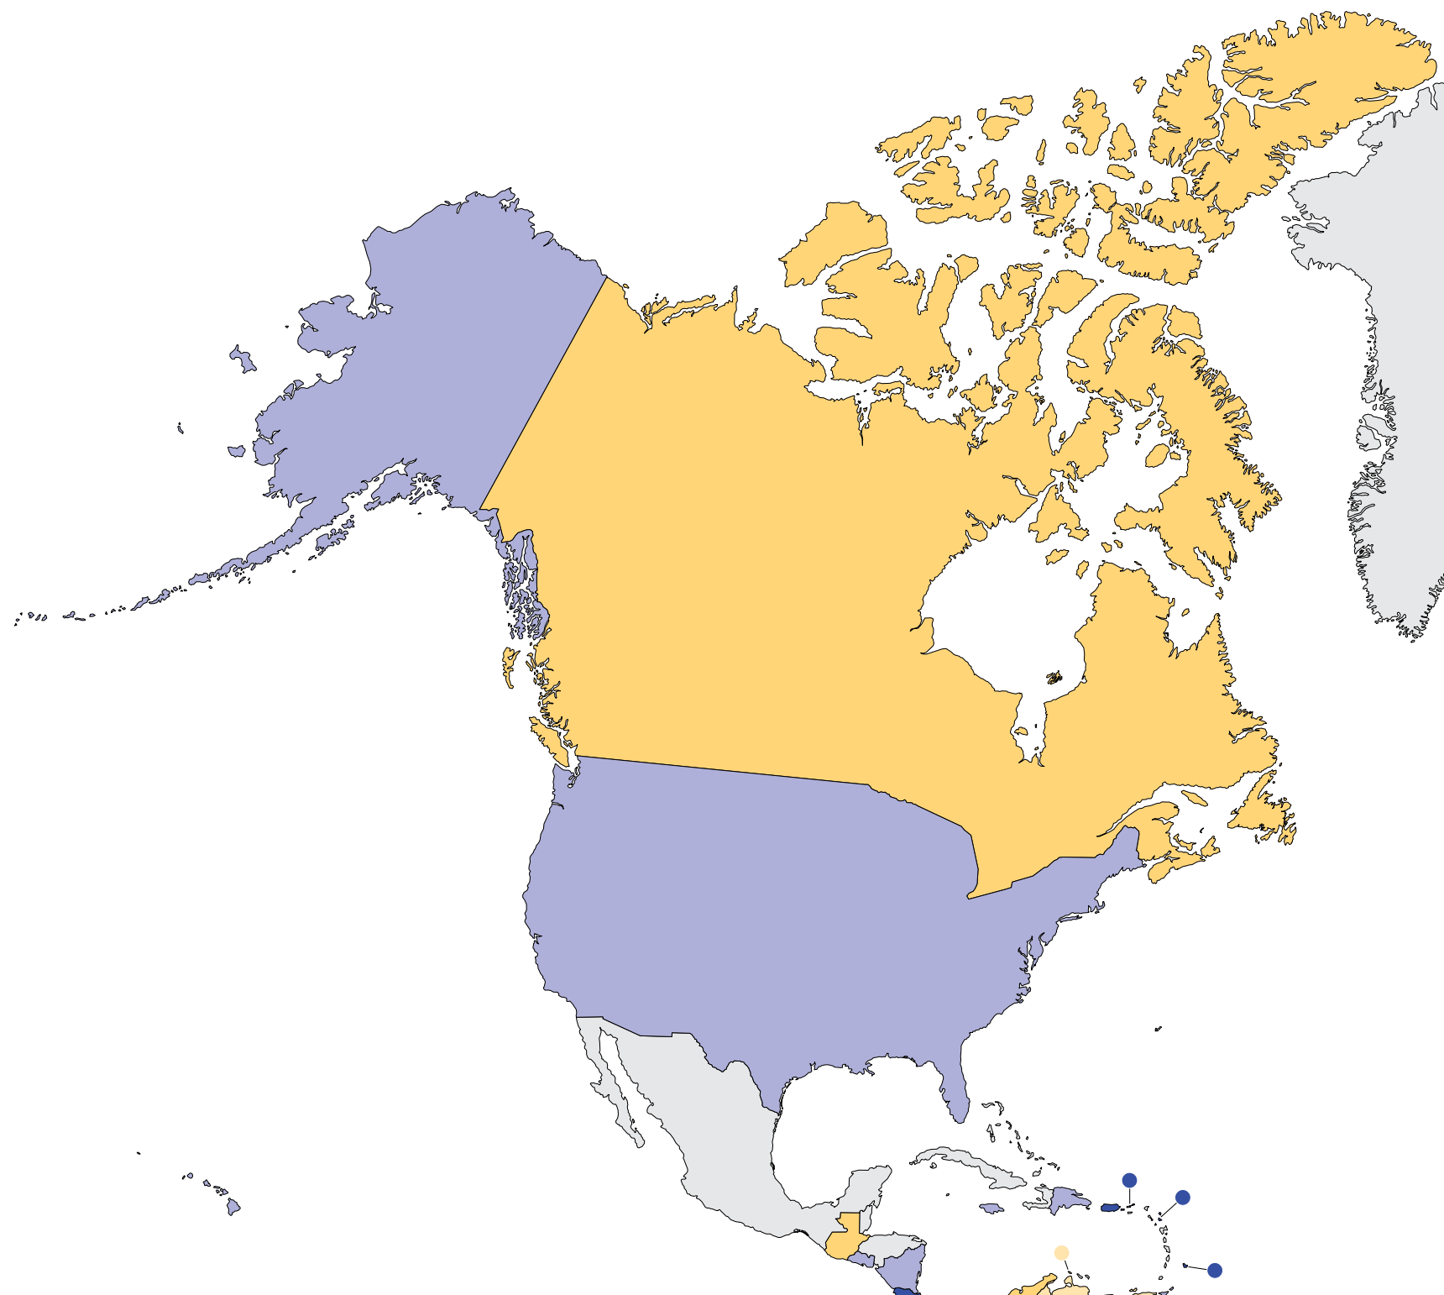
Capacity for Kidney Transplantation
Kidney transplantation centers
Country | Kidney Transplantation availability | Transplant centers PMP
Antigua and Barbuda | X | 9.97
Aruba |  | 0.00
Bahamas, The
Barbados | X | 3.30
Bermuda
Canada | X | 0.42
Jamaica | X | 0.71
St. Lucia
St. Vincent and the Grenadines
Trinidad and Tobago | X | 0.71
Turks and Caicos Islands
United States | X | 0.74
Kidney transplantation services are available in 6 (50%) countries of the region
The North America average of Kidney transplantation centers is 2.26 pmp
X : Yes
‘ – ’ : data not reported/unavailable

Slide 28
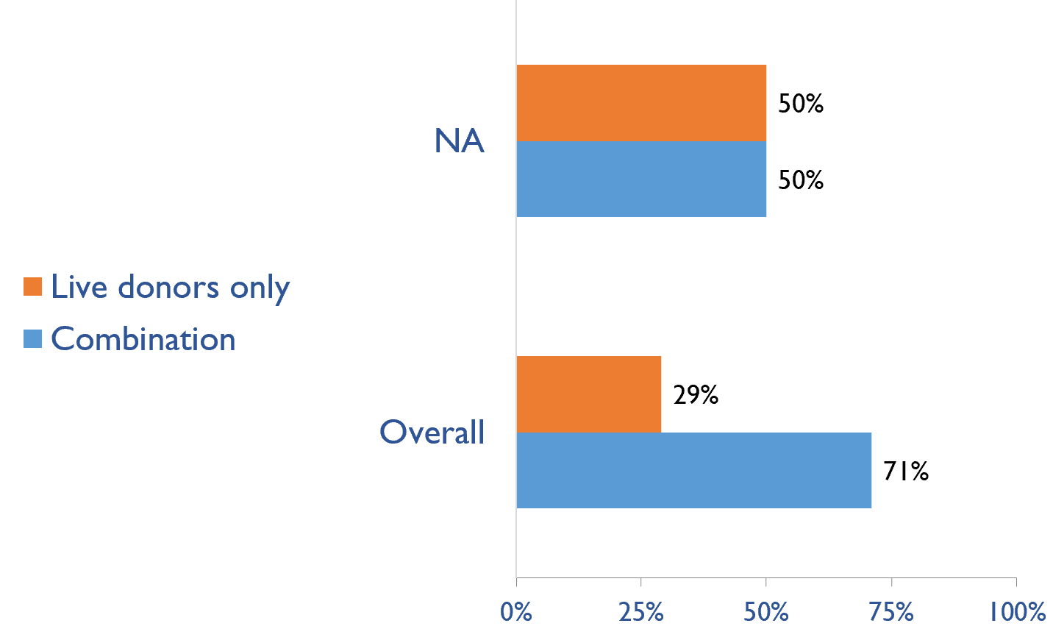
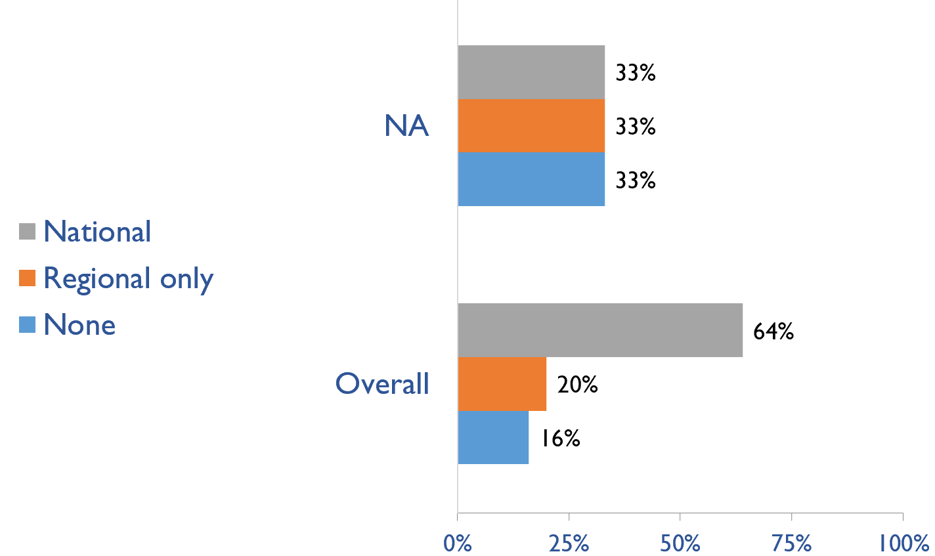
Capacity for Kidney Transplantation (cont’d)
Transplant donor type
Transplant waitlist
Country | Donor type |  | Transplant waitlist
 | Live donors only | Combination | National | Regional only | None
Antigua and Barbuda | X |  | X
Aruba
Bahamas, The
Barbados | X |  |  |  | X
Bermuda
Canada |  | X |  | X
Jamaica | X |  |  |  | X
St. Lucia
St. Vincent and the Grenadines
Trinidad and Tobago |  | X | X
Turks and Caicos Islands
United States |  | X |  | X
X : Yes

Slide 29
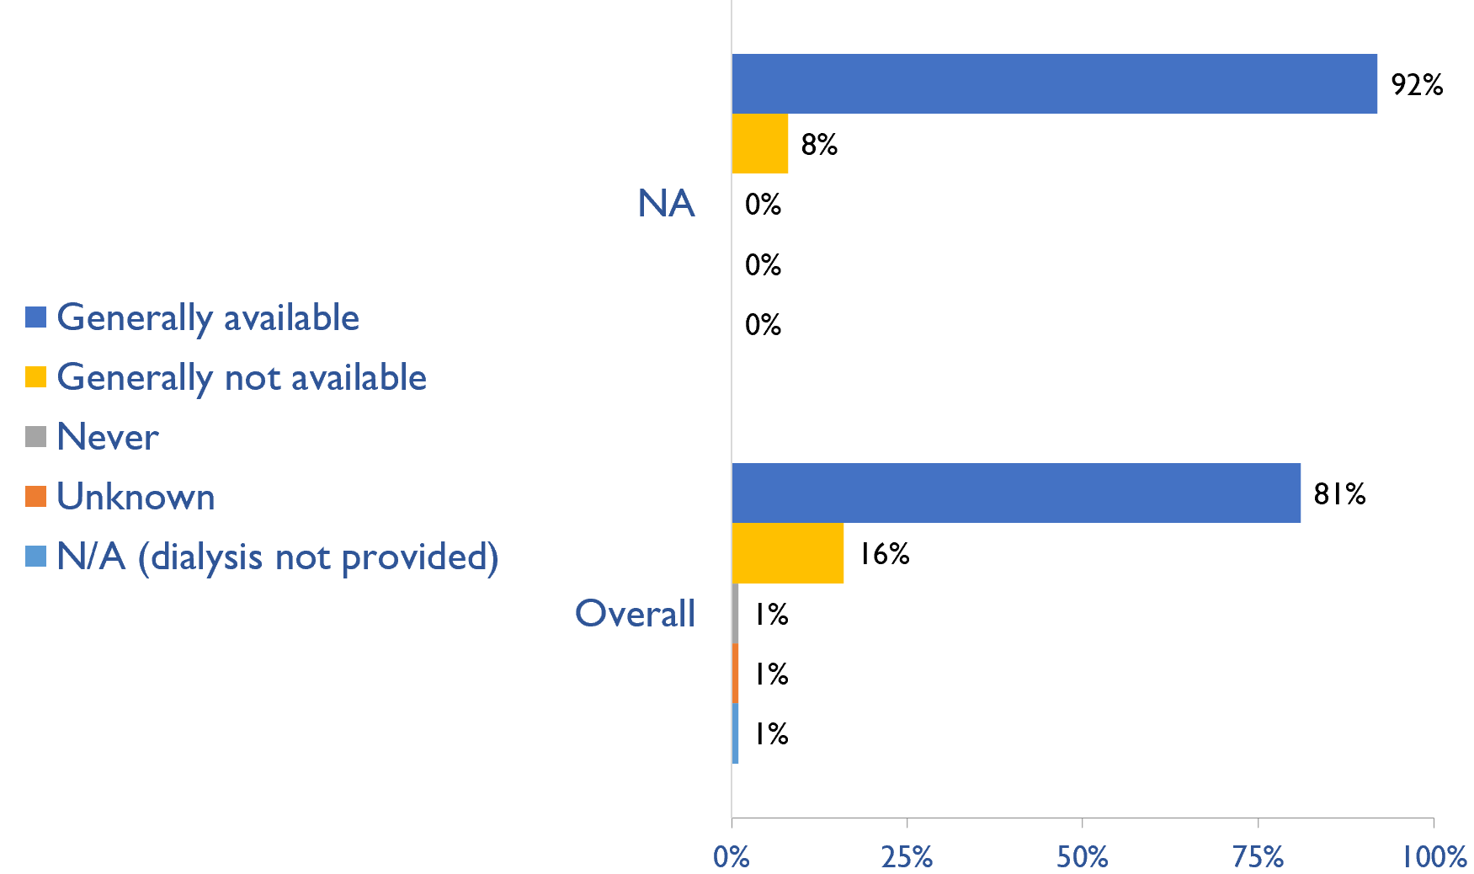
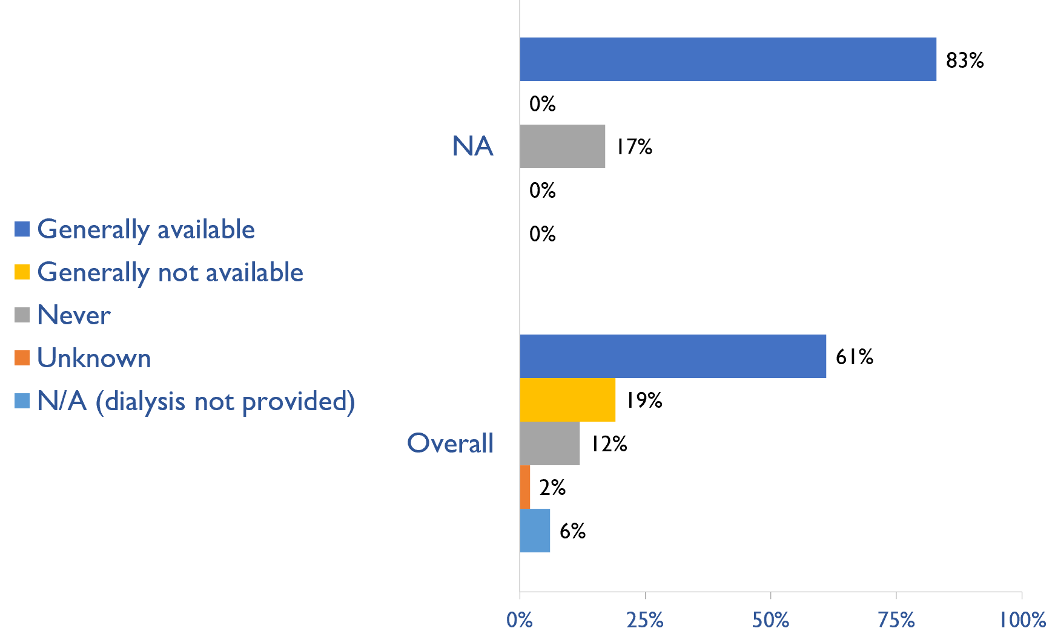
Availability of services within dialysis care
HD frequency
Country | HD frequency a center-based service that involves treatment 3x week/3-4x hours |  |  |  |  | PD frequency ability to do adequate exchanges 3-4x day (or equivalent cycles on automated PD)
 | Generally available | Generally not available | Never | Unknown | N/A (dialysis not provided) | Generally available | Generally not available | Never | Unknown | N/A (dialysis not provided)
Antigua and Barbuda | X |  |  |  |  |  |  | X
Aruba | X |  |  |  |  | X
Bahamas, The | X |  |  |  |  | X
Barbados |  | X |  |  |  | X
Bermuda | X |  |  |  |  | X
Canada | X |  |  |  |  | X
Jamaica | X |  |  |  |  | X
St. Lucia | X |  |  |  |  |  |  | X
St. Vincent and the Grenadines | X |  |  |  |  | X
Trinidad and Tobago | X |  |  |  |  | X
Turks and Caicos Islands | X |  |  |  |  | X
United States | X |  |  |  |  | X
PD frequency
X : Yes

Slide 30
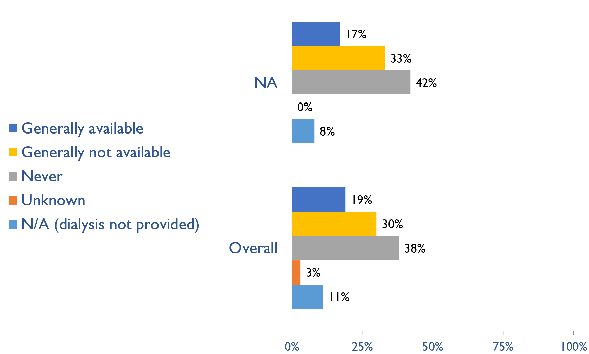
Availability of Home hemodialysis
Country | Availability of Home hemodialysis
 | Generally available | Generally not available | Never | Unknown | N/A (dialysis not provided)
Antigua and Barbuda |  |  | X
Aruba |  |  | X
Bahamas, The |  |  | X
Barbados |  |  |  |  | X
Bermuda |  | X
Canada | X
Jamaica |  | X
St. Lucia |  |  | X
St. Vincent and the Grenadines |  | X
Trinidad and Tobago |  | X
Turks and Caicos Islands |  |  | X
United States | X
X : Yes

Slide 31
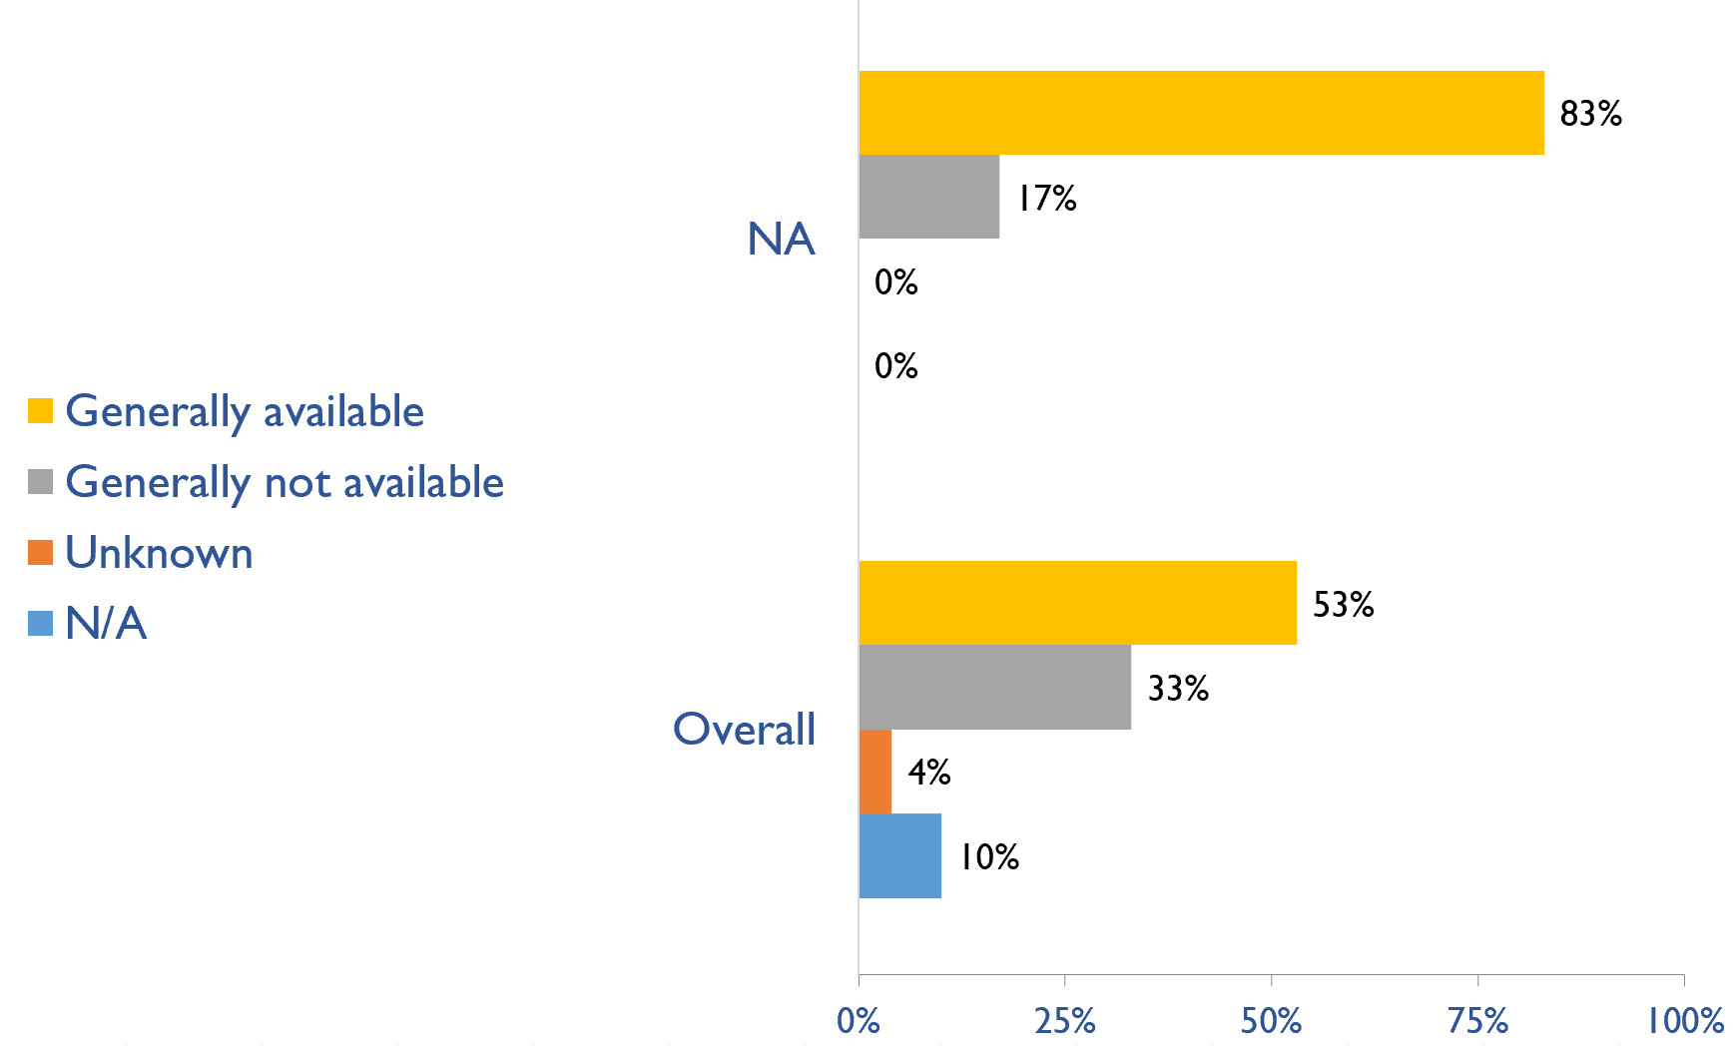
Capacity for conservative kidney management (CKM)
Country | Established conservative care that is chosen or medically advised
 | Generally available | Generally not available | Unknown | N/A (conservative care not available)
Antigua and Barbuda | X
Aruba | X
Bahamas, The | X
Barbados | X
Bermuda | X
Canada | X
Jamaica |  | X
St. Lucia | X
St. Vincent and the Grenadines | X
Trinidad and Tobago |  | X
Turks and Caicos Islands | X
United States | X
X : Yes

Slide 32
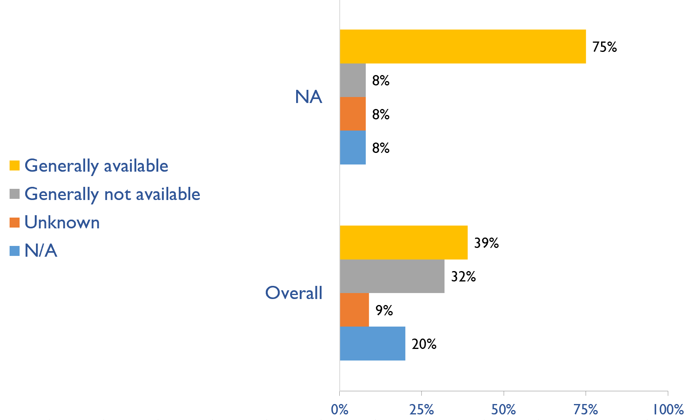
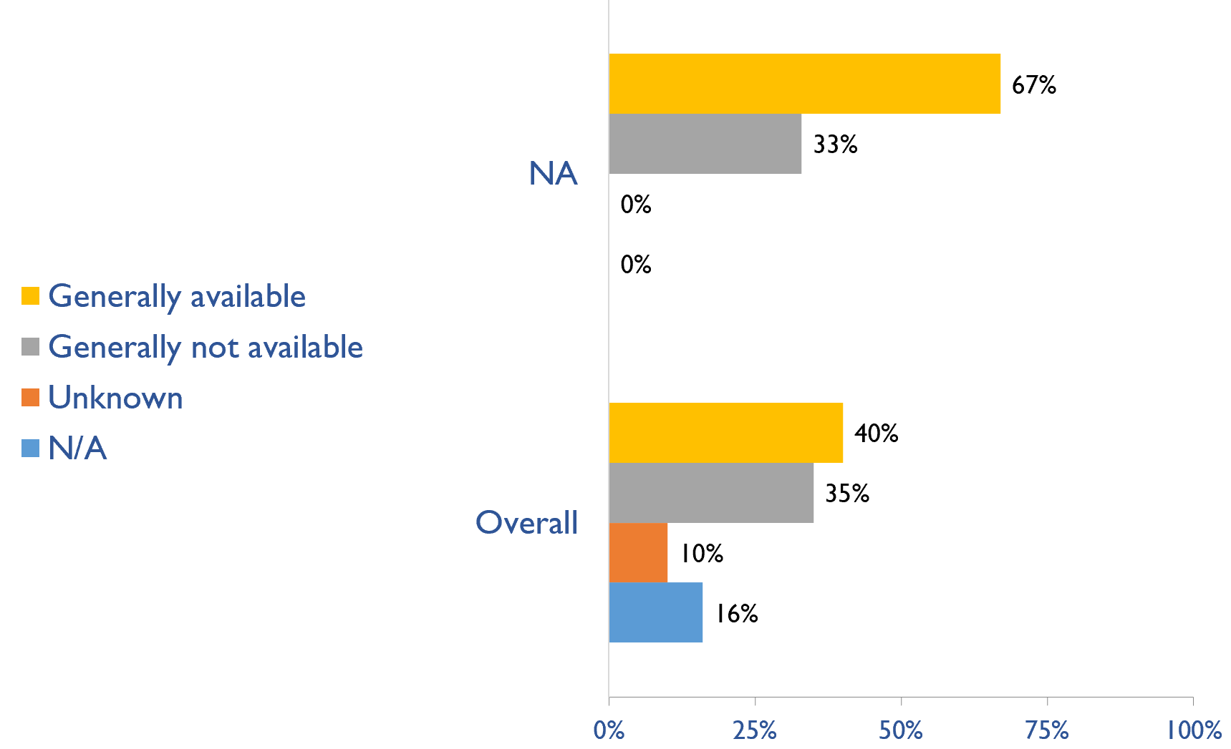
Capacity for conservative kidney management (CKM)
Where resource constraints to prevent or limit access to KRT
Country | where resource constraints to prevent or limit access to KRT |  |  |  | where there are no resource constraints to prevent or limit access to KRT
 | Generally available | Generally not available | Unknown | N/A (conservative care not available) | Generally available | Generally not available | Unknown | N/A (conservative care not available)
Antigua and Barbuda |  |  |  | X |  | X
Aruba | X |  |  |  | X
Bahamas, The |  |  | X |  | X
Barbados | X |  |  |  |  | X
Bermuda | X |  |  |  | X
Canada | X |  |  |  | X
Jamaica |  | X |  |  |  | X
St. Lucia | X |  |  |  |  | X
St. Vincent and the Grenadines | X |  |  |  | X
Trinidad and Tobago | X |  |  |  | X
Turks and Caicos Islands | X |  |  |  | X
United States | X |  |  |  | X
Where there are no resource constraints to prevent or limit access to KRT
X : Yes

Slide 33
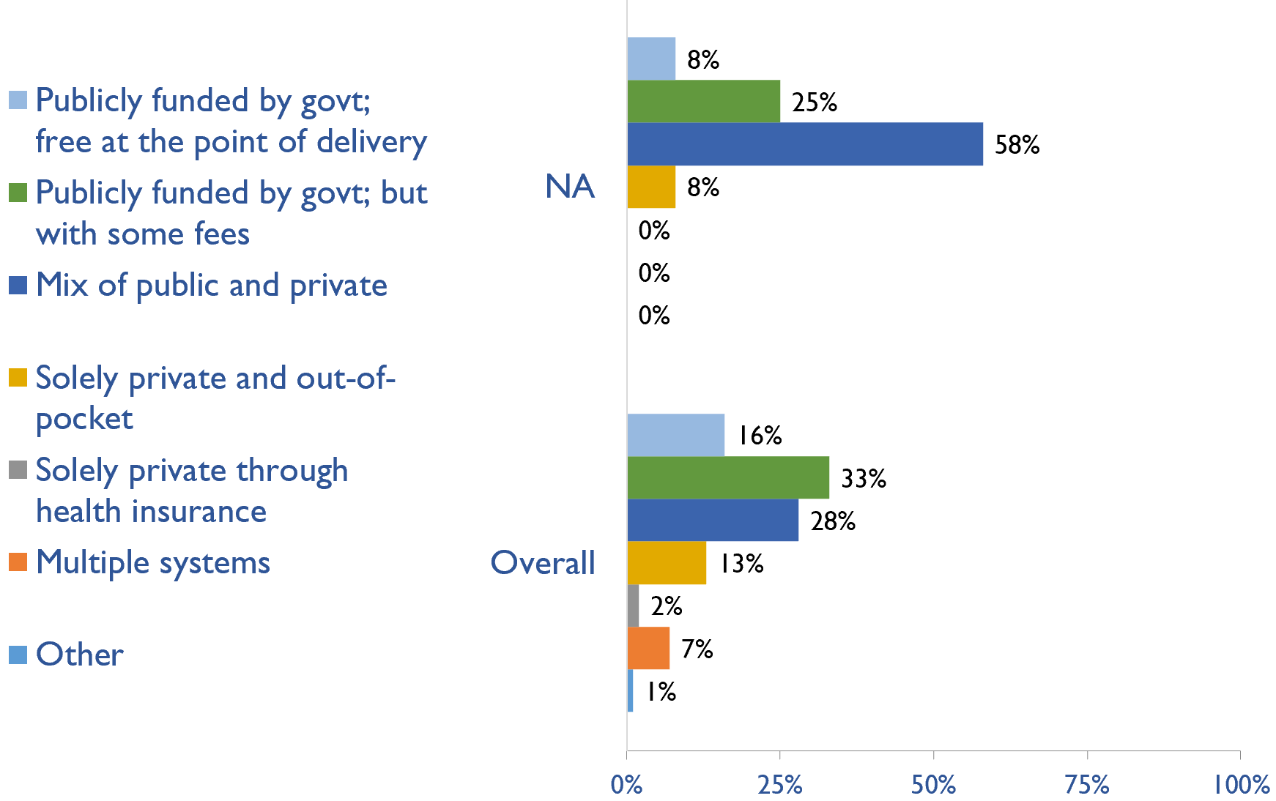
Funding for medications in CKD patients not on dialysis
Country | Publicly funded by govt; free at the point of delivery | Publicly funded by govt but with some fees at the point of delivery | Mix of public and private funding systems | Solely private and out-of-pocket | Solely private through health insurance providers | Multiple systems | Other
Antigua and Barbuda |  |  | X
Aruba |  | X
Bahamas, The |  |  | X
Barbados | X
Bermuda |  | X
Canada |  |  | X
Jamaica |  |  | X
St. Lucia |  |  |  | X
St. Vincent and the Grenadines |  |  | X
Trinidad and Tobago |  |  | X
Turks and Caicos Islands |  | X
United States |  |  | X
X : Yes

Slide 34
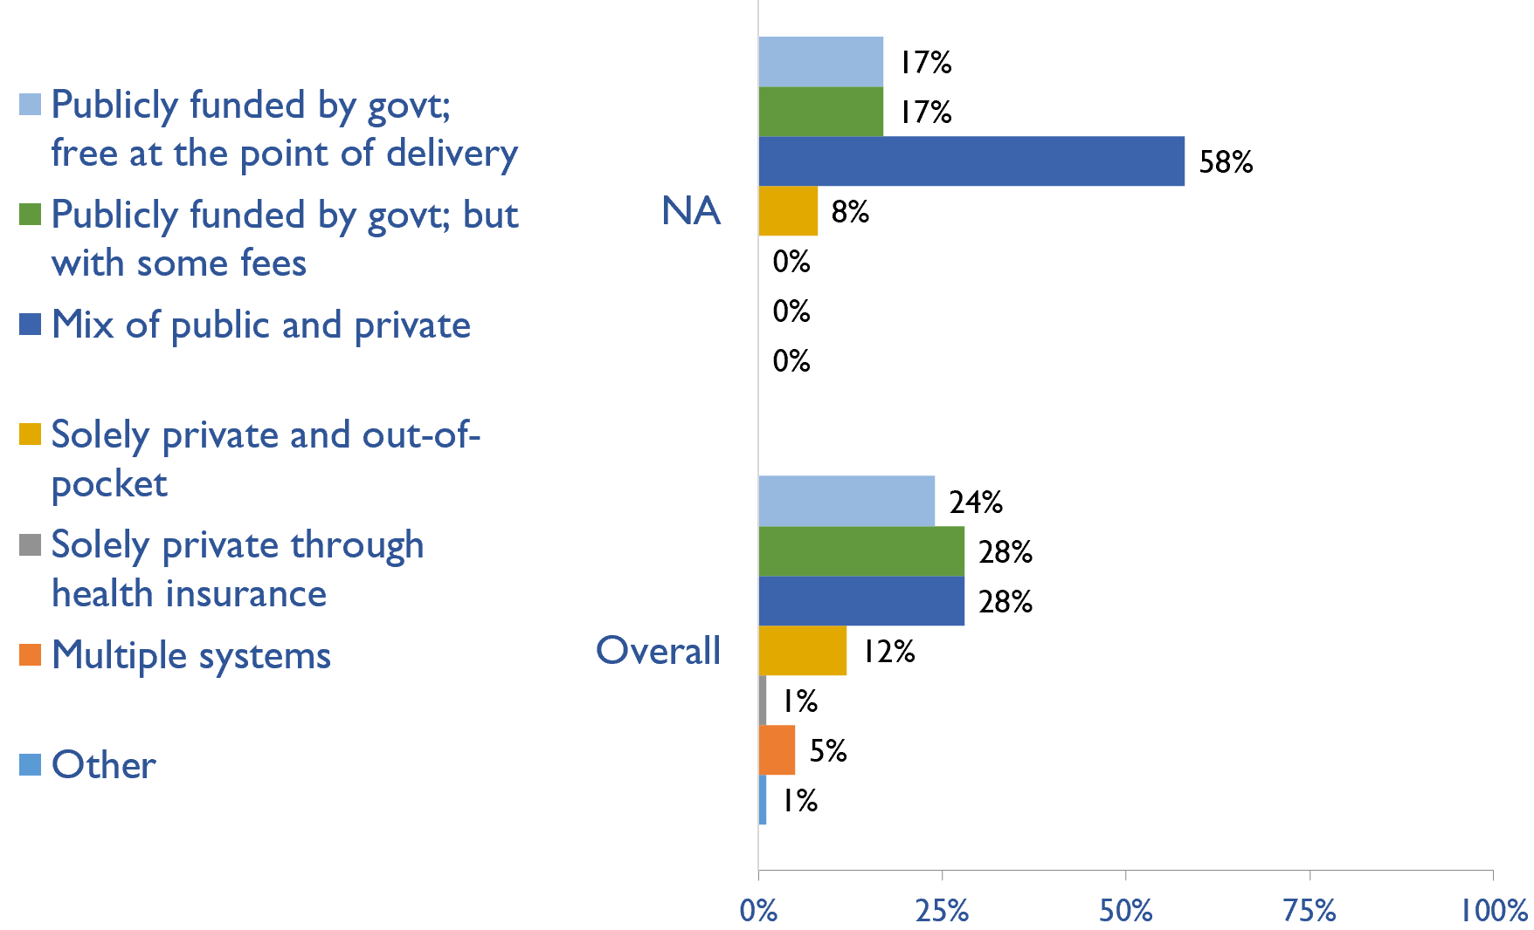
Funding for medications in all dialysis patients
Country | Publicly funded by govt; free at the point of delivery | Publicly funded by govt but with some fees at the point of delivery | Mix of public and private funding systems | Solely private and out-of-pocket | Solely private through health insurance providers | Multiple systems | Other
Antigua and Barbuda |  |  | X
Aruba |  | X
Bahamas, The |  |  | X
Barbados | X
Bermuda |  | X
Canada |  |  | X
Jamaica |  |  | X
St. Lucia |  |  |  | X
St. Vincent and the Grenadines |  |  | X
Trinidad and Tobago |  |  | X
Turks and Caicos Islands | X
United States |  |  | X
X : Yes

Slide 35
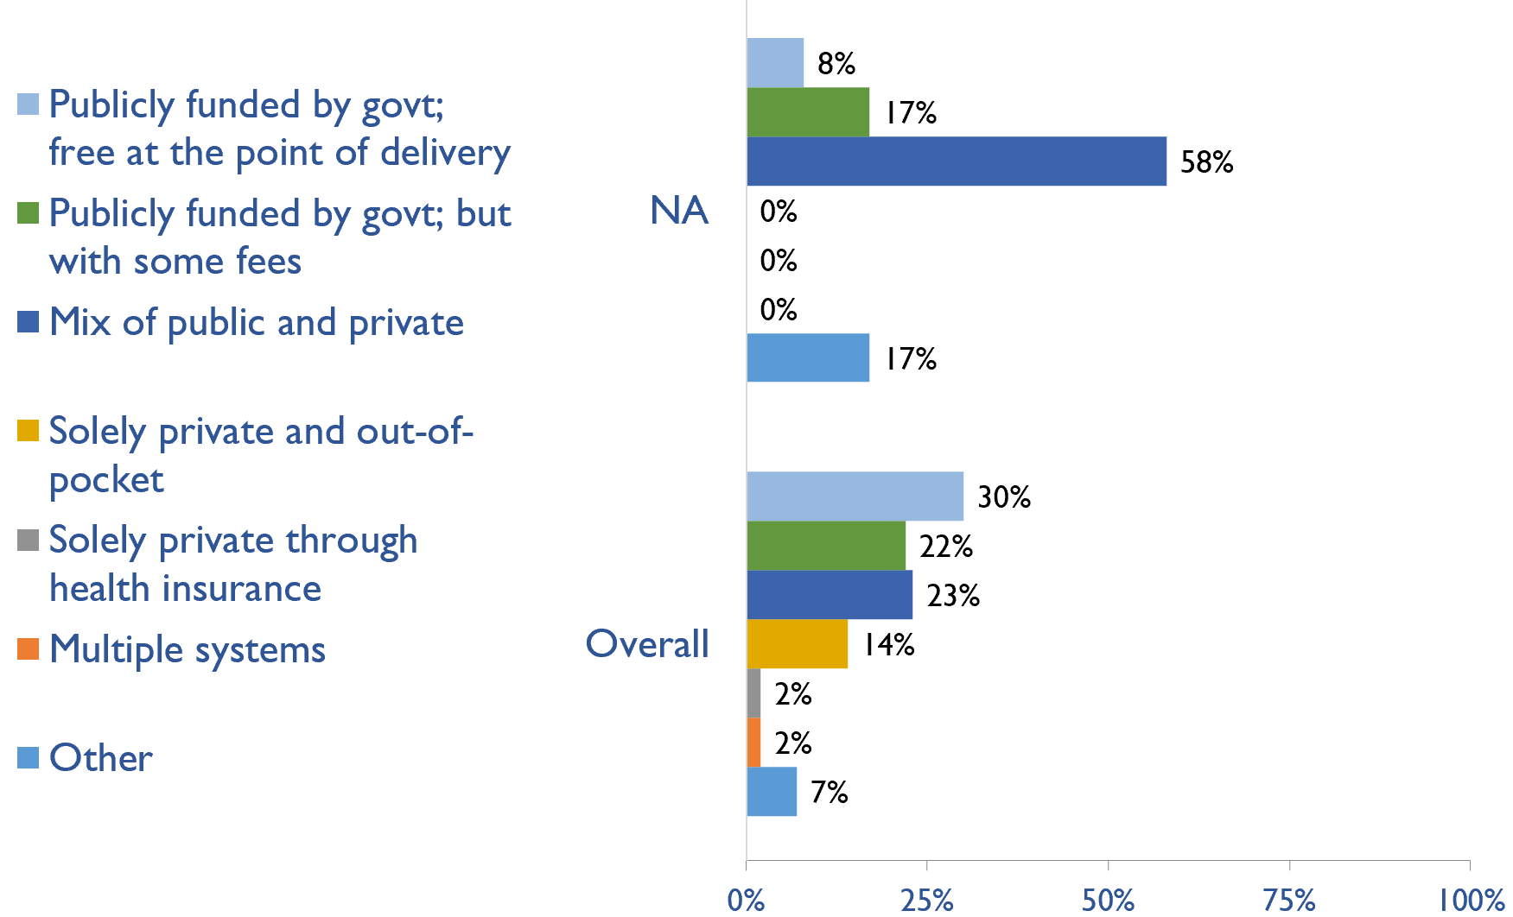
Funding for medications in all transplant patients
Country | Publicly funded by govt; free at the point of delivery | Publicly funded by govt but with some fees at the point of delivery | Mix of public and private funding systems | Solely private and out-of-pocket | Solely private through health insurance providers | Multiple systems | Other
Antigua and Barbuda |  |  | X
Aruba |  | X
Bahamas, The |  |  | X
Barbados | X
Bermuda |  |  |  |  |  |  | X
Canada |  |  | X
Jamaica |  |  | X
St. Lucia |  |  |  |  |  |  | X
St. Vincent and the Grenadines |  |  | X
Trinidad and Tobago |  |  | X
Turks and Caicos Islands |  | X
United States |  |  | X
X : Yes

Slide 36
Availability of official registry
Country | CKD | Dialysis | Transplant | AKI | Conservative care
Antigua and Barbuda
Aruba |  | X | X
Bahamas, The
Barbados
Bermuda
Canada |  | X | X
Jamaica |  | X
St. Lucia | X | X |  | X
St. Vincent and the Grenadines
Trinidad and Tobago |  |  | X
Turks and Caicos Islands
United States |  | X | X
X : Yes

Slide 37
Summary of Findings
In summary, the 2023 ISN-GKHA highlights several important findings for North America and the Caribbean.
KRT availability, access, and quality is high.
  HD services are available in all countries in the region. However, PD services remain unavailable in Antigua and Barbuda and St. Lucia in 2023 while KT services in the NAC region are only available in Antigua and Barbuda, Barbados, Canada, Jamaica, Trinidad and Tobago, and USA.
  Capacity to provide adequate frequency of HD i.e., three times weekly for 3 – 4 hours per session, was available in 92% of countries.
  Capacity to provide adequate PD exchanges i.e., three to four exchanges per day was available in 10 (83%) countries.
  Home HD was only available in Canada and USA.
  KT centres are available in 6 (50%) countries in the region; median prevalence of KT centres was 0.71 pmp.
CKM is available and predominately chosen or medically advised.
  Conservative kidney management (CKM) established through shared-decision making was available in 10 (83%) countries.
  Choice restricted CKM (where resource constraints prevent or limit access) was available in 9 (75%) of countries.
  Choice restricted CKM (where no resource constraints prevent or limit access) was also available in 8 (67%) of countries.
Government funding for kidney care services and medication is low.
  Reimbursement for medications that is free at point of delivery for ND-CKD, dialysis, and KT are available in 3 (25%), 2 (17%), and in only one country (Barbados), respectively.
  Reimbursement that is free for acute dialysis, chronic HD, and chronic PD were available in 6 (50%), 4 (33.3%), and 6 (50%) countries, respectively.

Slide 38
Summary of Findings (cont’d)
Most have registries for advanced kidney disease, few for CKD or AKI
  Availability of kidney registries varied across countries in the region.
  ND-CKD registry was available only in St. Lucia; dialysis registries in 5 (41.7%), and KT registries are available in 4 (33.3%) countries (Aruba, Canada, Trinidad and Tobago, and USA). Acute dialysis registries were only available in St. Lucia.
Some workforce limitations are present.
  The median prevalence of nephrologists in the NAC region was 18.8 pmp; Bermuda had the highest density of nephrologists (41.5 pmp) while Jamaica had the lowest (4.5 pmp).
  Aruba had the highest density of nephrology trainees (40.9 pmp) while Jamaica had the lowest (0.35 pmp).
  More than half of countries in the region reported shortages of paediatric nephrologists (58%), transplant surgeons (58%), surgeons or interventional radiologists for AVF/AVG creation (67%) and for PD catheter insertion (58%), dietitians (58%), vascular access coordinators (58%), transplant coordinators (58%), dialysis nurses (83%), dialysis technicians (58%), and palliative care physicians (58%).
Moderate advocacy for kidney disease in North America and the Caribbean.
  Advocacy groups for CKD, kidney failure and KRT remains low in the region.

Slide 39
Implications
There are important implications to consider. Based on these survey findings, key recommendations to drive future activities for optimizing kidney care globally are proposed:
Increase health care financing for kidney failure prevention and management.
  While resource limitations are an obvious barrier, focusing on preventing kidney failure through appropriate hypertension and diabetes management may be more cost-effective overall. Government funding to cover medication costs may allow more patients to treat earlier stage CKD, thereby preventing the need for more costly kidney failure treatment and the obvious burden this has on patients’ wellbeing.
Address workforce shortages through multidisciplinary teams and telemedicine
  Shortages of nephrologists, surgeons, dialysis nurses, and other key allied health professionals were noted across most countries. Similarly, simply producing more nephrologists may not be feasible or appropriate, and sharing the workload across multiple providers will not only promote the use of multidisciplinary teams but further, allow for more and better care delivery across more patients. Telemedicine may help particularly in addressing gaps in care among rural patients and enhancing capacity through training programs such as ISN Fellowship, visiting ambassador programs, etc.

Slide 40
Implications (cont’d)
Incorporate the collection and reporting of quality indicators in kidney failure care.
  Measuring and reporting on key quality indicators is an important driver in healthcare improvement. Ensuring facilities are supported with information systems that allow for the systematic measurement and reporting of indicators is a first key step to increasing the rate of monitoring among countries. Further, understanding if or how the collection and reporting of indicators are being used to improve care is needed.
Expand health information systems to prevent and manage kidney failure.
  Similarly, good quality HIS are vital for kidney disease management within a country. A lack of data on disease prevalence, incidence, resource use, and quality of care limits government and provider ability to monitor and evaluate the care provided as well as predicts appropriate resource allocation so that sufficient facilities, medicines, and healthcare professionals are trained and available.
Promote kidney failure prevention and treatment by implementing policies, strategies, and advocacy, and mitigating barriers.
  Lastly, policies and strategies are important for consistent approaches within a country for optimal care delivery, as well as for accountability, leadership, and knowledge exchange. Advocacy may help promote the increase of government prioritization and further, public awareness of how to prevent and manage kidney disease. Without acknowledging and mitigating barriers, it would be a challenge to achieve of successes out of these recommendations. Competing priorities and needs (for example, clean water supply and basic sanitation, maternal and child health, malnutrition, etc.) represent formidable barriers that can limit implementation of the recommended strategies in the region.

Slide 41







www.theisn.org
Global Operations Center
Americas Operations Center
Avenue des Arts 1-2
1210 Brussels, Belgium
340 North Avenue 3rd Floor
Cranford, NJ 07016-2496, United States
+ 32 2 808 04 20
+1 904 345 0866
info@theisn.org
info@theisn.org
Follow us

